Slide 1

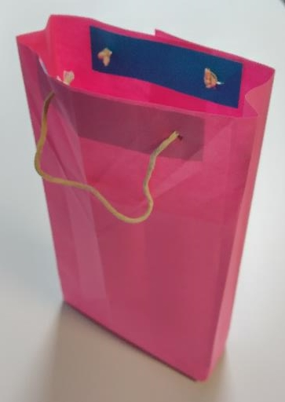

How to make a paper bag
Designing and making a carrier bag from sustainable materials

Slide 2
Stay safe
Whether you are a scientist researching a new medicine or an engineer solving climate change, safety always comes first. An adult must always be around and supervising when doing this activity. You are responsible for:
• ensuring that any equipment used for this activity is in good working condition
• behaving sensibly and following any safety instructions so as not to hurt or injure yourself or others
Please note that in the absence of any negligence or other breach of duty by us, this activity is carried out at your own risk. It is important to take extra care at the stages marked with this symbol: ⚠

Slide 3
The Plastic Bag Problem!
Carrier bags are useful!
However - they are often made of plastic.
This plastic is typically made from oil – if the current need for oil continues, it will run out during your lifetime.
When they are thrown away, many are buried in landfill – it takes over 500 years for a plastic bag to biodegrade!
Others are dumped at sea. Plastic waste – including carrier bags – kills 100 million marine animals each year.

Slide 4
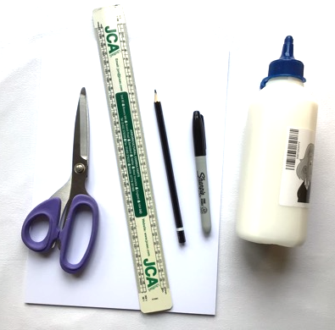
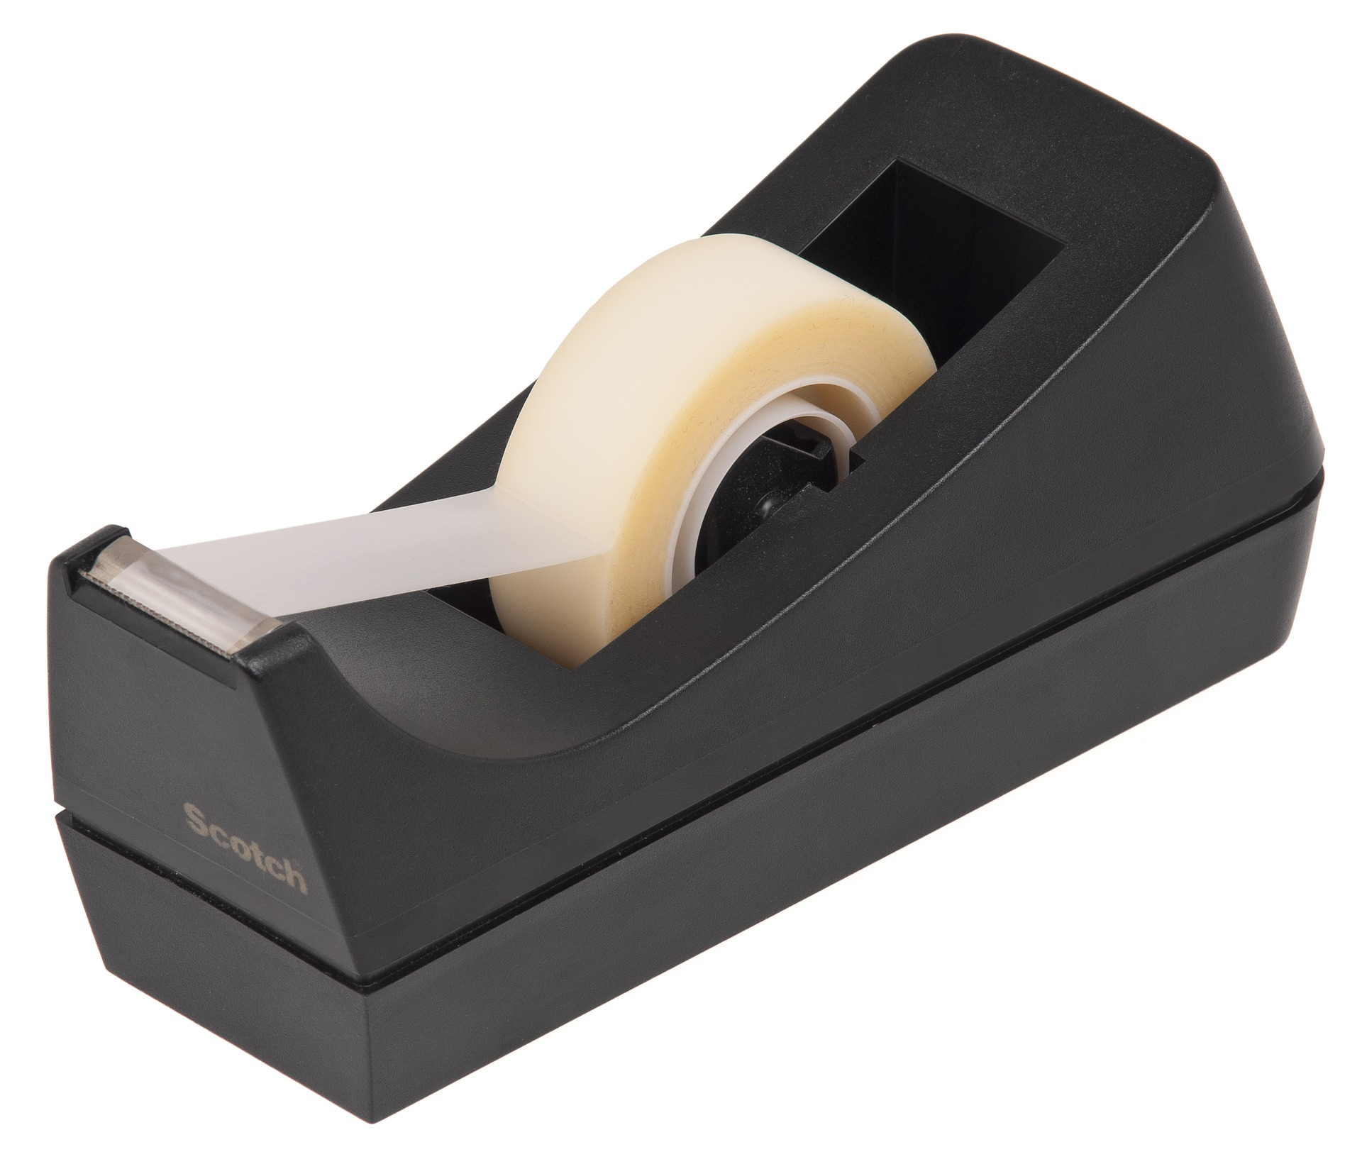
Resources
You will need:
Scissors
A3 Paper or thin ard
Glue (or a stapler)
Ruler
Pens, paint or crayons
String
Some weights (or groceries)
Note: no sticky tape allowed – its plastic!
X
Notes:
Plain paper, newspaper , wallpaper or wrapping paper will do.
An alternative to weights would be groceries with weights written on them

Slide 5
Design Brief
A supermarket has asked you to design a carrier bag from sustainable materials. It should be attractive and have the supermarket logo on it.
Specification
The bag must be made from sustainable materials – no plastic
The bag should carry up to 2 kg of shopping
The bag should have an attractive design on it, to appeal to shoppers
The bag must have handles so it can be carried comfortably

Slide 6

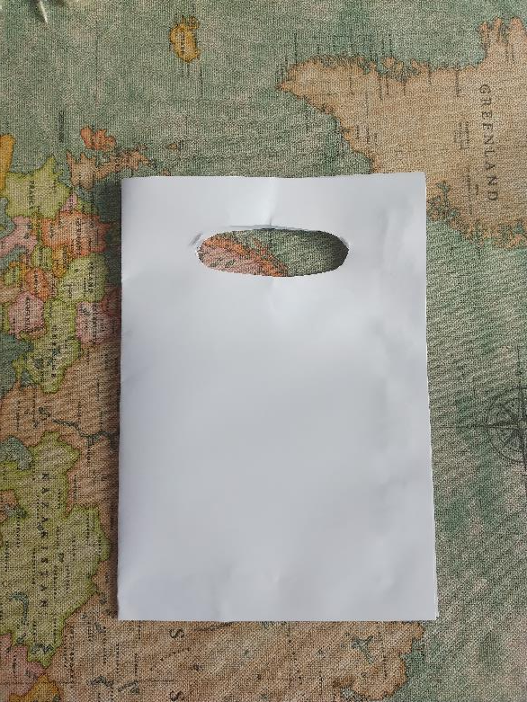
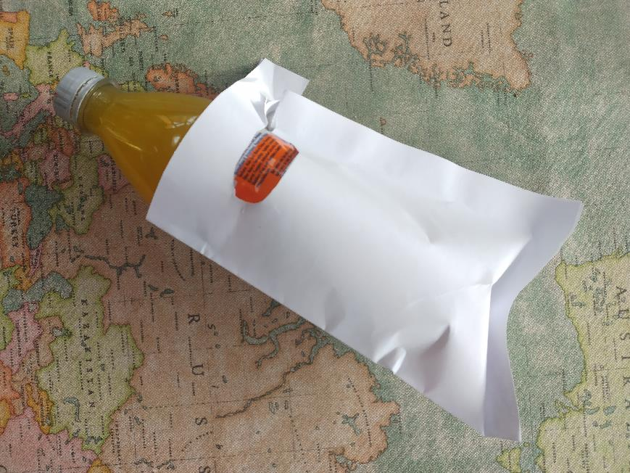
Step 1 - Making your first bag
Take a piece of paper and fold it down the middle
Glue the sides and bottom together. Let the glue dry!
Make a handle hole at the open end
Test your bag. How much weight can you get in before it breaks?
This first attempt took one bottle of pop weighing 500g before the handle broke

Slide 7
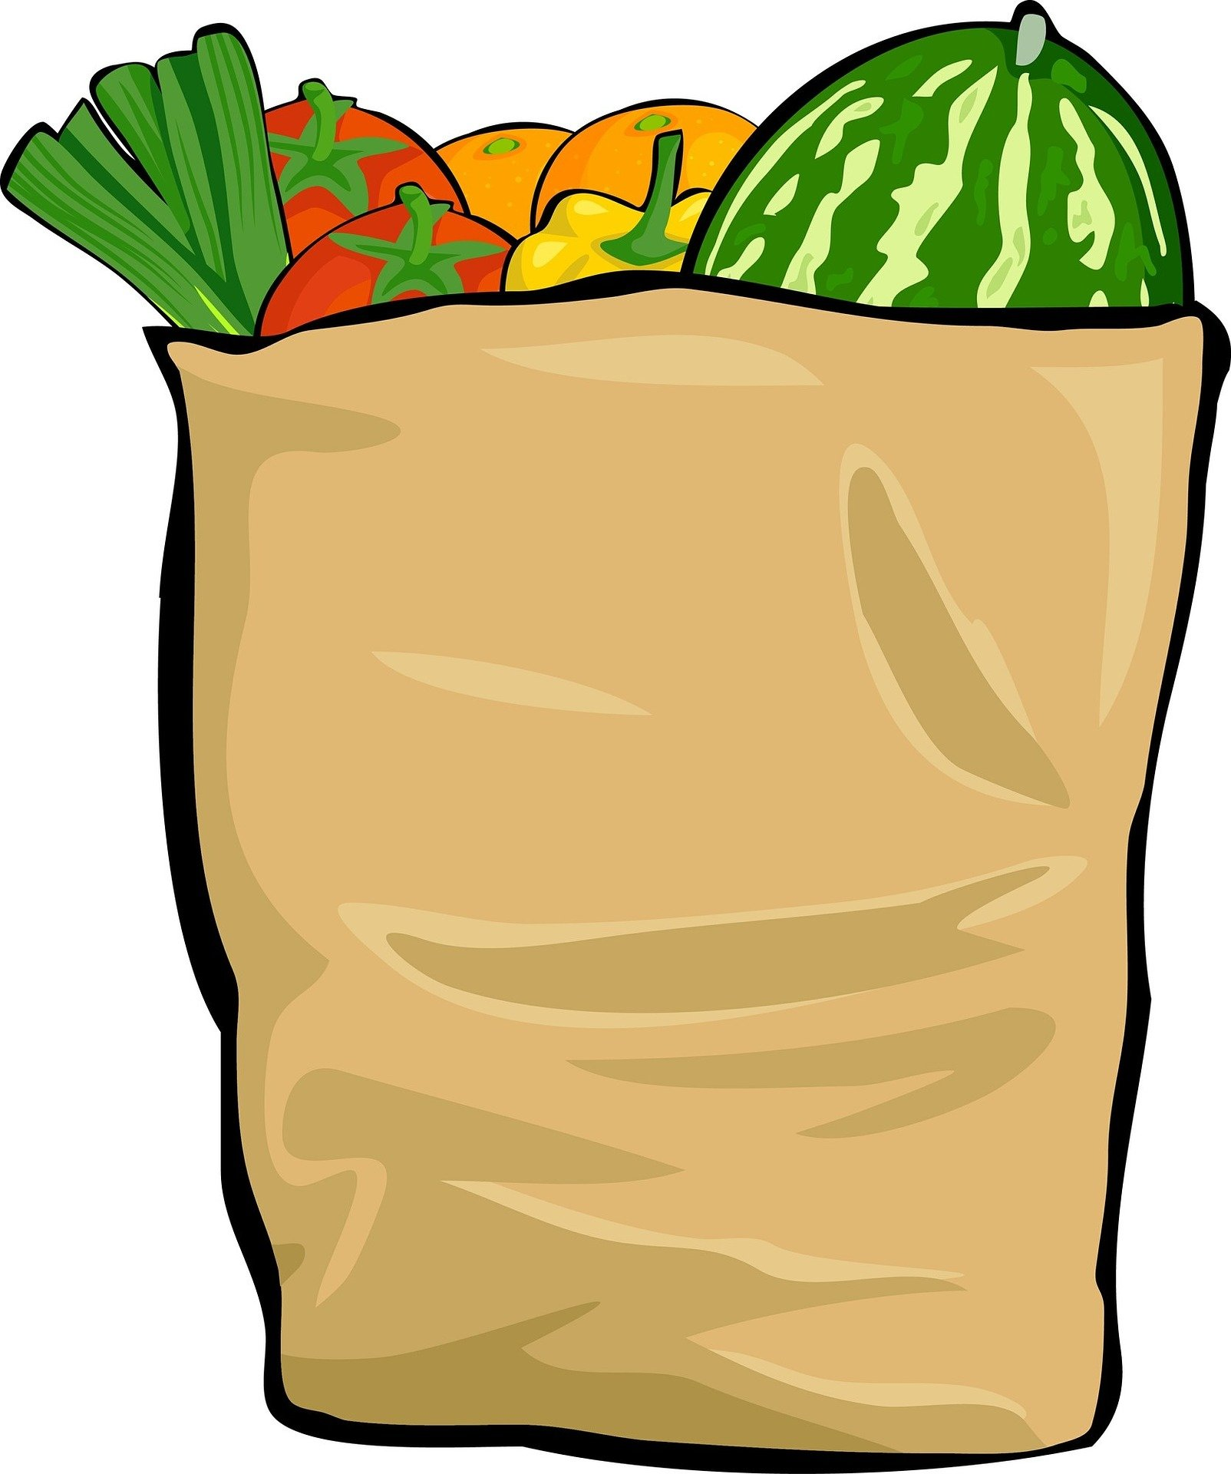
Step 2 – Improving the bag design
4
Look at the bag. Where did it rip?
Can you make another one that will not break there? You could add extra material, to reinforce it, or change the design
Make a bag to your new design.
Test the new bag until it breaks. Does it carry more weight?
Repeat steps a) – d) until you are happy with your bag design.
Each time you repeat the steps is called a Design Iteration.

Slide 8

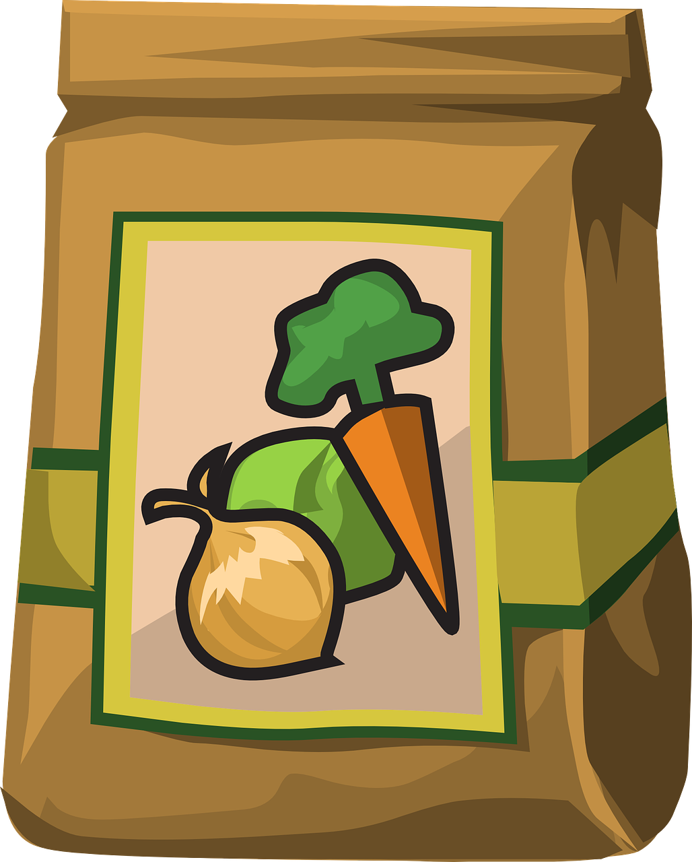
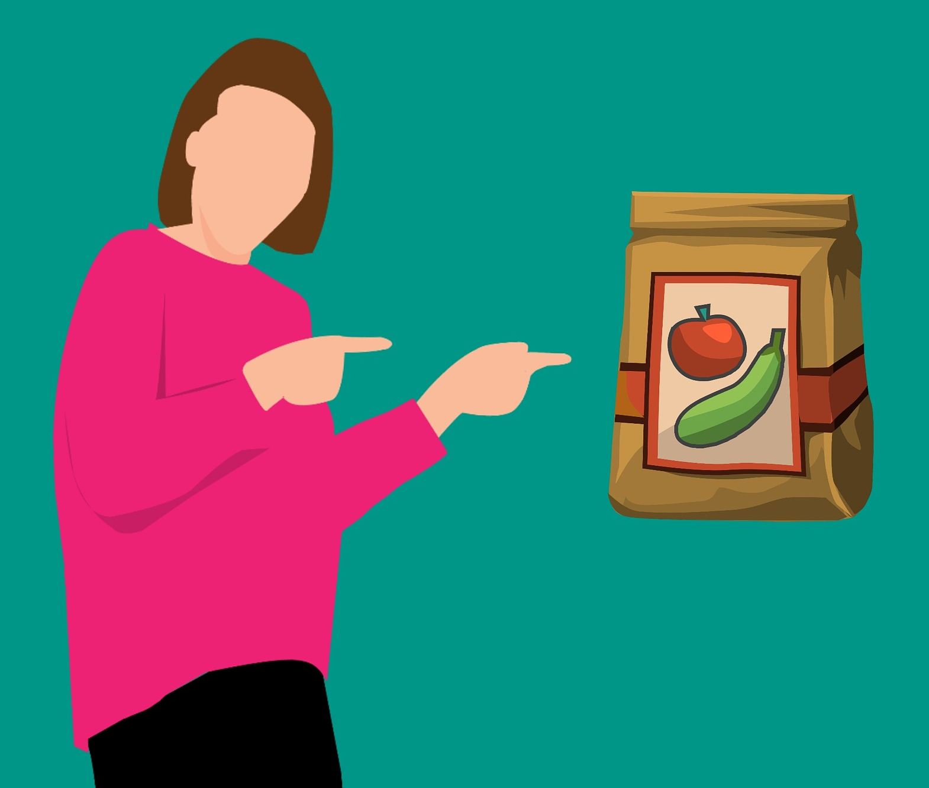
Step 3 – Check the Specification
You should now have a good bag design that is strong.
Now look at the Specification again. What is left?
The bag needs to be attractive to shoppers – how will you decorate it?
The bag also needs comfortable handles. How can you improve them?

Slide 9

Extension Activities
Make the biggest bag you can
Challenge your friends to see who can make the strongest bag
Try making a bag out of an old T shirt. What sort of T shirt works best?
What other clothes could you use? If you have a sewing kit or a sewing machine how would this help?

Slide 10
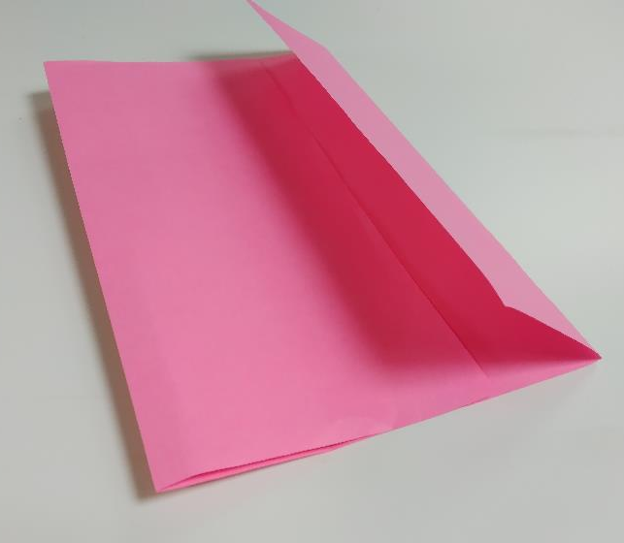
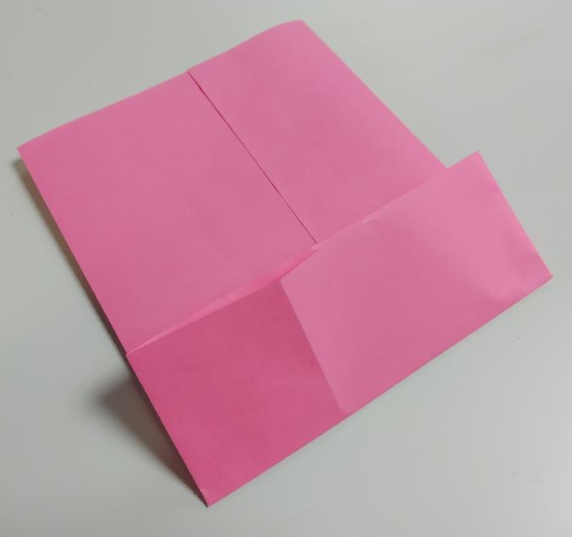
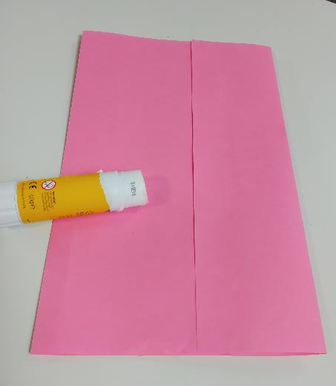
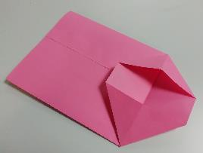
Example of bag making 1
Fold a piece of A3 from both short sides so that the folds overlap
Glue the overlap down
Fold up one of the open ends
Fold the sides in as shown
1
3
2
4

Slide 11
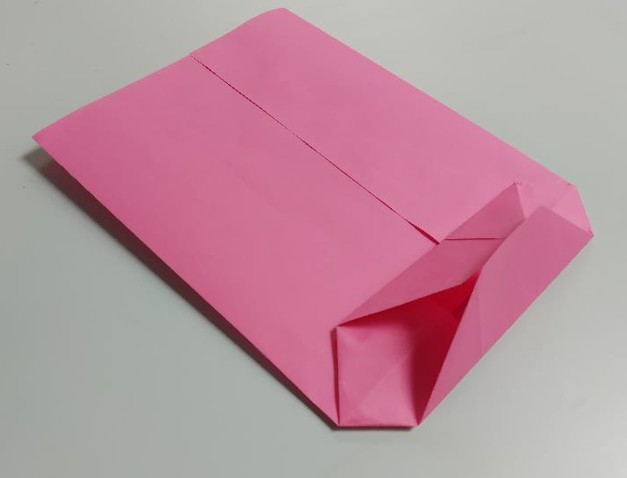
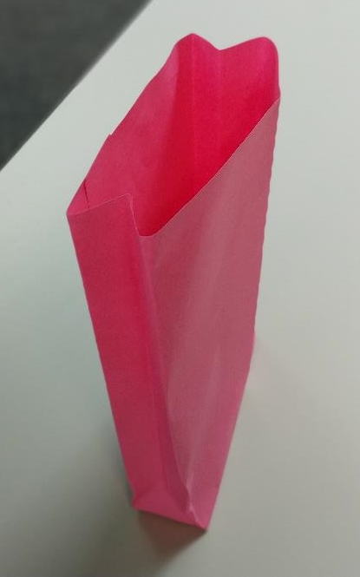
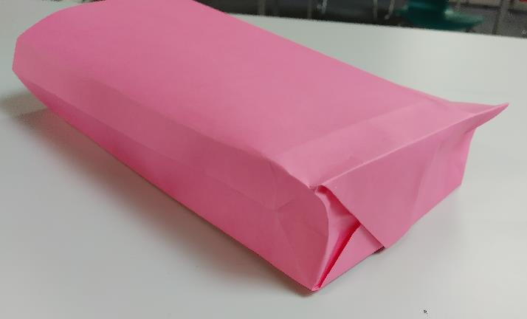
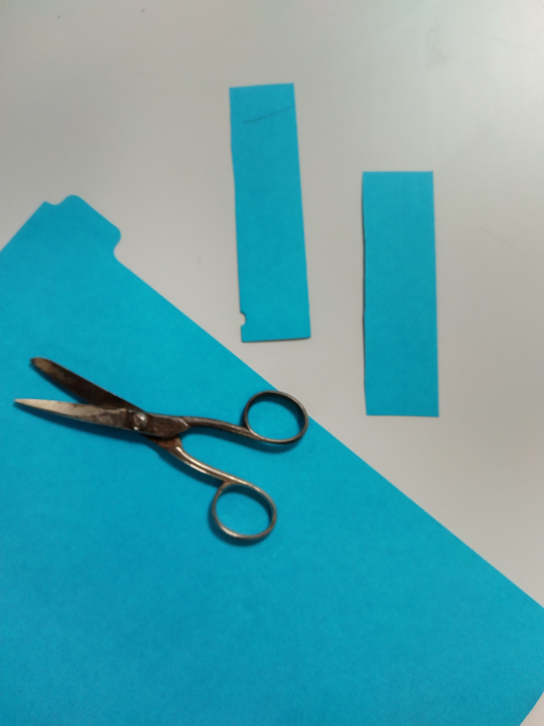
Example of bag making 2
Fold the bottom together as shown
Glue down firmly
Unfold the bag until it will stand up on its own
Cut two reinforcing pieces for the handle using card
5
7
8
6

Slide 12
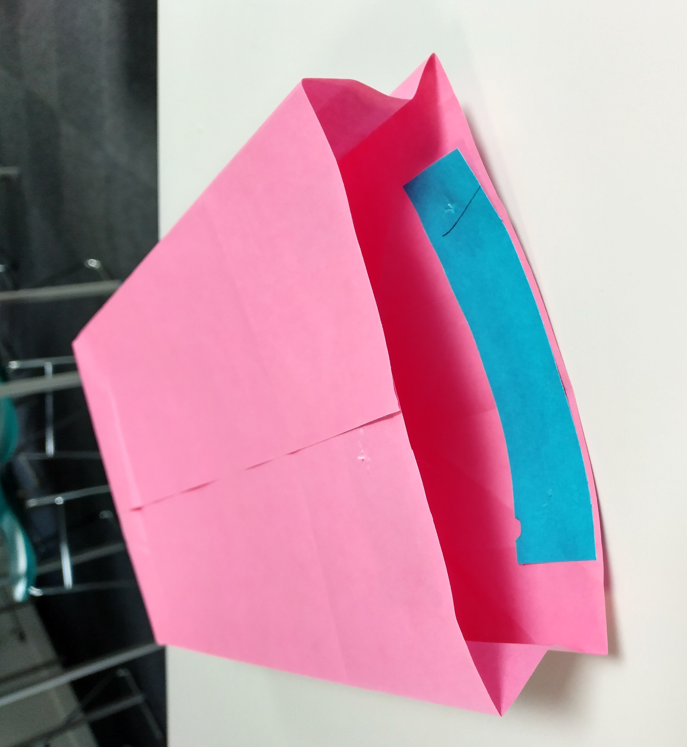
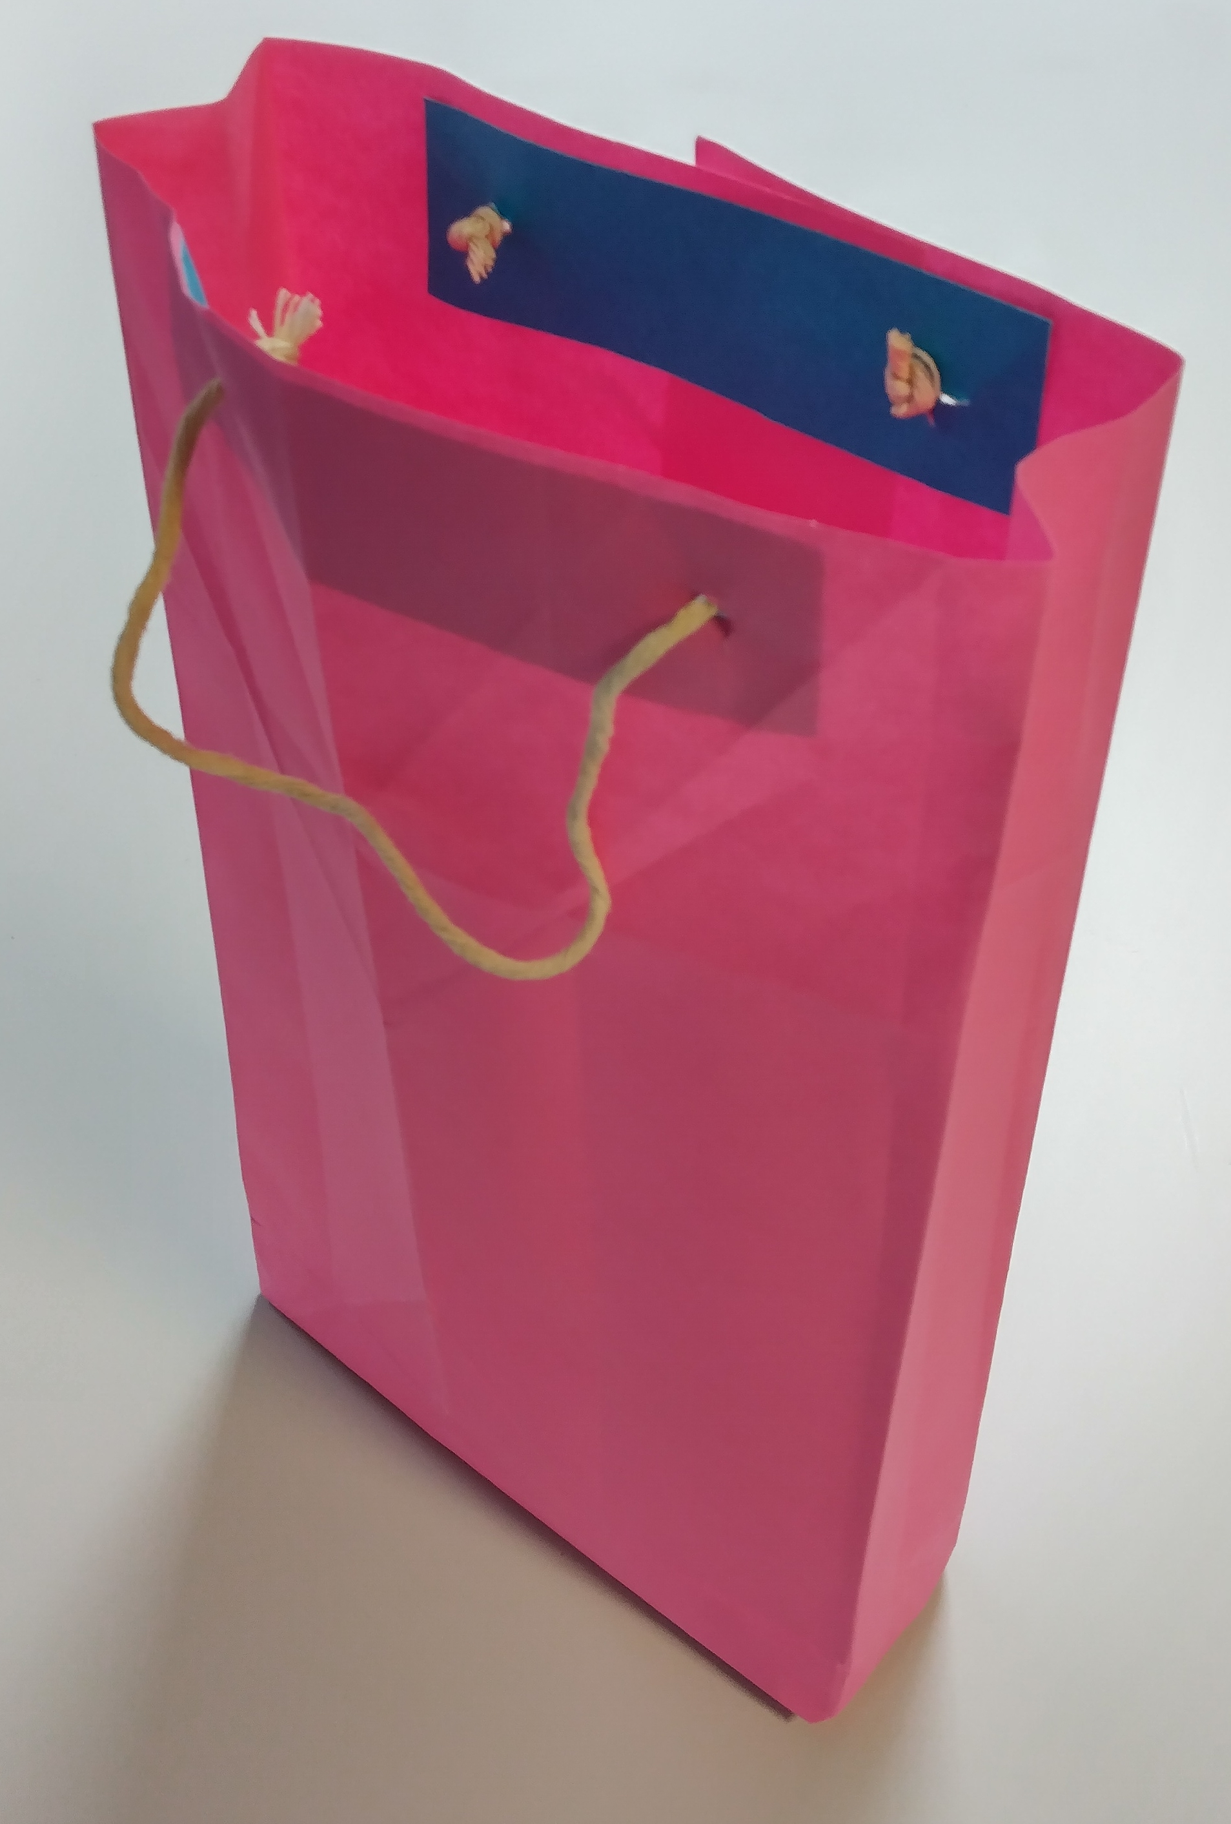
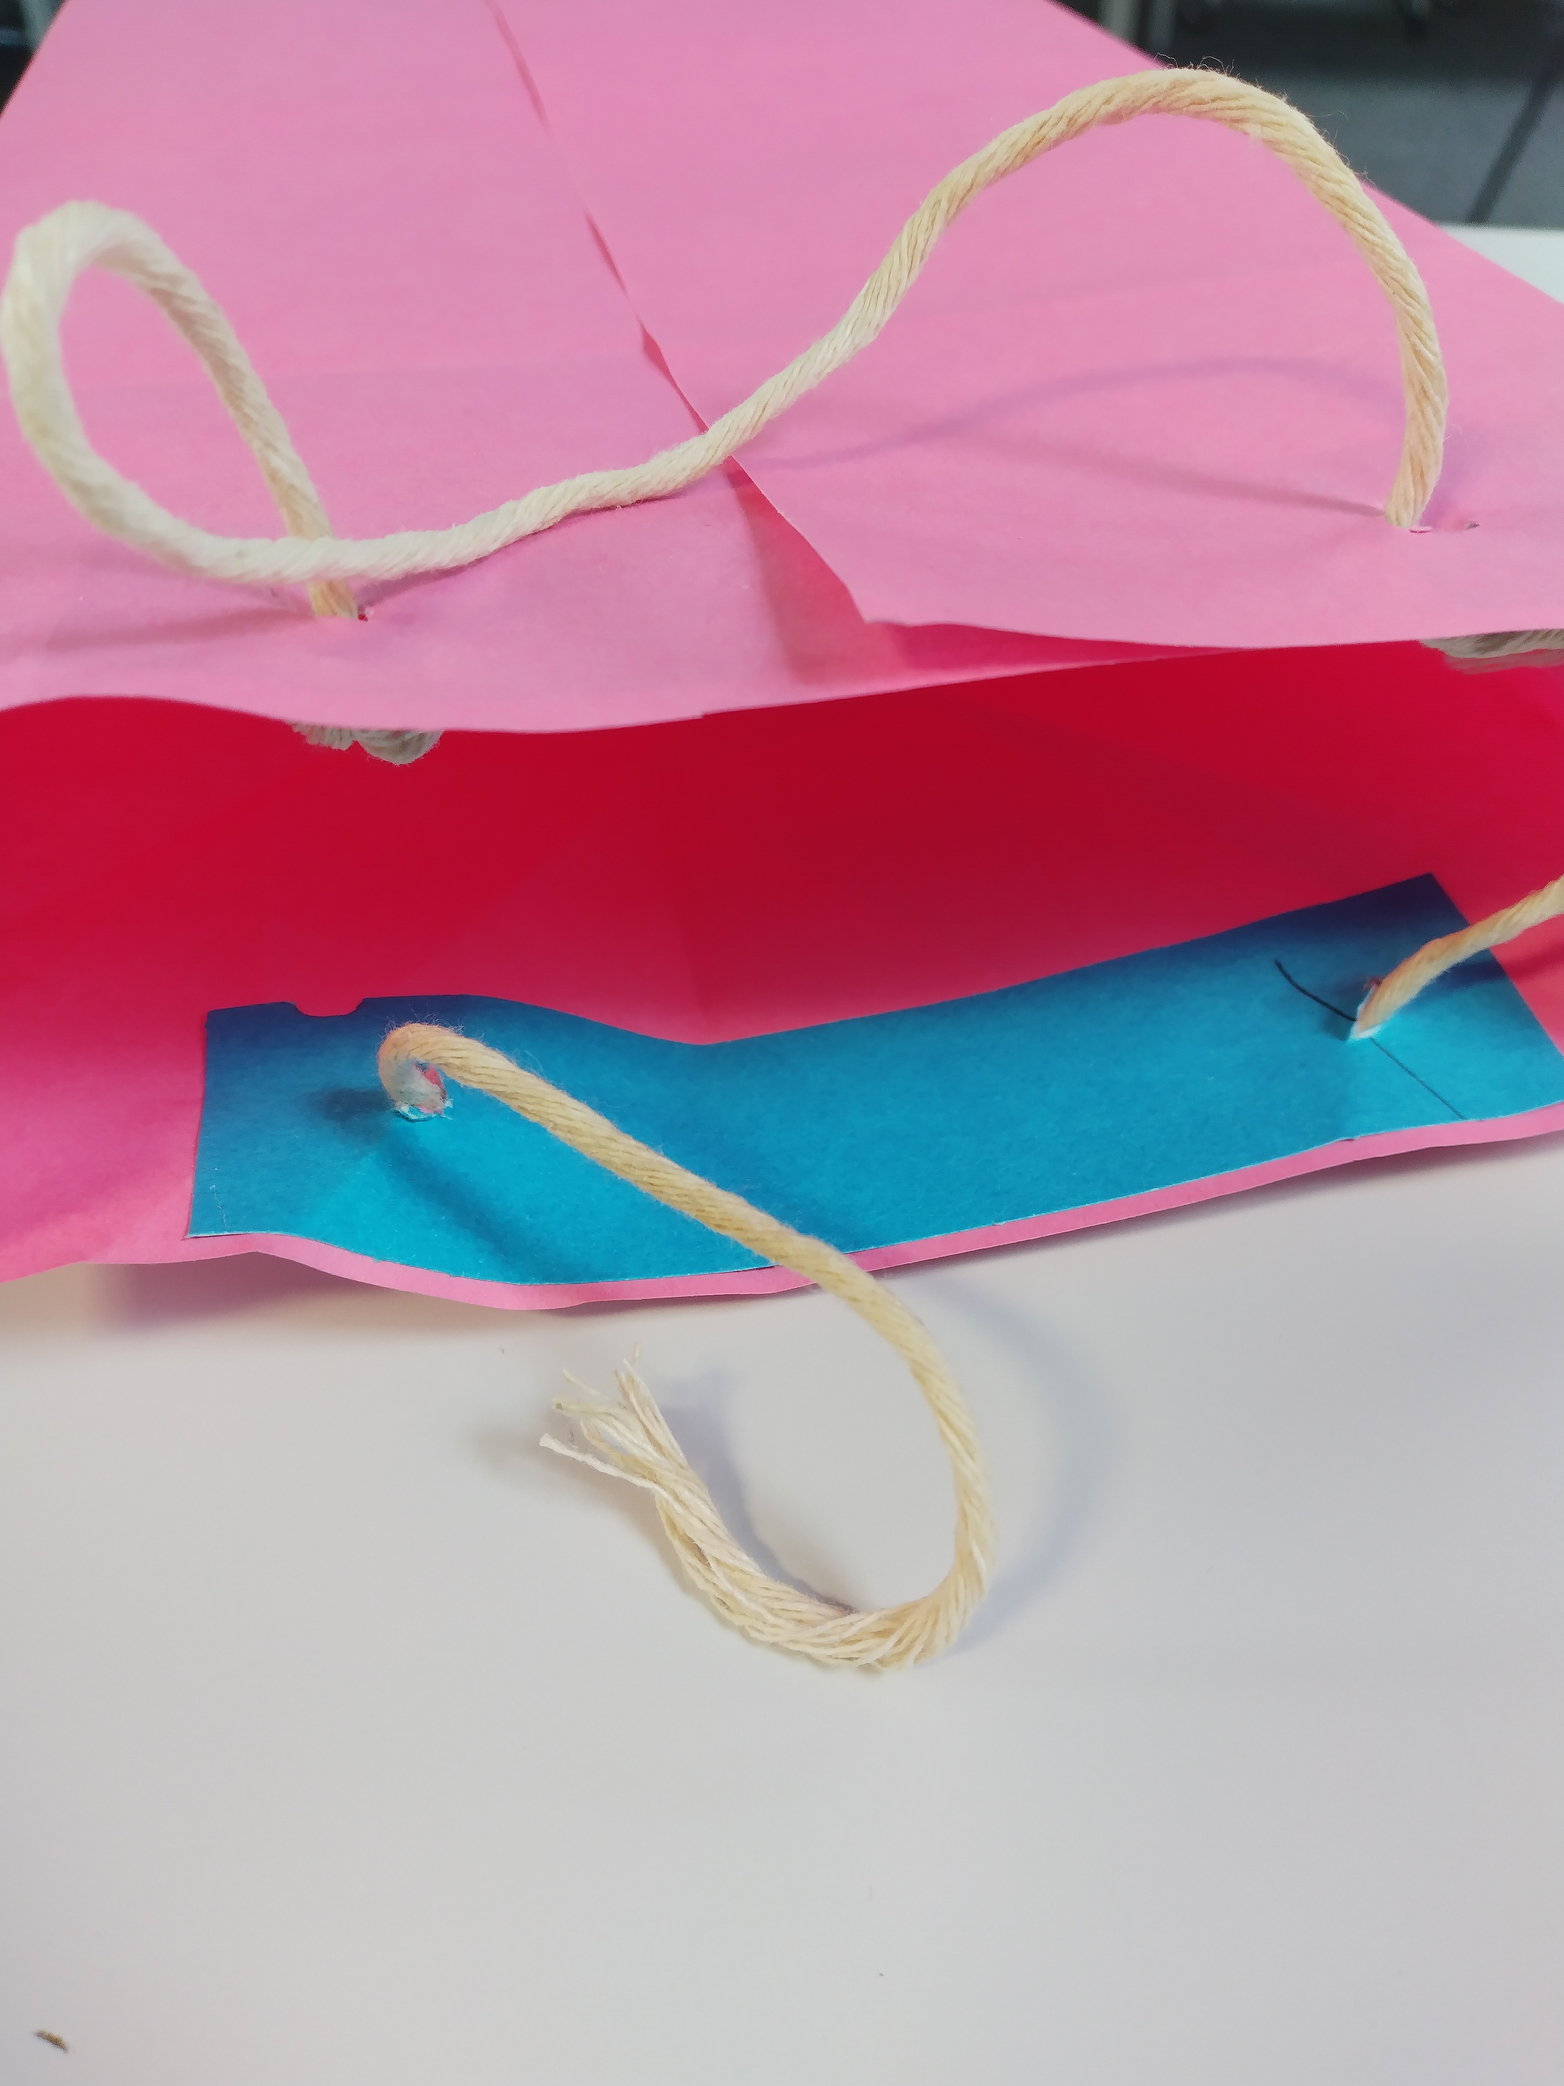
Example of bag making 3
Glue the reinforcing strips inside the top of the bag, one on each side
Make holes for the string using a pencil and eraser
Thread the string though and tie knots to secure
Test the bag!
9
11
10

