Slide 1
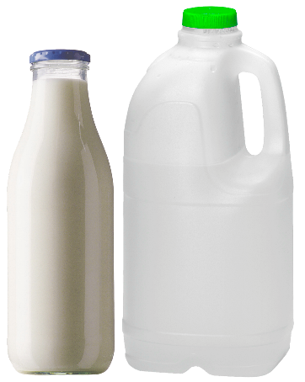
Turn milk into plastic
A project to make a mouldable plastic from milk

Slide 2
Stay safe
Whether you are a scientist researching a new medicine or an engineer solving climate change, safety always comes first. An adult must always be around and supervising when doing this activity. You are responsible for:
• ensuring that any equipment used for this activity is in good working condition
• behaving sensibly and following any safety instructions so as not to hurt or injure yourself or others
Please note that in the absence of any negligence or other breach of duty by us, this activity is carried out at your own risk. It is important to take extra care at the stages marked with this symbol: ⚠

Slide 3
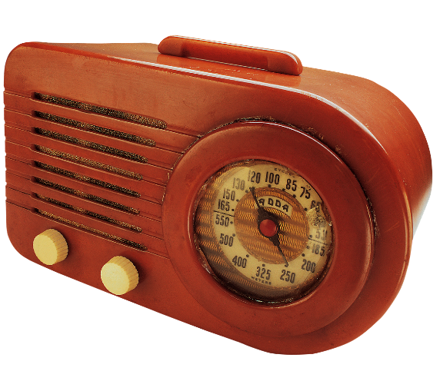
Milk plastic
Plastic has been made from milk for over 100 years!
This type of plastic is called ‘Casein’
It was used to make things like buttons and the cases for radios
This is how plastics were made before 1945, when synthetic plastics were invented

Slide 4
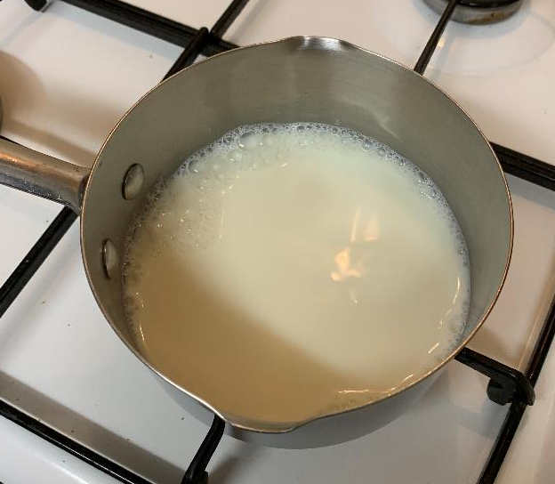
Step 1 – Warm the milk
Measure 1 cup (250ml) milk into a saucepan
Heat the milk until it is steaming ⚠
This should make 4 shapes

Slide 5
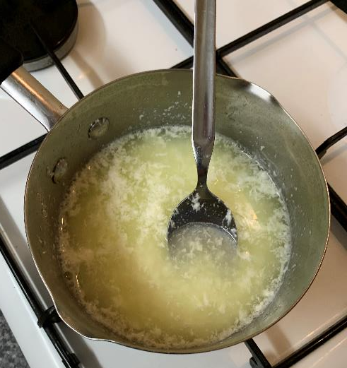
Step 2 – Add vinegar
Remove the saucepan from the heat ⚠
Add 4 teaspoons of vinegar
Gently stir for 1 minute - the milk will curdle

Slide 6
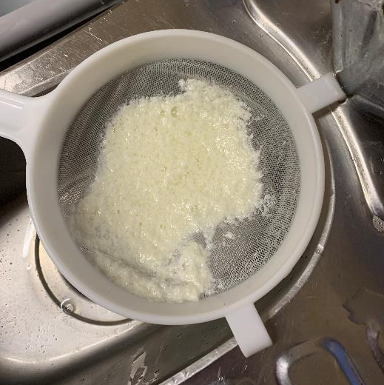
Step 3 – Sieve the milk
Sieve the milk over a sink ⚠
Make sure the liquid has all drained off
Let it cool
Gently press the curds in the sieve, to squeeze out the liquid

Slide 7
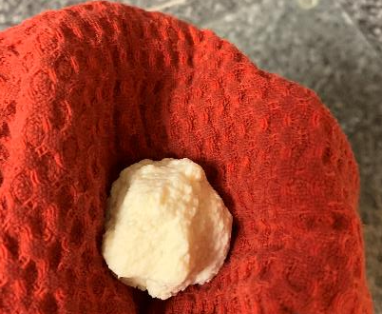
Step 4 – Remove the liquid
Remove the curds and gently squeeze to remove the liquid
Use a cloth or paper towel to remove more liquid
Make a curd ball
This is your plastic!

Slide 8
Step 5 – Ready to mould
Press the curd into a mould
Place the shape onto baking paper
Leave on a radiator to dry

