Slide 1
Comparing the Carbon Footprint of Transportation
A maths-based challenge to calculate the journey times and carbon footprint of different methods of travel

Slide 2
Sustainable transport
We need to reduce the impact that transport has on climate change
The impact can be quantified by the carbon footprint of the transport
The carbon footprint is the total greenhouse gas emissions caused by fossil fuel burning i.e. the amount of carbon dioxide (CO2) produced

Slide 3
Typical carbon footprint (g of CO₂ /mile)
Emissions per passenger per mile travelled
Walking 0
Bike 0
Train (Domestic) 25
Bus 65
Car (1 passenger) 106
Plane (Domestic) 158
Source: BEIS/Defra Greenhouse Gas Conversion Factors 2019

Slide 4
Typical Average Transport Speeds (mph)
Walking 3
Bike 15
Bus 50
Car 50
Train 125
Plane 560
Notes:
Any statistics or data on transport speeds used in this presentation is solely for the purpose of this activity and may not be an accurate reflection of actual current times

Slide 5
Journey time calculation
Nottingham to Liverpool: 100 miles in a car
Distance
Using the formulae
Time =
Speed
100 miles
Insert the values
Time =
50 mph
Time =
2 hrs

Slide 6
Carbon footprint calculation
Nottingham to Liverpool: 100 miles in a car
Multiply distance by carbon footprint (g of CO₂ /mile)
100 x 106 = 10,600 g of CO₂
= 1.6 kg of CO₂
Therefore a car would take 2 hours to travel this journey and produce 1.6 kg of CO2

Slide 7
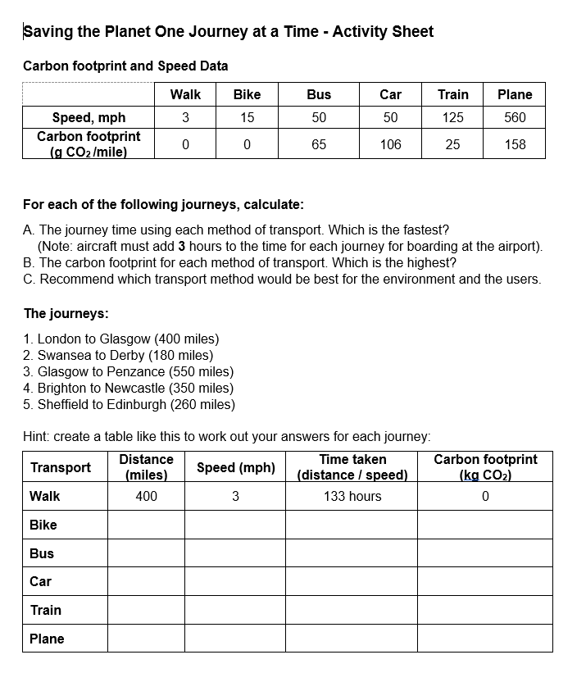
Activity sheet
Follow the instructions on the activity sheet: work out the journey time and carbon footprint of different methods of transport
Which transport method is the most sustainable?

Slide 8
Alternative Slides
(km rather than miles)

Slide 9
Typical carbon footprint (g of CO₂ /mile)
Emissions per passenger per mile travelled
Walking 0
Bike 0
Train (Domestic) 41
Bus 104
Car (1 passenger) 171
Plane (Domestic) 254
Source: BEIS/Defra Greenhouse Gas Conversion Factors 2019

Slide 10
Typical average transport speeds (kph)
Walking 5
Bike 24
Bus 65
Car 80
Train 200
Plane 900
Notes:
Any statistics or data on transport speeds used in this presentation is solely for the purpose of this activity and may not be an accurate reflection of actual current times

