Slide 1

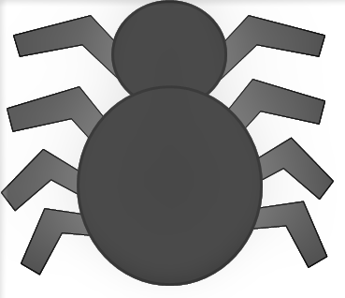
Shadow puppet experiment
Making shadow puppets

Slide 2
Stay safe
Whether you are a scientist researching a new medicine or an engineer solving climate change, safety always comes first. An adult must always be around and supervising when doing this activity. You are responsible for:
• ensuring that any equipment used for this activity is in good working condition
• behaving sensibly and following any safety instructions so as not to hurt or injure yourself or others
Please note that in the absence of any negligence or other breach of duty by us, this activity is carried out at your own risk. It is important to take extra care at the stages marked with this symbol: ⚠

Slide 3
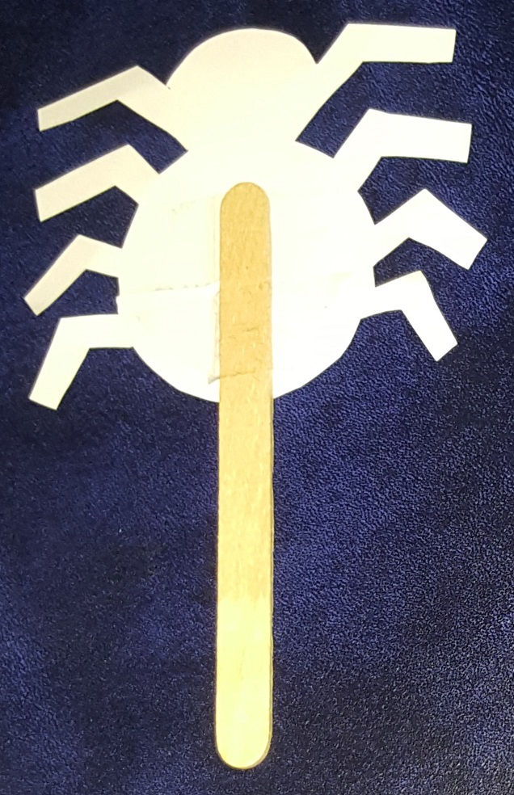

Making the shadow puppet
Choose the shape for your shadow puppet
Cut it out using scissors ⚠
Sticky tape
Attach a craft stick to one side using a piece of sticky tape
Notes:
The shadow puppets could be made out of thin card (paper does not have enough rigidity). Craft sticks can be obtained from commercial suppliers.
Note that the supporting stick does not need to be horizontal – it can be positioned in any direction for ease of use. See slide 4 for examples.

Slide 4
Casting the shadow…
Set up a torch so it shines onto the screen – put the shadow puppet into the beam of light, so it appears on the screen
Notes:
The screen could be made from tracing paper. This could be supported in a simple card frame or using a cut-out section from a cardboard box (see the additional websites in the associated lesson plan for an example). The room needs to be sufficiently dark that the image from the torch is fully visible on the ‘screen’.

Slide 5
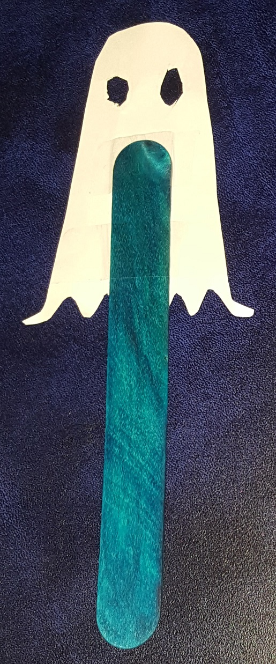
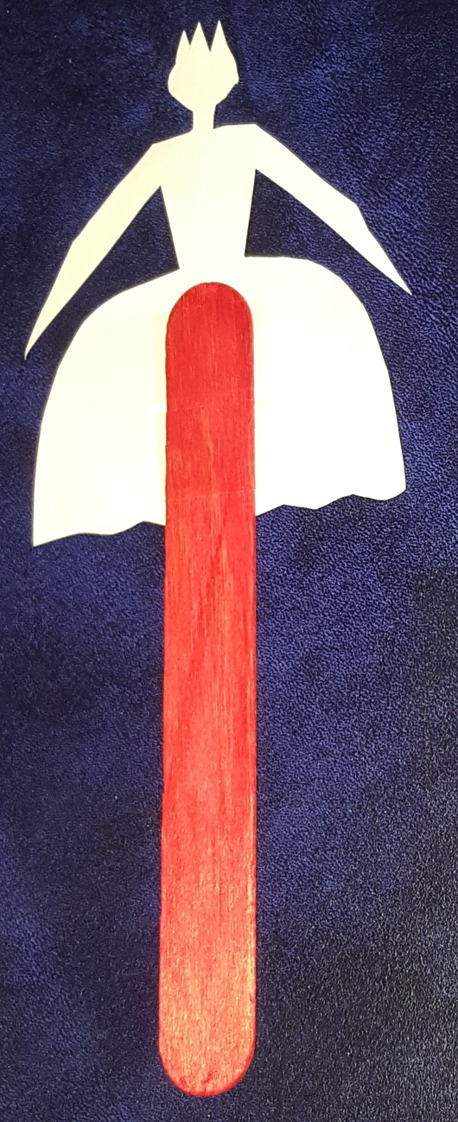
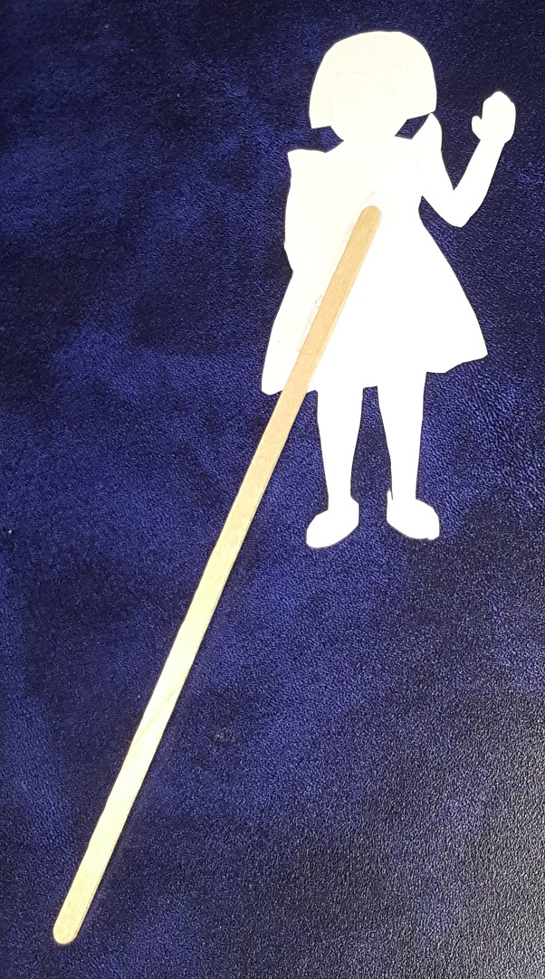
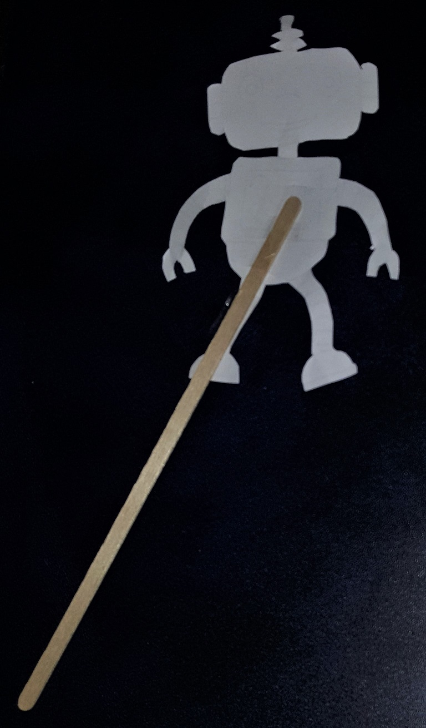

Examples of completed shadow puppets
Notes:
The shadow puppets, from left to right, are: ghost, butterfly, lady, girl and robot. The first three were made from the handout using craft sticks; the other two were made by learners using images that they found on the internet (the printing is on the other side) and used stirrers from a coffee shop (with permission).

Slide 6

Now try this…
Build a ‘theatre’ to hold the screen that the shadows appear on.
Create a short play using your shadow puppets.
Notes:
The ‘theatre’ could be made, for example, using a cut-out section from a cardboard box (see the additional websites in the associated lesson plan for an example).

