Slide 1

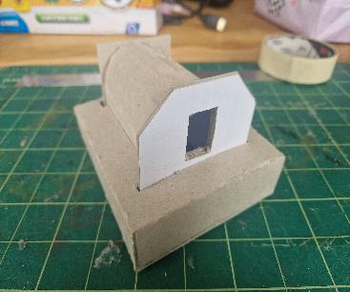
Create a World War 2 air raid shelter
Create a cardboard model of a World War 2 air raid shelter

Slide 2

Air raid shelter
During World War II, households needed protection against enemy air-raids
If you had a garden the most practical solution was to build your own shelter
The shelter was designed to be shipped in kit form - a bit like flat-pack furniture is today
The kit consisted of sheets of corrugated steel, a base, nuts & bolts, fixtures, instructions, and a spanner
“Anderson” shelter
It was named after Sir John Anderson who was briefly in charge of Air Raid precautions
Notes:
Details and images of Anderson shelters can be found athttps://andersonshelters.org.uk/ and https://en.wikipedia.org/wiki/Air_raid_shelter#Anderson_shelter

Slide 3

Preparation for the shelter
Before you constructed the shelter you had to dig a hole
The sheets of corrugated iron would be bolted together and fastened to the base
The soil from the hole would be piled on top so that only the front side would be visible
Hopefully, after all that hard work it would be bombproof
Notes:
Details and images of Anderson shelters can be found athttps://andersonshelters.org.uk/ and https://en.wikipedia.org/wiki/Air_raid_shelter#Anderson_shelter

Slide 4

The Challenge
You are going to make a model of an Anderson-style shelter used in World War 2
Your shelter will be made of three parts:
the shelter building
a base
a model of the earth cover.
Notes:
The image shows a Lancaster bomber, as used by the RAF in world war 2

Slide 5
Resources required
You will need:
Air Raid Shelter templates
Scissors
Card or cereal box
Glue stick
Coloured pens/pencils
Masking tape

Slide 6
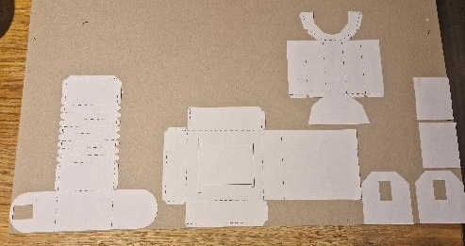
Shelter building Step 1 – Cut out the parts
⚠
Carefully cut along all the solid outlines
Glue onto card or cardboard
When glue is dry, cut out the cardboard

Slide 7
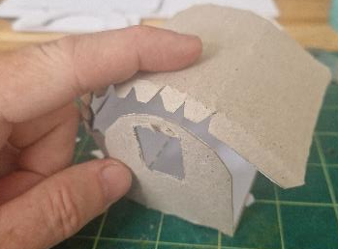
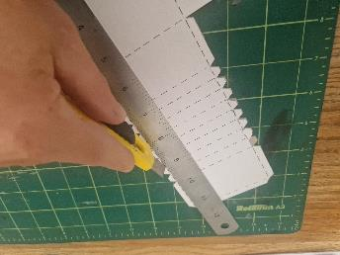
Step 2 – Scoring
⚠
Score along the dotted line, and fold

Slide 8
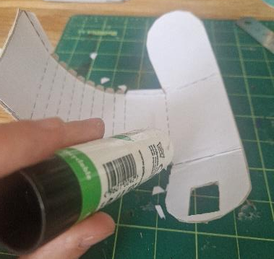
Step 3 – Gluing
Place some glue on the longest tab and hold against the opposite face
Put glue on the tabs for the side nearest the door and stick against the front panel

Slide 9
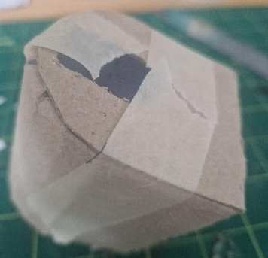
Step 4 – Assembly
Repeat with the remaining side and press until the glue dries
You could use masking tape to hold it until dry, then remove the tape

Slide 10
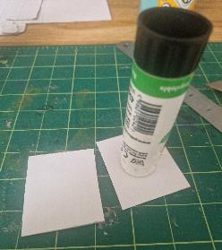
Step 5 – Back and front pieces
Glue the two back pieces together back-to-back
Glue the two front pieces together back-to-back so that the entrance lines up

Slide 11
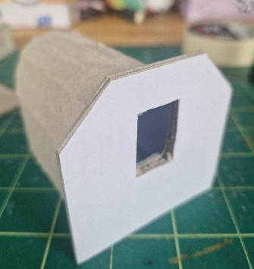
Step 6 – Front assembly
Place glue on the front end of the shelter
Carefully glue the front piece to the shelter, making sure the entrances lines up

Slide 12
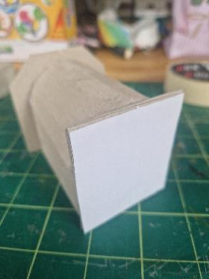
Step 7 – Back assembly
Put glue on the back of the shelter
Fix the back panel to the shelter - make sure the panel is central, with the bottom edge lined up with the bottom edge of the shelter

Slide 13
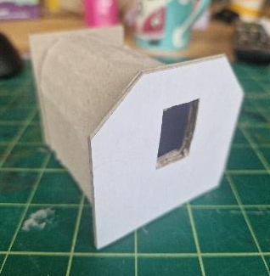
Step 8 – Decorate
Leave the shelter part of the model to dry
Decorate the front and back of your shelter to make it look real

Slide 14
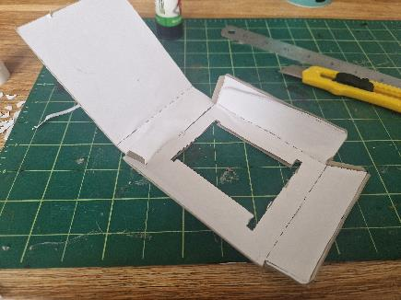
Construct the base Step 1 – Cutting out
⚠
Cut out the base and hole for the shelter

Slide 15
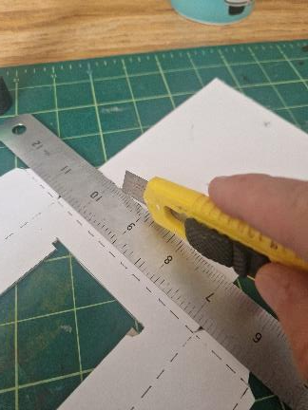
Step 2 – Scoring
⚠
Score the fold in the card and fold

Slide 16
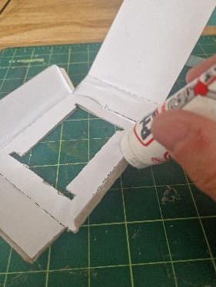
Step 3 - Glue
Glue the four corner tabs together to form a box shape

Slide 17
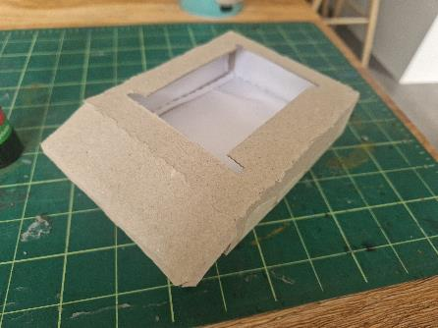
Step 4 - Assemble
Allow the glue to dry, then apply glue to the remaining tabs and stick them down
Leave the base section to dry

Slide 18
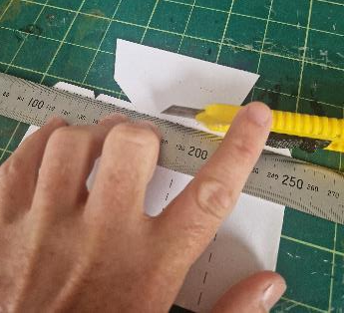
Construct the earth cover Step 1
⚠
Colour in the grass on the top with a felt tip pen
Cut out the shape including any tabs
Score along the dotted lines and fold

Slide 19
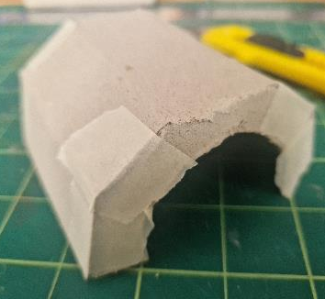
Step 2 - Assembly
Place glue on tabs and stick to the opposite faces
Let the glue dry

Slide 20

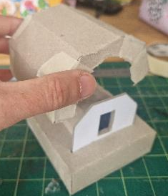
Finished model
Fit your shelter into the slot in the base
Place the grass-covered earth section of the model over your model - this provided more protection

Slide 21

Extension
Design a suitable layout for the interior – what would be needed? How would you arrange everything?
Remember a whole family would be inside!

