Slide 1
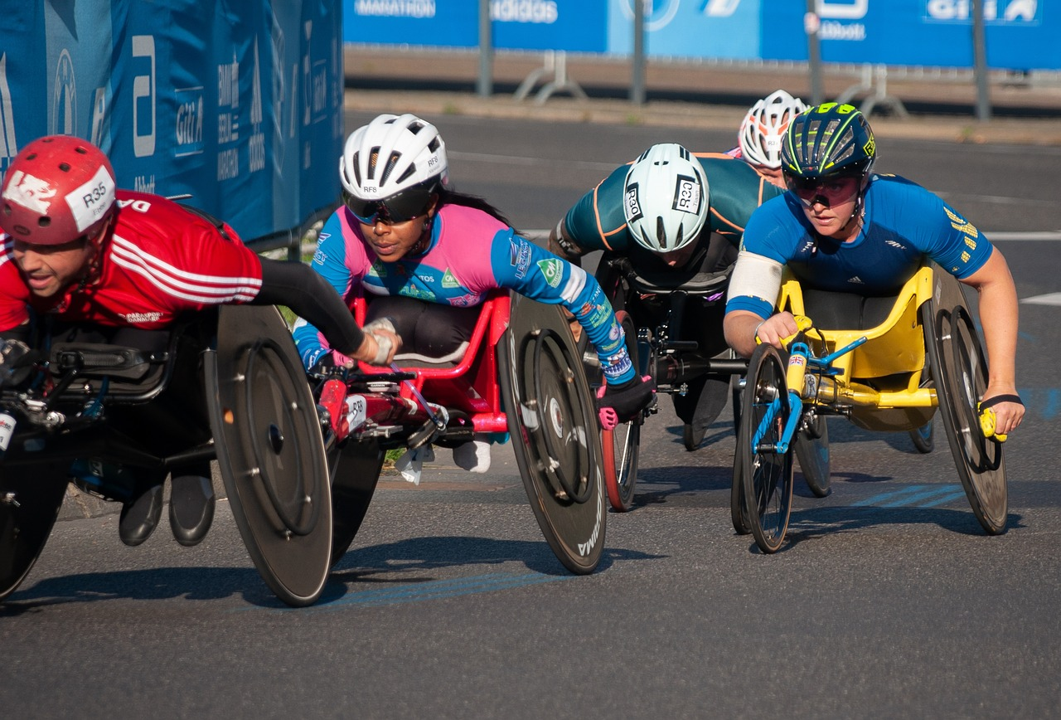
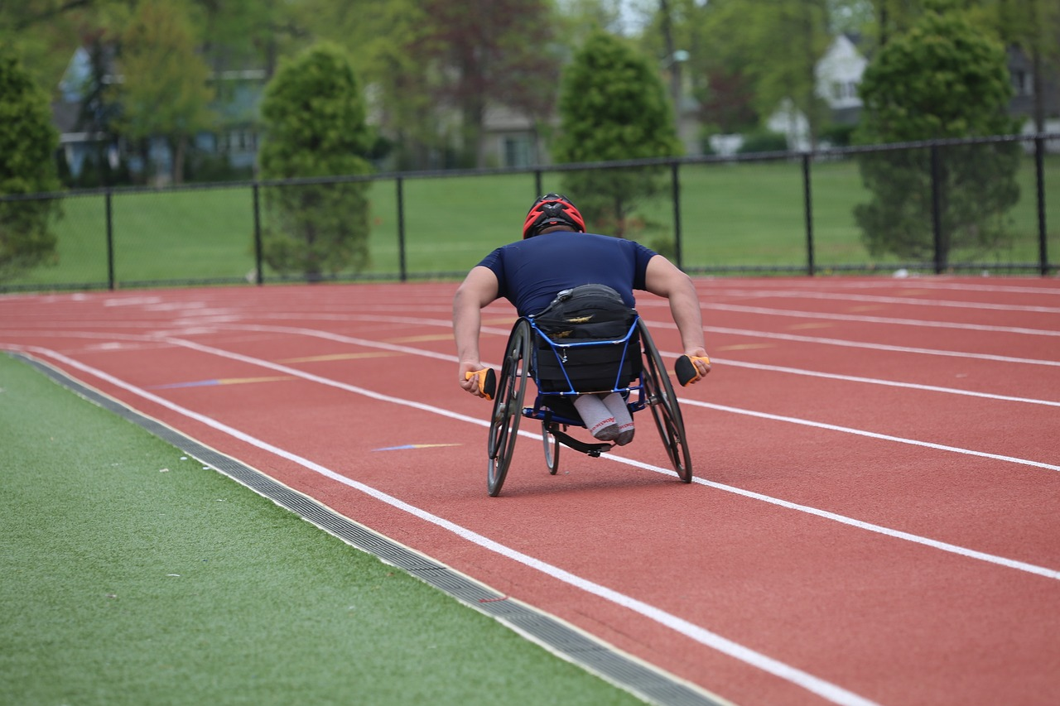
Measuring para-athletic performance
with a BBC micro:bit
Designing and programming a device that a wheelchair athlete can use to measure their performance

Slide 2
Stay safe
Whether you are a scientist researching a new medicine or an engineer solving climate change, safety always comes first. An adult must always be around and supervising when doing this activity. You are responsible for:
ensuring that any equipment used for this activity is in good working condition
behaving sensibly and following any safety instructions so as not to hurt or injure yourself or others
Please note that in the absence of any negligence or other breach of duty by us, this activity is carried out at your own risk. It is important to take extra care at the stages marked with this symbol: ⚠
Notes:
Safety Warning

Slide 3
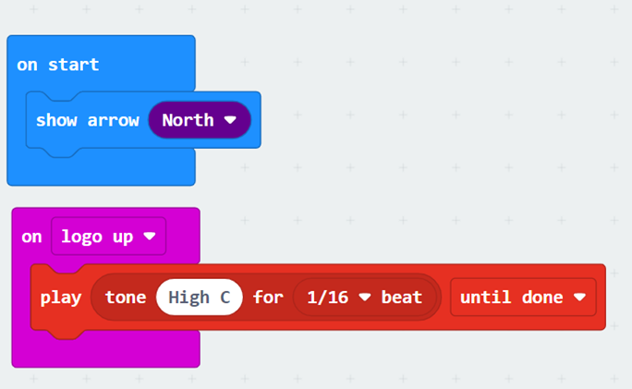
Starter
Look at the code
What do you think it does?
Run the code and see what it really does
Notes:
Teacher could deliver this starter using the PR of the PRIMM (Predict-Run-Investigate-Modify-Make) process:
Predict – show the code and ask students what it does.
Run – enter the code and run it in the simulator and then on the micro:bit and observe what it actually does.
The starter program shows the basic building block that will be used to measure wheel rotation. When the logo is facing up, the micro:bit beeps.
The micro:bits with this running on can be attached to a real wheel, and an experiment done to make sure that it correctly measures wheel rotations.
Also at this point, students could measure the circumference of the wheel, or measure the diameter/radius and calculate the circumference, for the later parts of the project.

Slide 4
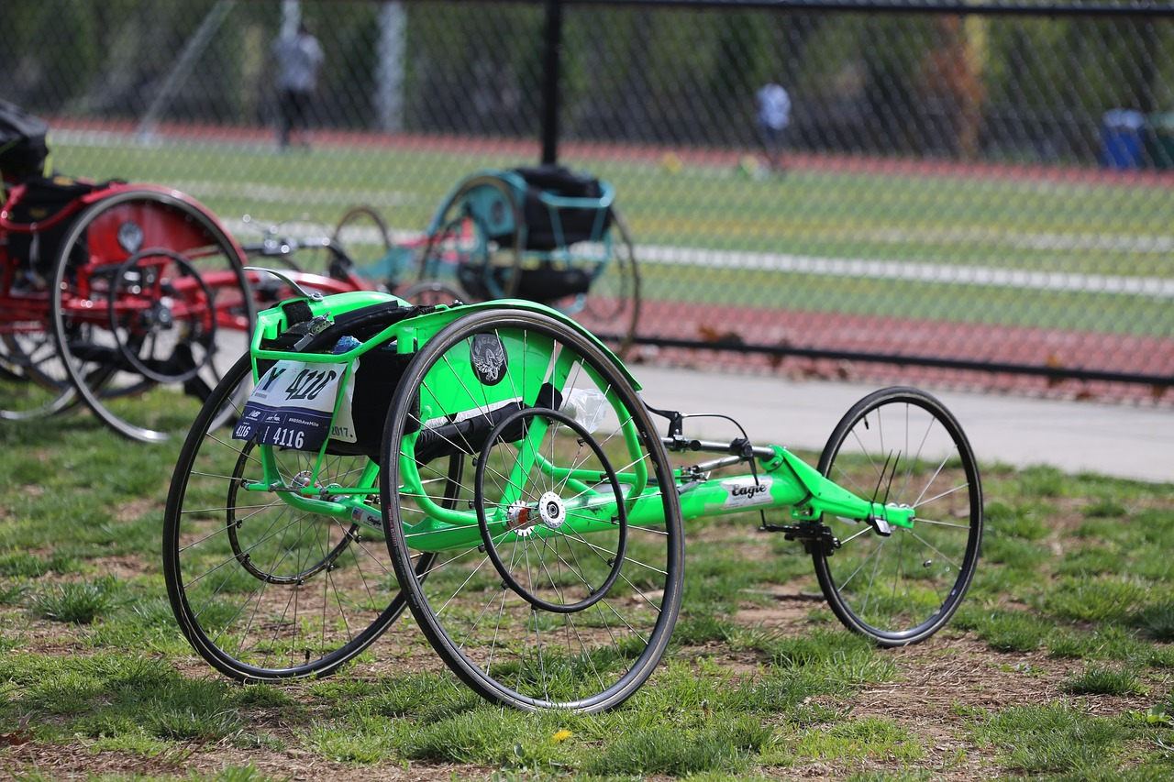
Design context
Wheelchair racing is an exciting paralympic sports event
Wheelchair athletes need to know how well they are racing over time
How do you think they could use technology to do this? How would it be helpful to them?
Notes:
Explain to learners that the design context is what sets the scene for the project that they will be working on.
In response to the questions asked, the teacher could discuss ways in which distance, speed etc could be electronically measured, logged and displayed to help the athletes understand how well they are performing in different events or training sessions over time. This would then be very helpful when preparing for a future major event or a race as they would have data on both their strengths and where they could improve.
If there are any local para-athletic clubs nearby, or any wheelchair users in the school, they could also be questioned about their needs and what would help them in this context.

Slide 5
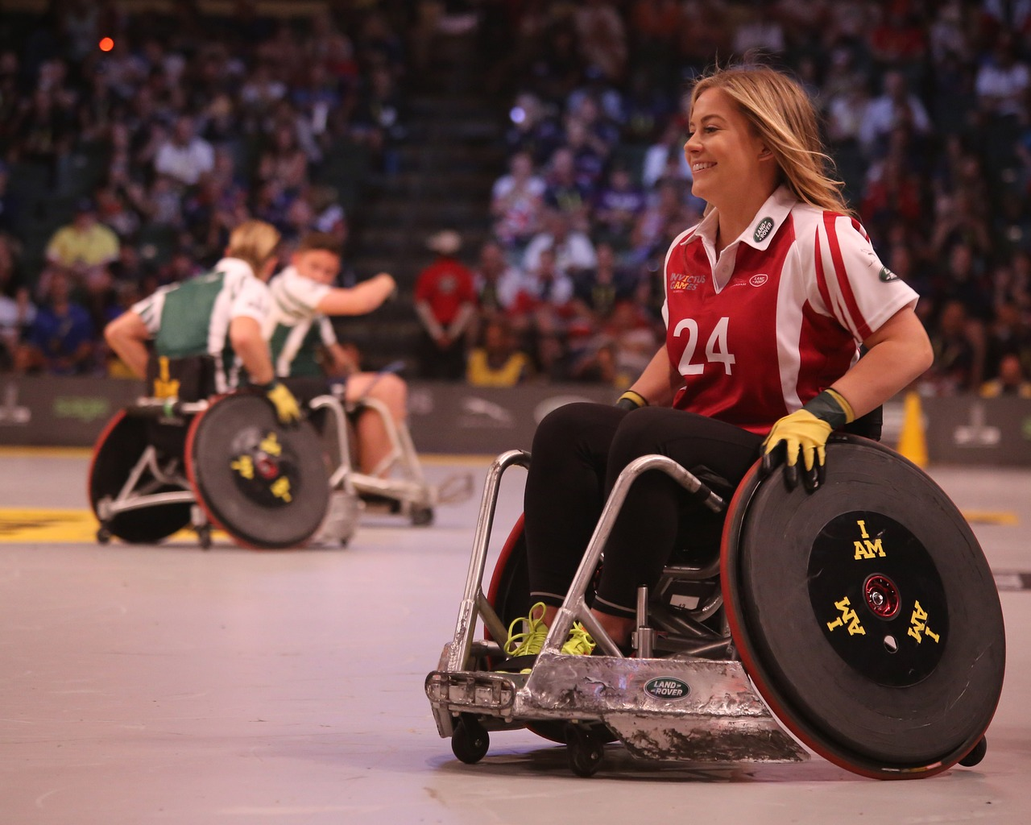
Design brief
Using the BBC micro:bit:
Design a programmable device that can measure the number of times a wheel turns and how far it moves
This can then be used by wheelchair athletes to help them to get ready for a big event
Notes:
Explain that the design brief describes what it is they are going to do in their project.
Discuss the brief with learners and check they understand it.
Learners could analyse the design brief and/or criteria by producing a mind map or spider chart of their initial thoughts on how to solve the problem given.

Slide 6
Design criteria
Your device must be able to:
Count the number of times a wheelchair wheel turns when moving in a straight line
Measure the distance travelled by the wheelchair
It could also:
Log the distance data collected so it can be shown as a graph
Notes:
Assessment advice – learners could be assessed on how many of the design criteria they have managed to fulfil with their devices.
The ‘it could also’ criteria is intended to be harder and provide more challenge.
Learners could analyse the design brief and/or criteria by producing a mind map or spider chart of their initial thoughts on how to solve the problem given.

Slide 7
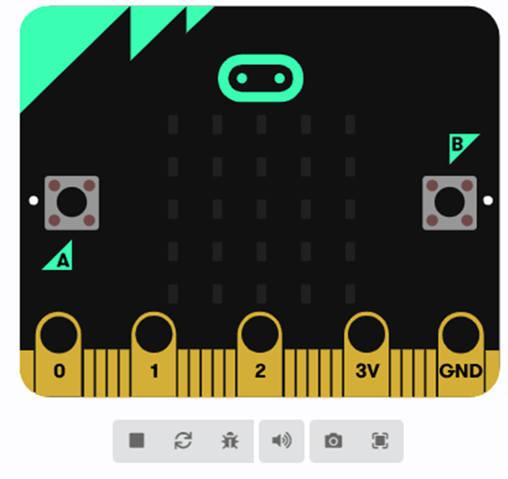
Your tasks (route 1)
⚠
Go to https://makecode.microbit.org
Click on ‘new project’
Write your code to meet the brief
Download it to your micro:bit
Test on a wheelchair wheel
View the data recorded on the MICROBIT drive
Notes:
Learners can be taken through this in one of two ways:
Option 1 – Learners themselves create the code to meet the design brief, with help as required from the teacher. In this instance the main focus is the programming activity.
Option 2 – The example code is treated as pre-written and downloaded onto the micro:bits ‘as is’. In this instance the main focus is on the overall system and the use of the device in context.
Route option 1:
For lower ability learners the teacher could show the learners how to create the program step-by step.
The example wheel:bit program can be used to help with this and to give an example for learners to follow as needed. This could be demonstrated working, prior to learners producing their own program, so they know what they are aiming to achieve.
Safety – always take care when using electrical or electronic devices. If something does not seem right, e.g. the circuit board is getting hot, take the power off and tell an adult immediately.
Testing:
The micro:bit should be attached to the wheel being used for testing. This could be an actual wheelchair wheel, a bike wheel or a trundle wheel. Alternatively, teachers could produce a scale model of a wheelchair in advance of the activity for testing, or challenge learners to make their own out of card, dowels, Lego, kits etc.

Slide 8
Your tasks (route 2)
⚠
Go to https://makecode.microbit.org
Drag the wheel:bit HEX file into the project homepage to open it
Download it to your micro:bit
Test on a wheelchair wheel
View the data recorded on the MICROBIT drive
Notes:
Learners can be taken through this in one of two ways:
Option 1 – Learners themselves create the code to meet the design brief, with help as required from the teacher. In this instance the main focus is the programming activity.
Option 2 – The example code is treated as pre-written and downloaded onto the micro:bits ‘as is’. In this instance the main focus is on the overall system and the use of the device in context.
Route option 2:
Teacher will need to place the wheel:bit example program in a shared drive for learners to access and drag on screen, or have it opened and ready on screen for them in advance.
Safety – always take care when using electrical or electronic devices. If something does not seem right, e.g. the circuit board is getting hot, take the power off and tell an adult immediately.
Testing:
The micro:bit should be attached to the wheel being used for testing. This could be an actual wheelchair wheel, a bike wheel or a trundle wheel. Alternatively, teachers could produce a scale model of a wheelchair in advance of the activity for testing, or challenge learners to make their own out of card, dowels, Lego, kits etc. With the wheel:bit program, every time the micro:bit screen faces up, it adds one to a counter. Learners will need measure the circumference of the wheel being used for testing (or measure the diameter and calculate the circumference) and enter this into the code. The display then shows the number of rotations on press A, and the total distance on press B.

Slide 9
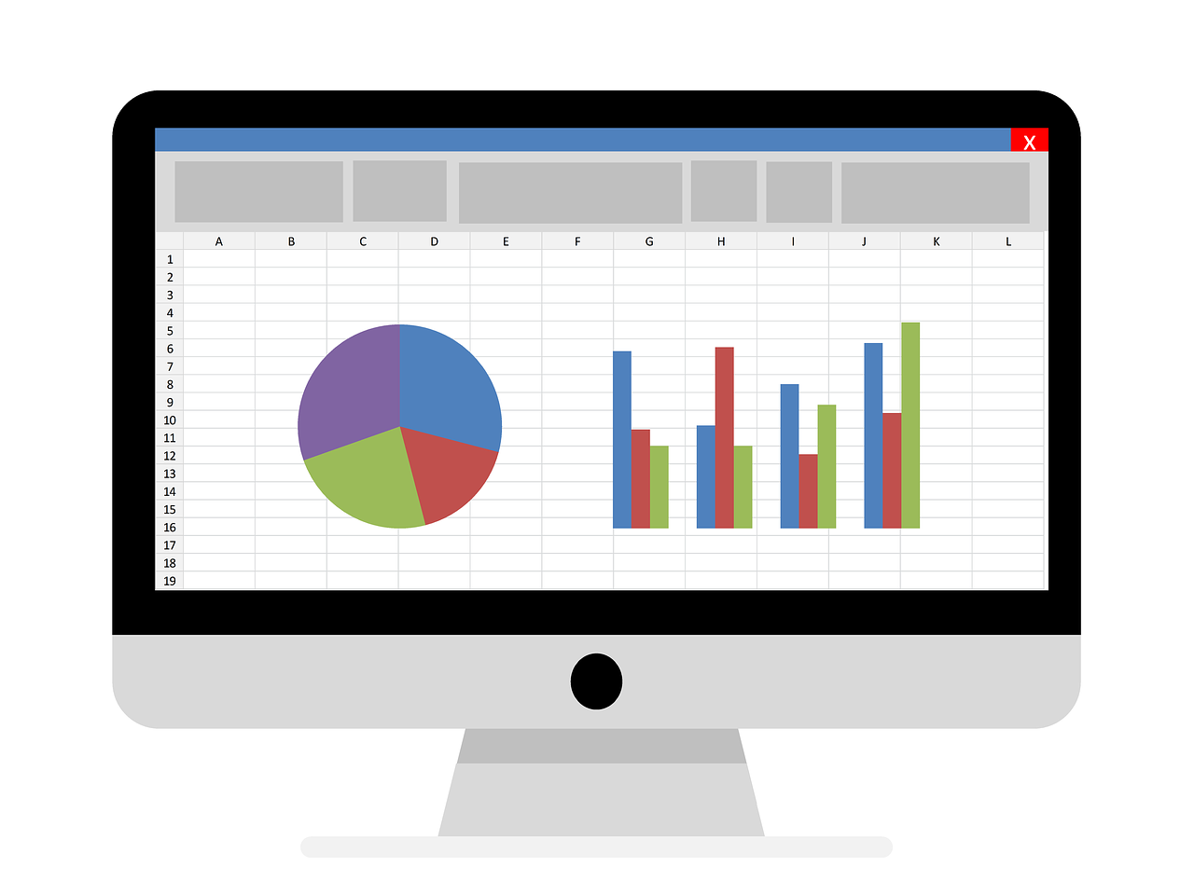
Extension
Watch all parts of the microbit.org data logging video
Download the CSV file of your data and load into Excel
Use the data to plot graphs and estimate other useful information, such as speed
Notes:
Teachers could show other parts of the microbit.org data logging video, and ask students to download and save the CSV file and load it into Excel; there they can plot graphs and also add other columns to estimate speed and other insights about the data.

Slide 10
Starter example program
Notes:
This program is for the starter activity (slide 3).
To open this program:
Open https://makecode.microbit.org in a new browser window.
Click on ‘import’ and select ‘import file’. Then choose the HEX file to upload.
Or, drag the HEX file from your computer into the edit window or project homepage.
https://support.microbit.org/support/solutions/articles/19000065686
Versions of this program are provided for both Windows and Mac operating systems.

Slide 11
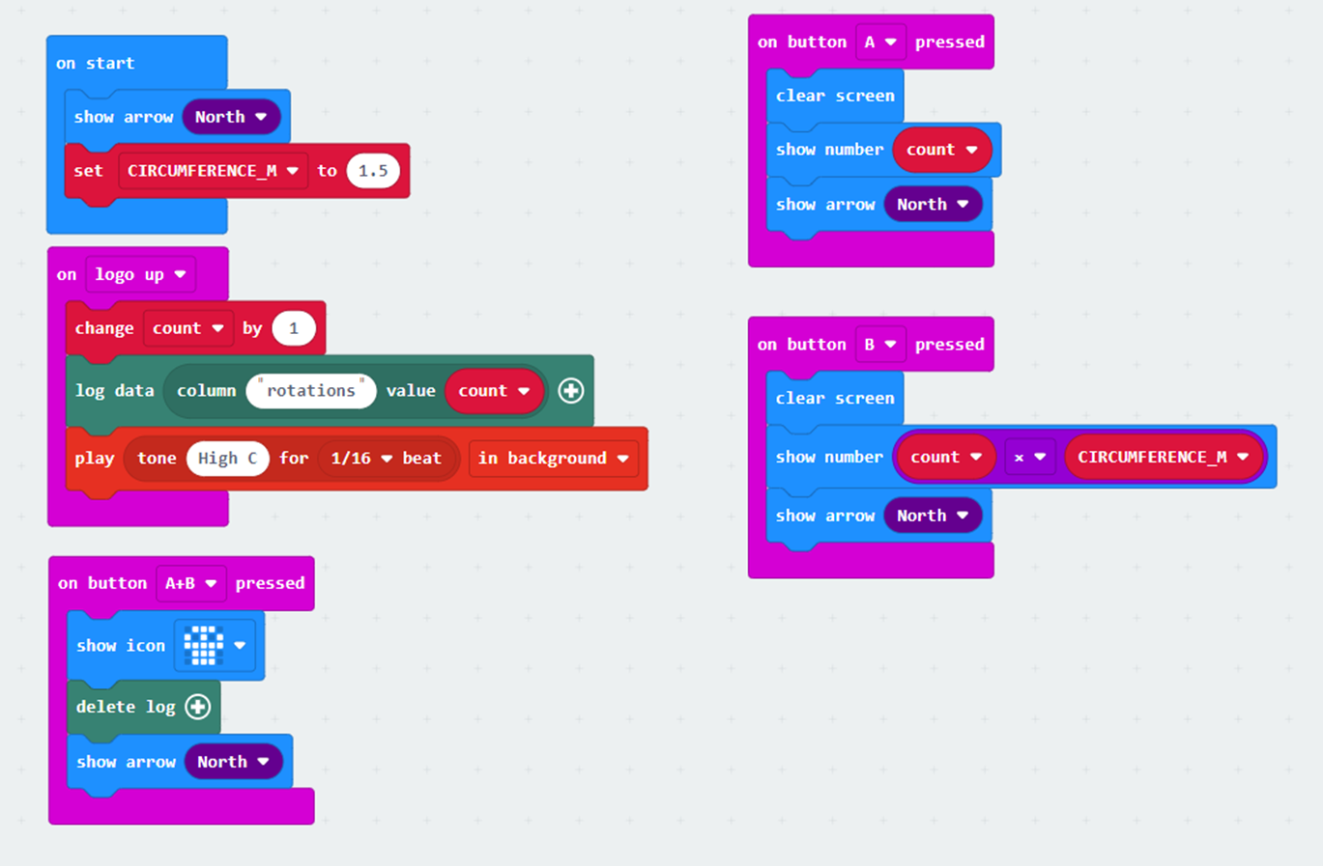
wheel:bit example program
Notes:
This program is for the main activity. The first part of this program, and the simplest solution to the problem set, is code that counts wheel rotations, based on the starter program. Teachers could explain how to calculate distance from the number of rotations and the wheel circumference. Also, explain that by convention we use upper case variable names to indicate something that is a constant (the CIRCUMFERENCE). Learners could also choose to code in the diameter/radius and put the maths in the code to calculate the circumference. The second part of the program adds code related to data logging. This allows data from a particular sports event or training session to be captured and analysed in the future to gain further insights.
Teachers could get students to try the standard micro:bit data logging video on the microbit.org website to understand how this works, or demonstrate clicking on data.htm on the MICROBIT drive, and looking at the numbers and the graph preview. They should also explain that if the data log fills up it needs to be cleared, and get learners to add an A+B press to delete the log. Note that if you power cycle or press RESET, the timestamp goes back to zero, and the log graph preview will not show any data after a timestamp goes backwards, so having a 'delete log' feature is very useful. You will need to use 'EXTENSIONS, add data logging' in order to get the data logging feature, and this won't work on a V1 micro:bit, only V2.
Teachers could show other parts of the microbit.org data logging video, and ask students to save the CSV file and load it into Excel; there they could plot graphs, and also add other columns to estimate speed and other insights about the data.
To open this program:
Open https://makecode.microbit.org in a new browser window.
Click on ‘import’ and select ‘import file’. Then choose the HEX file to upload.
Or, drag the HEX file from your computer into the edit window or project homepage.
https://support.microbit.org/support/solutions/articles/19000065686
Versions of this program are provided for both Windows and Mac operating systems.

