Slide 1
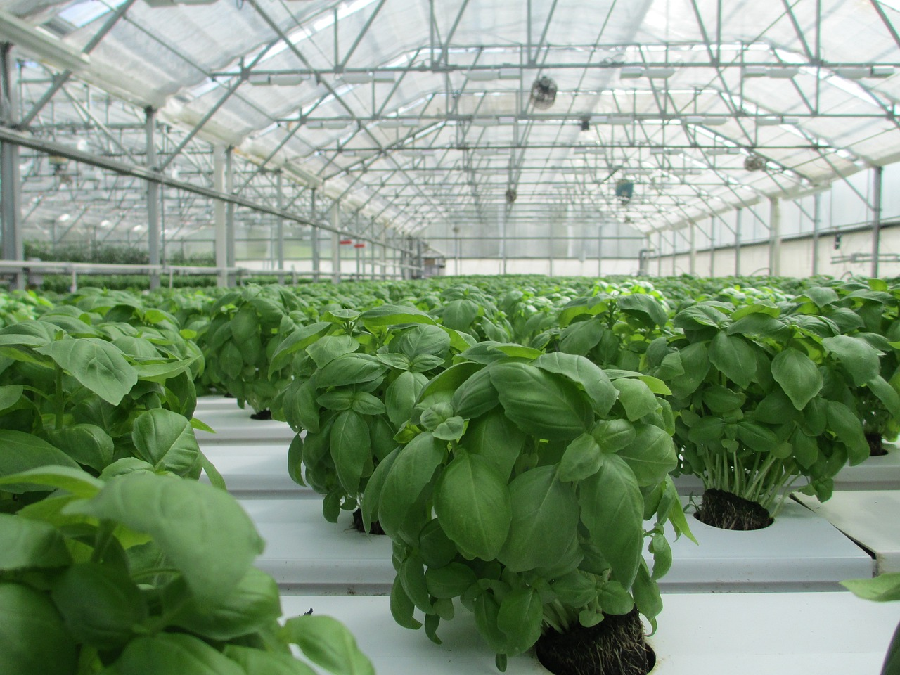
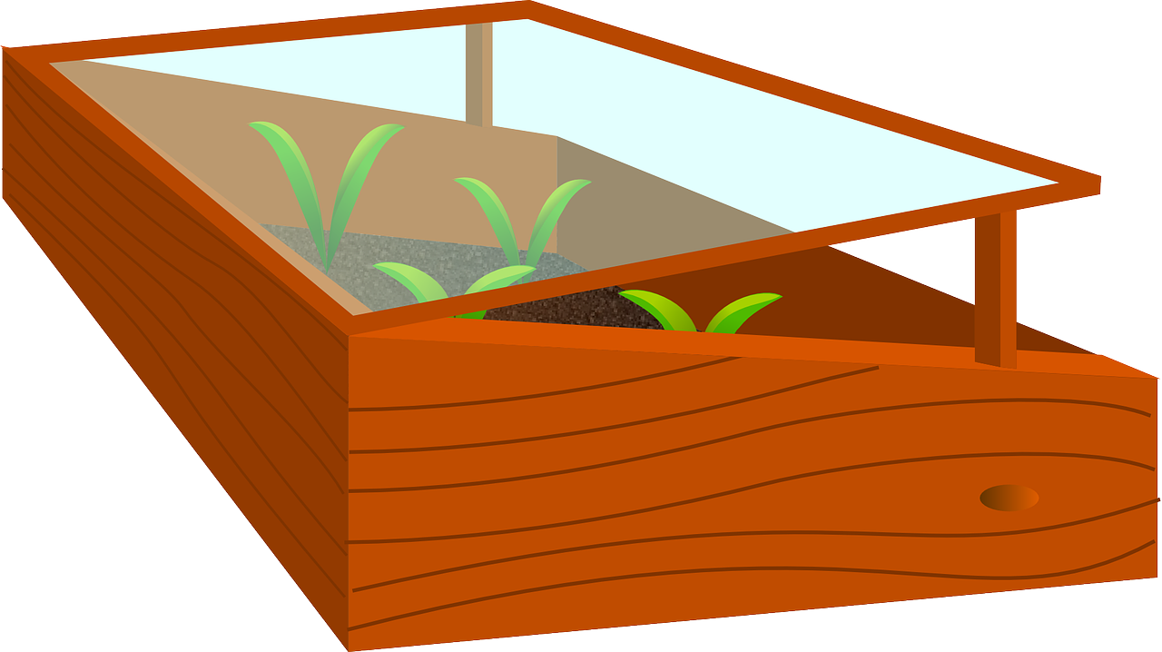
Smart greenhouse with the BBC micro:bit
Designing and programming a system that can keep conditions in a greenhouse ideal for growing food

Slide 2
Stay safe
Whether you are a scientist researching a new medicine or an engineer solving climate change, safety always comes first. An adult must always be around and supervising when doing this activity. You are responsible for:
ensuring that any equipment used for this activity is in good working condition
behaving sensibly and following any safety instructions so as not to hurt or injure yourself or others
Please note that in the absence of any negligence or other breach of duty by us, this activity is carried out at your own risk. It is important to take extra care at the stages marked with this symbol: ⚠
Notes:
Safety Warning

Slide 3
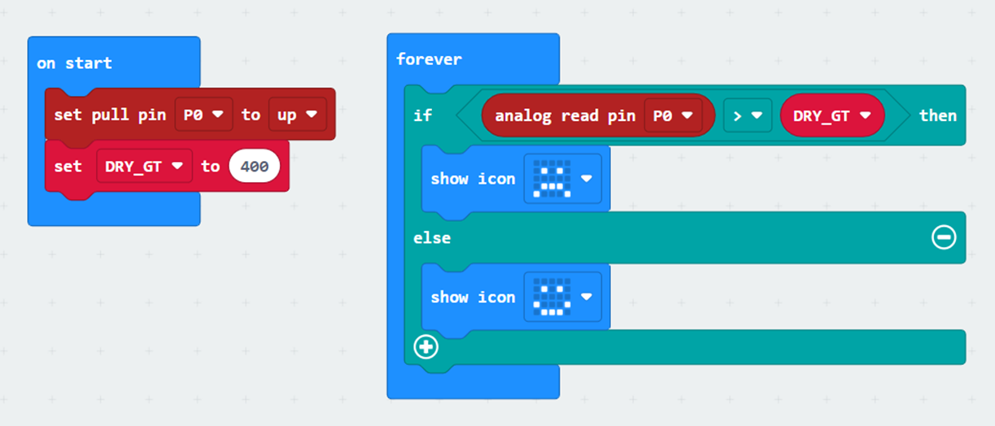
Starter
Look at the code
What do you think it does?
Run the code and see what it really does
Notes:
Teacher could deliver this starter using the PR of the PRIMM (Predict-Run-Investigate-Modify-Make) process:
Predict – show the code and ask students what it does.
Run – enter the code and run it in the simulator and then on the micro:bit and observe what it actually does.
This is a small aspect of the main program. It demonstrates how to measure the moisture of soil in a plant pot. The learners will need to use croc clips attached to nails or unfolded paper-clips stuck into the plant soil. As part of this starter, learners must measure the reading for both dry and wet soil, and work out where to set the DRY_GT threshold to (a figure where if the number is greater than this number, we assume the plant is dry and needs watering).

Slide 4
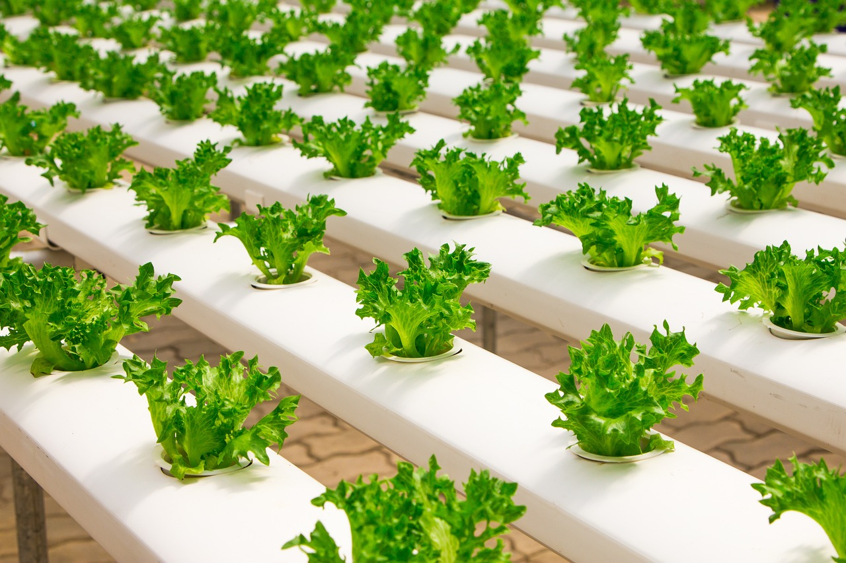
Design context
Lots of the food that we eat is grown in greenhouses
It is important that the conditions are kept just right for the food to grow well
What conditions do you think food plants need to grow?
Notes:
Explain to learners that the design context is what sets the scene for the project that they will be working on.
Conditions for plants to grow – learners could discuss the right temperature, soil moisture and/or light level needed for the plants to grow.

Slide 5
Design brief
Using the BBC micro:bit:
Design a programmable device that can keep the conditions good for growing food in a greenhouse
As part of this it must keep the temperature and soil moisture at the right level
Notes:
Explain that the design brief describes what it is they are going to do in their project.
Discuss the brief with learners and check they understand it.
Learners could analyse the design brief and/or criteria by producing a mind map or spider chart of their initial thoughts on how to solve the problem given.
Explain that the plant will need to be kept not too warm or not too cold. Similarly, the soil they are planted in must be not too wet or not too dry.

Slide 6
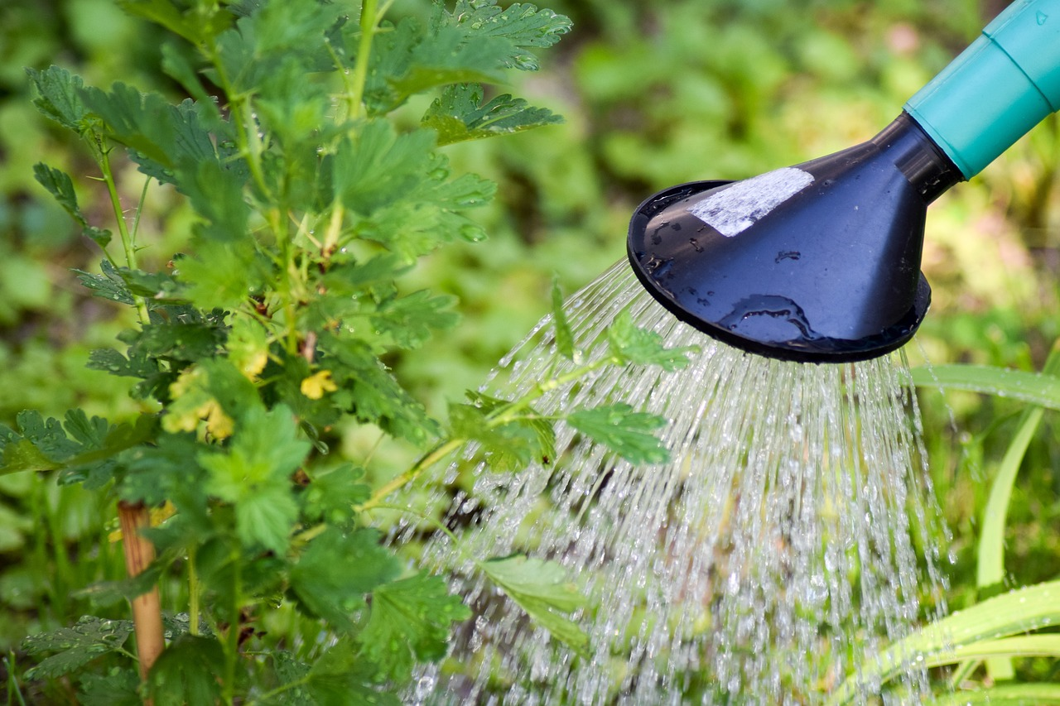
Design criteria
Your device must be able to:
Show the current temperature in the greenhouse, and moisture level in the soil
Open a window when it is too hot, and close it when it is not
It could also:
Turn on a system to water the plants if the soil gets too dry
Notes:
Assessment advice – learners could be assessed on how many of the design criteria they have managed to fulfil with their devices.
The ‘it could also’ criteria is intended to be harder and provide more challenge.
Learners could analyse the design brief and/or criteria by producing a mind map or spider chart of their initial thoughts on how to solve the problem given.

Slide 7
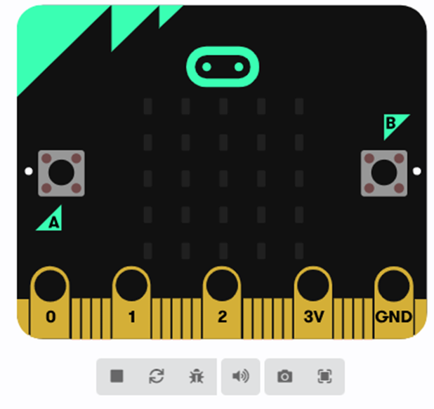
Your tasks (route 1)
⚠
Go to https://makecode.microbit.org
Click on ‘new project’
Write your code to meet the brief
Check it works on screen (simulate)
Download it to your micro:bit
Test your system to check it works
Notes:
Learners can be taken through this in one of two ways:
Option 1 – learners themselves create the code to meet the design brief, with help as required from the teacher. In this instance the main focus is the programming activity.
Option 2 – The example code is treated as pre-written and downloaded onto the micro:bit ‘as is’. In this instance the main focus is on the overall system and its use in context.
Route option 1:
For lower ability learners the teacher could show the learners how to create the program step-by step.
The example plant:bit program can be used to help with this and to give an example for learners to follow as needed. This could be demonstrated working, prior to learners producing their own program, so they know what they are aiming to achieve.
Safety – always take care when using electrical or electronic devices. If something does not seem right, e.g. the circuit board is getting hot, take the power off and tell an adult immediately.
Testing:
For opening a window and/or watering the plants, servo motors could be connected to the micro:bit to move a scale model of a window up and down, and/or knock a small bucket of water onto the soil if it is too dry.
Learners could also set this up as a test rig, with assistance as required from the teacher.
Servo motors used must be suitable for use with the BBC micro:bit.

Slide 8
Your tasks (route 2)
⚠
Go to https://makecode.microbit.org
Drag the plant:bit HEX file into the project homepage to open it
Check it works on screen (simulate)
Download it to your micro:bit
Test your system to check it works
Notes:
Learners can be taken through this in one of two ways:
Option 1 – learners themselves create the code to meet the design brief, with help as required from the teacher. In this instance the main focus is the programming activity.
Option 2 – The example code is treated as pre-written and downloaded onto the micro:bit ‘as is’. In this instance the main focus is on the overall system and its use in context.
Route option 2:
Teacher will need to place the plant:bit example program in a shared drive for learners to access and drag on screen, or have it opened and ready on screen for them in advance.
Safety – always take care when using electrical or electronic devices. If something does not seem right, e.g. the circuit board is getting hot, take the power off and tell an adult immediately.
Testing:
For opening a window and/or watering the plants, servo motors could be connected to the micro:bit to move a scale model of a window up and down, and/or knock a small bucket of water onto the soil if it is too dry.
Learners could also set this up as a test rig, with assistance as required from the teacher.
Servo motors used must be suitable for use with the BBC micro:bit.

Slide 9
Extension
How could you improve the system so that it also measures the light level in the greenhouse?
How could the system change the light level in the greenhouse if it is too bright or too dark?
Notes:
Extension:
This could involve the use of a light sensor input to measure the light level in the greenhouse, and the use of a lighting system, such as a series of lamps, to change the light level.

Slide 10
Starter example program
Notes:
This program is for the starter activity (slide 3).
To open this program:
Open https://makecode.microbit.org in a new browser window.
Click on ‘import’ and select ‘import file’. Then choose the HEX file to upload.
Or, drag the HEX file from your computer into the edit window or project homepage.
https://support.microbit.org/support/solutions/articles/19000065686
Versions of this program are provided for both Windows and Mac operating systems.

Slide 11
plant:bit program
Pin | Part connected to pin
P1 | Servo that opens and closes the window
P2 | Servo that turns the water supply on and off
Notes:
In its simplest form the program could simply show the readings of temperature and moisture level, without any element of output control. Every 15 sec, scroll T+ temperature(C) M + moisture (0..1023) – the moisture measured by two crocodile clips on P0+GND and two nails in the soil.
An EVERY 15000 ms block should be used; it is not necessary to introduce variables at this stage, but learners should think about how they want to present the two readings every 15 seconds. The -example shows a scrolling setup, but there are other ways this could be presented. Learners will also learn more about temperature and moisture readings - they could take measurements and work out the best threshold values to use for later.
For a medium level of challenge, the program can be progressed by introducing a simple control aspect. If temp > hot, screen shows open window, lift optional servo P1 up to show window open; if temp < cold, screen shows closed window, drop optional servo P1.
When it is too hot, the window is opened; when it is not hot, the window is closed. At this point teachers should choose if a real servo is used, or if the display is just going to show whether the window is open or closed; the display aspect is simple because a single value of open/closed could be represented by two icons. It could become a D&T focussed project here by using a scaled down model wooden house and actually physically attaching a servo to a small flap that opens and closes like a window.
For a much harder level of challenge, learners will need to water the plant with real water and also for a non-servo setup, work out how to display the status of both the window and the water delivery system. If moisture > dry, screen shows watering, move servo P2 to simulate tipping a water jug; if moisture < wet, screen shows not watering, return servo P2 to simulate levelling watering jug.
For a servo setup, the teacher could makes this into a D&T focussed project by working out how to mount and tip a small bucket of water into the plant pot.
For a non-servo project, the teacher needs to show learners how they could display two items at once (the -example file here shows an icon of a plant pot, with the left top LED plotted if the window is open, and the right top LED plotted if the water delivery system is on). Teachers could do a class-wide ideation session here to gather ideas from students on different ways to display two status values at the same time on the screen, and even show the example code at the end of this to see how it works and to analyse and add in the student ideas to get it working.
To open this program:
Open https://makecode.microbit.org in a new browser window.
Click on ‘import’ and select ‘import file’. Then choose the HEX file to upload.
Or, drag the HEX file from your computer into the edit window or project homepage.
https://support.microbit.org/support/solutions/articles/19000065686
Versions of this program are provided for both Windows and Mac operating systems.

