Slide 1
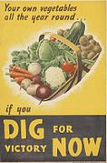
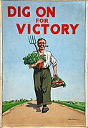

Design a wartime vegetable garden
Dig for Victory
Notes:
The Dig for Victory campaign was an initiative during the Second World War that was designed to:
Encourage cultivation: encourage people to grow their own food by cultivating gardens, allotments, and other open spaces. Instruction leaflets were distributed to guide people in how to grow vegetables and other crops.
Provide food security: with the naval blockade limiting food imports, homegrown produce became essential.
Assist with educational efforts: the ministry of Agriculture and Fisheries ran an educational campaign using leaflets, guides and short films in the cinema to teach people how to ‘Dig for Victory’.
Provide wider Impact: Keep the population fed but also free up shipping and aircraft for the war effort.

Slide 2
Stay safe
Whether you are a scientist researching a new medicine or an engineer solving climate change, safety always comes first. An adult must always be around and supervising when doing this activity. You are responsible for:
ensuring that any equipment used for this activity is in good working condition
behaving sensibly and following any safety instructions so as not to hurt or injure yourself or others
Please note that in the absence of any negligence or other breach of duty by us, this activity is carried out at your own risk. It is important to take extra care at the stages marked with this symbol: ⚠

Slide 3
Dig for Victory
What was it?
Why was it used?
Watch the video below:
https://www.youtube.com/watch?v=35NpLveVZDg
Notes:
Dig for Victory meant digging up your garden to grow as much of your own food as possible.
5 mins video: https://youtu.be/35NpLveVZDg
The United Kingdom produced less of half of the food needed to feed the population before the start of WW2. It was mainly imported from other countries.
When the war started, boats and aircraft delivering food were being sunk or shot down, so there were shortages. Rationing was introduced to ensure there was enough for everyone and people were encouraged to their own vegetables and fruit.
Posters were produced, such as shown above, to advertise the scheme and get people involved.

Slide 4
Your task
Design a ‘Dig for Victory’ garden to feed your family
What vegetables and fruit will you grow?
Will you share food with the neighbours?
Design criteria
Your garden must be 5 metres by 3 metres
It must include at least 5 different vegetables
There must be a 25 cm gap between each type of plant
Notes:
What is the benefit of sharing with your neighbours?
Share produce
Grow different foods and get variety
Differentiation:
1. pre drawn grid
Cut out pictures of different fruit/vegetables to allow them to select their own and place on the grid.
Draw the food instead of writing the words.
Layout a large sheet of plastic on the floor that is approximately the size of the garden.
Draw with board markers the actual dimensions of each area of the garden.
Visualise the actual area.
Get real food items, e.g. carrots, potatoes, onions and lay them in each area.

Slide 5
Your task (extended version)
Design a Dig for Victory garden to feed your family
What vegetables and fruit will you grow?
Will you share food with the neighbours?
What crops will you rotate?
Design criteria
Your garden must be 5 metres by 3 metres
It must include at least 5 different vegetables
There must be a
25 cm gap between each type of plant
  25 cm between each row of plants/seeds
  25 cm between each plant/seed
Notes:
Extended task:
Dimensions to consider:
25 cm between each row of seeds
25 cm between each plant.
Share food with neighbours – increase variety of foods, improve morale.
Crop rotation – what would you grow in each season? Research season vegetable and plan for spring/summer/autumn.

Slide 6
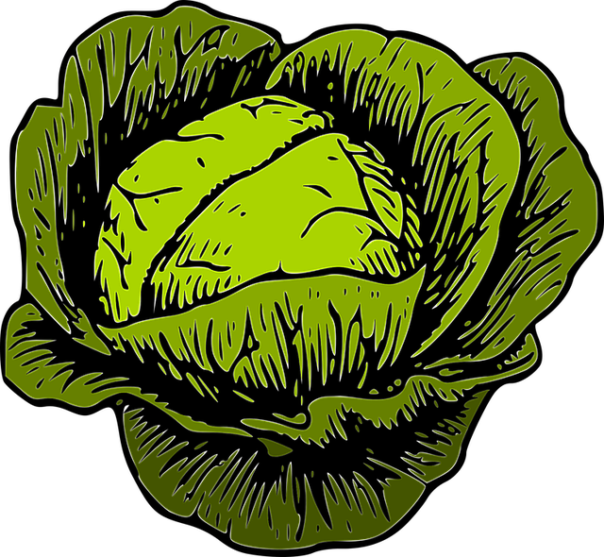
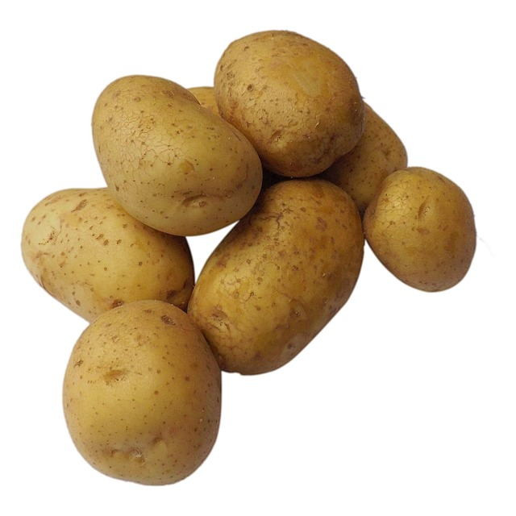
Things to think about for your garden
What fruits and vegetables can be grown on an allotment or in a vegetable garden?
What can be grown in the United Kingdom in both winter and summer?
What can’t be grown easily in the UK climate?
What other things could you add to your garden?
Notes:
What fruits and vegetables can be grown on an allotment/vegetable garden?
The government advised that you grow vegetables for you and your family every week of the year - never a week without food from your garden or allotment.
Not only fresh peas and lettuce in June - new potatoes in July, but all the health-giving vegetables in winter when supplies were scarce:
savoy cabbages, sprouts, kale, sprouting broccoli, broccoli, onions, leeks, carrots, parsnips - vegetables all the year round if you
“DIG WELL AND CROP WISELY”
Vegetables: beetroots, carrots, courgettes, peas, pumpkins, potatoes, runner beans.
Fruit: strawberries, gooseberries, if have trees already, apple/pear/plums.
REMEMBER OUR UK CLIMATE IS NOT SUITABLE FOR A LOT OF FRUIT LEARNERS MAY BE USED TO.
Other things that could be added:
Chickens – provide meat and eggs – meat and eggs are rationed during the war.
Greenhouse – help cultivate the plants, protect from the cold.
Shed – store your equipment and vegetables

Slide 7


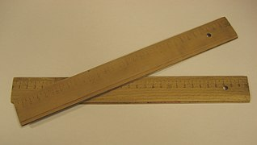
Equipment and resources
Squared paper
Rulers
Pencil/pens
Coloured pencils

Slide 8
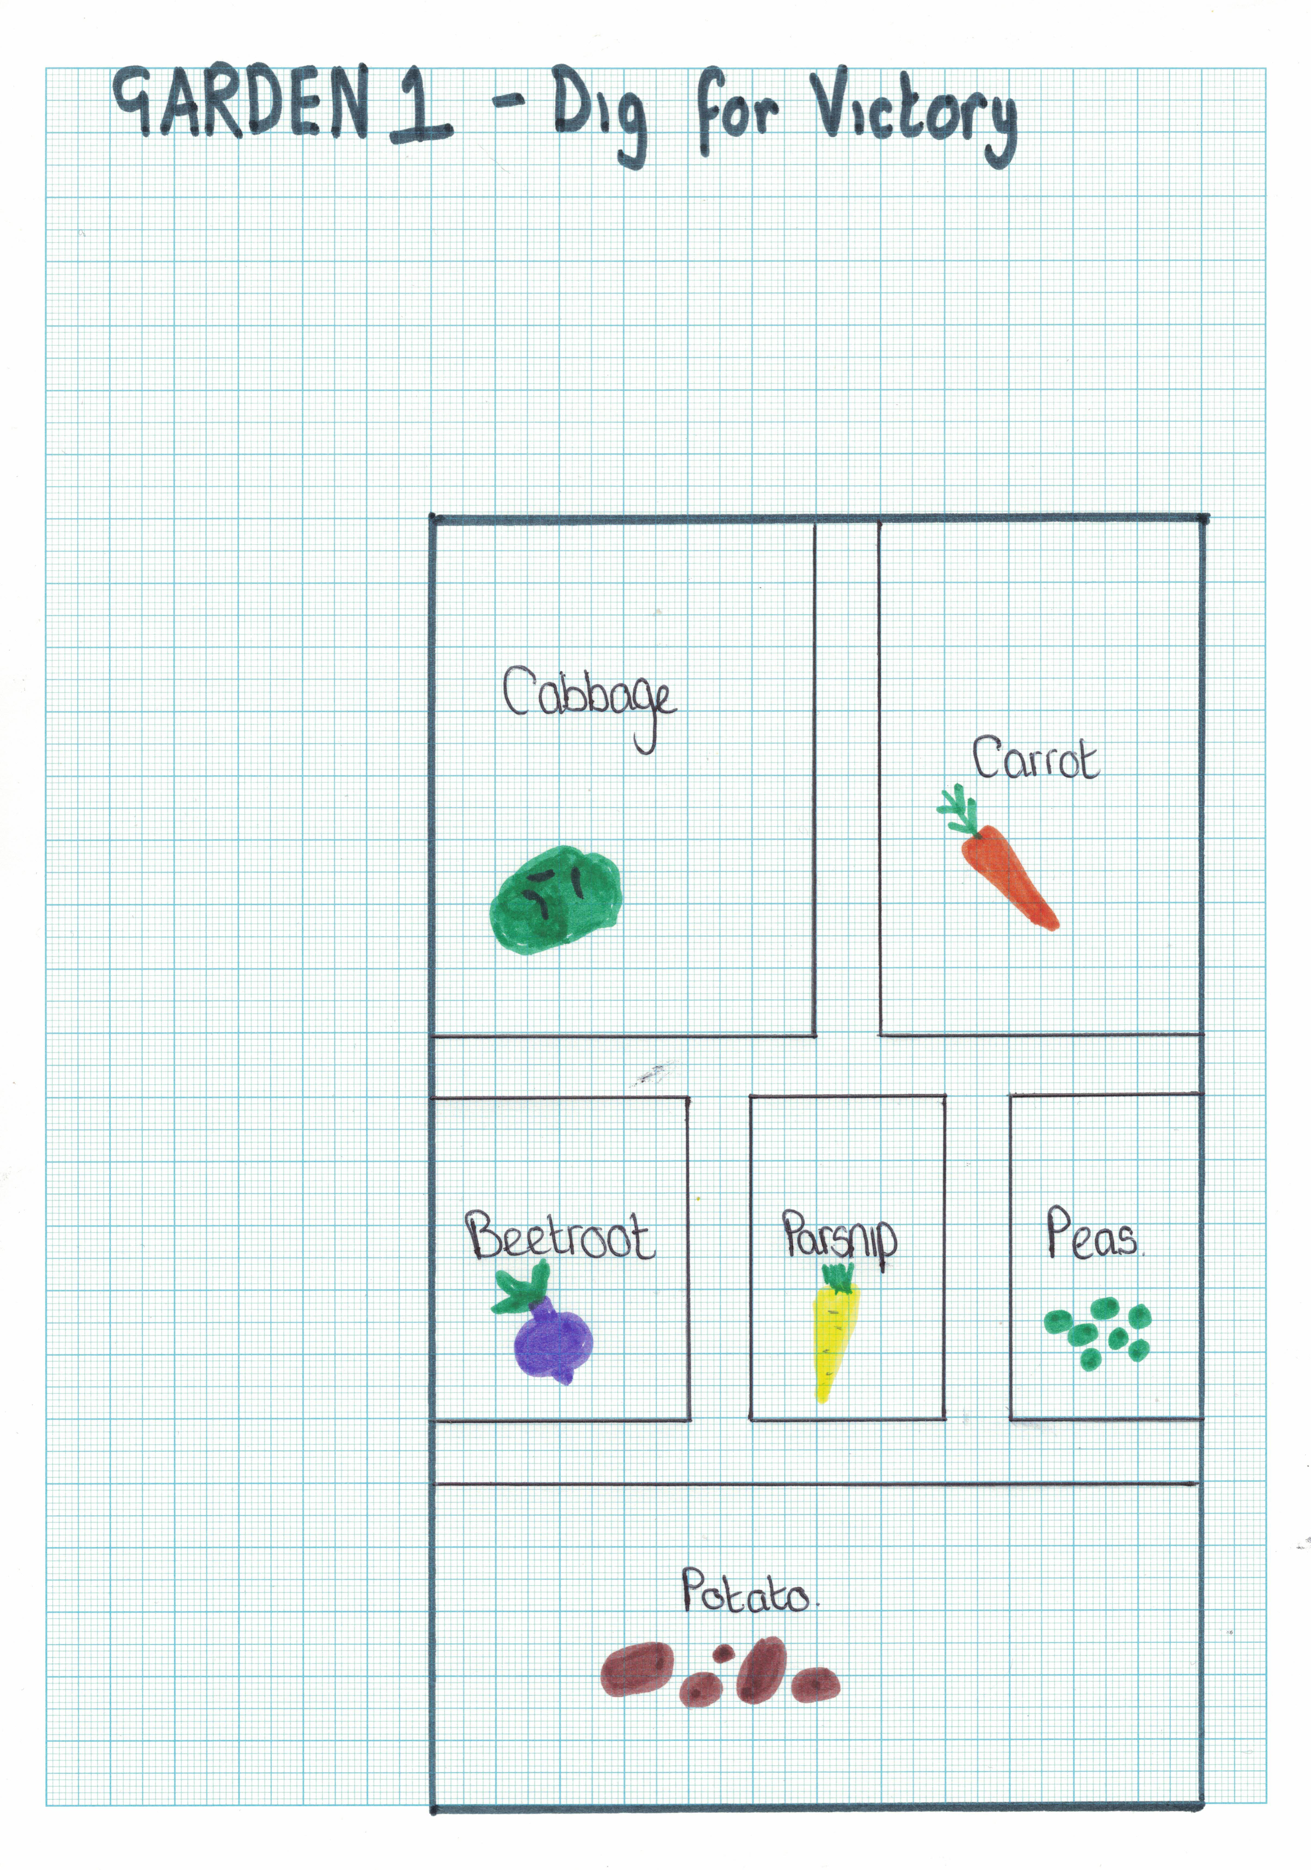
Notes:
Example of a simple design – share to aid learners.

Slide 9
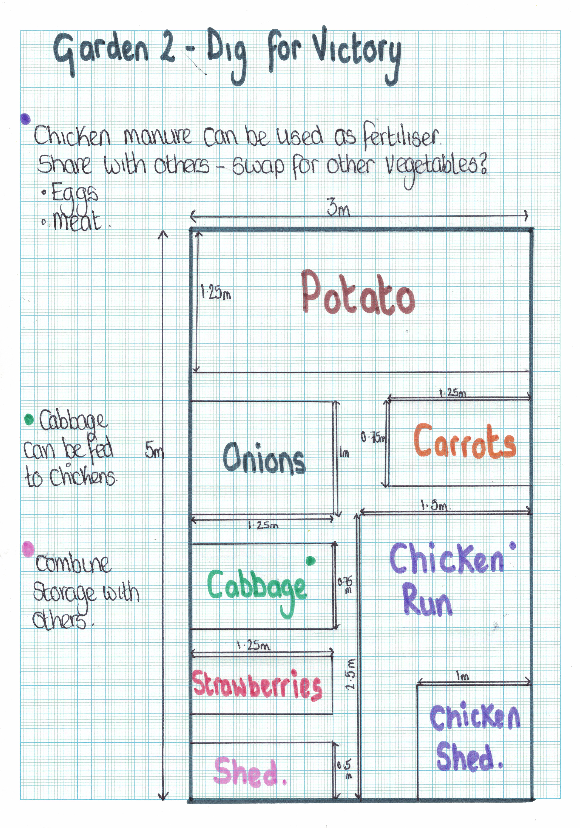
Notes:
Example of an extended design - share to aid learners.

Slide 10
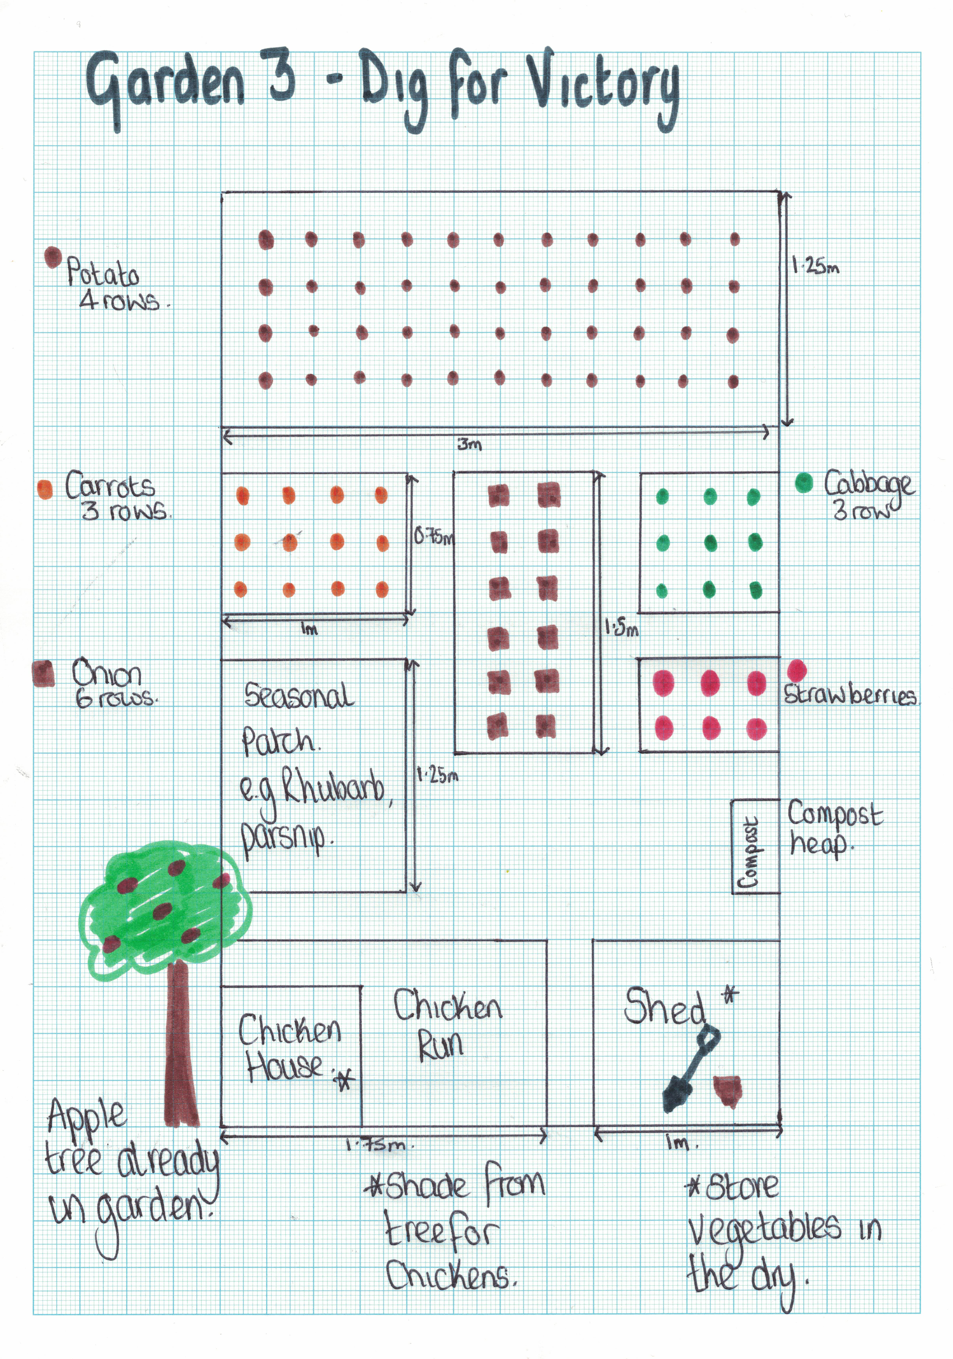
Notes:
Example of a more complex extended design - share to aid learners.

Slide 11
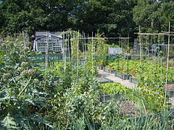
Extension
Create a table showing which fruits and vegetables will be seeds and which will be seedlings
Design a poster to encourage your neighbours to ‘Dig for Victory’

