Slide 1
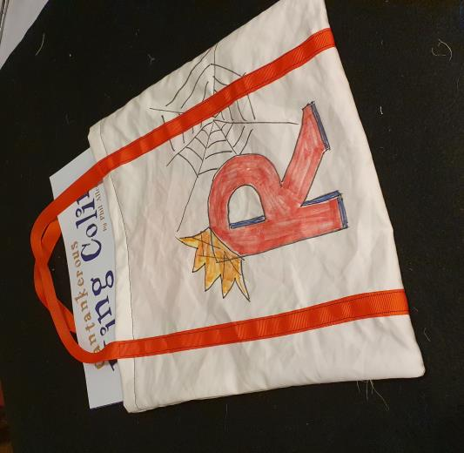
Design a Book Bag
Designing and making a book bag to carry your favourite book to school for World Book Day

Slide 2
Stay safe
Whether you are a scientist researching a new medicine or an engineer solving climate change, safety always comes first. An adult must always be around and supervising when doing this activity. You are responsible for:
ensuring that any equipment used for this activity is in good working condition
behaving sensibly and following any safety instructions so as not to hurt or injure yourself or others
Please note that in the absence of any negligence or other breach of duty by us, this activity is carried out at your own risk. It is important to take extra care at the stages marked with this symbol:
⚠

Slide 3
The Problem
Sometimes books can be dropped and might get dirty
Carrying books to school and back means they might get dropped more often
If they were in a bag they would be better protected
Design Brief
Design and make a bag so that you can protect your favourite book

Slide 4
What you will need:
plain paper
pencil crayons
felt tip pens
ruler
fabric for the bag
ribbon
pins
fabric scissors
thread

Slide 5
Things to think about when designing…
What is your favourite book?
How big is the book?
What do you want the design on the book bag to look like?
What colours will you use?

Slide 6
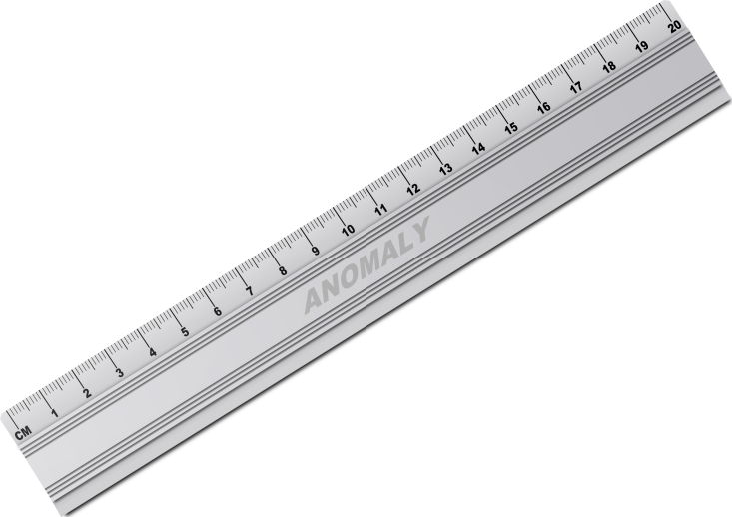
Measure your book
You will need a ruler
Measure your book and write down the measurements
Measure the width from left to right
Measure the height from top to bottom

Slide 7
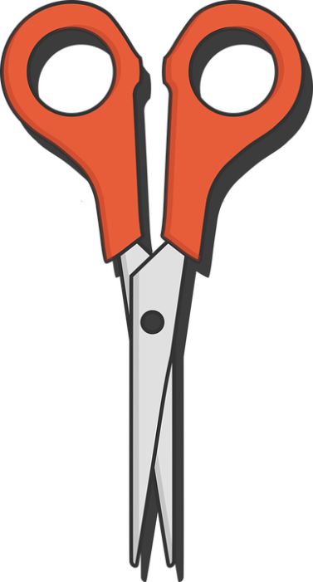
⚠
Cutting out the fabric
Fabric (or textile) is the correct name for the cloth you will make the bag from
You will need a piece of fabric big enough so that it will:
fold over the book
and have at least 4 cm extra fabric from the edge of the book, all the way round
Draw an outline showing where to cut – then cut it using scissors
⚠ Be careful when using the scissors

Slide 8
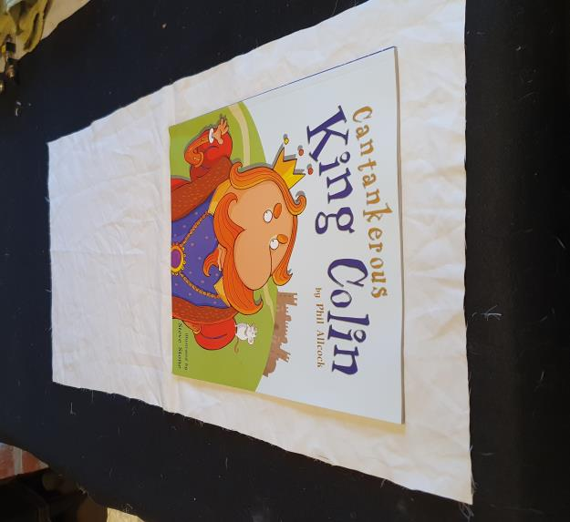
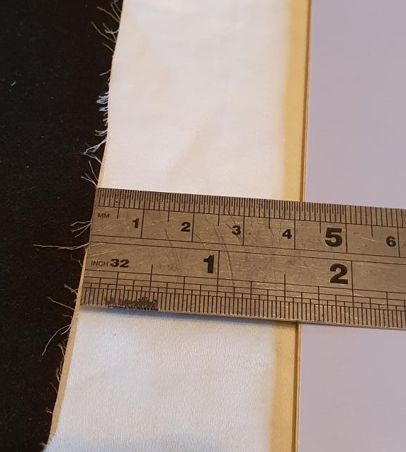
Cut out Fabric Example
⚠

Slide 9
Designing your Bag
Draw your ideas for the pattern that will be on your bag
Make the design colourful and clear
You could add your initial or even your name
You could use a theme from your favourite book

Slide 10
⚠
Decorating
You drew your design on paper using standard felt pens and colouring pencils
For a textile you will need to use special fabric pens that will not wash off
These might not wash off you or your clothes either, so be careful with them!
⚠ Be careful with the fabric pens

Slide 11
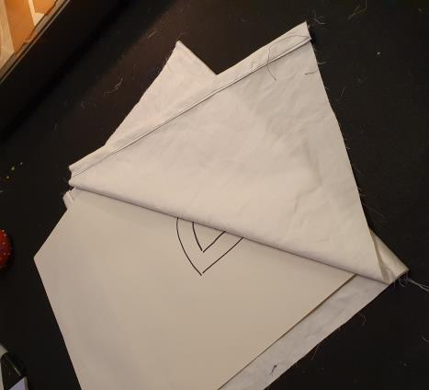
Decorating your bag
⚠
Draw your design on the bag or trace it from your design
Draw outlines and fill them afterwards
Remember to stay at least 4 cm from any edge
There is an example on the following slide

Slide 12
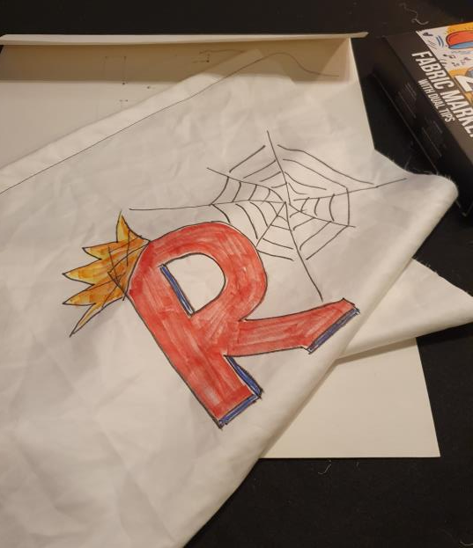
Decorating - Example
⚠
This learner’s name starts with an R
Red is his favourite colour
His favourite book is King Colin so he has put a crown on the R
His favourite character is Spiderman so he’s added a web

Slide 13
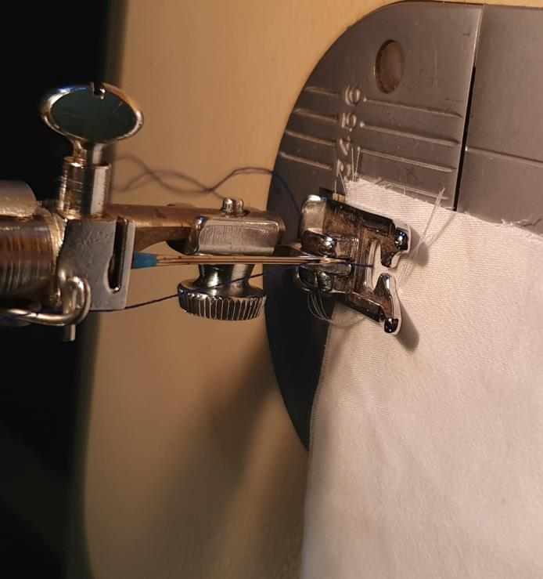
Sewing the Book Bag
⚠
Using a sewing machine is difficult - it can be dangerous and trap your fingers
You will need help until you get really good with it
Someone might have to do all the sewing for you but you can watch the demonstration and try again next time

Slide 14
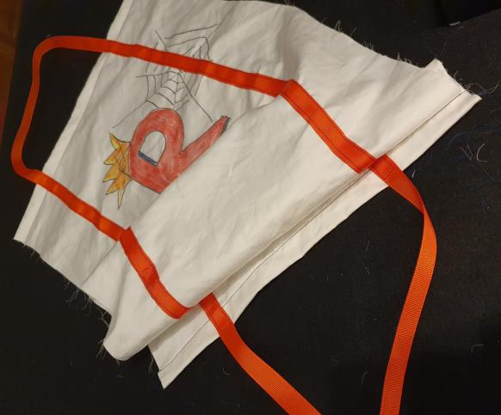
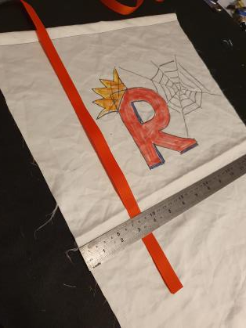
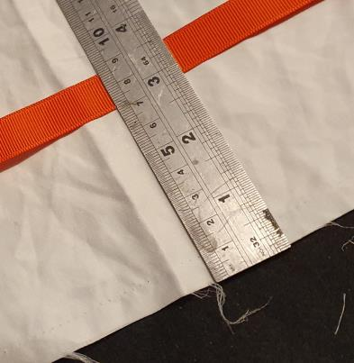
Sewing the Book Bag - Handles
Using the ribbon, pin it all the way up one side of the fabric, (about 11cm in from the edge)
Leave a loop at the top
Pin the ribbon all the way back down the other side, leaving a loop at the other end
Sew along the ribbon to hold it in place

Slide 15
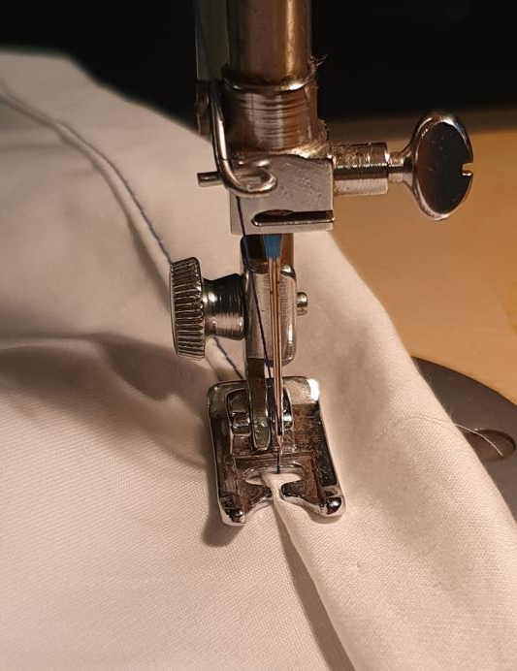
Sewing the Book Bag – Top Edge
⚠
Fold the tops of the fabric over to make a strong top to the bag
2 cm is a good measurement to give a strong top edge

Slide 16
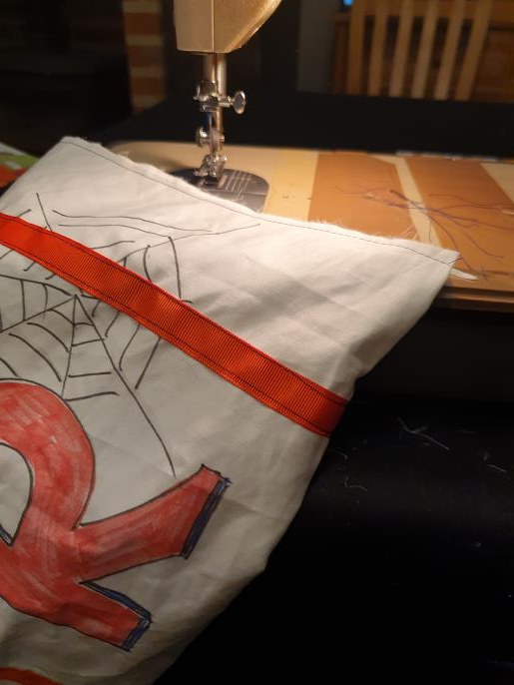
Sewing the Book Bag - Seams
⚠
Fold the bag fabric in half with the outside showing
Sew up the sides with 1 cm seams

Slide 17
Sewing the Book Bag - Finishing
⚠
Turn it inside out and sew the edges up again
This is called a ‘French’ Seam - it gives a nice, neat edge that should not ‘fray’

Slide 18
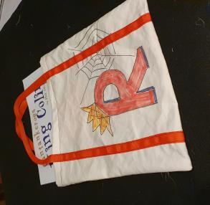
Testing the Book Bag
Does your book fit in the bag, without being folded or crumpled?
Is it strong enough to carry the book?
What do you most like about the bag?
Is there anything that could be improved?

