Slide 1
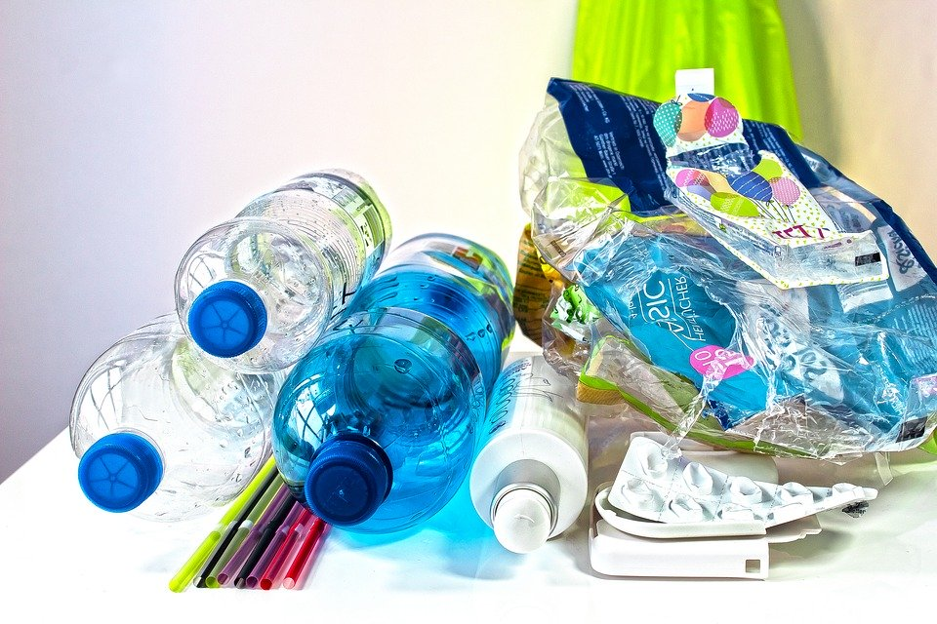
Create a litter collection pictogram
Collecting litter around school and creating a tally chart and pictogram

Slide 2
Stay safe
Whether you are a scientist researching a new medicine or an engineer solving climate change, safety always comes first. An adult must always be around and supervising when doing this activity. You are responsible for:
ensuring that any equipment used for this activity is in good working condition
behaving sensibly and following any safety instructions so as not to hurt or injure yourself or others
Please note that in the absence of any negligence or other breach of duty by us, this activity is carried out at your own risk. It is important to take extra care at the stages marked with this symbol: ⚠

Slide 3
What is litter?
Litter is waste that has been left somewhere it should not have been.
Can you think of some examples of litter that you have seen?
Notes:
This slide can be used to introduce learners to what is meant by litter and discuss examples of it. For example, chocolate wrappers, drinks cans/bottles, paper/plastic bags etc.

Slide 4
Collecting litter
Get into groups of four.
Collect as many pieces of litter as you can.
Use the tally chart to record how much of each type of litter you have found.
Create a pictogram showing the different amounts of each litter type found.
Notes:
Learners could be placed into small groups for this activity. This activity could be based on a location such as the playground or school field. Appropriate risk assessments will need to be in place for going outside and collecting the litter. Learners must have access to appropriate equipment such as litter collection sticks and gloves (no litter should be handled directly). Learners should be advised to be aware of and not to pick up anything that looks potentially dangerous, such as broken glass (the teacher should be advised immediately if this is the case). There must be either bin liners available to place the litter into once collected, or easy access to the school recycling station.

Slide 5
Tally chart of litter found
Type of litter | Tally | Total
Crisp packet
Chocolate/sweet wrapper
Paper bag
Plastic bag
Drinks bottle
Drinks can
Other
Notes:
This slide could be printed and used as a handout for learners to record a tally and total of the types of litter found, prior to completing the pictogram. If any litter does not fall into one of the given categories it can be classified under ‘other’, or the sheet could be edited to include additional types. Once the tally has been completed for each type of litter, the total number of each should be added up and recorded under the ‘total’ column. Go through how to complete this in advance of learners doing so.

Slide 6
Pictogram of litter found
Type of litter | Number of each type
Crisp packet
Chocolate/sweet wrapper
Paper bag
Plastic bag
Drinks bottle
Drinks can
Other
Notes:
This slide could be printed and used as a handout for learners to create their pictogram, or more able learners could construct one from scratch on blank paper. Learners should use their tally chart to aid them and create a suitable graphic for each litter type. If any litter does not fall into one of the given categories it can be classified under ‘other’, or the sheet could be edited to include additional types. Go through how to complete this in advance of learners doing so with examples as appropriate.

