Slide 1

The IET Faraday® Challenge Day
Notes:
4 minutes
Welcome to the Institution of Engineering and Technology’s Faraday Challenge Day. My name is xxxx and I will be your Challenge Leader today.
The IET Faraday® is a STEM Challenge held in many schools and universities for Year 8 students and their equivalents across the UK.
This year, IET is working with the Faraday Battery Challenge team, a group funded by Innovate UK to develop new battery technologies.
This is a competition and we are looking for the best teams of engineers. All of you will receive a certificate to say you have worked as an engineer for the Faraday Battery Challenge team.
The team which scores the most points will win this trophy and a place on the season’s league table.
At the end of the year, the top five teams will be invited to the final to compete for the top prize of £1000 for your school.

Slide 2
Project Flow
Apprenticeship
Project brief
Planning
Team roles selection
Development
Presentation to client
Notes:
3 minutes
Today you will be working as real-life engineers.
You will be following an engineering project flow as shown.
We will explain each of these stages when we get to them so you will need to listen carefully to make sure your team completes each section of the project.

Slide 3


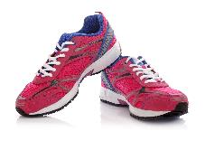


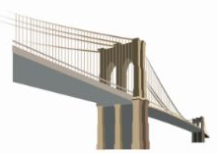
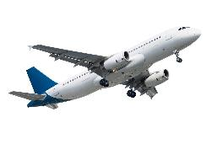
What is engineering?
“The application of knowledge and creativity to the needs of humanity”
Notes:
7 minutes
We want you to think about being an engineer in the future. Anyone thinking of being an engineer?
What do you think engineering is? Try to get response from each group. Stress idea that engineering is difficult to define.
At the IET we use this phrase [click on definition]. Use your own example of engineering to illustrate this idea. This could be anything from a kitchen appliance to a metal knee joint but try to use something which motivates or relates to you.
There are many different areas of engineering. All require creativity and innovative problem-solving. Engineers use their knowledge and ideas to come up with new products or adapt existing products. They challenge themselves. We want you to do the same.

Slide 4
Project Flow
Apprenticeship
Project brief
Planning
Team roles selection
Development
Presentation to client
Notes:
10 minutes
First we need to see you have the skills required to undertake this challenge.
There are many different routes into engineering and one of them is to do an apprenticeship. (If time you can talk a little more about routes into engineering).
Find the Engineering Apprenticeship brief on page 6 of your Student Booklet.
You will need to work as a team to complete the task and we are watching to see how you work. Don’t forget to read the instructions!
You will need to use everything in the box and you must show me your circuit when you have successfully completed it.

Slide 5
Engineering Apprenticeship
All teams MUST complete the Apprenticeship and everyone in your team MUST be involved.
Use the components in the box to connect the circuit shown in your student booklet on page 6.
What happens when you shine a light onto the Light Dependent Resistor?
What happens when you cover it up?
Notes:
10 minutes
As each group completes circuit, go round with a torch to show what happens in less/more light.
Once all teams have finished quickly discuss the idea of resistance. Remind them these ideas might be important in their development.
NOTES:
Watch for them splitting into boy groups and girl groups during apprenticeship.
Watch also for one/two students taking control and excluding other members of the team. Remind them that every member of their team will need to be an engineer if they are to get to the final.

Slide 6

Project Flow
Apprenticeship
Project brief
Planning
Team roles selection
Development
Presentation to client
Notes:
1 minute
Fantastic! You have all completed your apprenticeship so give yourselves a round of applause. Well done!
Now we can give you the project brief from the Faraday Battery Challenge team

Slide 7

Project Flow
Apprenticeship
Project brief
Planning
Team roles selection
Development
Presentation to client
Notes:
1 minute
Watch the video carefully to see what they want you to do today. The presentation is also subtitled.
You do not need to take notes, just watch and listen carefully.

Slide 8
Briefing video
Notes:
Play the briefing video at this point.

Slide 9
The brief
Design and build ONE prototype which:
is capable of using a battery or batteries;
can help someone from one of the following:
a person with a disability or specific need;
an educational toy for a child aged 2 to 5 years old;
someone who takes part in a sport or outdoor activity.
Your prototype MUST contain at least one working electric component
Complete the planning and events log
Present your prototype to the IET Faraday® Challenge judge.
Notes:
8 minutes
On click: Show overview of brief.
Highlight the categories but be careful of giving examples as the students will pick up on these as the only ideas.
Remind them it must include at least one electronic circuit. (Point out that they can use solar to charge their batteries but that we do not carry rechargeable batteries. They should use either solar or battery, not both).
Your design will be a prototype. What’s a prototype? (Seek responses from students and emphasize that their design may not be the finished product but should do something of what was intended).
On click: Engineering is not just about the end result. The journey to this is just as important. You will need to complete the event log. We’ll explain this later.
On click: Engineers need to be able to tell people about their ideas so that they can be used in the real world. We will brief you about what should be in your presentation later so don’t start writing this until then.

Slide 10
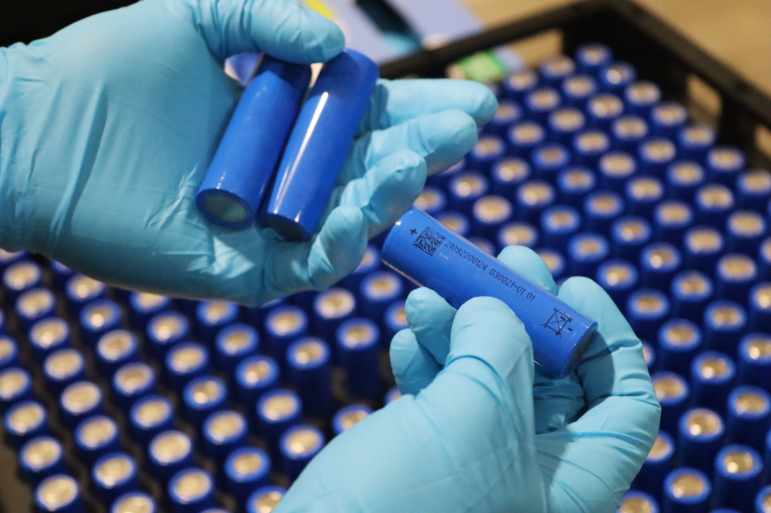
Key considerations
You must also show how you have considered all the following in your final design:
sustainability, recharging your battery;
how long your battery will last between charges;
disposal of your battery.
Notes:
3 minutes
On click: Show each consideration and briefly mention.
Remind them that each of these is important and they will need to show that they have thought about each one in their presentation.
Tell them the brief is on page 4 of their Student Booklet if they need a reminder of this.

Slide 11
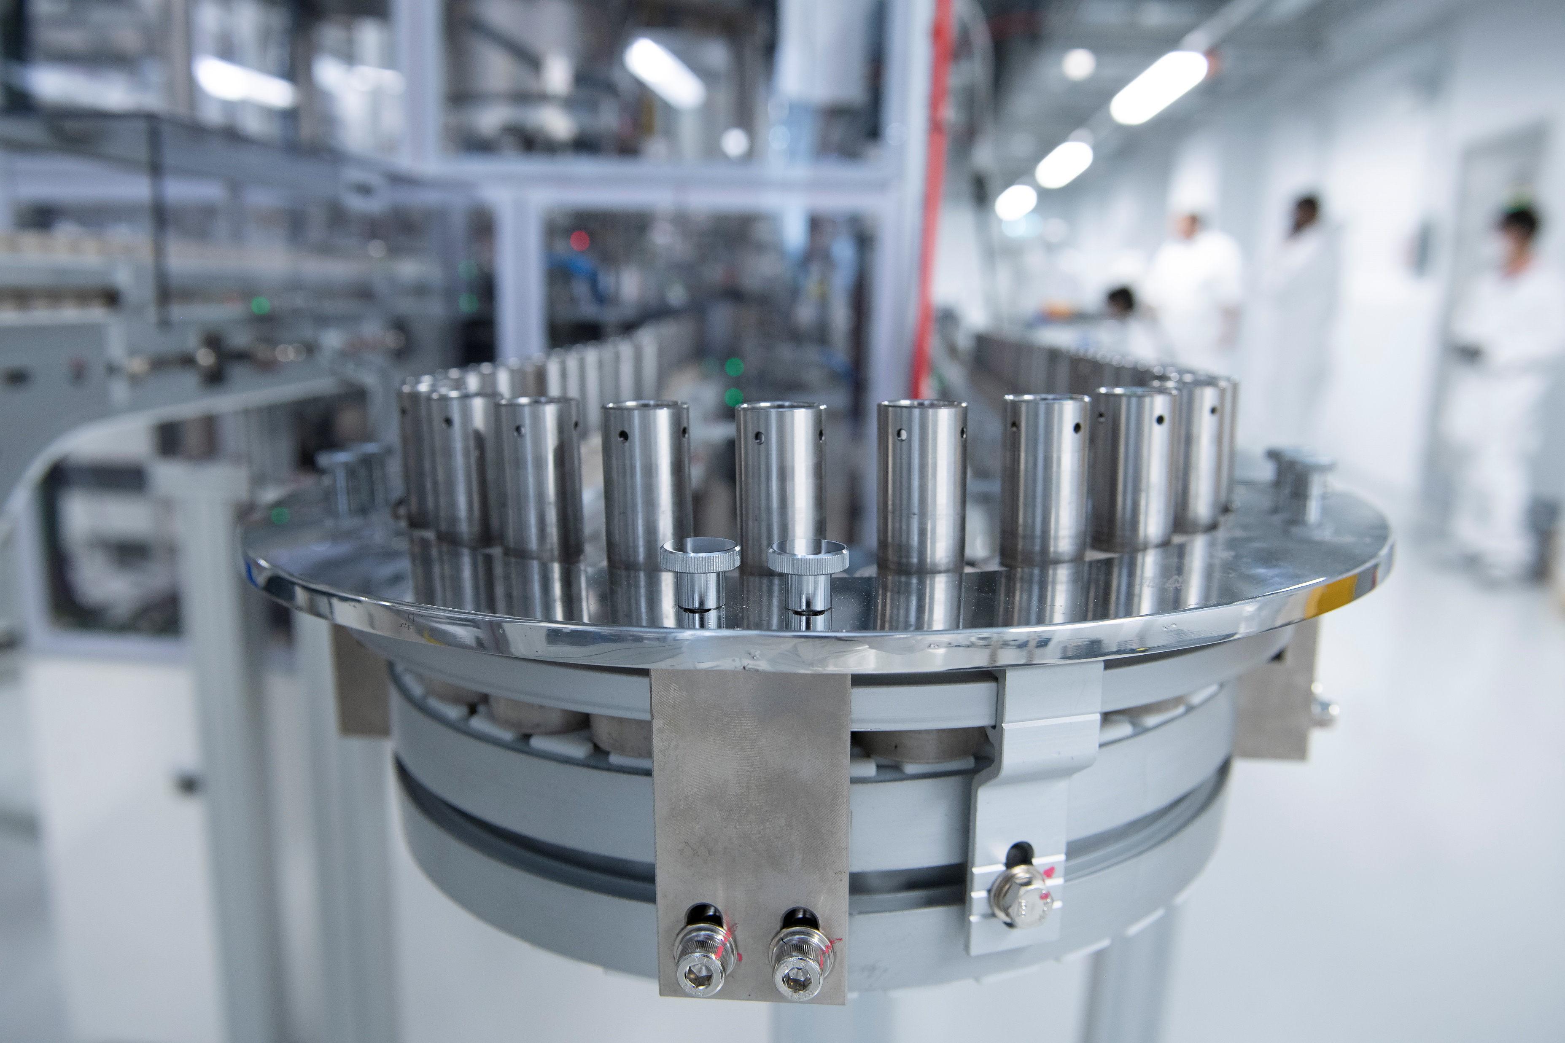
Assessment criteria
Planning
Development
Budget
Product engineering
Presentation
Teamwork
Notes:
4 minutes
You will be scored on all of your work today. It isn’t just about your finished product, engineering is a journey and we want to know how you have arrived at your final prototype.
The marking criteria can be found on the back pages of your Student Booklet (direct students to look at pages 12 and 13) so it is a good idea to have a look at this to see how you can score marks. You will need to do well in all the areas in order to score highly.
You do not get marks for having money left at the end of the challenge but we are looking at how you have spent your budget. If you buy things you don’t need you can sell them back if they are not used but only for half your money back. (Tell them they cannot sell between teams.)
Tell them they will get more points if they make their prototype do more than one thing so they may need to think about how they are going to do this. Stress that pushing themselves beyond the minimum brief will get them extra points.

Slide 12

Project tools
Engineering shop
Cutting station
Hire centre trade card
‘How to’ sheets
The Faraday Battery Challenge Student Booklet
Engineering consultant
Notes:
8 minutes
Engineering Shop – This will open later. You have 120 Faradays to spend in the shop. Details of what is available to buy are in your Student Booklet. You MUST read this as it tells you important information and will prevent you buying things you cannot use.
Point out the Cutting Station and Hire centre and explain rules for trade card.
Introduce the Bargain Bin at this stage if using.
How To sheets – you can take them to your table but please return them to the centre table when you have finished with them. These sheets will help you with some of the aspects of your designs and some of them MUST be read before you try to connect the equipment.
Student booklet. This MUST be read if you want to have any chance of winning. You can write in this booklet if you want as it is yours to keep.
STEM consultant – I am your consultant for the day. I will support you but I will not do it for you. Ask your team first before asking me as you will be amazed what you can work out together.

Slide 13
Project Flow
Apprenticeship
Project brief
Planning
Team roles selection
Development
Presentation to client
Notes:
You have now completed the Project Brief.

Slide 14
Project Flow
Apprenticeship
Project brief
Planning
Team roles selection
Development
Presentation to client
Notes:
Time to move on to Planning.

Slide 15


“Failing to plan is planning to fail”
Be creative!
Planning
Think think think
Notes:
1 minute
Planning is essential to a successful project. We have seen many teams have great ideas and rush into developing them, only to realise that they won’t work, they don’t have enough Faradays or they simply don’t have the time to develop them.
All projects have a large planning aspect. This is an important stage of your project.

Slide 16
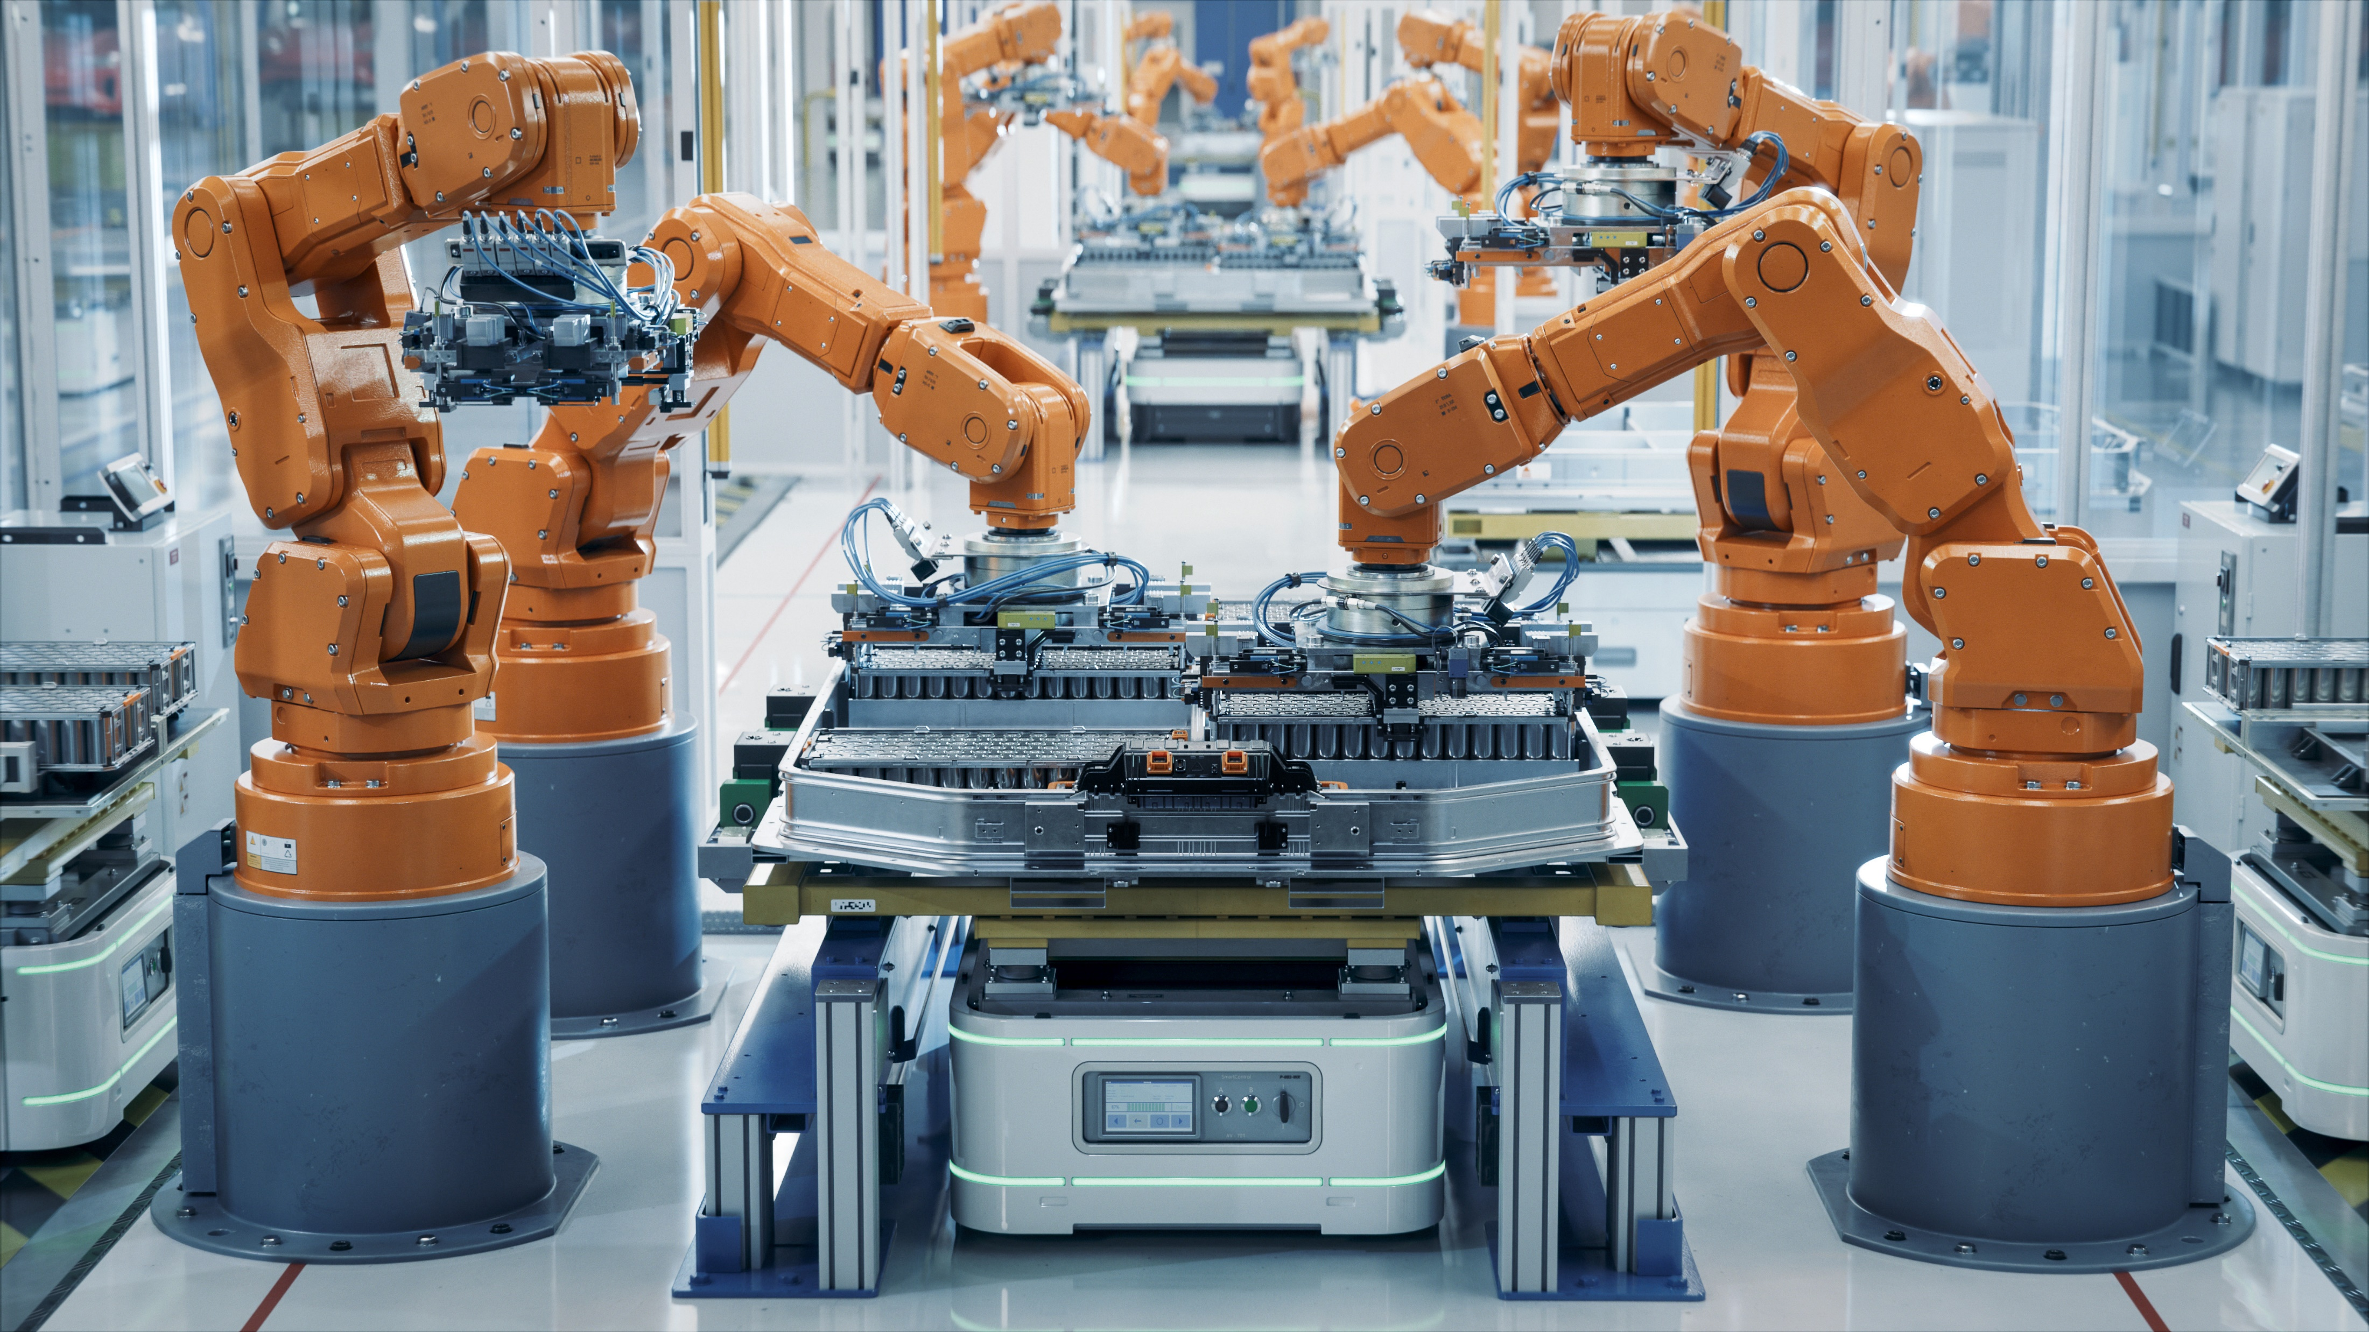
Planning
1
2
3
TIME UP
4
5
6
Explain how your idea might support the Faraday Battery Challenge team (3 marks).
Draw out your idea with labels. Provide as much detail of the construction as possible (5 marks).
Draw the electronic circuit(s) you will use (5 marks).
7
8
9
10
11
12
13
14
START
15
Notes:
18 minutes
You have 15 minutes to plan out your prototype idea. The numbers on the screen will count you down.
You will not finish the planning in the next 15 minutes but this paperwork must be handed in at 12.30, lunchtime. I WILL NOT remind you of this again so make sure you go back to update it regularly as your design progresses.
When I mark it I will use the assessment criteria in your booklet, I have put them on the screen.
Go through how the marks are allocated. Remind them to use annotations and tell them we are not marking their drawing, writing or spelling.
Remind them the brief is in the Student Booklet on page 5 and that they can use the ‘How to ….’ sheets. Ask them to limit this to 2 or 3 at first so everyone gets to use them.
ON CLICK: The countdown will begin automatically and run through the 15 minutes. Do not freeze the Powerpoint as this will stop the countdown. Do not give students any longer than 15 minutes for this stage.

Slide 17
Project Flow
Apprenticeship
Project brief
Planning
Team roles selection
Development
Presentation to client
Notes:
1 minute
You have now completed the planning part of the project. Now it is time to move onto our next task which is team roles selection.

Slide 18
Project Flow
Apprenticeship
Project brief
Planning
Team roles selection
Development
Presentation to client
Notes:
5 minutes
In real life, engineers work in teams and their ability to work well as a team is key to their success. Today, you are going to take on real–life engineering roles to experience what it is like to be part of a problem solving team.

Slide 19
Team Roles
Design engineer
Project manager
Client communication officer
Stress engineer
Safety officer
Accountant
Electronics engineer
Decontamination engineer
Mechanical engineer
Notes:
4 minutes
You have 4 minutes to choose a Project Manager and an Accountant for your team. Remember that these people will also be part of the engineering team so they can’t just put their feet up and shout orders!
The Project Manager will manage the project, checking out the marking criteria, keeping the team together and making sure the team meets all the deadlines.
The Accountant will manage the budget. They are the only one who can go to the shop but they may take one other person. They will also need to keep a record of their spending on the accounts sheet.
You may decide you want to allocate other roles in your team, it is your team so do you what you feel will work well. But remember everyone is an engineer.
Notes:
Give 1 minute warning.

Slide 20
Project Flow
Apprenticeship
Project brief
Planning
Team roles selection
Development
Presentation to client
Notes:
Well done. You are now ready to begin your work as part of the Faraday Battery Challenge engineering team.

Slide 21
Project Flow
Apprenticeship
Project brief
Planning
Team roles selection
Development
Presentation to client
Notes:
1 minute
Before we can open the shop we need to do a health and safety briefing.
It is important you all pay attention to this as you are now engineers and this is our engineering workshop. Each one of you is responsible for keeping us all safe.

Slide 22

Health and safety briefing
Keep your work station tidy (including the floor around it), no food or drink around work areas or shop.
Three people only at the cutting station at any time.
Take care with craft knives, hacksaw, scissors and staplers. No blade to be left open and no tools to be removed from the cutting station.
Report spillages, accidents or potential hazards to the Challenge Leader or shop keeper immediately.
Be careful of the lamp, it gets very hot.
Be careful of short circuits.
Notes:
3 minutes
IMPORTANT: This relates to your risk assessment so must not be missed out.
Remind them that working as a team is important and they need to keep themselves and everyone in the room safe. We will be looking at this when marking their team work.
Go through the tips for safe working!
Emphasise the rules of the Cutting Station. If the area is small you can reduce the number allowed here at any one time.

Slide 23
Development
Shop open
Hand in your apprenticeship pack to begin using the shop.
Begin to develop your product.
Remember to go back to your Planning sheet to make sure it is completed.
Notes:
25 minutes to Event log 1
Shop open for business and you can start building your design.
I will tell you what you need to do for the Events Log after your break.

Slide 24
Morning break
Notes:
10 minutes maximum (unless different timings agreed with school).
Take 10 minutes to have a snack and get some fresh air.
Move students away from their group tables and the shop to ensure no food or drink is near the resources.

Slide 25
Event Log Entry 1
Record your engineering developments during this period. Include what problems you have faced and how you have solved these.
Record how your team has worked together.
Be specific, honest and accurate.
Notes:
3 minutes to explain then 25 minutes to Event log 2
Notes:
Remind them to complete the event log for the time period up to this point. An event log is what other engineers look at to see what engineering has been done in a given time, what problems there are and whether these have been solved yet. It can also include any issues or any successes within a team. It is like a daily diary but goes beyond just a simple explanation of ‘We did this, we did that ……’
Explain that the journey to their final product is really important. Get them to focus on the engineering progress and to think about how their team is working.
Remind them to look at the assessment criteria for the events logs.
Tell them you will not interrupt them for Event log 2 and 3 they will just hear the drum roll when it is time to do them.

Slide 26
Event Log Entry 2
Record your engineering developments during this period. Include what problems you have faced and how you have solved these.
Record how your team has worked together.
Be specific, honest and accurate.
Notes:
20 minutes to Event log 3
Do not interrupt them for this unless the sound is poor and they cannot easily hear the drum roll.

Slide 27
Event Log Entry 3
Record your engineering developments during this period. Include what problems you have faced and how you have solved these.
Record how your team has worked together.
Be specific, honest and accurate.
Notes:
20 minutes to presentation brief
Do not interrupt them for this unless the sound is poor and they cannot easily hear the drum roll.

Slide 28
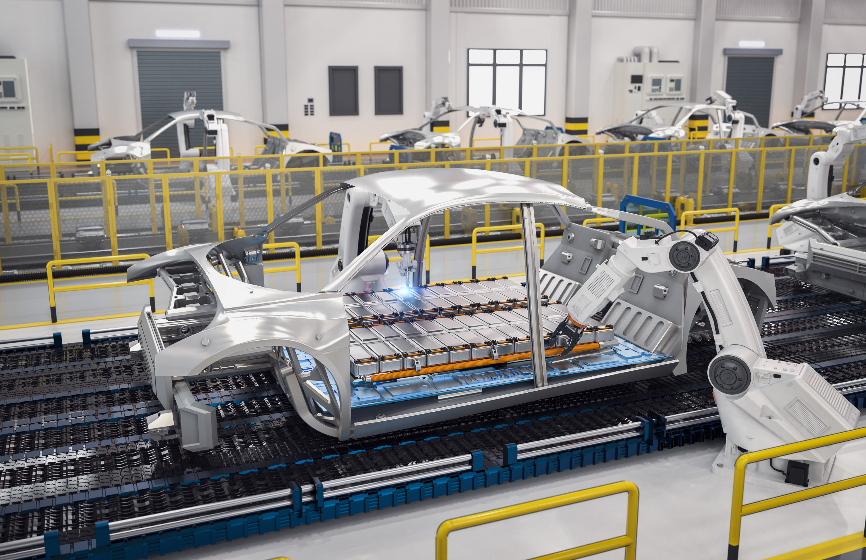
Engineering Priorities
List:
at least three engineering priorities for the last half hour of development,
in the order you will do them, and
identify who in your team will do what.
Note: Writing the presentation should not be included in this list
Notes:
5 minutes
Ask teams to spend time before lunch identifying their priorities for the last 30 minutes of workshop time.
Remind them to be specific about what they will do, be realistic about what they can achieve in the time remaining, to look at the marking criteria for the product and to focus on the engineering rather than on aesthetics.
Remind them they get 5 marks for this section!
Don’t include writing the presentation in these priorities, stick to engineering priorities only.
Give them 5 minutes to complete this section then collect in the Planning and Events log for each team. Do not give them back to the students .Make sure team number is on the sheet. These must be marked at lunchtime.

Slide 29

Presentation briefing
5 minutes, maximum, to present.
Look at the assessment criteria and write notes.
Demonstrate and explain how your prototype works.
Make it interesting.
Notes:
5 minutes
Remind them that all the team should present.
Emphasise the need to look at the assessment criteria. Make sure you cover each element. If there are 4 marks for something then one sentence is not going to be enough to score highly. For example, simply saying what role each member of the team had is not the same as explaining what was done well and what could be improved in the teamwork.
Be specific and detailed. For example, if you have used a parallel circuit you might want to explain why. Remember our discussion about resistance in the Engineering Apprenticeship.
Tell them to write notes for their presentation which they can read from when they come up to present.
Tell them it is their presentation and they may present in any way they like – make it interesting!

Slide 30
Lunch
Tools down – take a 30 minute break
Notes:
Ask students to sit away from their tables if they are remaining in the room for lunch.
Ensure all tools are at the cutting station before the students leave the room

Slide 31
Final preparations
Can you complete your prototype in the time left?
Have you started preparing your presentation?
Have you filled in your accounts sheet?
Do you need to buy anything else from the shop?
How can you best use the time remaining?
Notes:
30 minutes
Important here to focus the students on reflecting on what is achievable. Some teams try to start something completely new but get them to reflect back on their engineering priorities.
The shop will close in 30 minutes so make sure you have bought or sold back any items. You must be ready to submit your accounts sheets to the shop when it closes.
You must be ready to present your pitch in 45 minutes (or when scheduled with your Challenge Leader) so spend time rehearsing it.

Slide 32
Preparing your presentation
Remember to look at the assessment criteria
Did the team explain what their prototype is and how it works, including details of the electronic and mechanical designs? (5 marks)
Did the team explain how their prototype meets the key considerations of sustainability, time between charges and disposal? (4 marks)
Did the team identify the most challenging engineering aspect(s) they faced during their development and how they overcame the challenge(s)? (3 marks)
Did the team explain what they did well in their teamwork and what aspects they could have improved? (3 marks)
Notes:
Put slide up to remind students of what to include in their presentation.

Slide 33
Preparing to present
The shop is now closed
Submit your accounts sheets to the shopkeeper.
Return any items you are not using.
Practise your presentation – remember to check the assessment criteria!
Shop closed
Notes:
5 minutes
Accountants to submit accounts sheets to shop. Ask shopkeeper to note any discrepancies between what they say they have remaining and what they hand back and then to return accountancy sheets to you. These must be given to the Challenge Leader for marking.
Remind teams of importance of rehearsing their presentation and emphasise that this can really make a difference between winning and losing the Challenge Day.

Slide 34
Project Flow
Apprenticeship
Project brief
Planning
Team roles selection
Development
Presentation to client
Notes:
You have now completed your development section.

Slide 35
Project Flow
Apprenticeship
Project brief
Planning
Team roles selection
Development
Presentation to client
Notes:
This is the time that the engineers would present their ideas to their client; in this case, the Faraday Battery Challenge team.

Slide 36

Presentation
Notes:
45 minutes for introduction and all teams’ presentations.
Get students sitting in a semi-circle around the presentation area. Make sure they leave their prototypes and any presentation notes on their tables. This avoids noise due to fiddling with resources and stops teams adding to their presentation notes.
Telling others about your ideas is fun. There may be problems or issues with prototypes but it is important to be relaxed! Remember the judge is marking a number of different things and the competition is not won or lost on the performance of the prototypes. They are using all of the sections of the marking criteria to award marks
Run through how the presentations will work e.g. numerical order, once the previous team has finished – round of applause and then the next team can stand up and get ready.
There may be questions if you have time or if anything needs clarifying. Do not allow questions from students or teachers.
Emphasise that any questions are intended to get them extra marks and not to trip them up. Keep questions as positive as possible.
Remind them they will be will cut off if they go over time.

Slide 37
Project Flow
Apprenticeship
Project brief
Planning
Team roles selection
Development
Presentation to client
Notes:
10 minutes
You have now completed the whole project and worked in the way engineers work in real-life. Well done to all of you. You should be very proud of your achievements.
You can ask for a show of hands about who would consider engineering as a future career to see if there has been any change during the period of the challenge. This could be followed up by pointing them towards careers’ resources in your organisation.

Slide 38
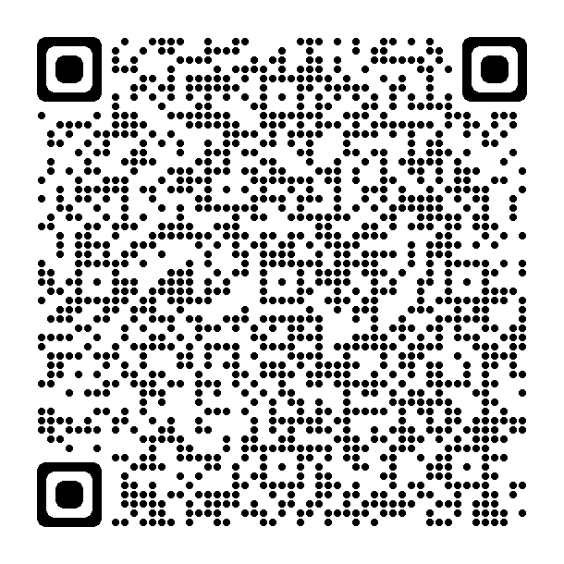
Please give us your feedback
Students
Notes:
Please collect student and teacher feedback using the QR codes if appropriate or the paper forms provided.

Slide 39
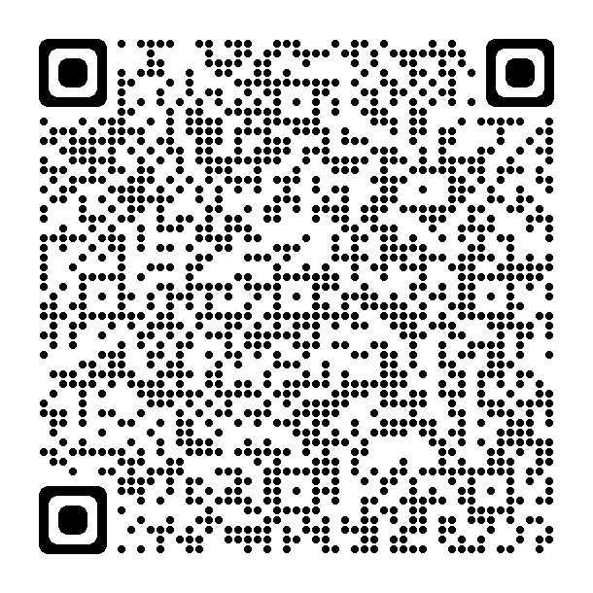
Please give us your feedback
Teachers
Notes:
Please collect student and teacher feedback using the QR codes if appropriate or the paper forms provided.

Slide 40
And the winner is...
Notes:
14.50
Notes:
Present trophy.
Students cannot keep any part of their prototypes but you may wish to take photographs/videos to pass to the theme partner, particularly if there are good ideas.

Slide 41

Thank you and goodbye!
With thanks to all our supporters and this season’s theme partners…
To find out more information on the IET Faraday® Challenge Day supporters visit our website, theiet.org/faraday.
Notes:
Give thanks to all our supporters and this season’s theme partners.

