Slide 1
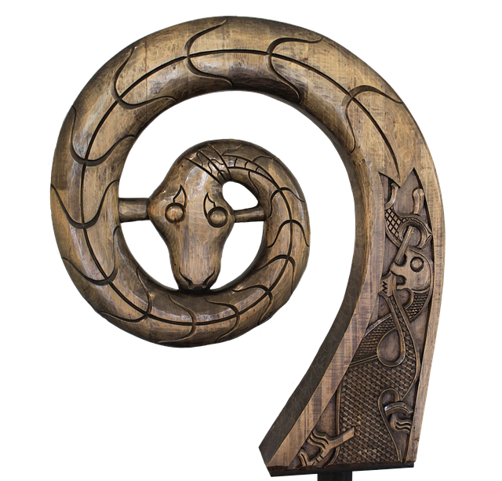
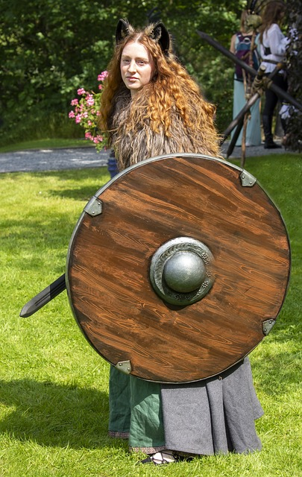
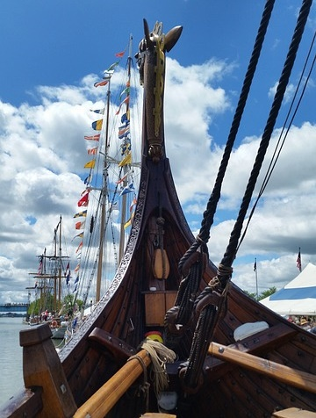
Integrated Project – The Vikings
A multi-lesson activity where learners will use the theme of the Vikings to develop knowledge and skills across different curriculum areas
Notes:
This project covers aspects of literacy, numeracy, computing, drama and design & technology/engineering.
It aims to show how D&T and Engineering activities can be completed with learners as part of a wider theme-based project.
It presents four different activities covering multiple curriculum areas:
Activity 1 – Research the Viking longboat (computing/ICT, literacy, engineering)
Activity 2 – Write and perform a script about how the Vikings lived (drama, literacy)
Activity 3 – Designing a Viking pin badge (art and design)
Activity 4 – Making Viking purses (design and technology, numeracy)

Slide 2
Stay safe
Whether you are a scientist researching a new medicine or an engineer solving climate change, safety always comes first. An adult must always be around and supervising when doing this activity. You are responsible for:
ensuring that any equipment used for this activity is in good working condition
behaving sensibly and following any safety instructions so as not to hurt or injure yourself or others
Please note that in the absence of any negligence or other breach of duty by us, this activity is carried out at your own risk. It is important to take extra care at the stages marked with this symbol: ⚠
Notes:
Safety Warning

Slide 3
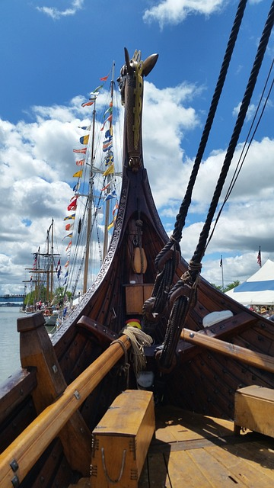
The Vikings
The Vikings came from Scandinavia (Denmark, Sweden and Norway)
They raided and colonised large parts of Europe in the 9th to the 11th centuries, including England
In this project you will learn lots of interesting facts about this important group of people
Notes:
Explain the overall theme and context of the project to learners. Teacher could explain that the countries of Denmark, Sweden and Norway did not exist at the time of the Vikings – the region that they came from is what we now call Scandinavia.
Teacher could ask learners to write down five things that that they already know about the Vikings.

Slide 4
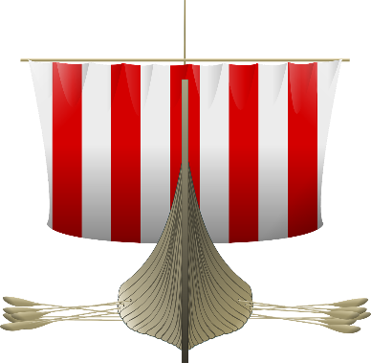
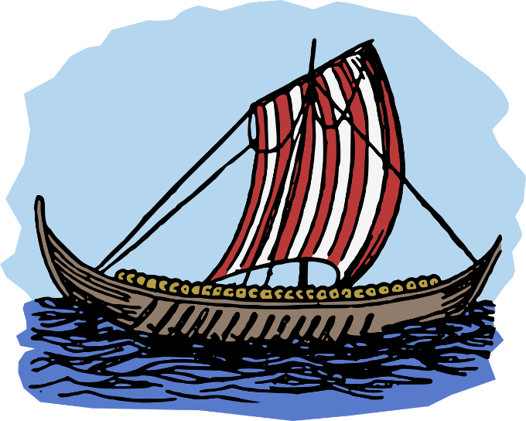
Activity 1 – Longboat Research
Vikings were well known for their use of longboats
Research the Viking longboat
Produce a presentation to show the class
This could include:
What they looked like
The different parts of each boat
What they were used for
How they were made and what from
How they floated and moved
Notes:
Learners could use the internet to complete their research.
The teacher could split the ‘this could include’ points, so different learners/groups cover each point if it is felt that all of this is too much for one learner/group.
Teacher could set a maximum length for the presentation e.g. 10 minutes or 5 slides.
Learners could work in small groups or as individuals. One good way of doing this is where they complete their research independently, then form small groups and combine what they have found and create a group presentation.
This activity covers aspects of computing/ICT and literacy.
Extension – Design and/or make a model of a Viking longboat.

Slide 5
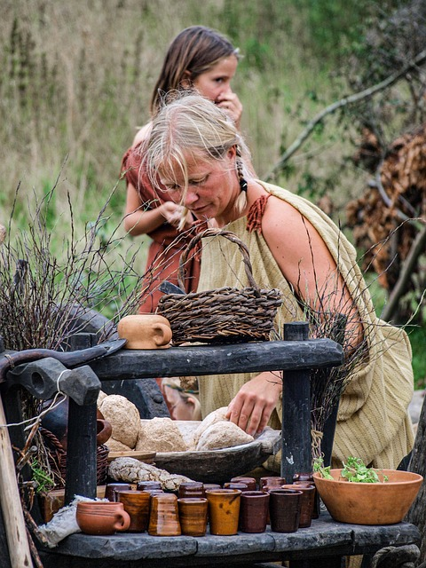
Activity 2 – Life as a Viking
Write a script for a scene about one aspect of what life was like for the Vikings
This could include:
Where they lived (their homes and villages)
Their laws and customs
What they ate
The clothes that they wore
Act out your script
Notes:
Learners should be put into small groups 3-4 maximum. Each group could cover one of the aspects listed.
Once the script is completed, learners should be given time to practice acting it out before presenting to the class.
This task covers aspects of drama and literacy.

Slide 6
Activity 3 – Designing a Viking Pin Badge
Vikings wore pin badges to hold their clothes in place and as decorative art
Design a Viking pin badge
Include images related to Vikings
Use colour to bring your design to life!
Notes:
Further information for teachers about Viking art:
https://www.worldhistory.org/Viking_Art/
Teacher could show examples of Viking art and badges to support learners.
This task covers aspects of art and design.

Slide 7
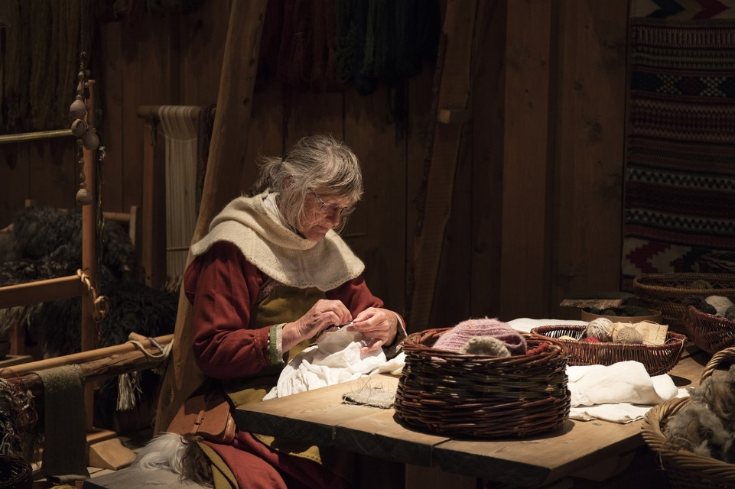
Activity 4 – Making a Viking Purse
Viking purses:
Who would have used them?
What they would have been made from?
Why were they used?
Notes:
This task covers aspects of design and technology and numeracy.
Support for introductory questioning:
Who would have used them? Both men and women https://en.natmus.dk/historical-knowledge/denmark/prehistoric-period-until-1050-ad/the-viking-age/the-people/clothes-and-jewellery/
What they would have been made from? Leather https://wiki.vikingsonline.org.uk/Pouches
Why were they used? Storage https://www.bbc.co.uk/history/ancient/vikings/money_01.shtml

Slide 8
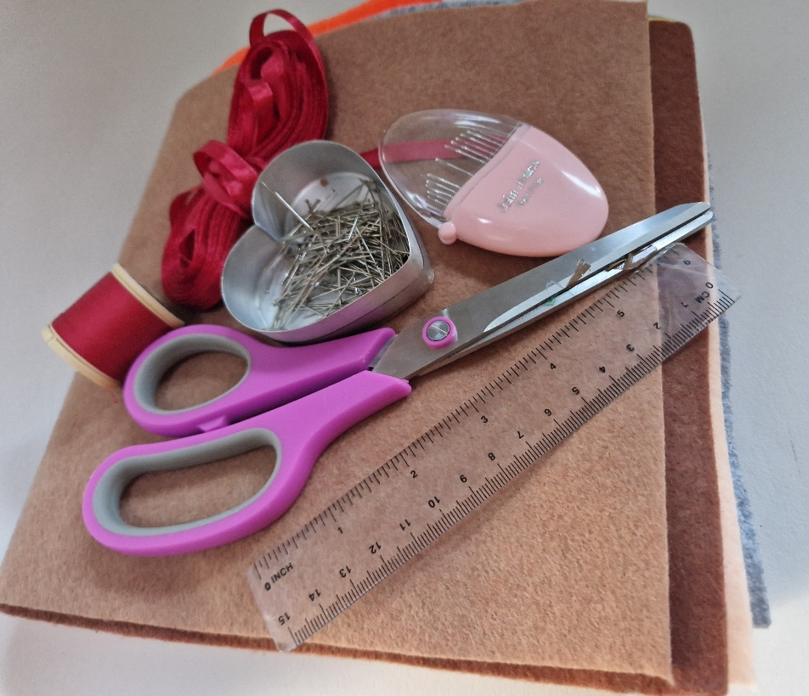
Equipment and Resources
⚠
Felt
Ribbon
Scissors
Pins
Needle
Thread
Pens and pencils
Rulers
Notes:
Felt should be a minimum of 100 mm by 200 mm – fold the squares over to create an envelope so you only need to sew two sides.
Can use other fabric, such as cotton, pre-owned denim/t-shirts to incorporate Reduce, Reuse, Recycle.
Instead of sewing the edges, PVA glue can be sparingly applied.
Can also use embroidery thread.
Take care when using sewing needles as they are sharp. Take care when using scissors.

Slide 9
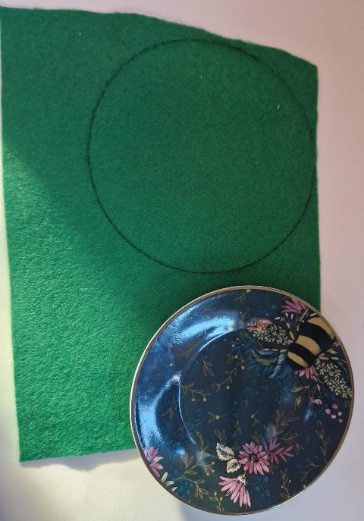
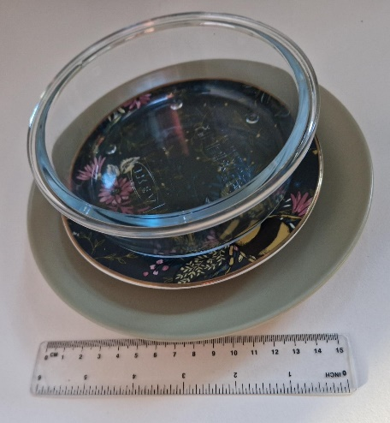
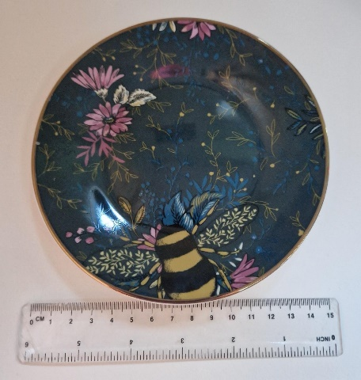
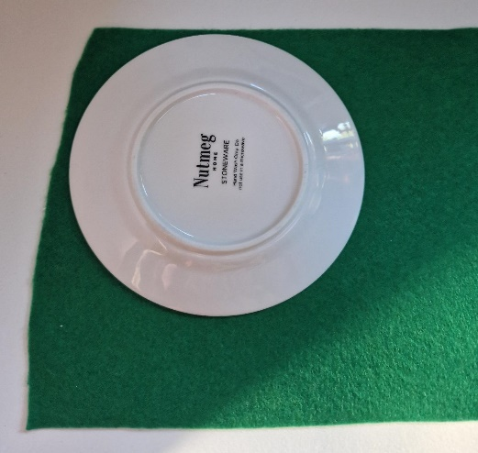
Circle Purse – Step 1
Draw round a 150 mm circle template
Notes:
The following slides show how to make a simple circle purse.
Measure the template to ensure it is the correct diameter. The template could be pre-produced by the teacher on card, or an object such as a saucer or plate could be used.
Draw round the object onto the felt – ensure that there isn’t too much felt wastage.

Slide 10
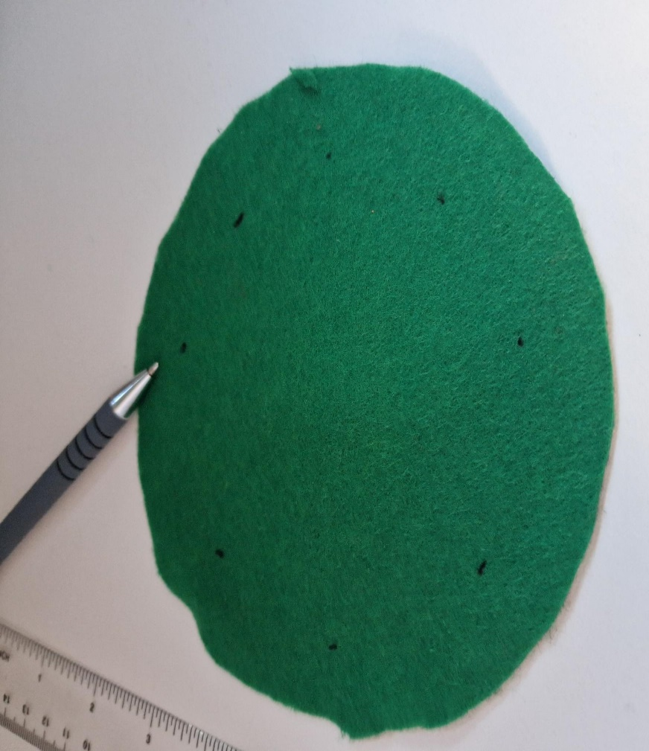
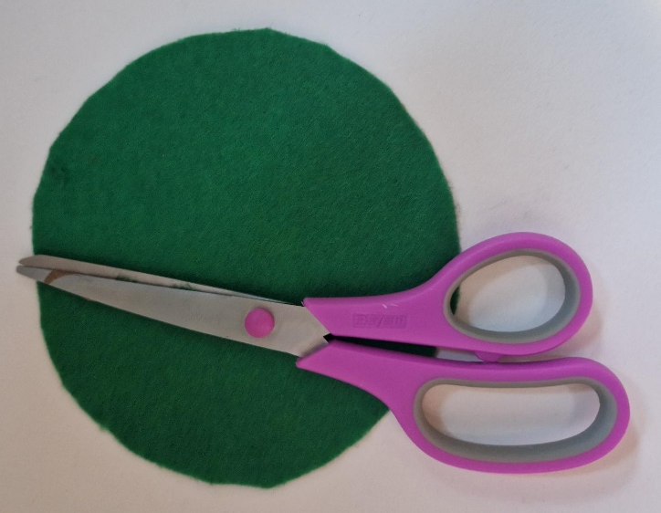
Circle Purse – Step 2
⚠
15 mm
Cut out the circle
Mark eight holes evenly spread around the edge of the fabric
Notes:
Leave a 15 mm gap between each hole and the edge of the fabric.

Slide 11
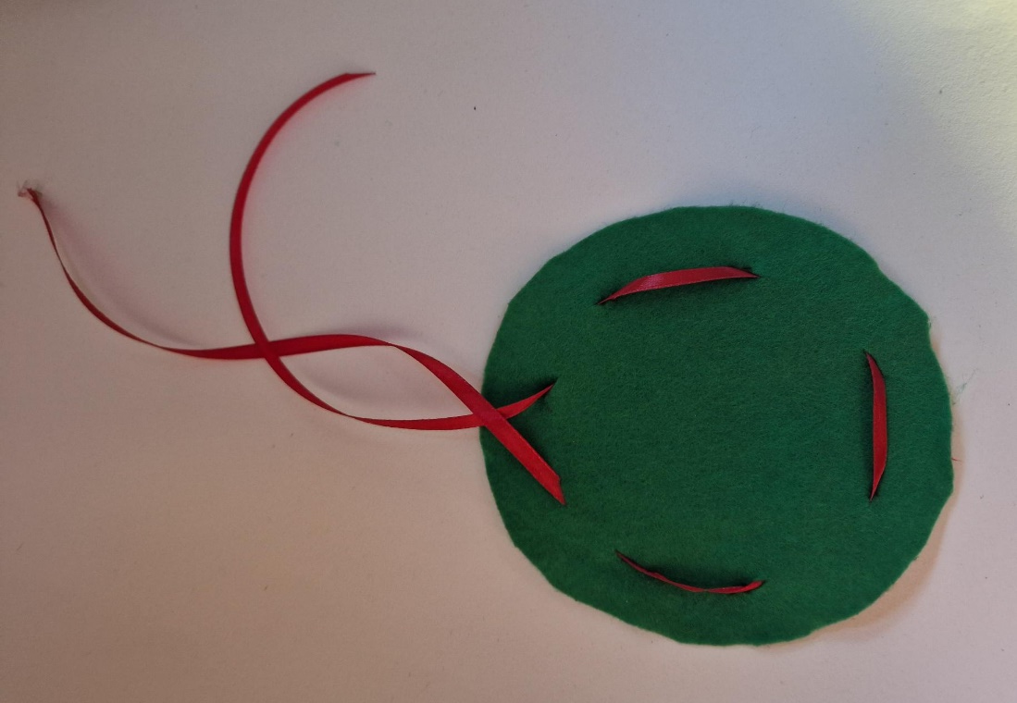
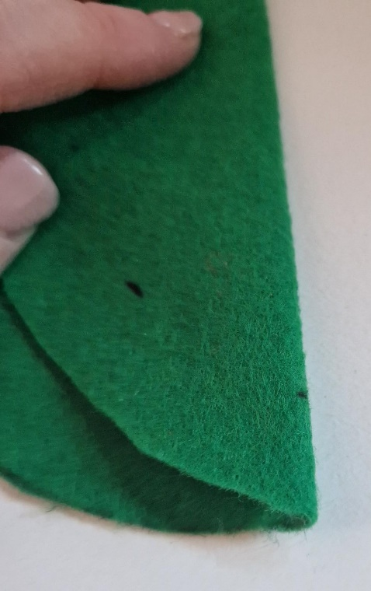
Circle Purse – Step 3
⚠
Cut the holes and thread ribbon through them as shown
Notes:
Snip the holes with the tip of a pair of scissors. Ensure the holes are no more than 5 mm (approximately) each.
Length of ribbon can be from 300-400 mm, then trim once the purse has been created.

Slide 12
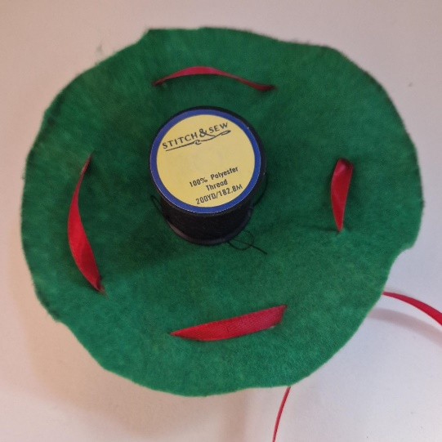
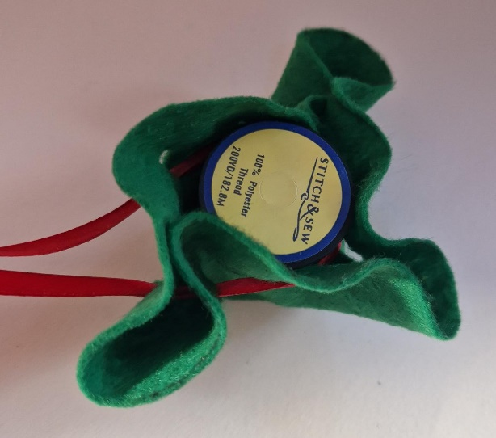
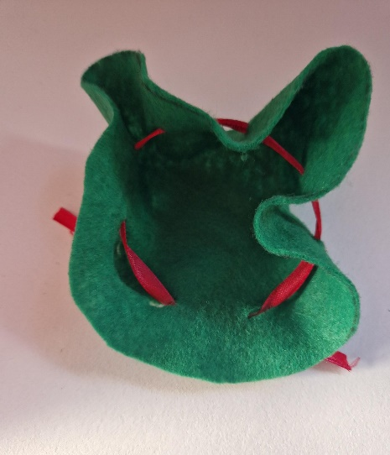
Circle Purse – Step 4
Gently pull the ribbon to make the purse
Notes:
Place an object in the middle to help with forming the shape of the purse, remove once shape created.
Trim the ribbon to a usable length – tie knots in the ends to prevent fraying.

Slide 13
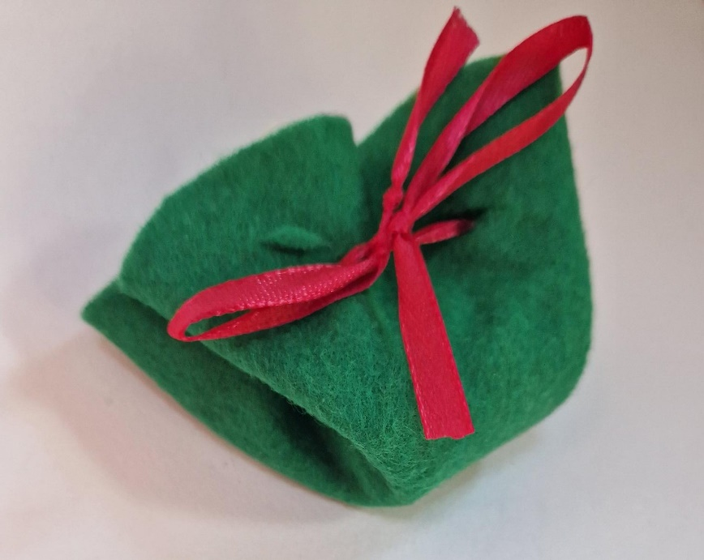
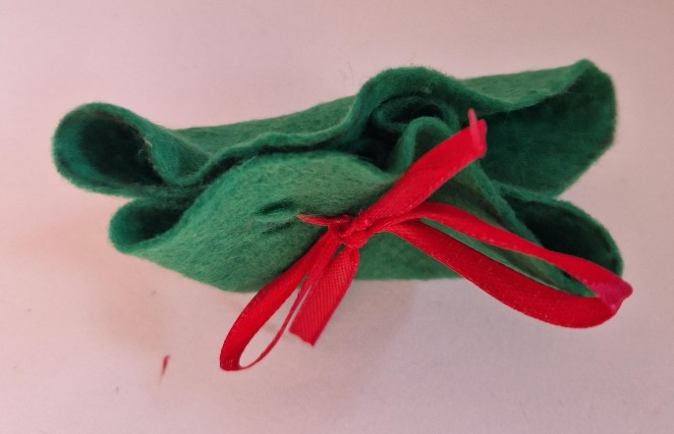
Finished Circle Purse
Notes:
An example of a completed circle purse.

Slide 14
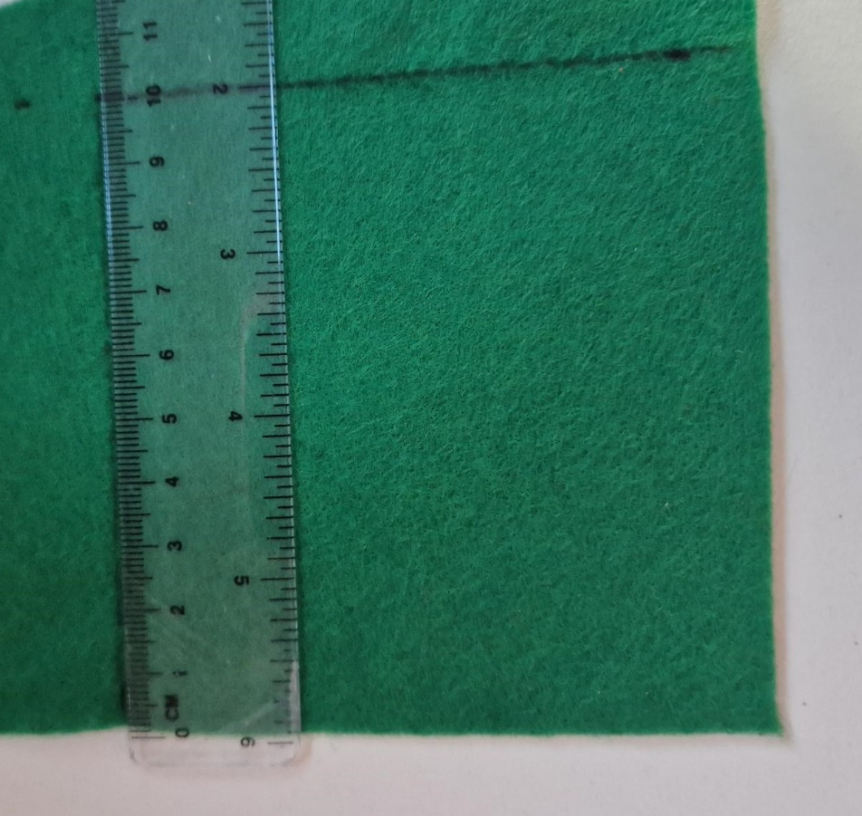
Pouch Purse – Step 1
Measure a 100 mm by 100 mm square on a large piece of felt
Notes:
The following slides show how to make a more complex pouch purse.
Lay a large piece out flat and draw the square on one end.

Slide 15
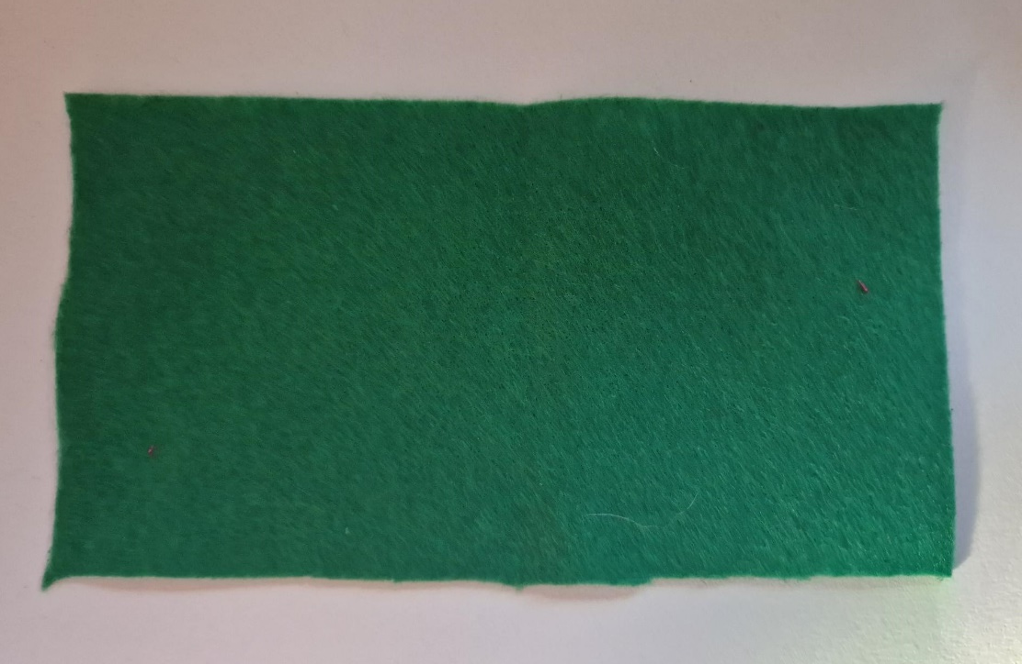
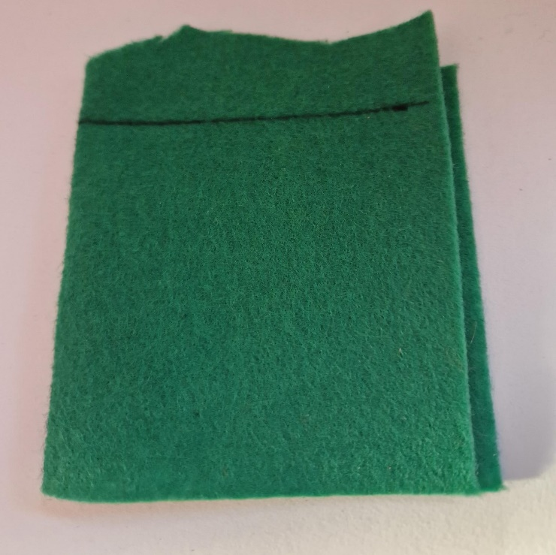
Pouch Purse – Step 2
Fold the felt over and cut to 100 mm
Open up the fold as shown
Folded edge
Notes:
Fold over the felt and create an ‘envelope’ that is 100 mm x 100 mm.
Trim to size.
Open up the felt into one large piece.

Slide 16
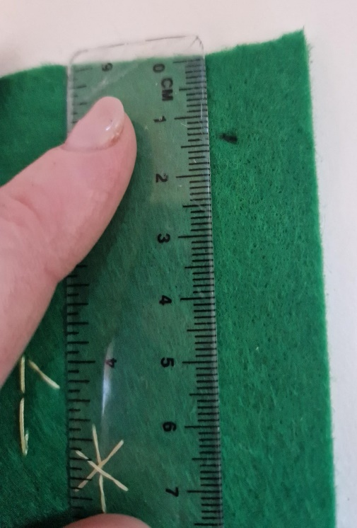
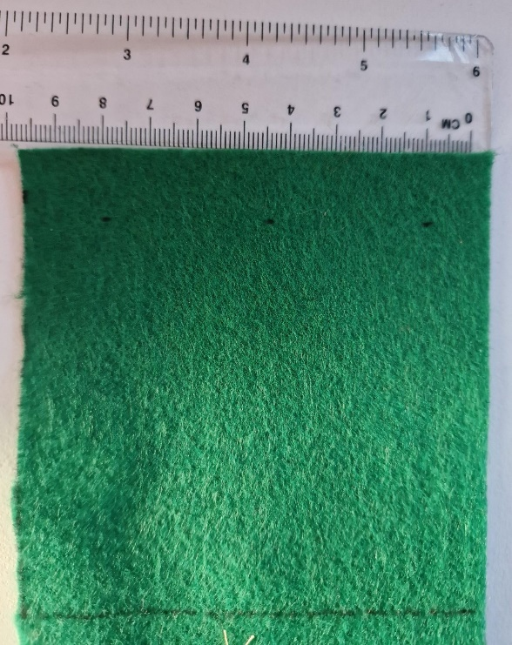
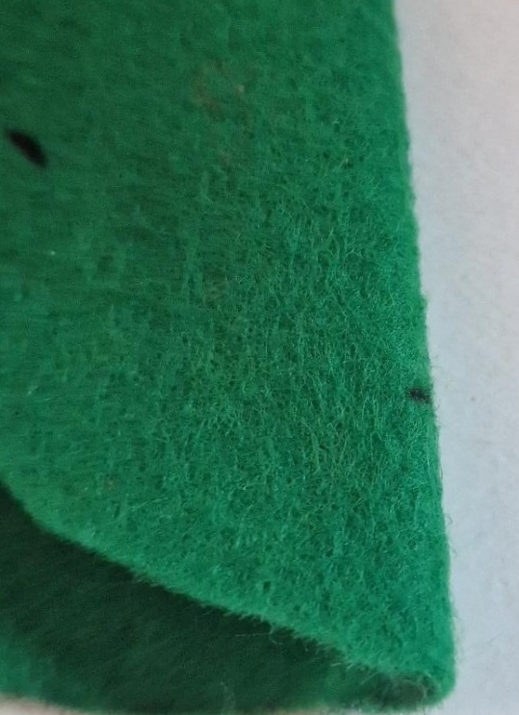
Pouch Purse – Step 3
Measure 15 mm in and mark three evenly spaced dots
Fold and snip each dot to create holes for the ribbon
Notes:
On the two shorter ends, measure the holes for the ribbon, snip with tip of scissors to create the holes.

Slide 17
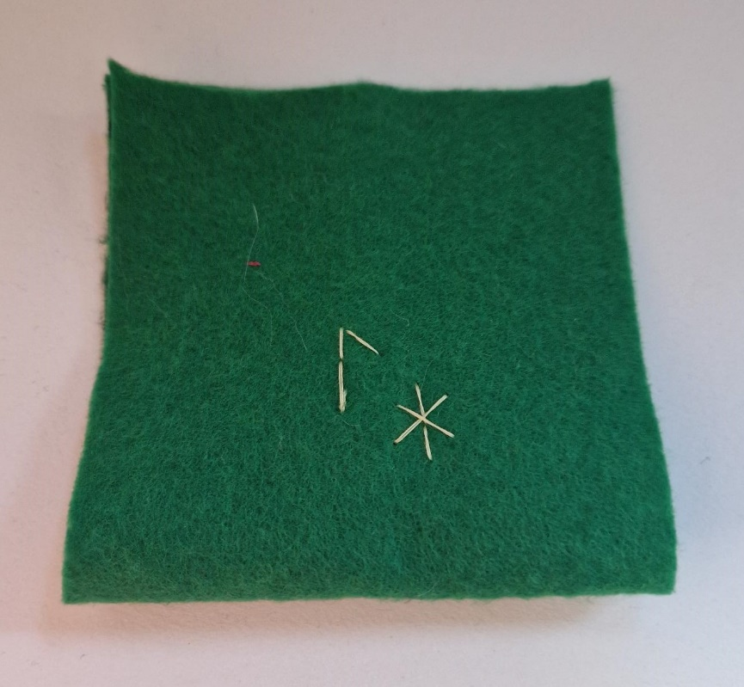
Pouch Purse – Step 4
⚠
Add decorative stitching on the purse
Notes:
For more able students use hand stitching to decorate their purses.
Ideas:
- Use Viking Runic to decorate the purse, spell their name in Runic, e.g. Laura, Mark.
https://i.pinimg.com/originals/61/8a/a4/618aa46d6a036eeda949cf67bcd6a6cc.jpg
- Flowers
- Name in English
- Own acceptable idea.

Slide 18
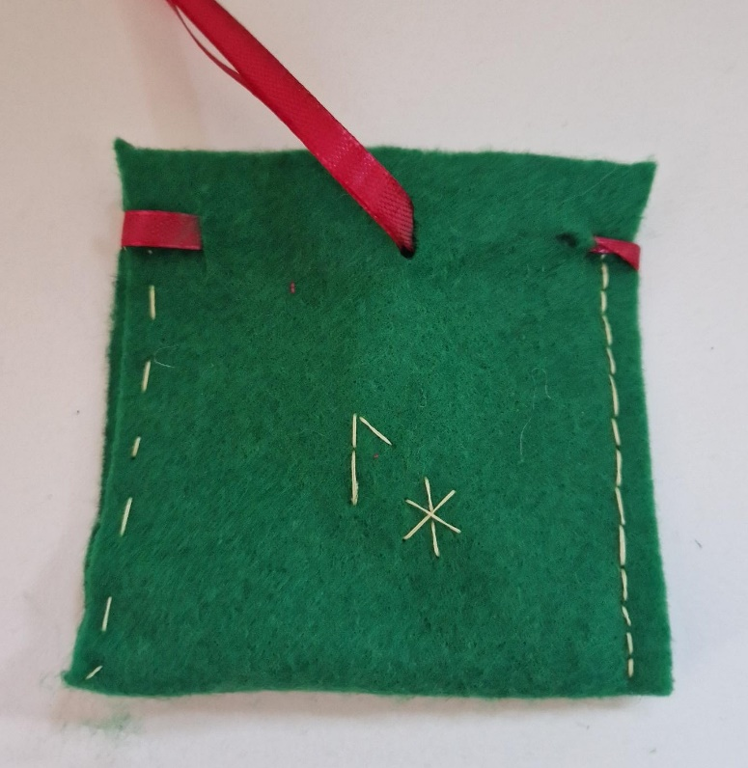
Pouch Purse – Step 5
⚠
Stitch up the two open edges of the purse up to the holes for the ribbon
Running stitch
Back stitch
Notes:
Stitching used depends on ability of learners:
Running stitch:
The running stitch is a basic hand-sewing technique that is used to join two pieces of fabric together.
https://youtu.be/4DB2bcYY1-M?si=9Bj2x0E3WR7I5sAY
Back stitch:
The back stitch is a simple outline stitch in hand embroidery. It joins straight stitches together to create a line that is simple and versatile.
https://youtu.be/zQsmZxpFnbg?si=8RqMqUtTBQDGByAh

Slide 19
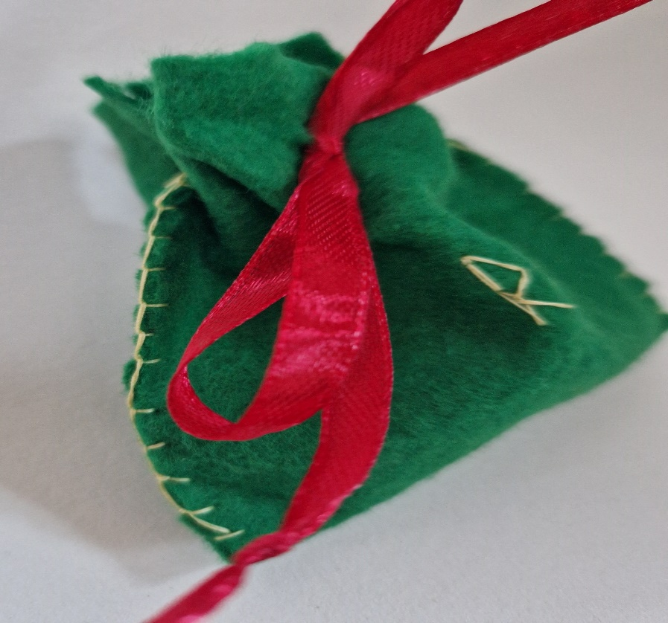
Pouch Purse – Step 6
⚠
Stitch up the two open edges of the purse up to the holes for the ribbon
Blanket stitch
Notes:
https://youtu.be/14ALMp1E1do?si=VNz_RAEK5P79Zku7
The blanket stitch is a decorative stitch used primarily for edging. It is often seen as the border on a blanket.

Slide 20
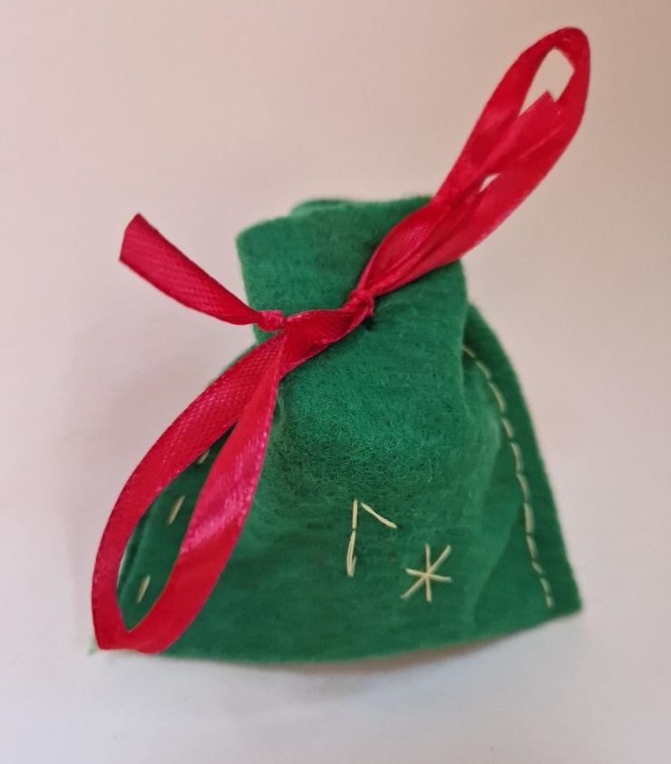
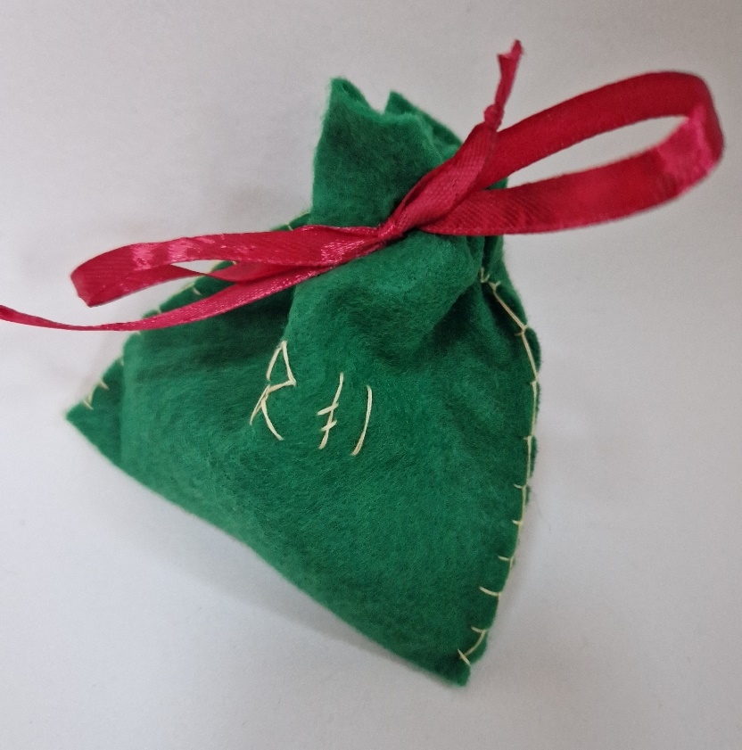
Pouch Purse – Step 7
Thread ribbon through the holes and tie
Notes:
Holes need to be below 5 mm ideally, depending on width of ribbon.

Slide 21
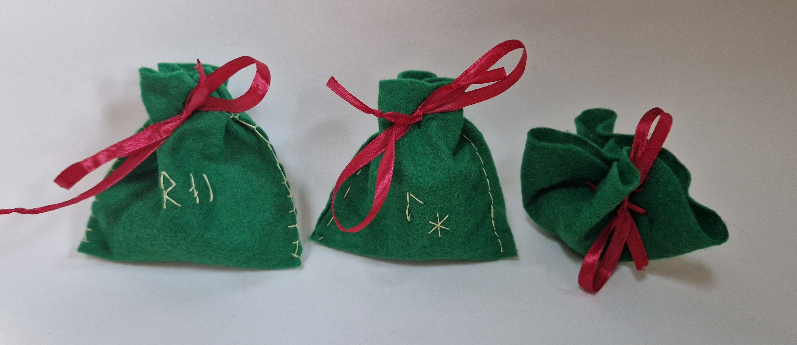
Finished Viking Pouch Purses
Notes:
Examples of finished pouch purses.

