Slide 1
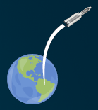
Discover Mass, Volume and Density
Launching a telescope into space

Slide 2
Stay safe
Whether you are a scientist researching a new medicine or an engineer solving climate change, safety always comes first. An adult must always be around and supervising when doing this activity. You are responsible for:
ensuring that any equipment used for this activity is in good working condition
behaving sensibly and following any safety instructions so as not to hurt or injure yourself or others
Please note that in the absence of any negligence or other breach of duty by us, this activity is carried out at your own risk. It is important to take extra care at the stages marked with this symbol: ⚠

Slide 3
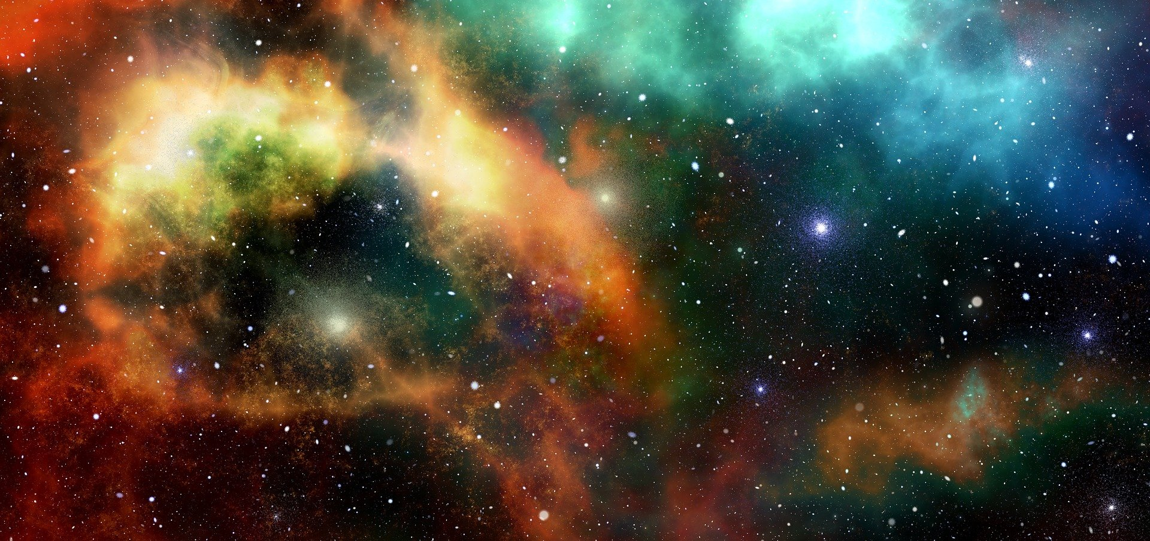
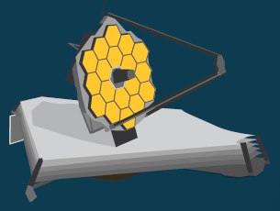
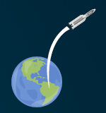
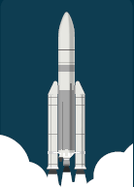
James Webb Space Telescope
The James Webb Space telescope will allow us to look at far away stars and galaxies
It will be positioned in space, 1.5 million km from earth!
It will be launched into space on a rocket
Notes:
The James Webb Space Telescope (Webb) will be the largest, most powerful telescope ever launched into space. It follows in the footsteps of the Hubble Space Telescope as the next great space science observatory, designed to
answer outstanding questions about the Universe and to make breakthrough discoveries in all fields of astronomy.
Webb will reveal the hidden Universe to our eyes: stars shrouded in clouds of dust, molecules in the atmospheres of other worlds, and light from the first stars and galaxies. With its suite of state-of-the-art instruments, Webb will push the frontiers of our knowledge of the Solar System, of how stars and planets form, and of galaxy formation and evolution, in new ways.
The telescope will launch on an Ariane 5 rocket from Europe’s Spaceport in French Guiana. From there it embarks on a month-long journey to its destination orbit around the second Lagrange point (L2), about one and a half million kilometres from Earth. In the first month after launch, Webb will unfold its sunshield, which is the size of a tennis court, and then deploy its 6.5-metre primary mirror that can detect the faint light of distant stars and galaxies with a sensitivity a hundred times greater than that of Hubble.
The bottom right images are an Ariane 5 rocket taking off and leaving earth. The middle image is the James Webb Space Telescope that will be deployed in space. The image at the top right shows distant stars in space.

Slide 4
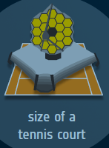
James Webb Space Telescope
The telescope is the size of a tennis court!
The heavier the telescope is, the harder it will be to launch it into space
We need to understand about density so we can choose lightweight materials to make it – so it will be easier to send into space

Slide 5

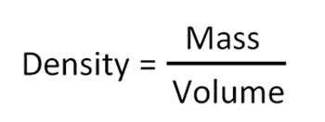
What is density?
If two things are the same size, the one that is more dense is heavier.
The cubes are the same size
High density
Low density
The density of an object is its mass divided by its volume:
The units of density are g/cm³

Slide 6
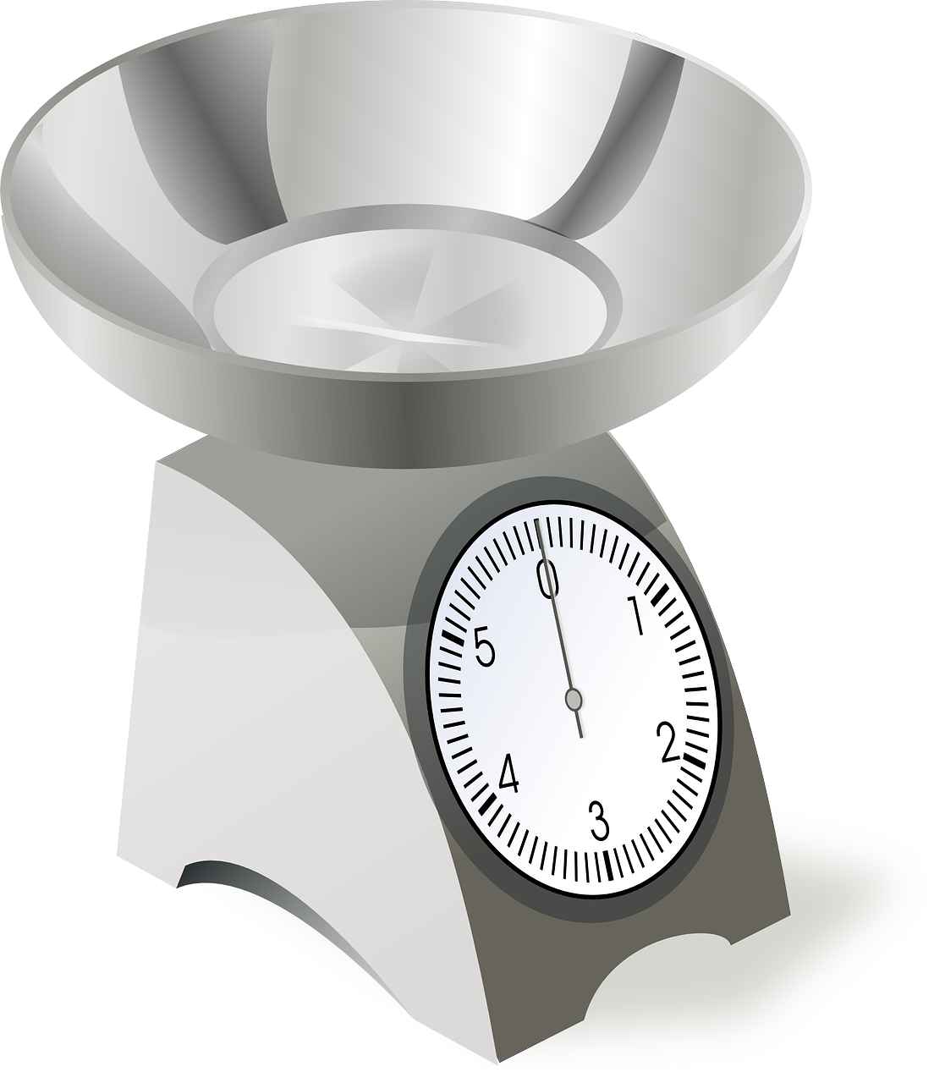
What is mass?
Mass is how heavy something is.
It is measured in grams, g.

Slide 7
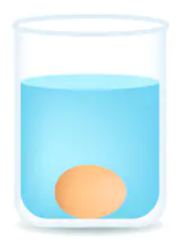
What is volume?
Volume is the amount of space an object takes up.
It is measured in cm³.
We can measure volume by putting an object in water and seeing how much the water rises.

Slide 8
Testing activity – step 1
Weigh each object. ⚠
Write down the weight in grams/g.

Slide 9
Step 2 – find the volume
Place a bowl on a tray.
Fill the bowl to the brim with water.
Put the object in the water.
The tray will catch all
the water that
overflows.
⚠

Slide 10
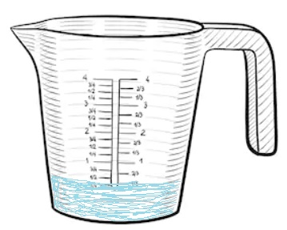
Step 3 – measure the water
Carefully take the bowl from the tray.
Pour the water on the tray into a jug.
Write down how much water has been collected in ml.
⚠

Slide 11
Step 4 – work out the density
Weight = 9 grams
Volume of water = 4.5 ml = 4.5 cm³
9
____
Density $=$
$$=$$
2 g/cm³
4.5

