Slide 1
What is Aerodynamics?
Making and testing an aerofoil

Slide 2
Stay safe
Whether you are a scientist researching a new medicine or an engineer solving climate change, safety always comes first. An adult must always be around and supervising when doing this activity. You are responsible for:
• ensuring that any equipment used for this activity is in good working condition
• behaving sensibly and following any safety instructions so as not to hurt or injure yourself or others
Please note that in the absence of any negligence or other breach of duty by us, this activity is carried out at your own risk. It is important to take extra care at the stages marked with this symbol: ⚠

Slide 3
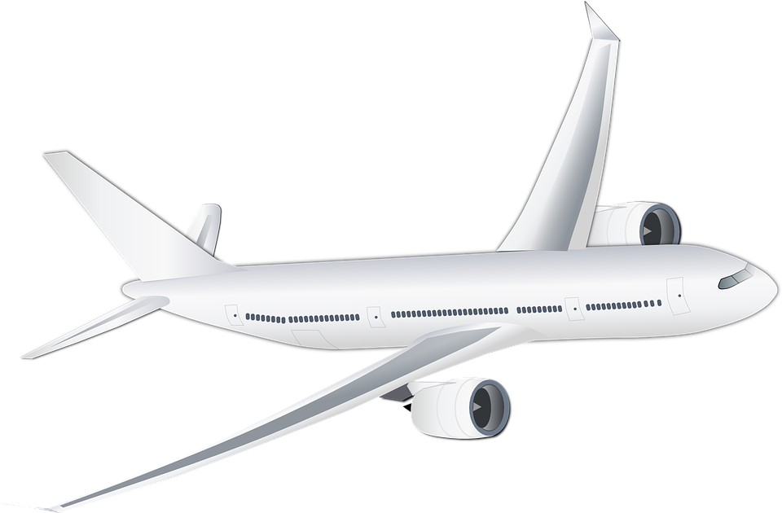
What is aerodynamics?
Aerodynamics is the study of how solid objects move through the air.
It is crucial to understanding how aircraft are able to fly.
Notes:
Discuss the importance of understanding aerodynamics with the class.

Slide 4
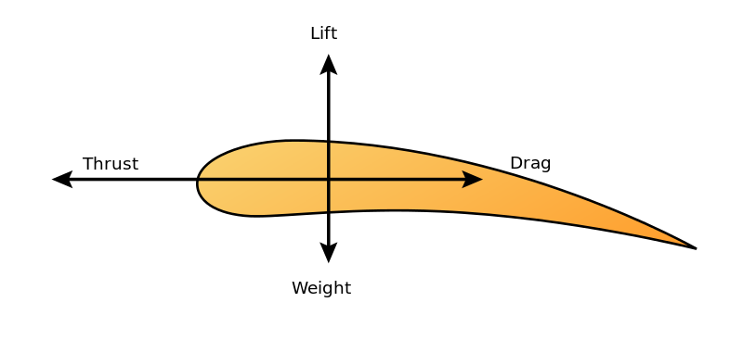
Lift, drag and thrust
Lift is the force that opposes the weight of an aircraft, causing it to move upwards.
Drag is the force that opposes the forward motion of an aircraft through the air.
Thrust is the pushing force that moves an aircraft forwards through the air.
Aerofoils, or wings, allow aircraft to achieve flight by reducing drag and increasing lift.
Notes:
Explain how aerofoils work using the key terms outlined.

Slide 5
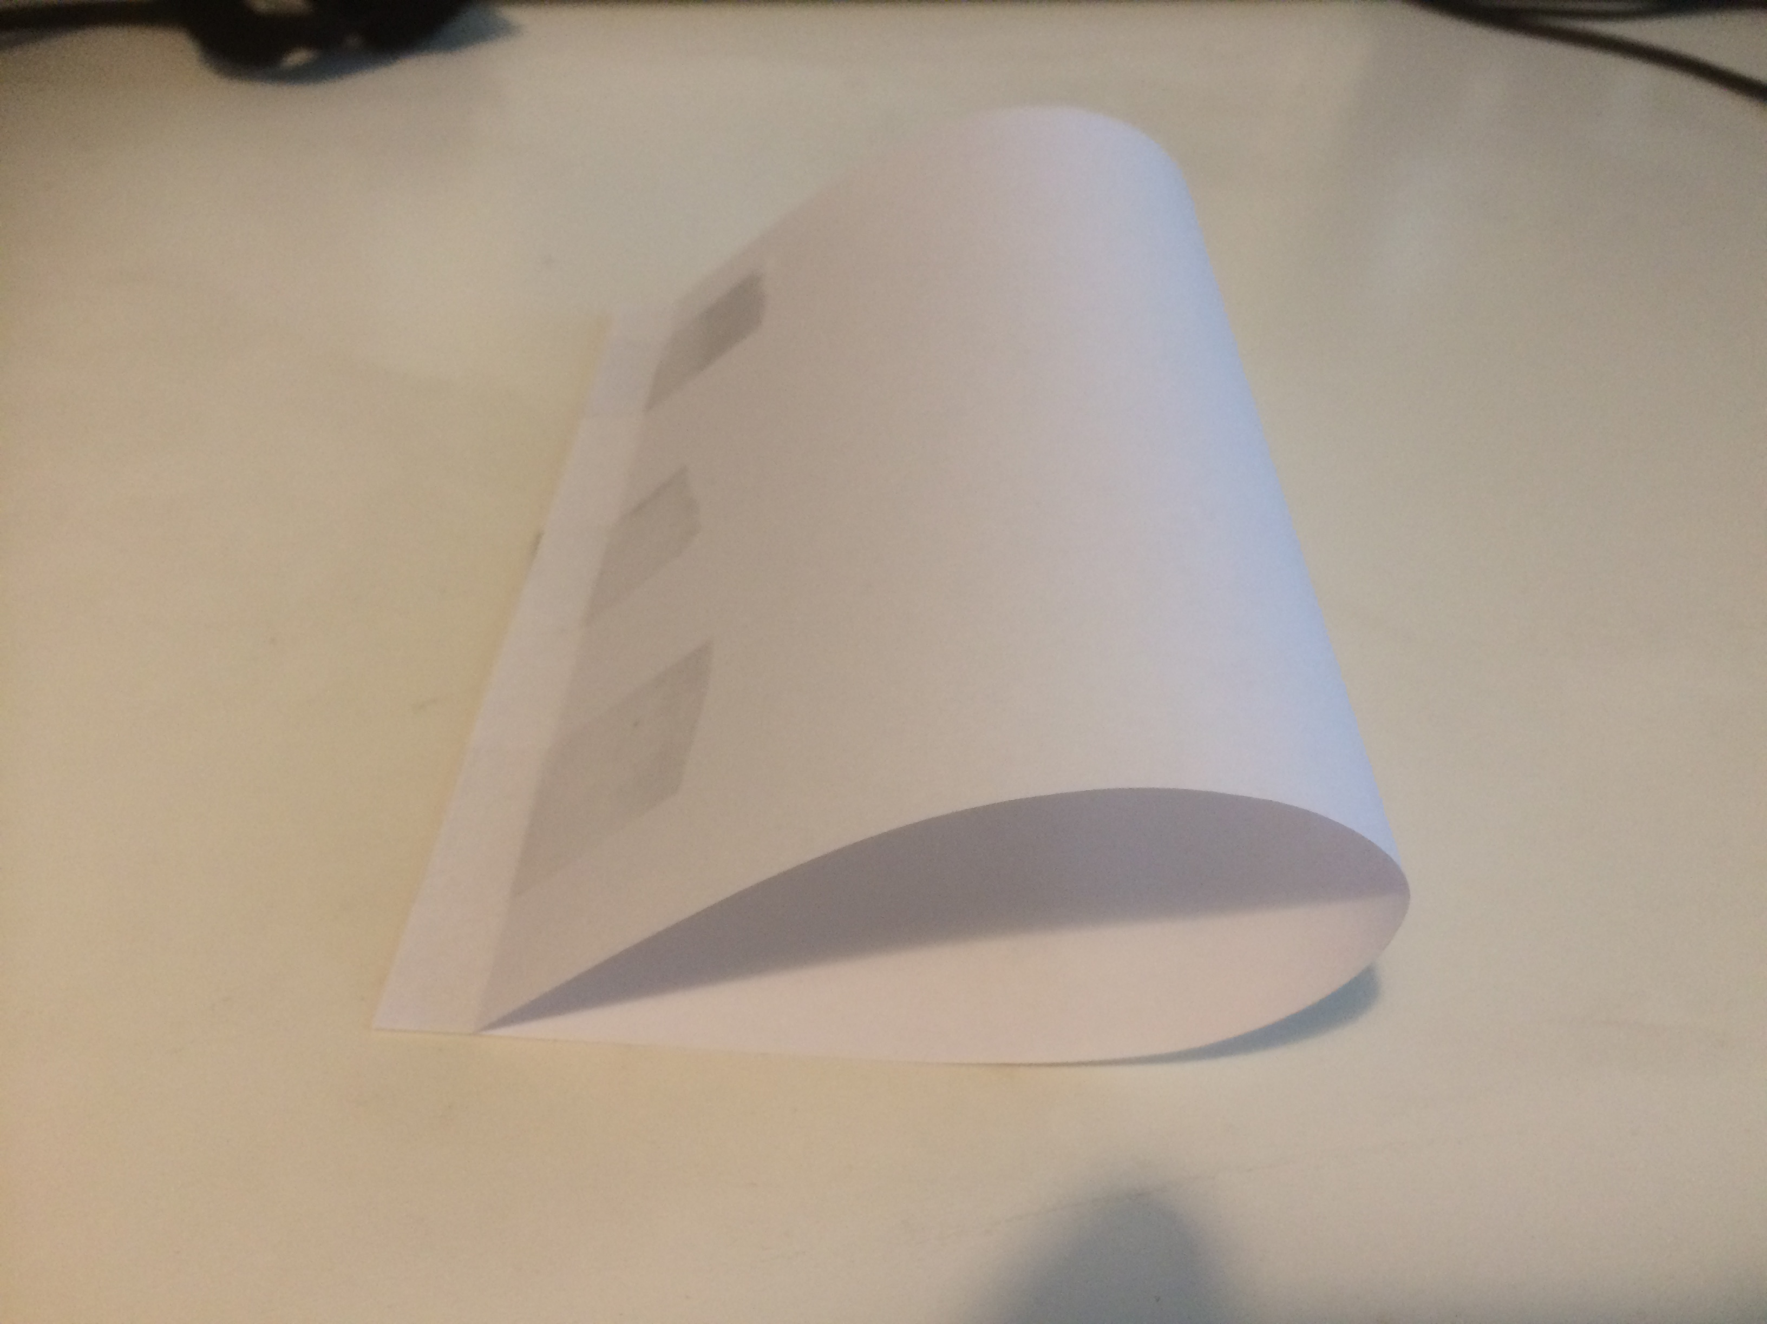
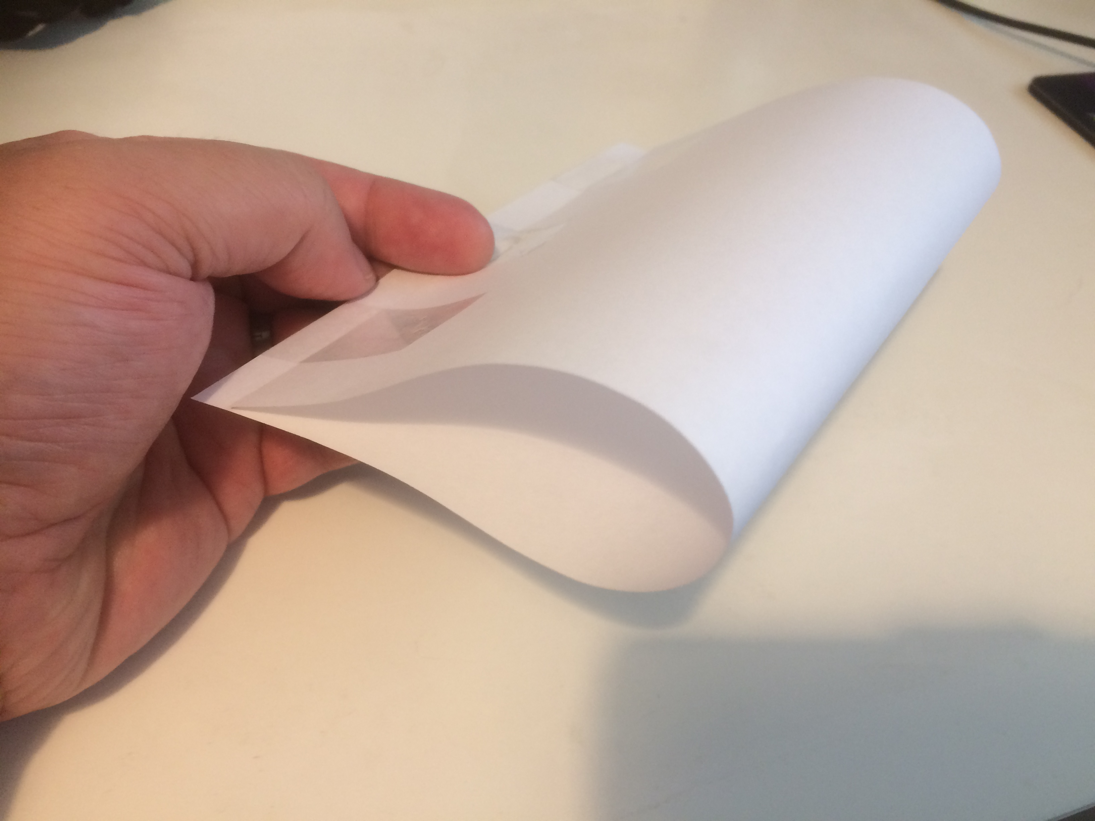
Making an aerofoil
You are now going to make and test an aerofoil:
Fold your piece of paper in half.
Create an upwards camber by moving the top end of the paper back slightly from the bottom end.
Stick the top end down with tape.
Put your aerofoil on your desk and apply moving air to the front of it, level with the edge of the table. What happens?
Notes:
Air could be applied by blowing or using an electric fan on a low setting. The aerofoil could also be attached to the desk with a piece of string string during the testing to prevent it from moving backwards too far and so that flight can be more easily observed; this could be fed through the space inside the aerofoil, and taped to the desktop at both ends, allowing some slack so that it can raise/fly. Alternatively a wood dowel could be inserted through a hole made in the top and bottom of the aerofoil. Half a piece of A4 paper (A5 size) is suitable for use in making the aerofoil.

Slide 6
Different aerofoil shapes
Different shapes affect how an aerofoil works.
Try each of the following:
Create an aerofoil with a flat bottom and small upwards camber.
Create an aerofoil with a flat bottom and a larger upwards camber.
Create an aerofoil with a square front.
Notes:
Discuss the results and how different designs of aerofoils affect flight.

