Slide 1
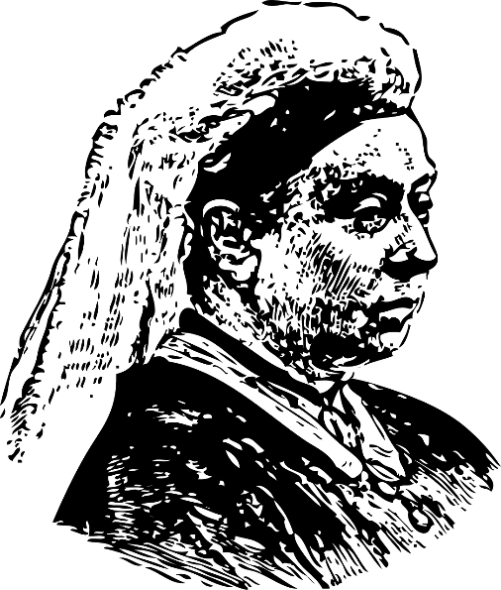
Victorian Light Bulb Experiment
Performing an experiment to learn about how filament light bulbs and basic electricity works
Notes:
This activity would work well as a starter or lead-in activity to ‘Making a Pinhole Camera’.

Slide 2
Stay safe
Whether you are a scientist researching a new medicine or an engineer solving climate change, safety always comes first. An adult must always be around and supervising when doing this activity. You are responsible for:
ensuring that any equipment used for this activity is in good working condition
behaving sensibly and following any safety instructions so as not to hurt or injure yourself or others
Please note that in the absence of any negligence or other breach of duty by us, this activity is carried out at your own risk. It is important to take extra care at the stages marked with this symbol: ⚠
Notes:
Safety Warning

Slide 3
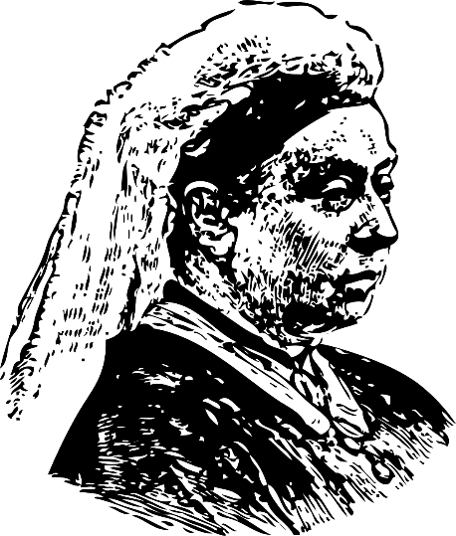
The Victorians
The Victorian age was a period in time in the United Kingdom where Queen Victoria reigned
This was between June 1837 and January 1901
There were huge changes to how people lived and worked during this period
In this project you will learn about how Thomas Edison’s light bulb worked!
Notes:
Explain the theme of the Victorians to learners.
Teacher could ask learners to write down five things that that they already know about the Victorians and/or the Victorian era.
The Victorian era is sometimes also defined as being between around 1820 and 1914, based on the defining characteristics of society at the time, rather than the exact dates of Queen Victoria’s reign as monarch. Either definition, or a mixture of the two, is historically accurate to use.

Slide 4
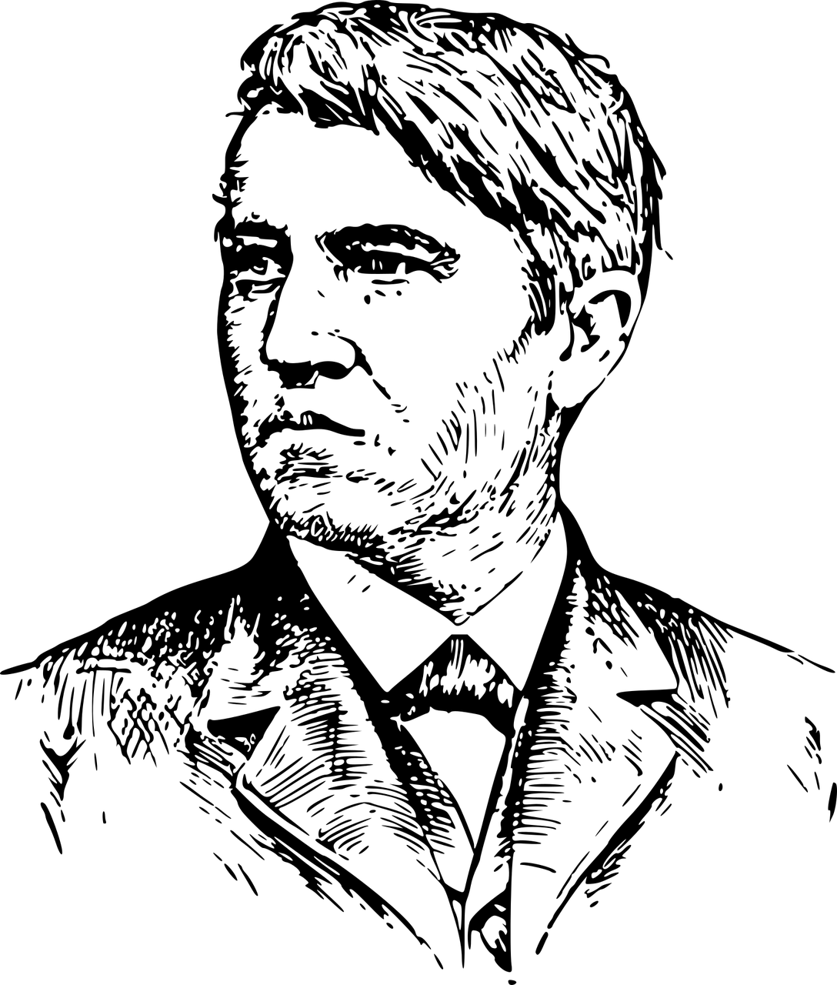
Thomas Edison
An American inventor born in 1831
His inventions include the phonograph (early record player), motion picture camera and the first practical electric light bulb
One of his most famous quotes is ‘I have not failed. I've just found 10,000 ways that won't work’
Notes:
The teacher could explain that the first electric light was actually invented by Humphry Davy in 1802, but it was not bright or long lasting enough to be practical.
https://en.wikipedia.org/wiki/Incandescent_light_bulb
Learners could research Edison and his work.

Slide 5
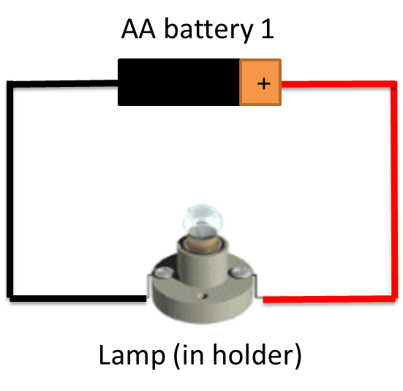
Light Bulb Experiment
The first practical light bulb was invented in 1879 by Thomas Edison
It was much safer than gas lighting, especially in Victorian factories
Build the light bulb circuit shown
Write a short summary of how it works
Notes:
Learners should use two crocodile clips coloured as shown above (red for positive connection, black for negative connection) to connect the battery to the lamp holder.
An AA battery is rated at 1.5 V, so a 1.5 V lamp should be used.
How filament light bulbs work:
Electricity passes through, but because its flow is resisted some of its energy turns to heat. This heats the metal so it glows. The gas inside the bulb stops the metal being attacked by the air and makes it last longer.

Slide 6
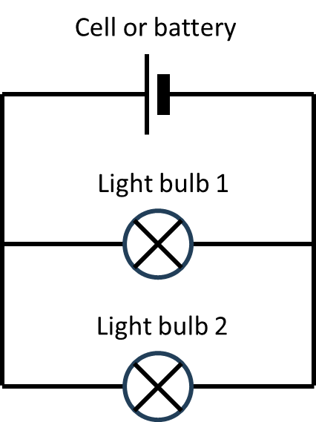
Extension
Create a parallel light bulb circuit
Explain how it works
Notes:
A schematic of a parallel light bulb circuit is shown on the slide above.

