Slide 1
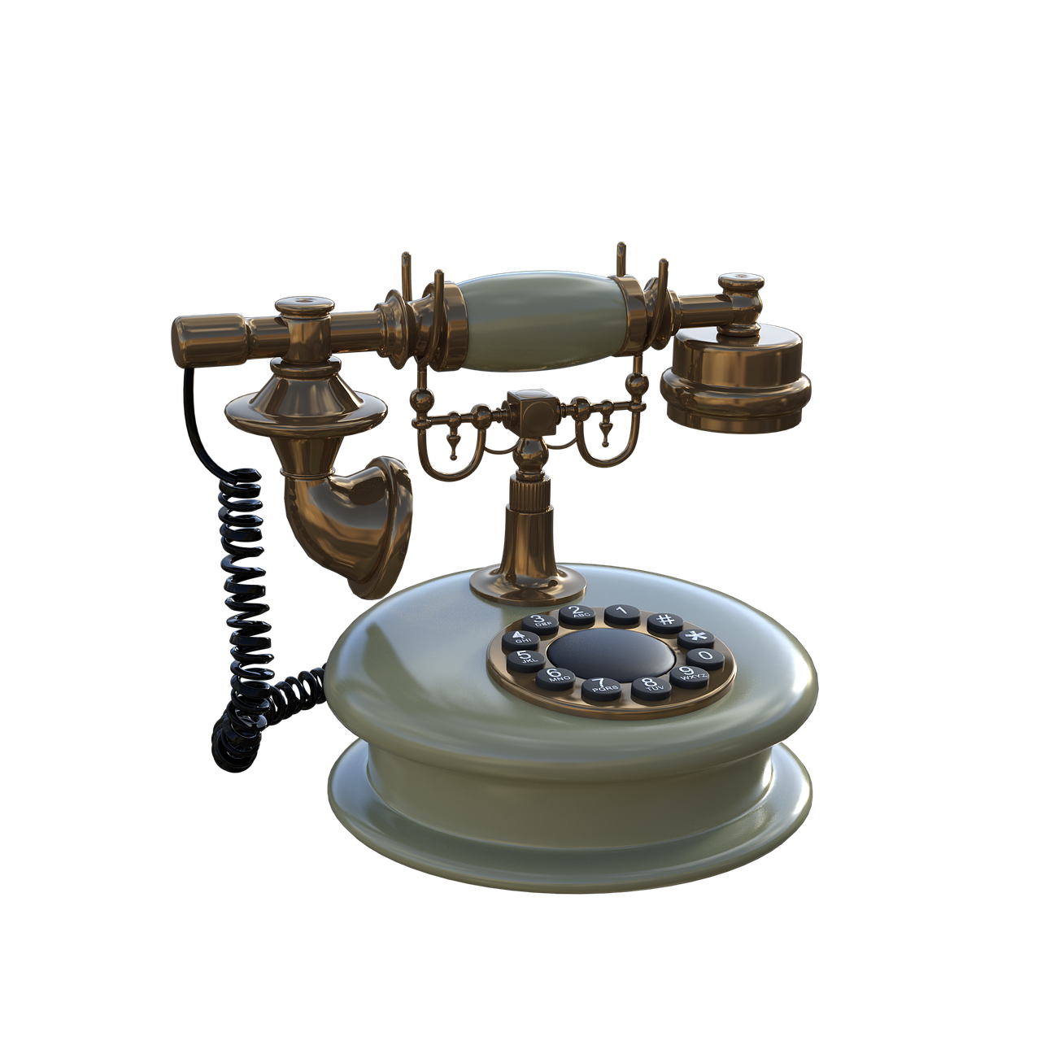
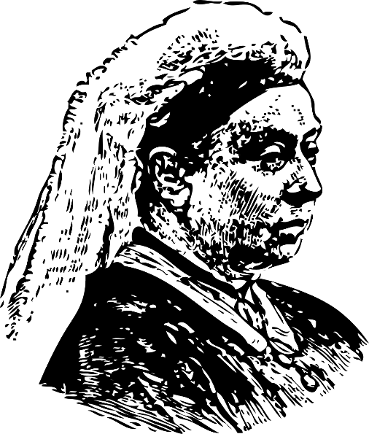
Make a Victorian Timeline
Producing a timeline of key events that took place during the Victorian era
Notes:
This activity would work well as a starter or lead in activity to ‘Making a Pinhole Camera’.

Slide 2
Stay safe
Whether you are a scientist researching a new medicine or an engineer solving climate change, safety always comes first. An adult must always be around and supervising when doing this activity. You are responsible for:
ensuring that any equipment used for this activity is in good working condition
behaving sensibly and following any safety instructions so as not to hurt or injure yourself or others
Please note that in the absence of any negligence or other breach of duty by us, this activity is carried out at your own risk. It is important to take extra care at the stages marked with this symbol: ⚠
Notes:
Safety Warning

Slide 3
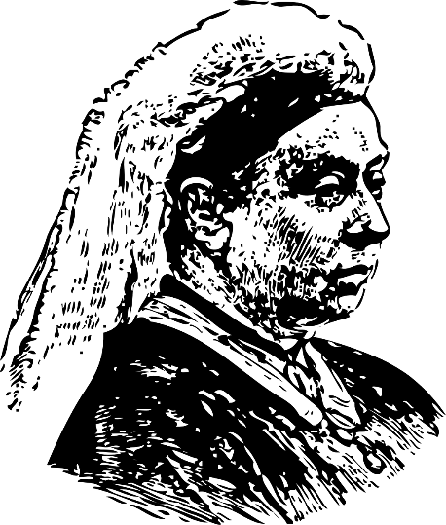
The Victorians
The Victorian age was a period in time in the United Kingdom where Queen Victoria reigned
This was between June 1837 and January 1901
There were huge changes to how people lived and worked during this period
In this activity you will learn about the key events that shaped the Victorian era!
Notes:
Explain the theme of the Victorians to learners.
Teacher could ask learners to write down five things that that they already know about the Victorians and/or the Victorian era.
The Victorian era is sometimes also defined as being between around 1820 and 1914, based on the defining characteristics of society at the time, rather than the exact dates of Queen Victoria’s reign as monarch. Either definition, or a mixture of the two, is historically accurate to use.

Slide 4
Victorian Timeline
The Victorian era saw many important events that still affect our lives today
Produce a timeline of events that took place during the Victorian era
Use the template given by your teacher to help
Notes:
To support weaker learners the teacher could give them a list of events to include – these are also included on the Victorian timeline template for lower ability learners (slide 5).

Slide 5
Victorian Timeline Template
Queen Victoria dies - 1901
The London Underground opens - 1863
The first telephone call is made - 1876
Opening of the Suez Canal - 1869
Britain abolishes slavery - 1838
Development of national police force - 1856
The Great Exhibition opens - 1851
Victoria becomes Queen - 1837
Creation of the Public Health Act -1848
Education becomes compulsory for children under 10 - 1880
Notes:
Template with events (for lower ability learners).
The events are not in the right order and need to be rearranged before placing on the timeline.

Slide 6
Victorian Timeline Template
Notes:
Template without events (for higher ability learners).

Slide 7
Effects of the Victorian Era
Write a short summary of one way in which the Victorian era has influenced modern engineering and/or society
You must limit this to a social media post of one paragraph

Slide 8
Extension
Produce timelines for other key periods in the history of the United Kingdom. E.g. the Elizabethan era, the Georgian era
Produce a class display of different technological inventions that occurred during the Victorian era, and how they have influenced technology today

Slide 9
Completed Victorian Timeline
Creation of the Public Health Act -1848
Opening of the Suez Canal - 1869
Victoria becomes Queen - 1837
Development of national police force - 1856
Queen Victoria dies - 1901
Britain abolishes slavery - 1838
The London Underground opens - 1863
Education becomes compulsory for children under 10 - 1880
The Great Exhibition opens - 1851
The first telephone call is made - 1876
Notes:
Template with events (for lower ability learners).
The events are not in the right order and need to be rearranged before placing on the timeline.

