Slide 1
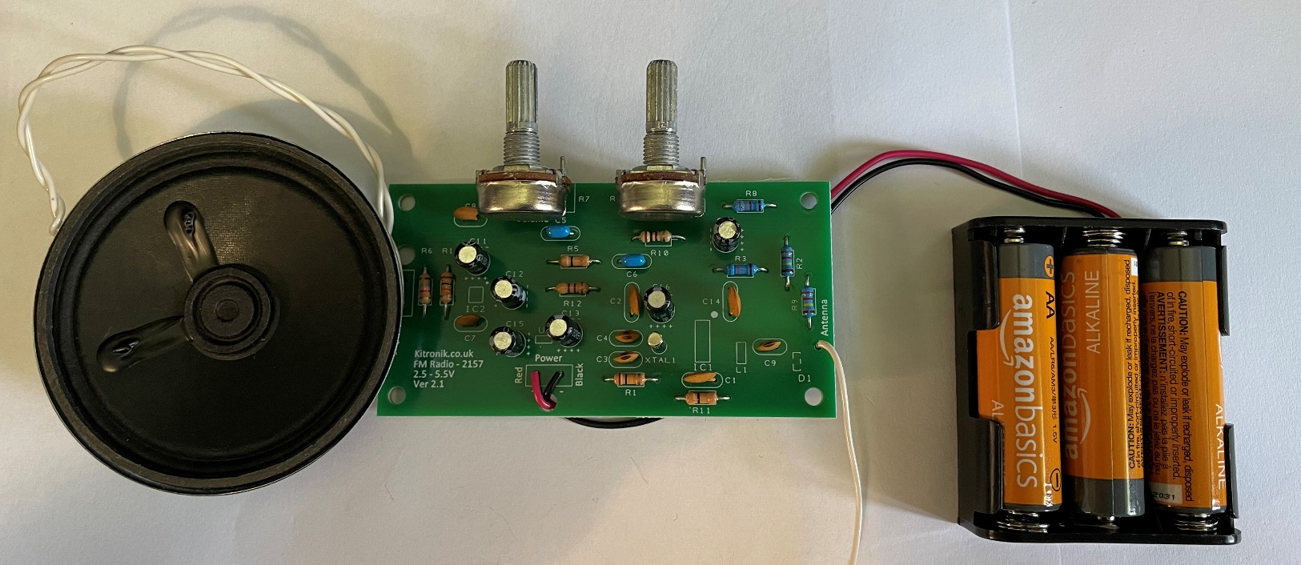
Make a radio receiver
Making an electronic circuit that can both receive and play
FM radio signals

Slide 2
Stay safe
Whether you are a scientist researching a new medicine or an engineer solving climate change, safety always comes first. An adult must always be around and supervising when doing this activity. You are responsible for:
ensuring that any equipment used for this activity is in good working condition
behaving sensibly and following any safety instructions so as not to hurt or injure yourself or others
Please note that in the absence of any negligence or other breach of duty by us, this activity is carried out at your own risk. It is important to take extra care at the stages marked with this symbol: ⚠
Notes:
Safety Warning

Slide 3
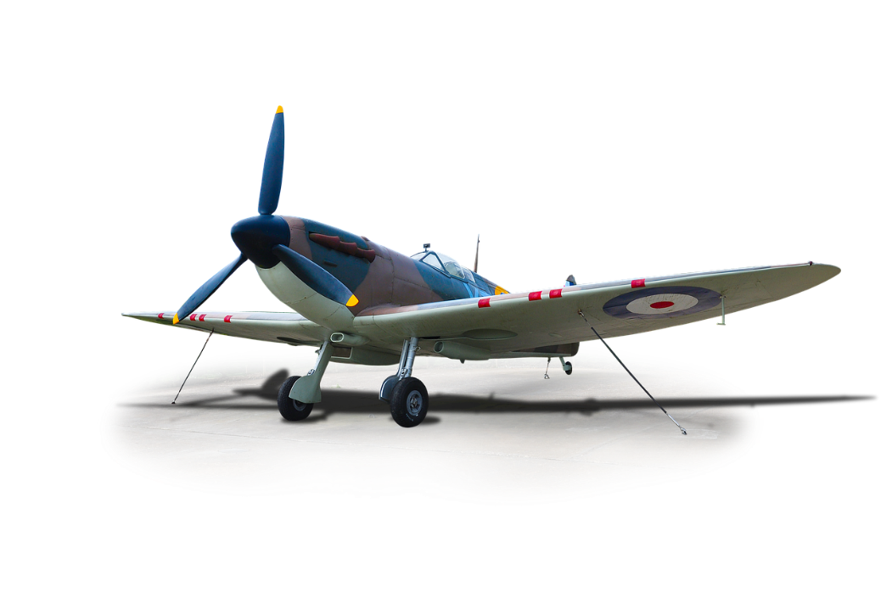
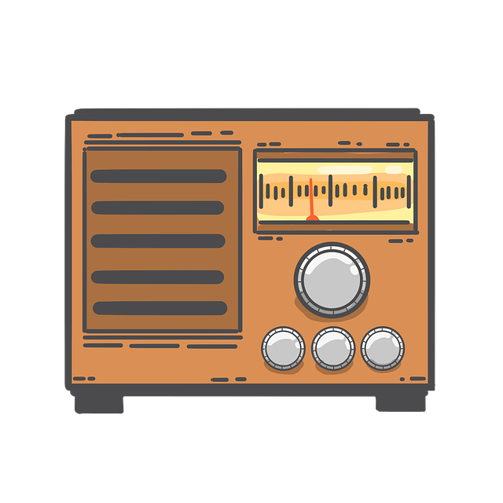
Radio in World War 2
The second world war happened between 1939 and 1945
Radio played an important part in the Allies winning the war
FM radio was used to allow ground soldiers, and aircraft, to talk to each other at short range
This was because of its high-quality sound
Radio was also used to boost morale for people at home
Notes:
The role of radio during the war: https://www.bbc.co.uk/bitesize/guides/zwscng8/revision/2
FM radio: https://en.wikipedia.org/wiki/FM_broadcasting

Slide 4
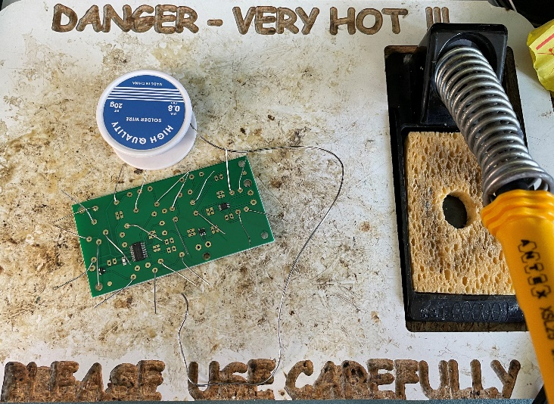
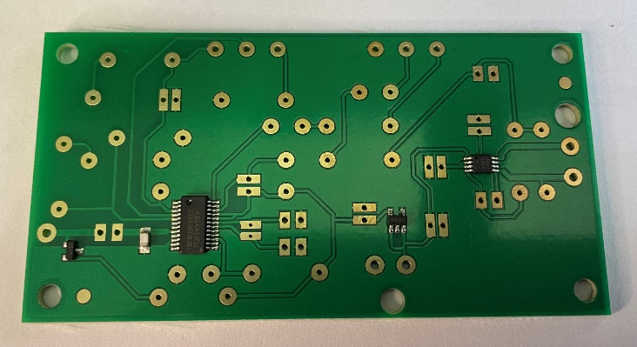
Making an FM radio receiver safely
⚠
You are going to make an electronic circuit that can receive and play FM radio signals
Soldering irons can get very hot
Never touch the metal part of the soldering iron
Put the iron in its stand when you are not using it
Use a board to protect the desk
Wear safety glasses to protect your eyes
Notes:
Discuss health and safety issues with learners.
Provide suitable fume extraction – the use of lead-free solder is strongly recommended.

Slide 5
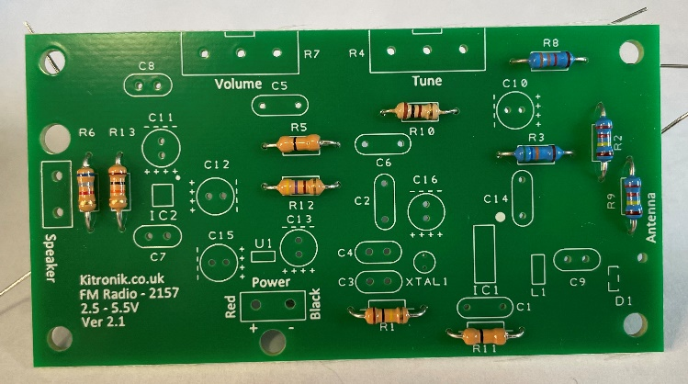
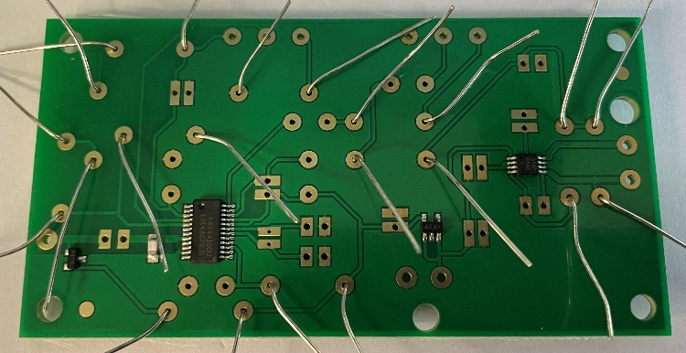
Step 1 – Mounting resistors
Using the colour code, place each resistor into the right part of the circuit board:
R1 – brown, black, yellow
R2 & R9 – red, red, yellow
R3 – green, blue, orange
R5 & R11 – black
R6 – blue, grey, red
R8 – orange, orange, red
R10 – brown, black, brown
R12 – yellow, purple, brown
R13 – brown, black, orange
Notes:
This is a good opportunity to teach the resistor colour code to learners, but it is not essential to completing this activity as long as learners follow the instructions above.
This stage could be completed in advance for weaker learners.

Slide 6
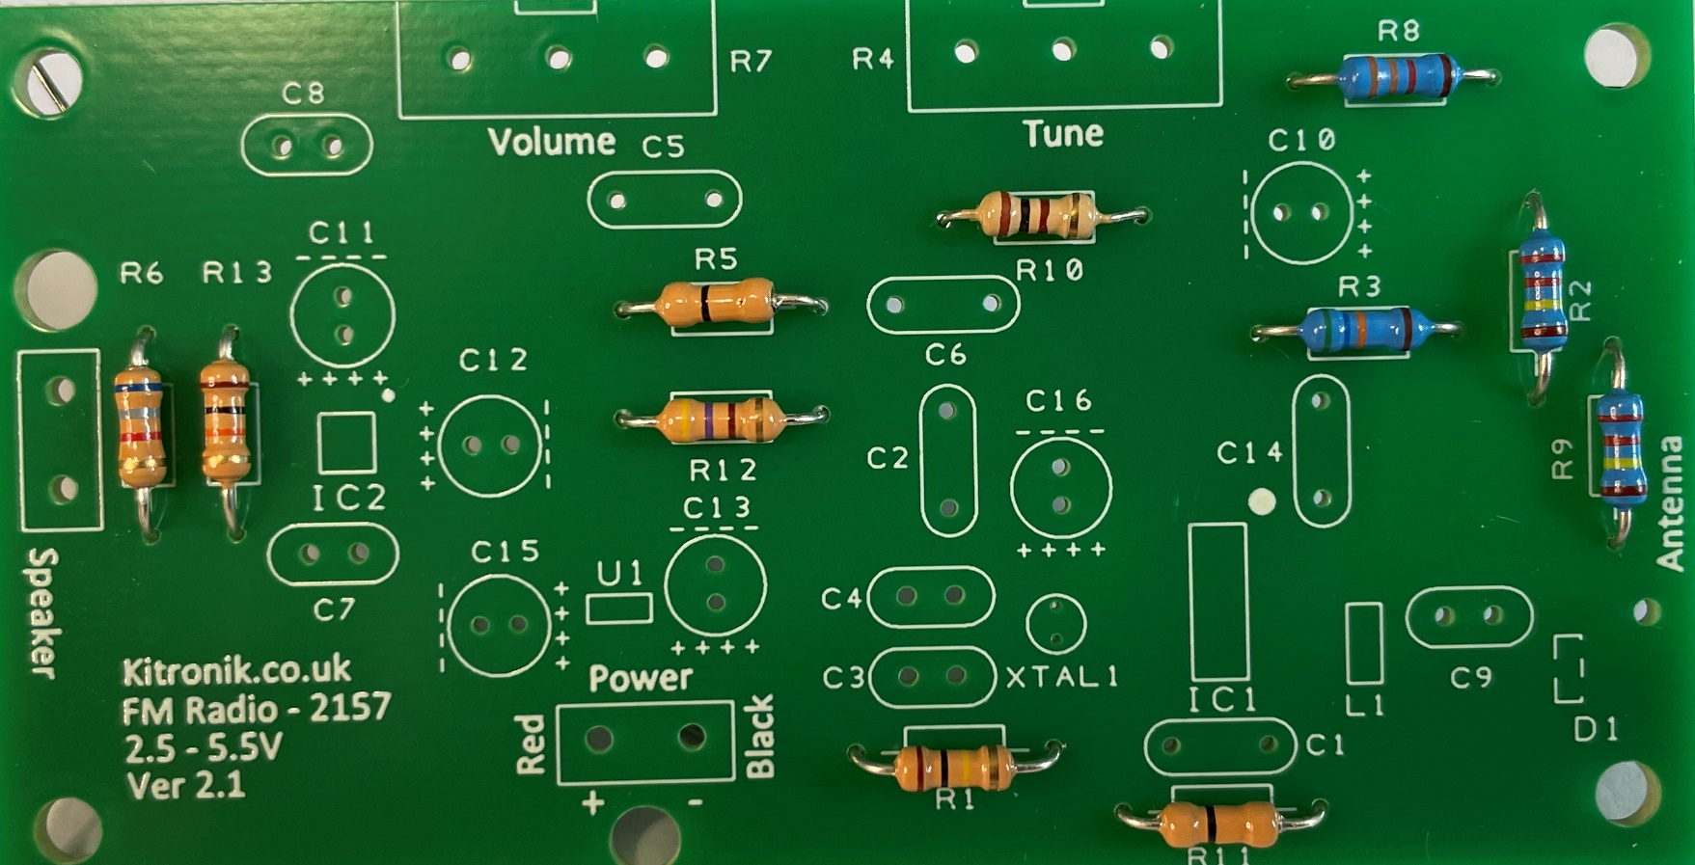
Step 1 – Mounting resistors
Notes:
This stage could be completed in advance for weaker learners.

Slide 7
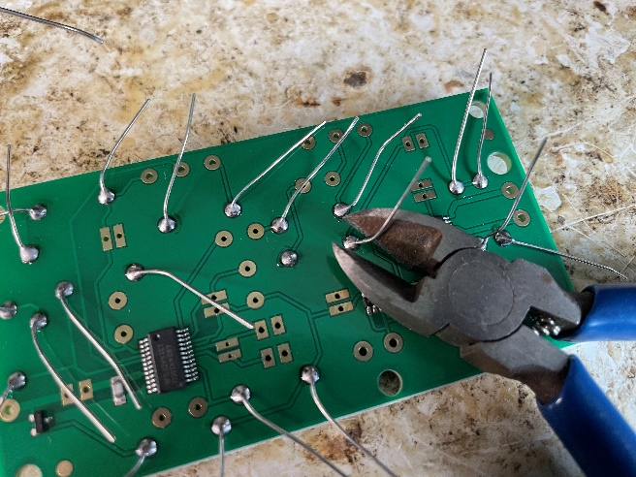
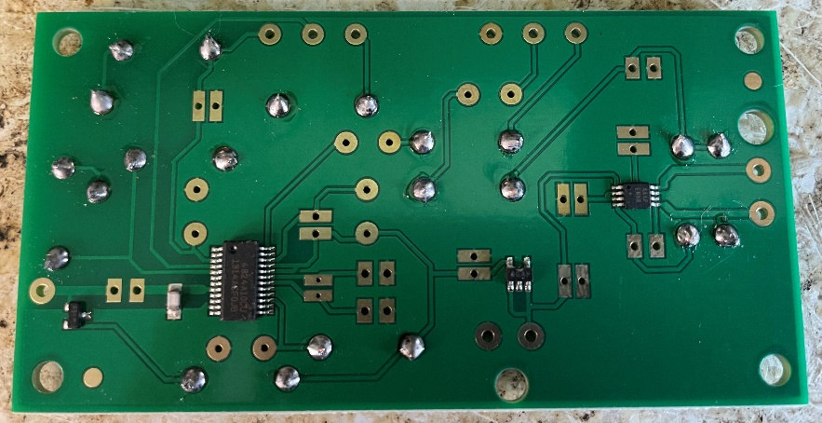
Step 2 – Soldering resistors
⚠
On the track side, solder the metal legs to the metal pads on the board
Be careful not to use too much solder
Use wire cutters to snip the ends off the legs when done
Notes:
This stage could be completed in advance for weaker learners.

Slide 8
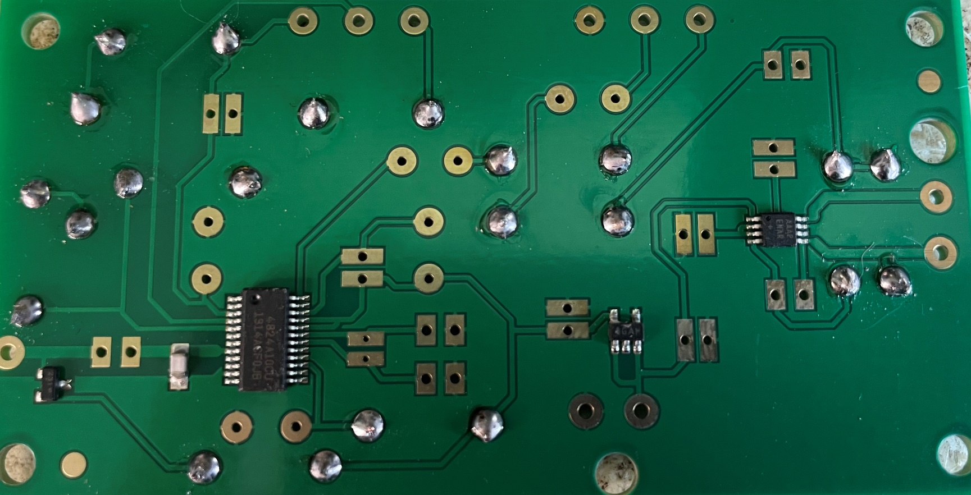
Step 2 – Soldering resistors
⚠
Notes:
This stage could be completed in advance for weaker learners.

Slide 9
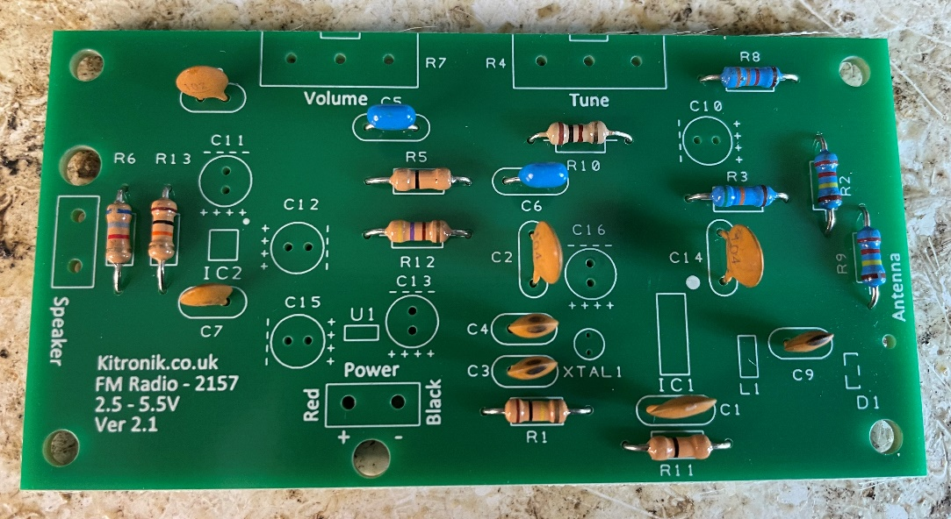
Step 3 – Mounting ceramic capacitors
Place each ceramic capacitor into the right part of the circuit board:
C1, C2 & C14 – labelled 104
C3 & C4 - labelled 22
C5 & C6 – labelled 474
C7 – labelled 471
C8 – labelled 102
C9 – labelled 33

Slide 10
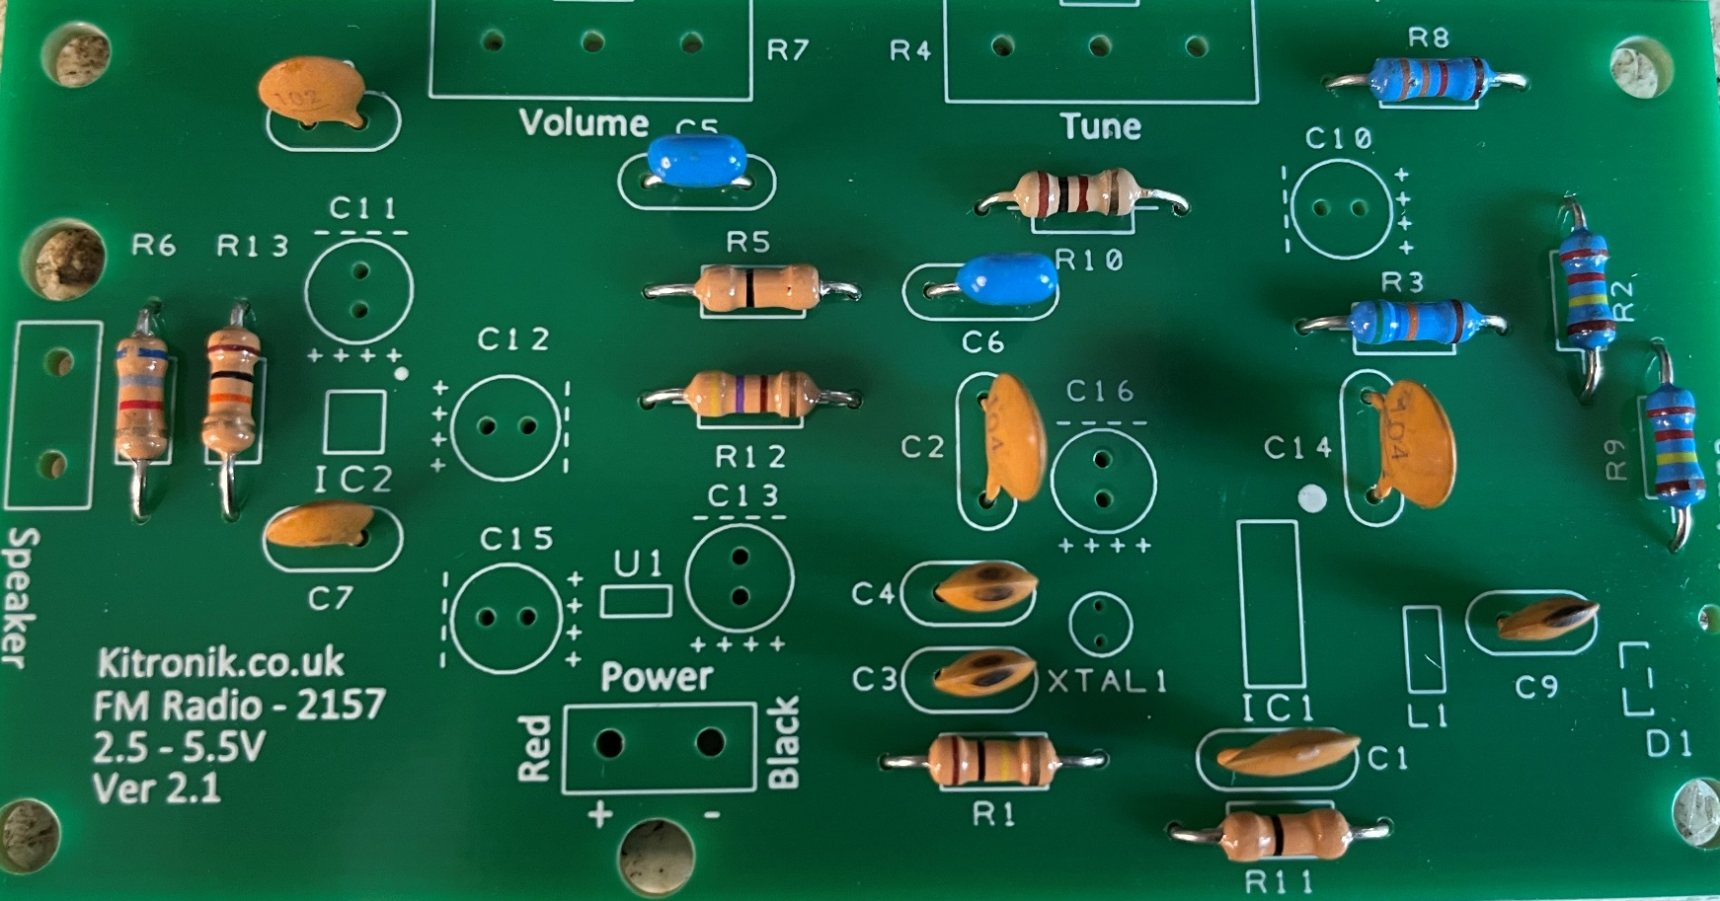
Step 3 – Mounting ceramic capacitors

Slide 11
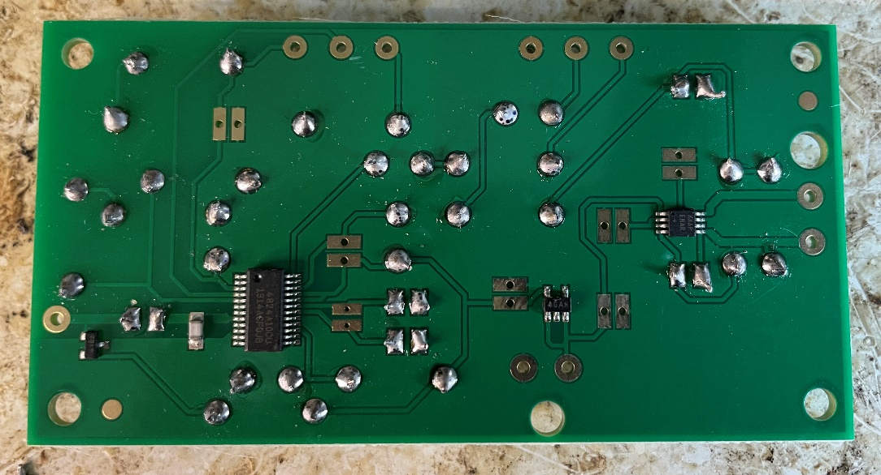
Step 4 – Soldering ceramic capacitors
⚠
On the track side, solder the metal legs to the metal pads on the board
Be careful not to use too much solder
Use wire cutters to snip the ends off the legs when done

Slide 12
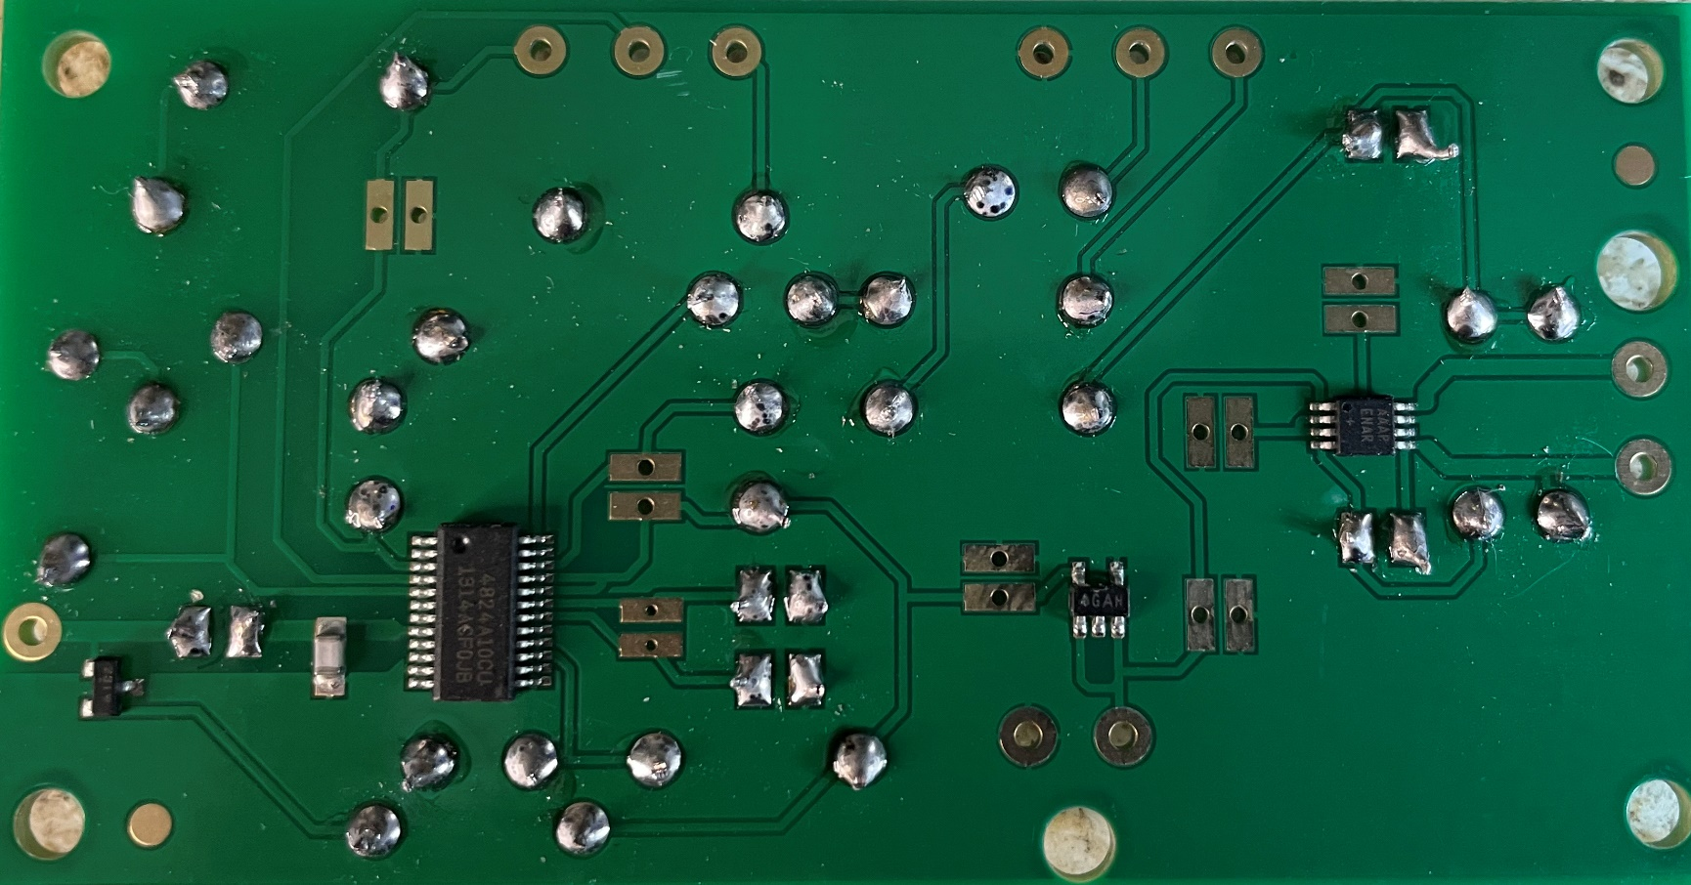
Step 4 – Soldering ceramic capacitors
⚠

Slide 13
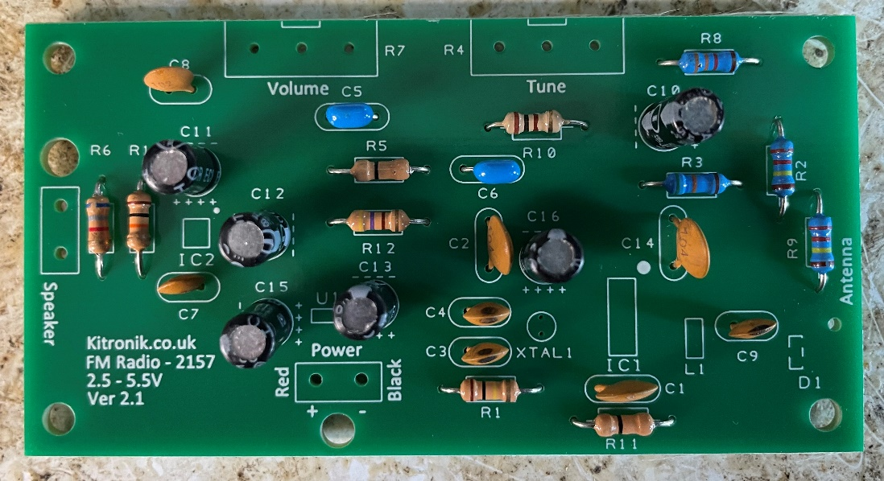
Step 5 – Mounting polarised capacitors
Place each polarised capacitor into the right part of the circuit board:
C10 – labelled 100 μF
C11, C12, C13, C15 & C16 – labelled 1 μF
Make sure you put the short legs in the holes labelled - , and the long legs in the holes labelled +
Notes:
This is a good opportunity to discuss the difference between components that are polarised, and those that are not.
Explain that polarised means that the capacitor has a positive (+) leg and a negative (-) leg and must be fitted the right way around on the PCB.
The PCB has labels showing which way round to put each one on the board itself.

Slide 14
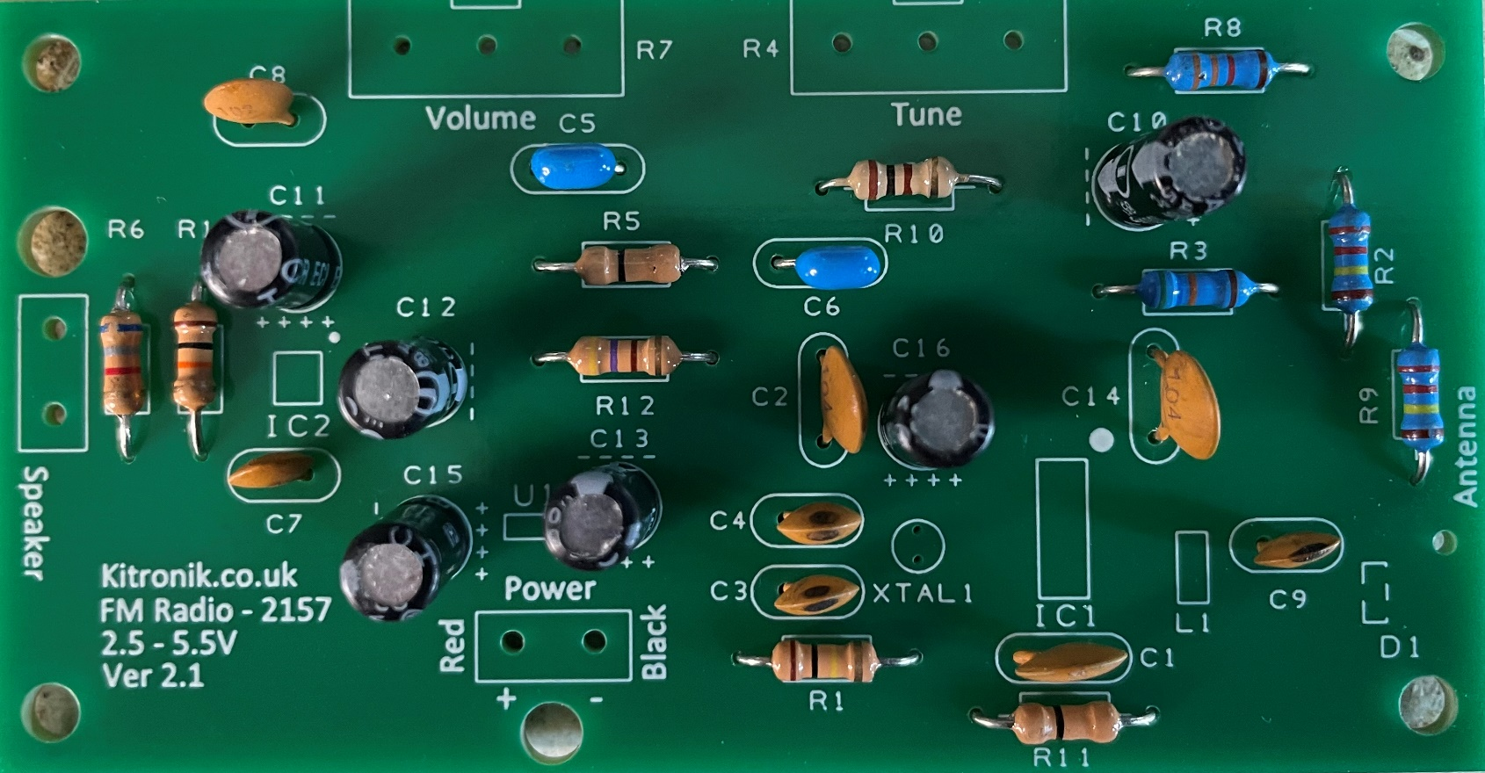
Step 5 – Mounting polarised capacitors
Notes:
This is a good opportunity to discuss the difference between components that are polarised, and those that are not.
Explain that polarised means that the capacitor has a positive (+) leg and a negative (-) leg and must be fitted the right way around on the PCB.
The PCB has labels showing which way round to put each one on the board itself.

Slide 15
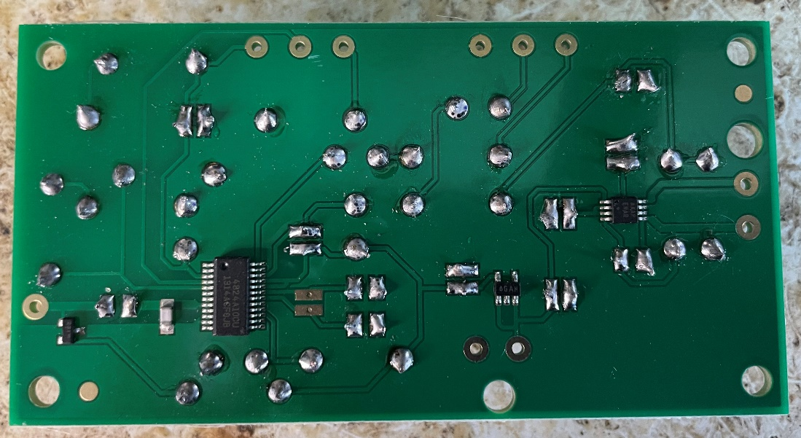
Step 6 – Soldering polarised capacitors
⚠
On the track side, solder the metal legs to the metal pads on the board
Be careful not to use too much solder
Use wire cutters to snip the ends off the legs when done

Slide 16
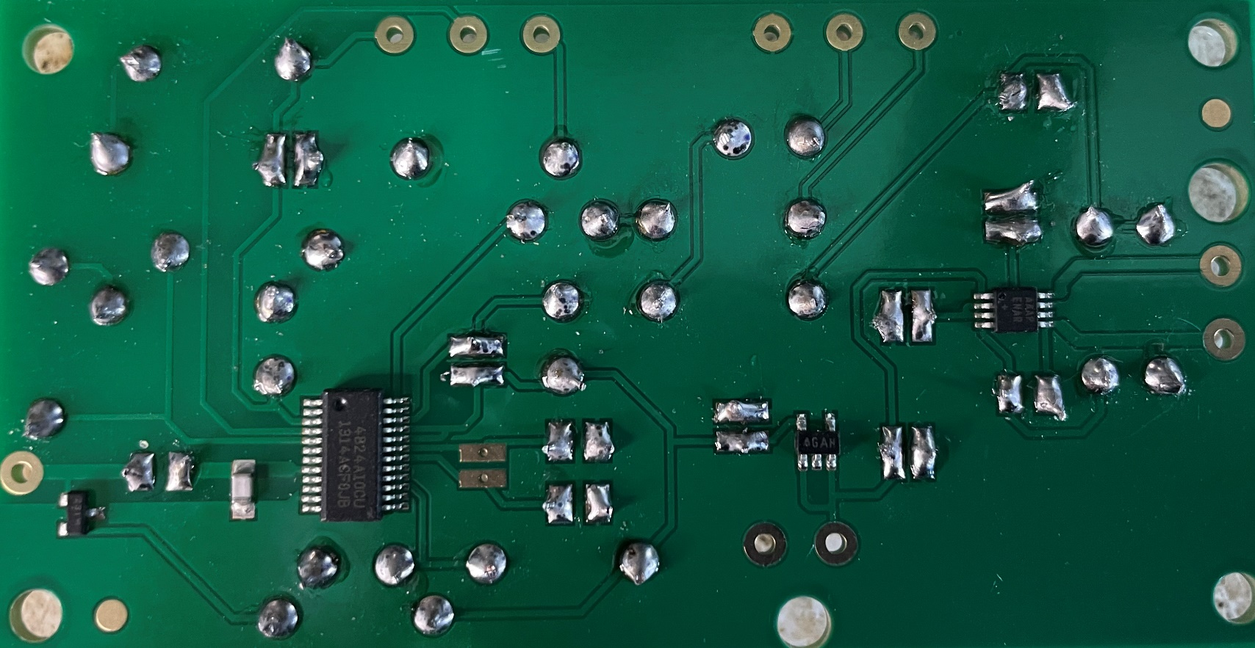
Step 6 – Soldering polarised capacitors
⚠

Slide 17
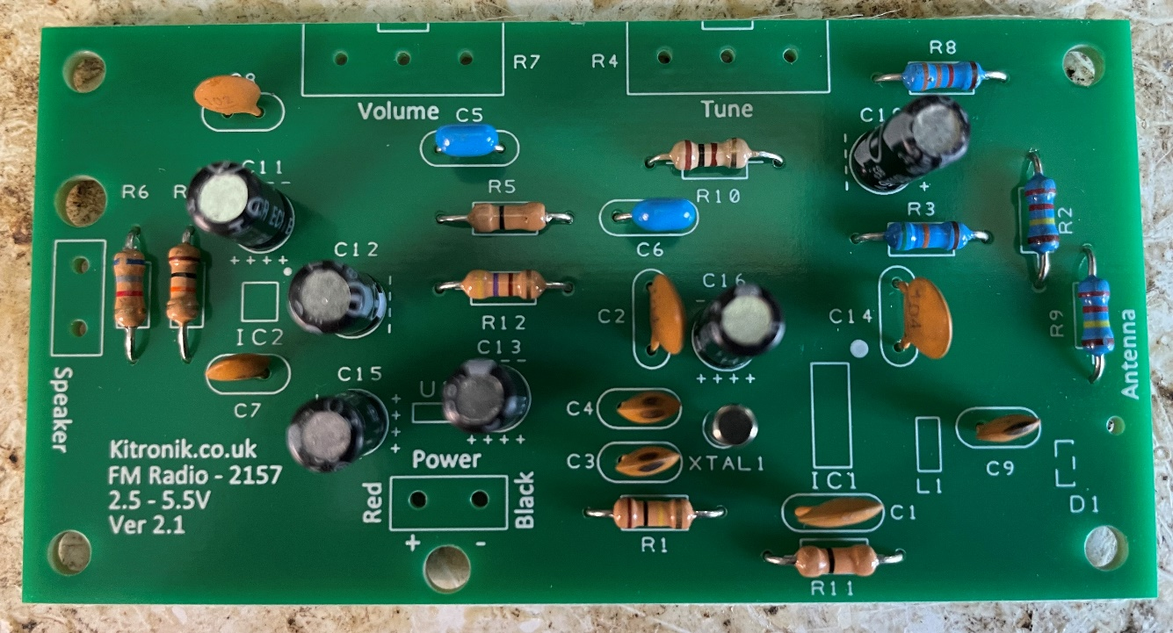
Step 7 – Mounting the timing crystal
Place the silver timing crystal into the part of the circuit board labelled XTAL1:

Slide 18
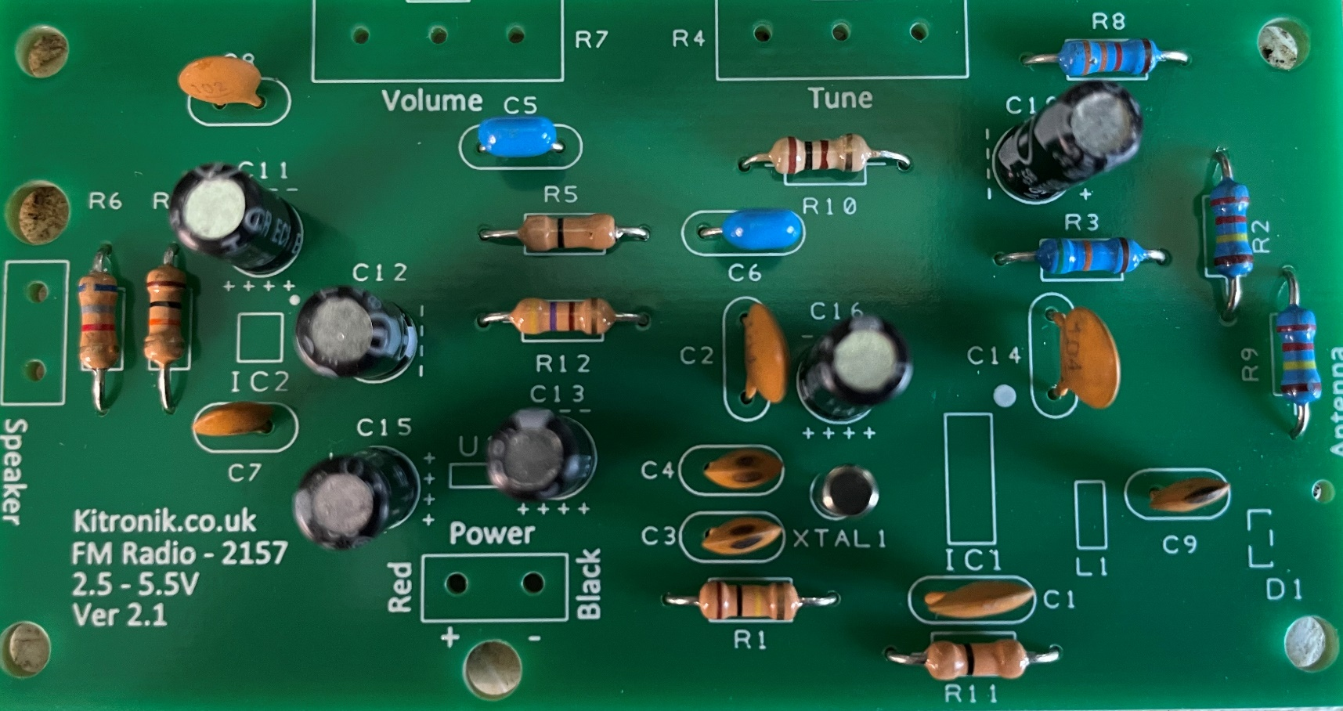
Step 7 – Mounting the timing crystal

Slide 19
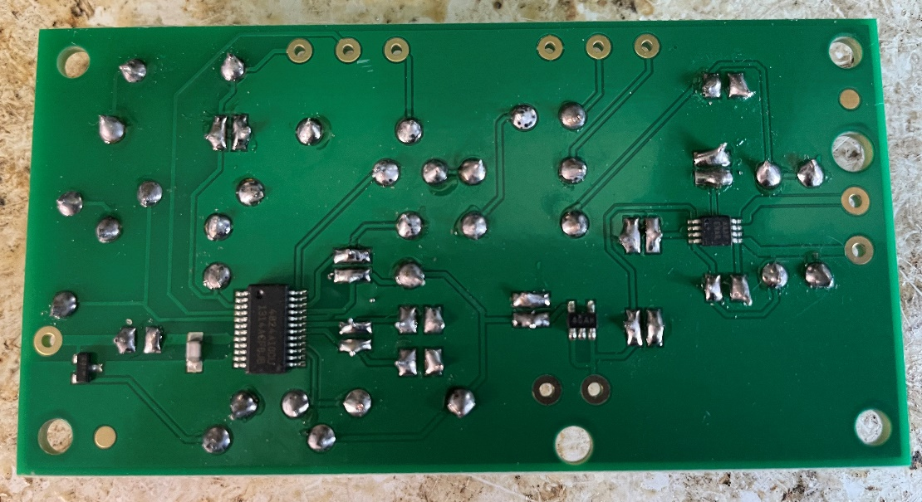
Step 8 – Soldering the timing crystal
⚠
On the track side, solder the metal legs to the metal pads on the board
Be careful not to use too much solder
Use wire cutters to snip the ends off the legs when done

Slide 20
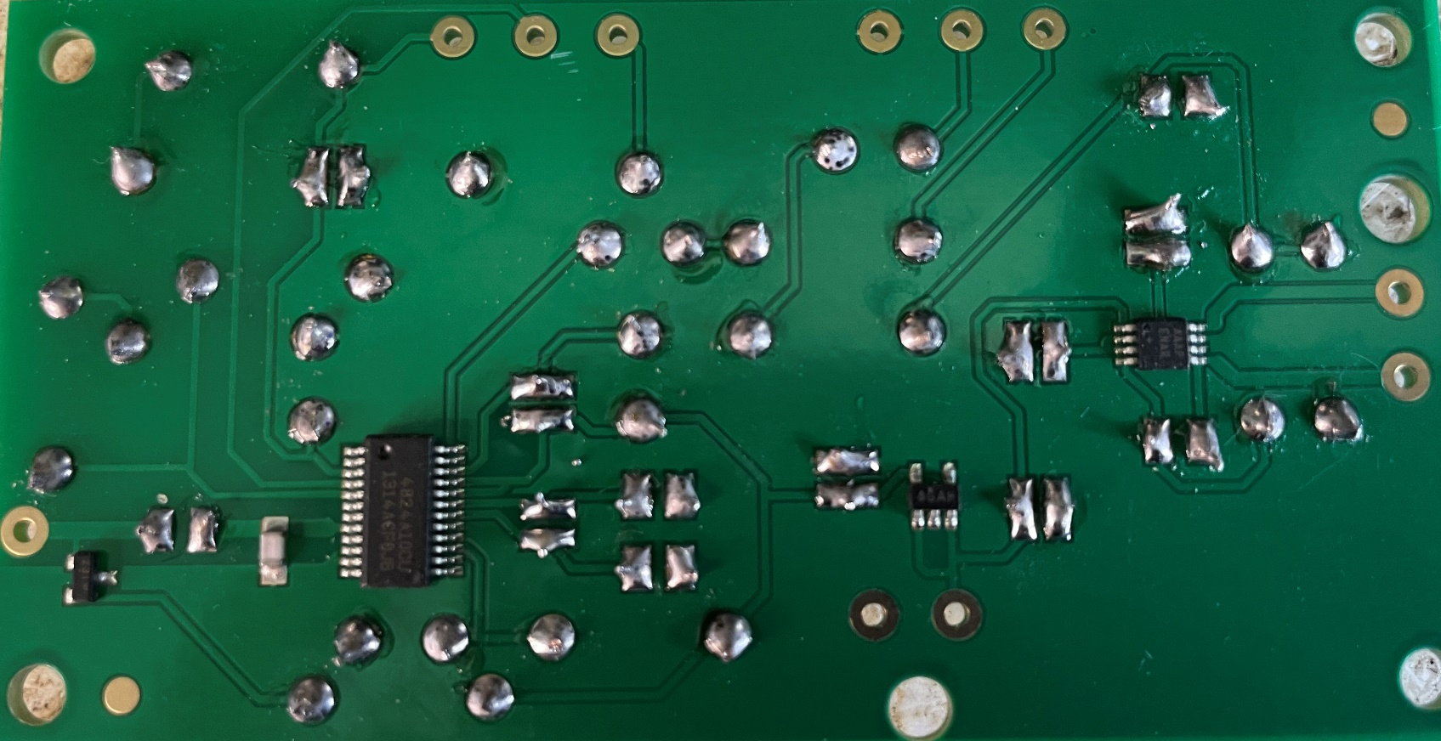
Step 8 – Soldering the timing crystal
⚠

Slide 21
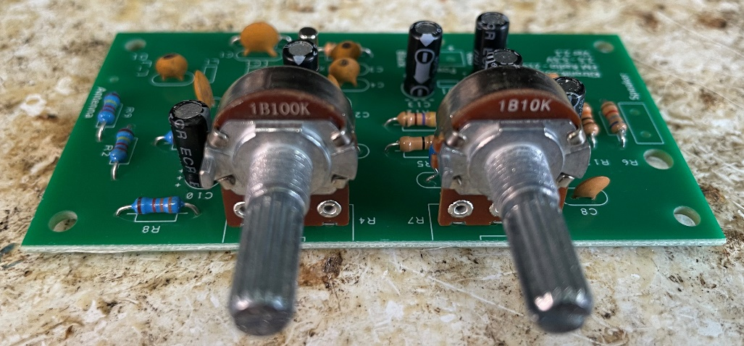
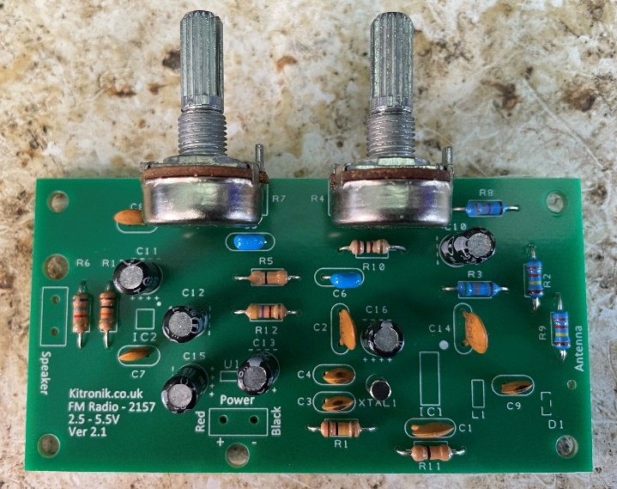
Step 9 – Mounting the potentiometers
Place the ‘volume’ and ‘tune’ potentiometers into the right parts of the circuit board:
R7 = Volume – labelled 10 k
R4 = Tune – labelled 100 k
Notes:
These are the controls for volume and tuning.

Slide 22

Step 9 – Mounting the potentiometers
Notes:
These are the controls for volume and tuning.

Slide 23
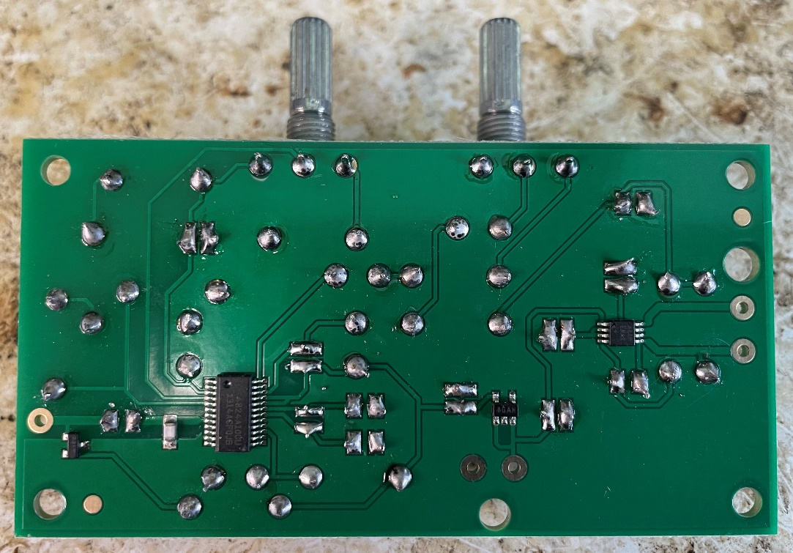
Step 10 – Soldering the potentiometers
⚠
On the track side, solder the metal legs to the metal pads on the board
Be careful not to use too much solder

Slide 24

Step 10 – Soldering the potentiometers
⚠

Slide 25
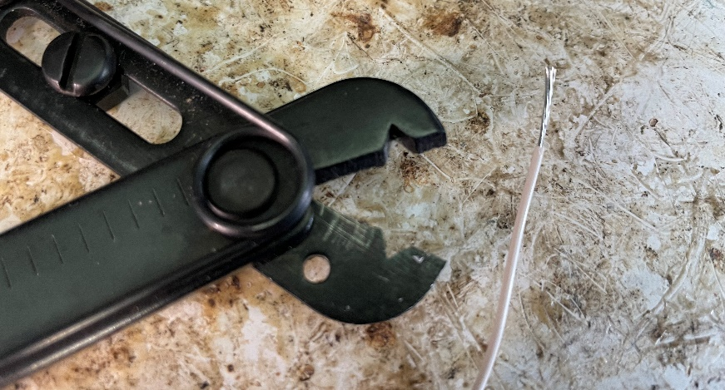
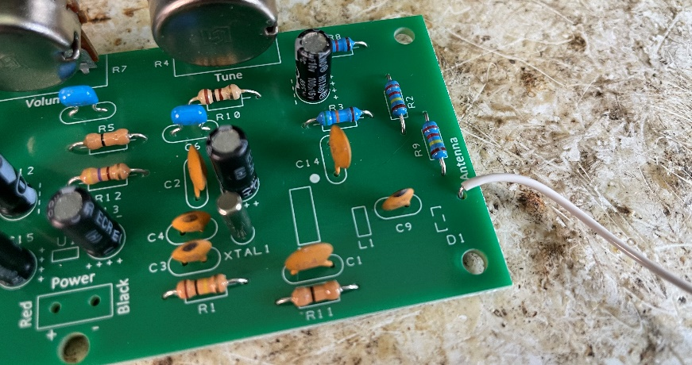
Step 11 – Adding the antenna
⚠
Cut a 600 mm long piece of wire
Strip the insulation off one end with wire strippers
Place this end into the hole on the PCB marked ‘antenna’
Solder on the other side of the board
Use wire cutters to snip the ends off the legs when done
Notes:
This will be the antenna that receives the radio signal.
Teacher could pre-cut and strip the wire to use for this to assist weaker learners or reduce the time needed.

Slide 26
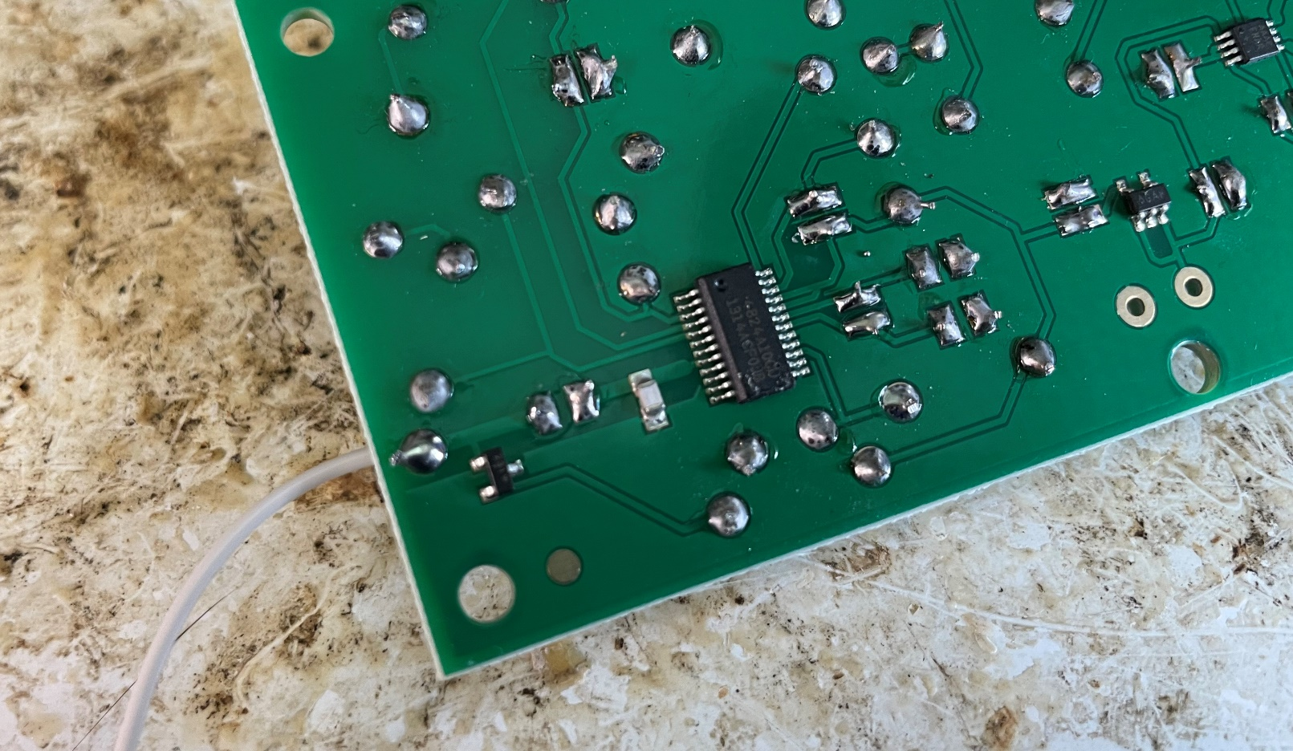
Step 11 – Adding the antenna
⚠
Notes:
This will be the antenna that receives the radio signal.
Teacher could pre-cut and strip the wire to use for this to assist weaker learners or reduce the time needed.

Slide 27
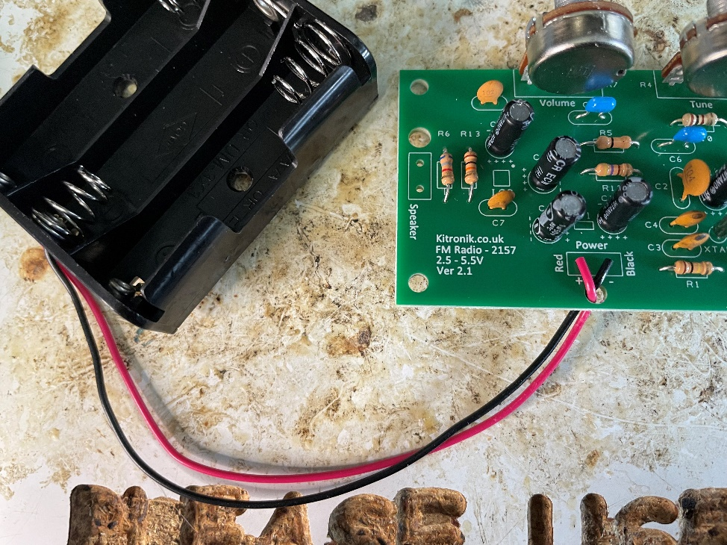
Step 12 – Adding the battery pack
⚠
Place both wires through the strain hole
Mount the red wire where it says ‘red’ on the PCB
Mount the black wire where it says ‘black’ on the PCB
Solder on the other side of the board
Use wire cutters to snip the ends off the legs when done
Notes:
Black is the negative battery wire (-).
Red is the positive battery wire (+).
Do not put the batteries into the battery pack at this stage.

Slide 28
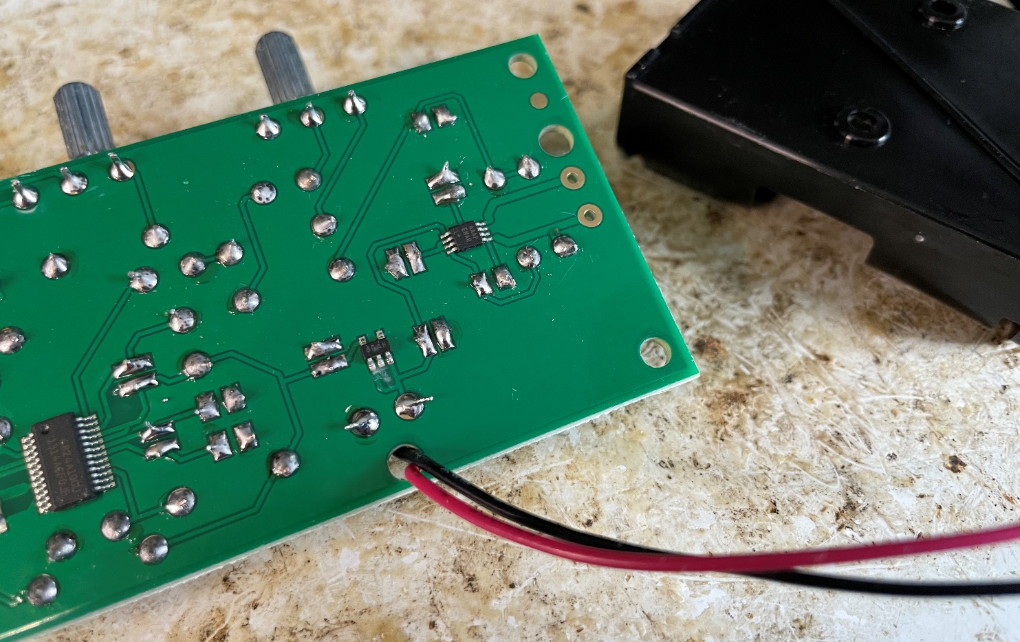
Step 12 – Adding the battery pack
⚠
Notes:
Black is the negative battery wire (-).
Red is the positive battery wire (+).
Do not put the batteries into the battery pack at this stage.

Slide 29
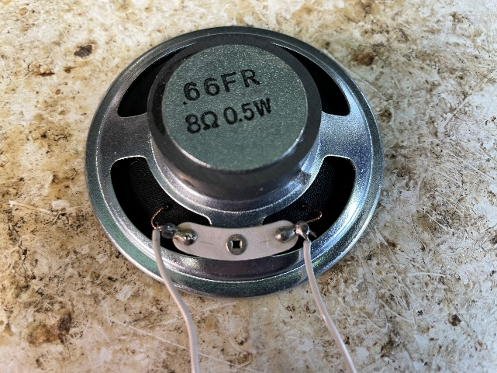
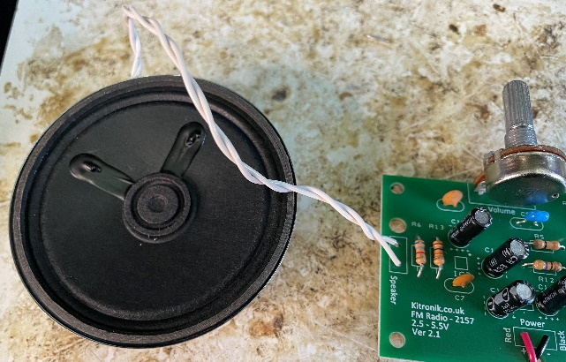
Step 13 – Adding the speakers
⚠
Cut and strip two wires for the speaker
Mount and solder one end of each wire to the speaker
Mount and solder the other end of each wire to the part of the PCB marked ‘speaker’
Use wire cutters to snip the ends off the legs when done
Notes:
Teacher could pre-cut and strip the wires to use for this to assist weaker learners or reduce the time needed.
Wires can be twisted together for a tidier finish.

Slide 30
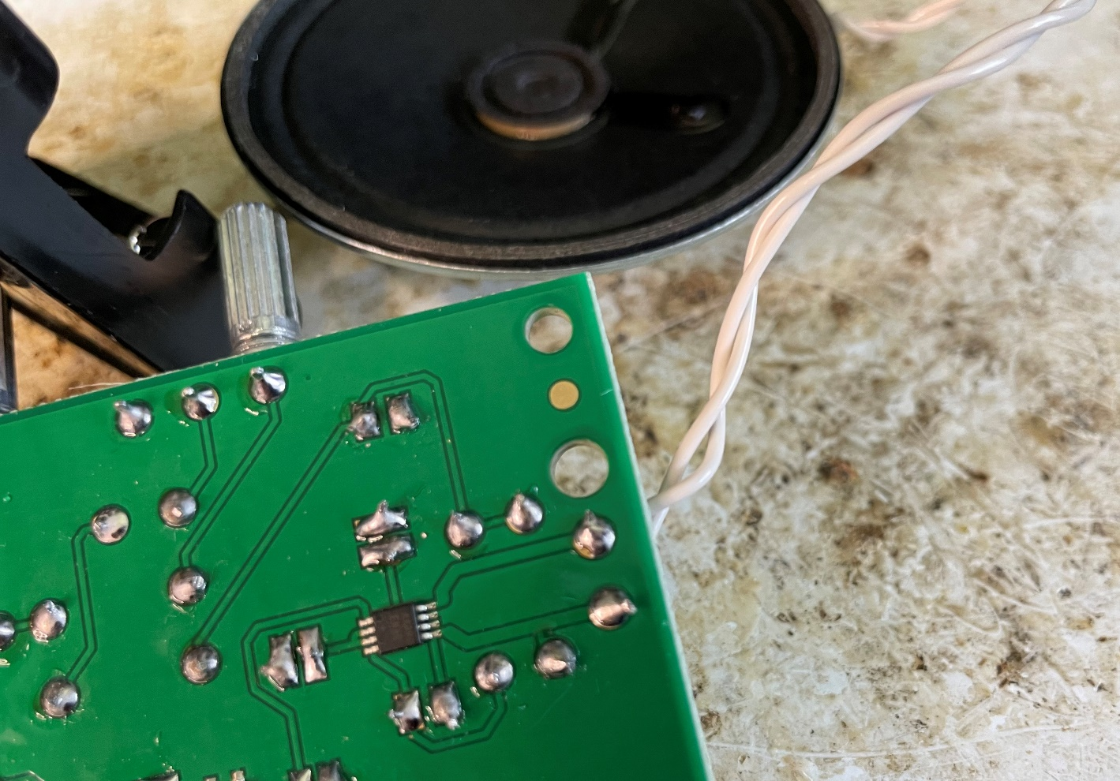
Step 13 – Adding the speakers
⚠
Notes:
Teacher could pre-cut and strip the wires to use for this to assist weaker learners or reduce the time needed.
Wires can be twisted together for a tidier finish.

Slide 31
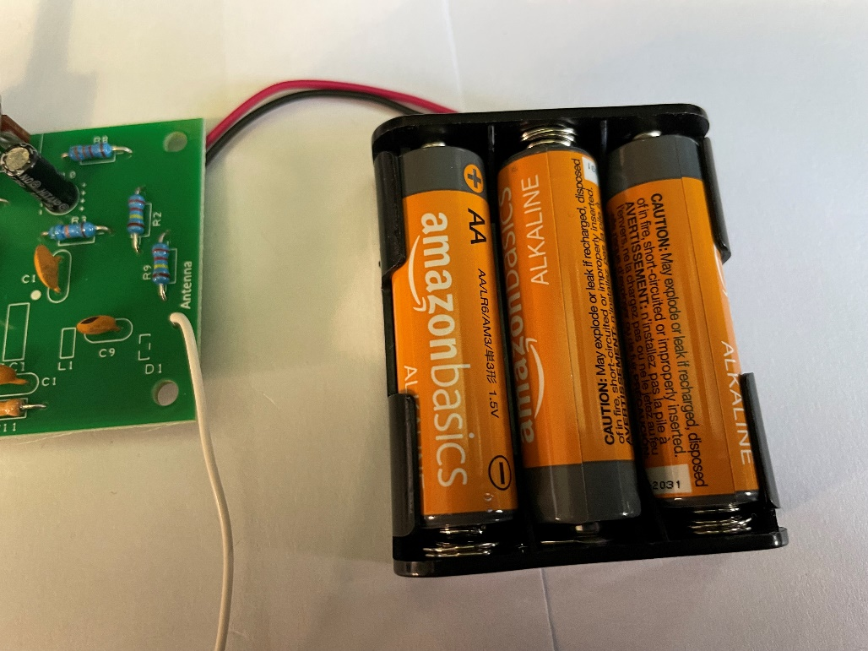
Step 14 – Testing
⚠
Put 3 AA batteries into the battery pack
Use the volume and tuning knobs to hear different radio stations playing
If the signal is poor, move the antenna around or try going outside
Notes:
Make sure the positive and negative ends of the batteries are the right way round in the battery pack.

Slide 32
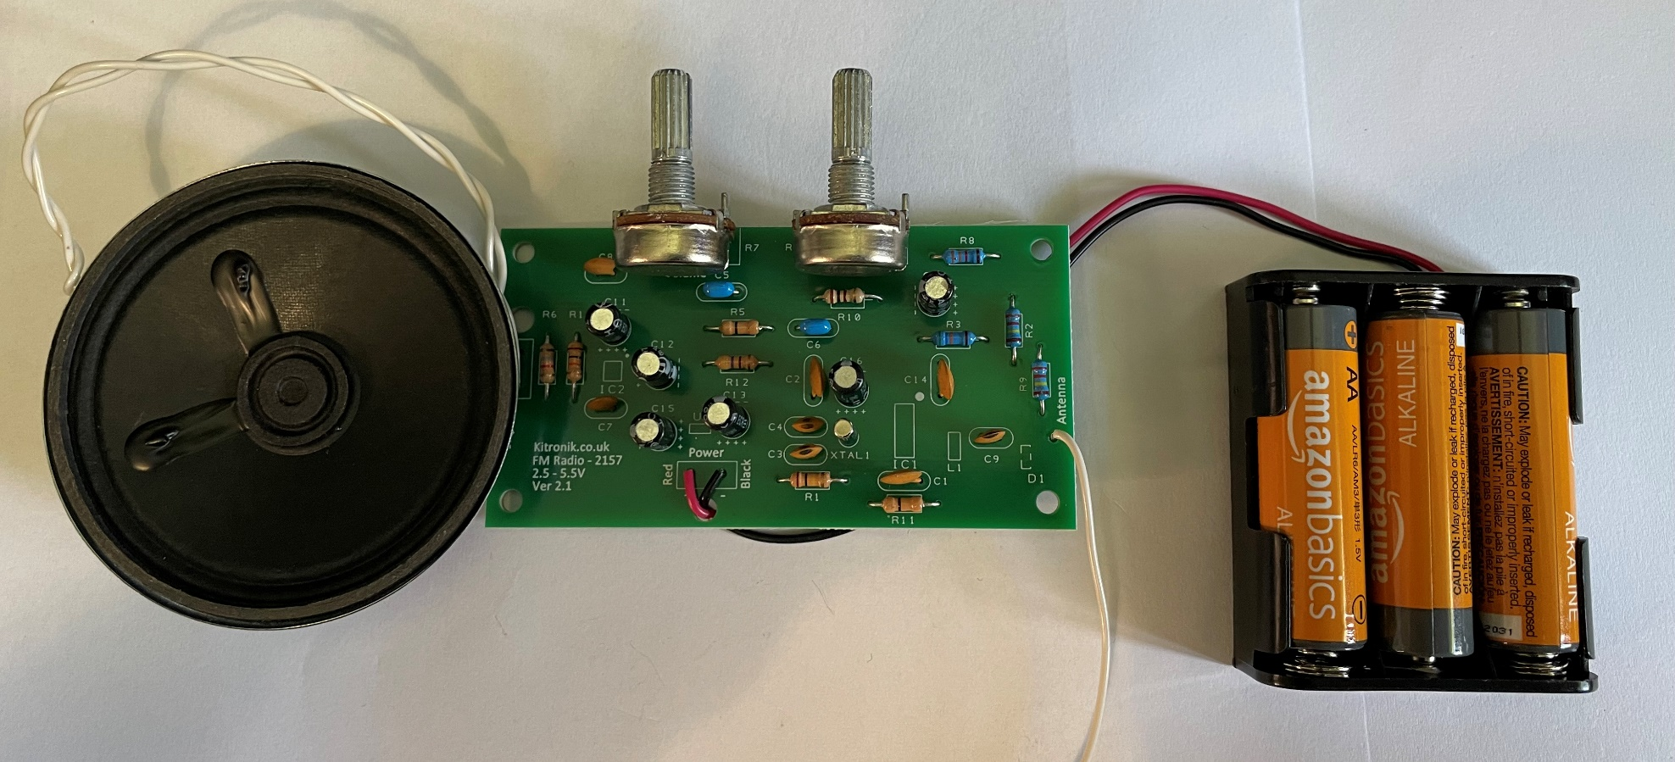
Finished example
Notes:
Show learners a finished physical example if possible and have this available to check against whilst they are making their own.

Slide 33
Extension
Design a casing for the radio circuit
Make a model of your casing in card
Design a carry case for the radio

