Slide 1
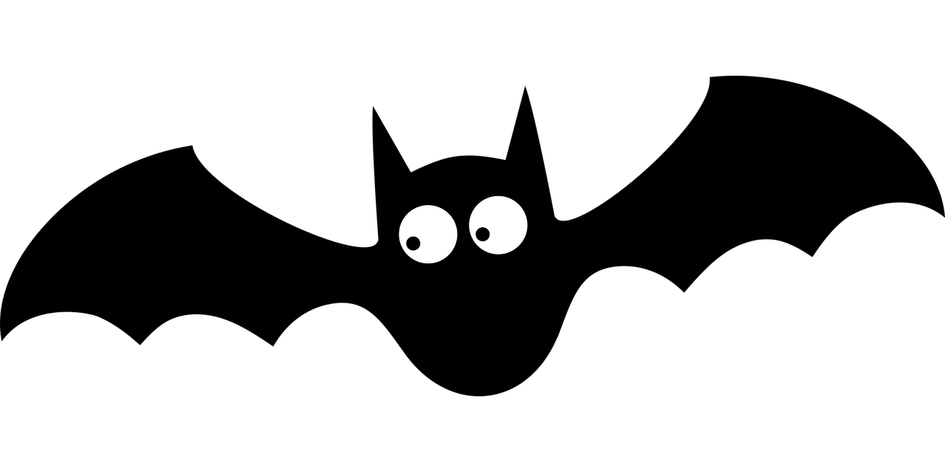
Make a flapping bat
Making a flapping bat for a Halloween decoration

Slide 2
Stay safe
Whether you are a scientist researching a new medicine or an engineer solving climate change, safety always comes first. An adult must always be around and supervising when doing this activity. You are responsible for:
ensuring that any equipment used for this activity is in good working condition
behaving sensibly and following any safety instructions so as not to hurt or injure yourself or others
Please note that in the absence of any negligence or other breach of duty by us, this activity is carried out at your own risk. It is important to take extra care at the stages marked with this symbol: ⚠
Notes:
Safety Warning

Slide 3
Where does Halloween come from?
Halloween is an old festival that dates back many centuries
First observed by the Scottish and Irish as ‘All Hallows Eve’, when it was believed the souls of the dead returned home
All Hallows Day is the 1st of November - it is a date that the Christian church uses to celebrate and honour the Saints of the church
So, All Hallows Eve is the 31st October, Halloween
Notes:
Explain the theme and origins of Halloween to learners.
Learners could be asked what they already know about Halloween and what they would like to learn about it during this activity.

Slide 4

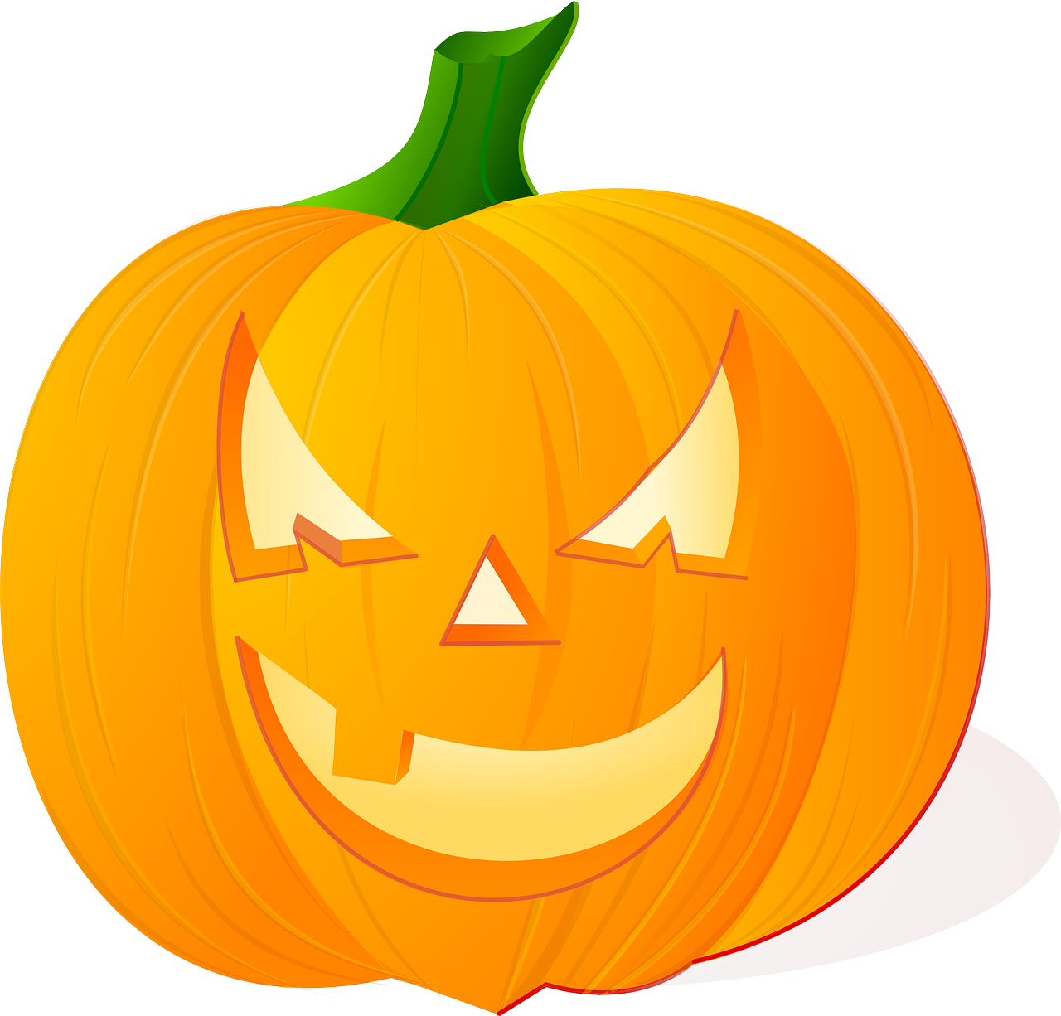
Halloween today
Halloween was taken to the United States of America when many families moved there in the 19th Century
It was then expanded to include ‘Trick or Treat’ and dressing up
Across the world, people now decorate their houses with Halloween decorations such as pumpkin lanterns, witches’ cauldrons, bats and spiders’ webs
Notes:
Explain the theme and origins of Halloween to learners.
Learners could be asked what they already know about Halloween and what they would like to learn about it during this activity.

Slide 5
Why bats?
Halloween is a time to pretend to be scared
Bats flap and fly fast
People used to think they were evil because they could ‘see’ in the dark
Now we know different - bats use a clever echo sounding system to tell them where objects are, and stop them flying into things

Slide 6
Equipment and Resources
⚠
Printed template
Good quality card (corrugated or grey card)
String
Small change, 1p or 2p pieces, washers or small weights
Scissors
Sticky tape
A stick to hold the bat
Black paint
Pencil
Googly eyes (optional)
Craft knife
Notes:
Take care when using sharp objects such as a craft knife and/or scissors.
Printed template can be found on slide 20.
The stick to hold the bat could be strung on a string across a room.

Slide 7
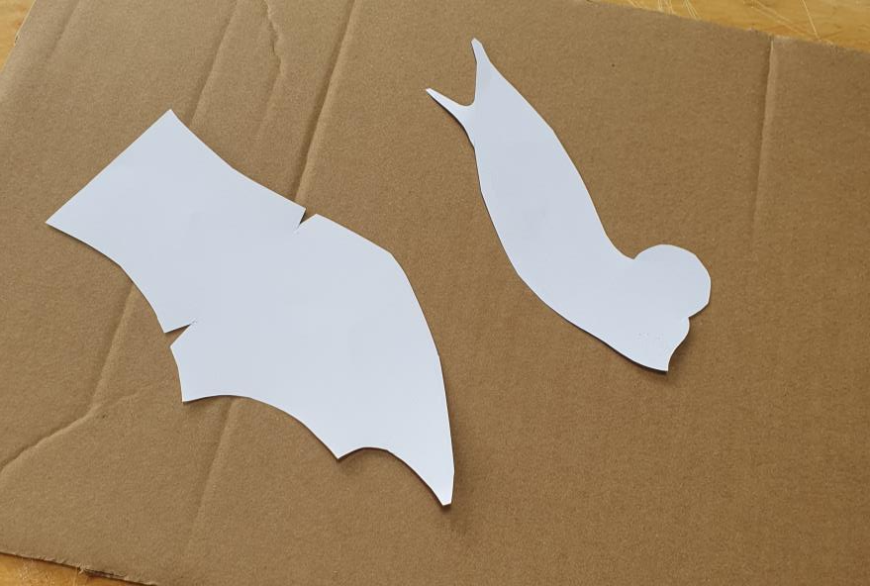
Step 1
⚠
Cut the shapes out of the template
Don’t forget that you will need two wings
Notes:
The template can be printed from slide 20.

Slide 8
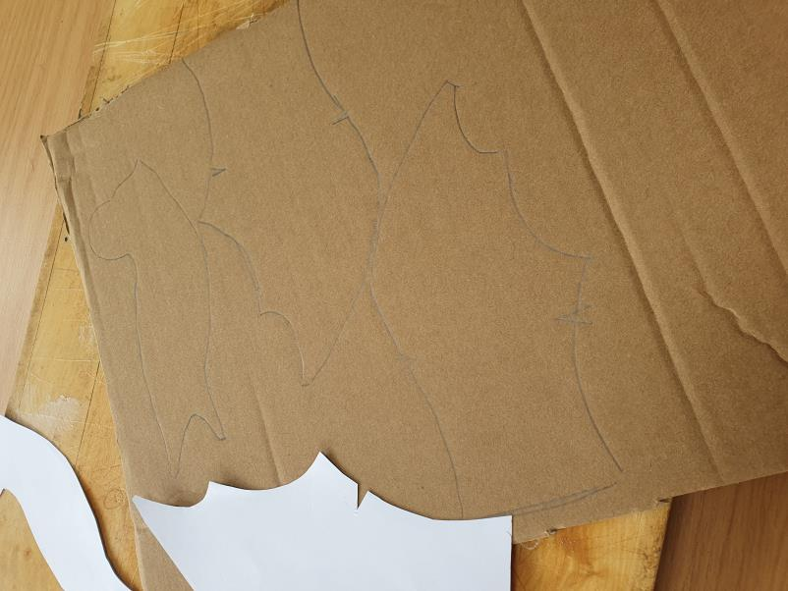
Step 2
Holding the templates still, draw round them onto the card or cardboard

Slide 9
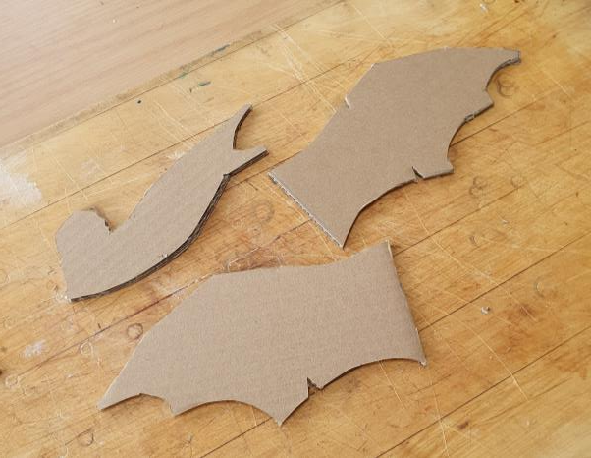
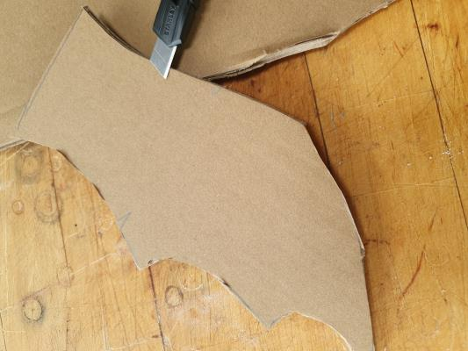
Step 3
⚠
Cut out your shapes, taking care to follow the line
If you are using a craft knife, be very careful and do your cutting on a tough surface, like an old chopping board

Slide 10
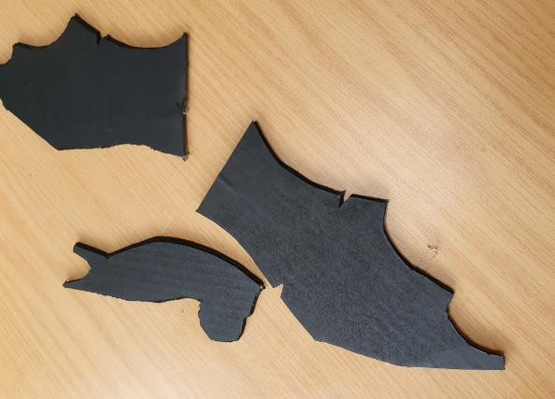
Step 4
⚠
Paint your shapes
Let the shapes dry before you put them together
Notes:
Matt black spray paint can be used but poster or acrylic paint will work well too.

Slide 11
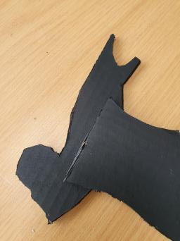
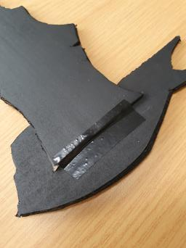
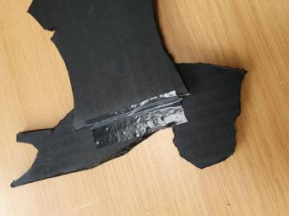
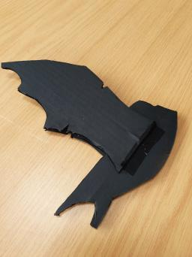
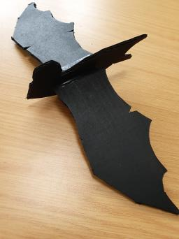
Step 5
Stick the wings onto the body, making sure they line up
The bases of the wings should follow a line like the one marked as dotted on the template
Fold the wings in the opposite direction and attach another piece of tape
Notes:
Black sticky tape is used here but clear tape would work well too.

Slide 12
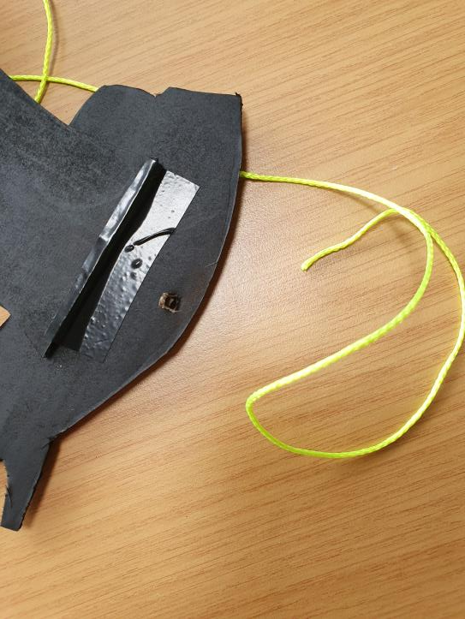
Step 6
⚠
Make a hole in the ‘chest’ of your bat
Use about 600 mm of string to loop through the hole
Tie at the top and make a loop at the bottom
Notes:
Very bright yellow string has been used here so it can be seen where to put the string, but it would be better to use black wool for the final display.

Slide 13
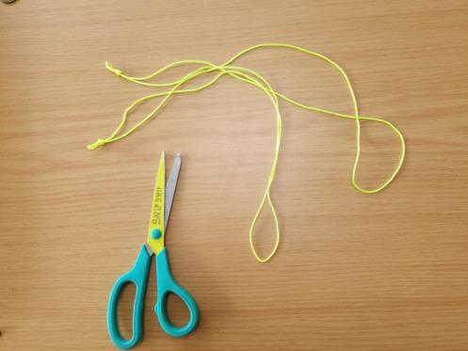
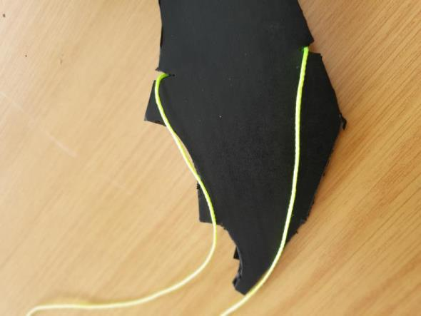
Step 7
⚠
Using the rest of the string, make two big loops (500 mm of string each) and loop them through the notches in the wings

Slide 14
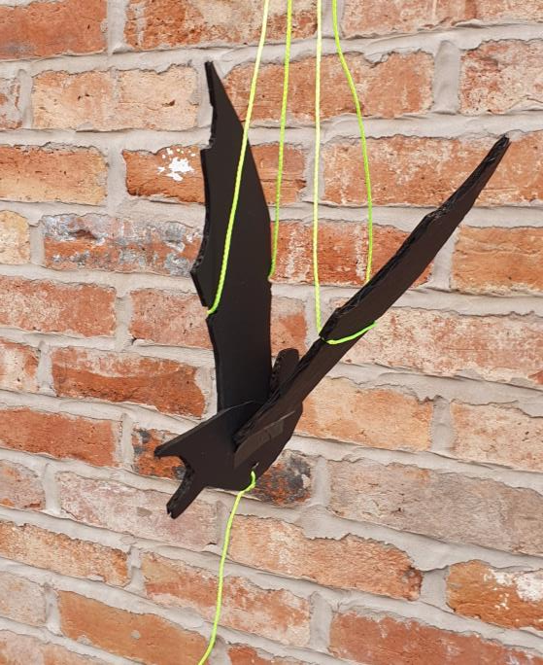
Testing 1
Thread the two loops onto a stick or tree branch
It will probably hang a little like this with its wings up and body hanging down
Gently pull and release the string attached to the body to make it flap the wings
It needs some weights to make it hang better and work more like a bat

Slide 15
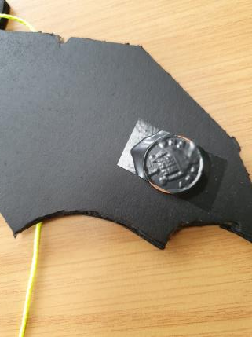
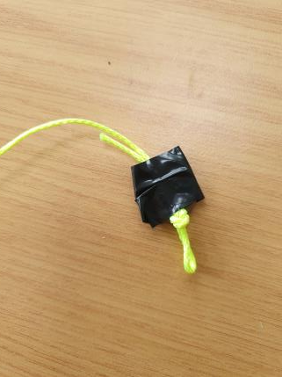
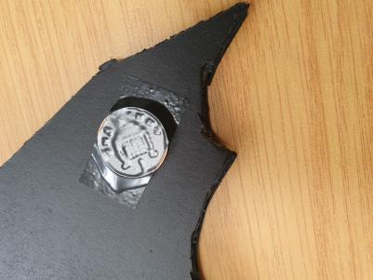
Step 8
There are two places to add weight:
  the tips of the wings
  and the end of the hanging loop
Use some sticky tape so you can move the weights around
Use pennies and 2p pieces or similar
Experiment as your bat might not be the same as everyone else’s

Slide 16
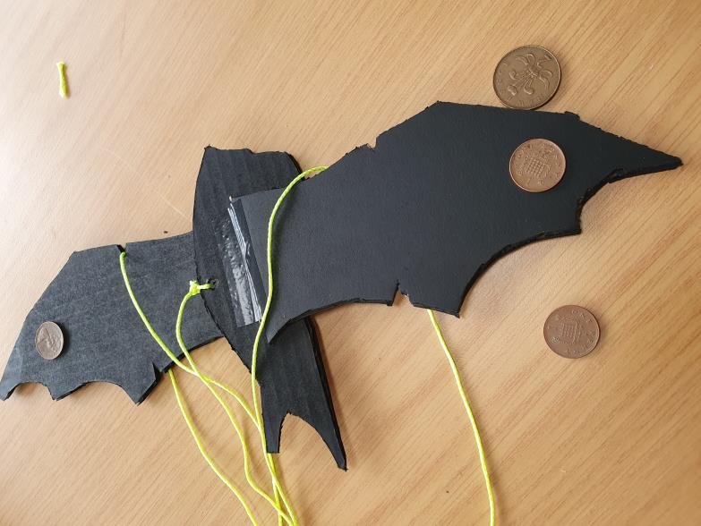
Step 8
This bat needed a penny on each wing, quite close to the ends, and a 2p at the end of the loop hanging down

Slide 17
Testing 2
Try the flapping bat again
You might have to adjust the weights by using 2p pieces instead of 1p pieces
You might have to move the weights on the wings further out or in
You might have to move the weights backwards or forwards
This sort of testing is used in industry all the time
It is called iterative testing, where you test, improve and retest several times
Notes:
This could be an opportunity to discuss what is meant by iterative design with learners.

Slide 18
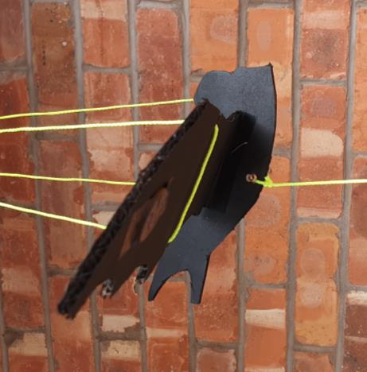
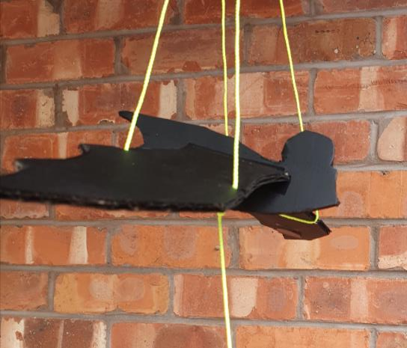
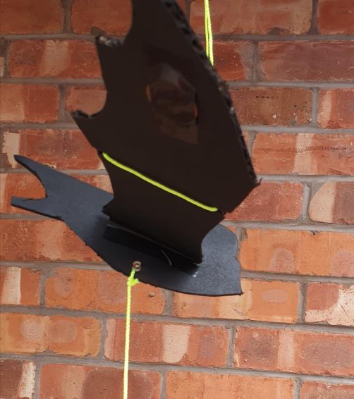
Finished Flapping bat
Add googly eyes or stickers to make your bat look special

Slide 19
Extension
Make another bat from thin painted plywood to make it more weatherproof
Cut out shapes to make another type of animal - for example, birds or pterodactyls
Research more about bats and how they act
Notes:
Learn more about bats at
https://www.bats.org.uk/about-bats
https://www.wildlifeonline.me.uk/questions/answer/what-should-i-do-if-i-find-an-injured-bat

Slide 20
Notes:
Template for cutting out the initial shapes.

Slide 21
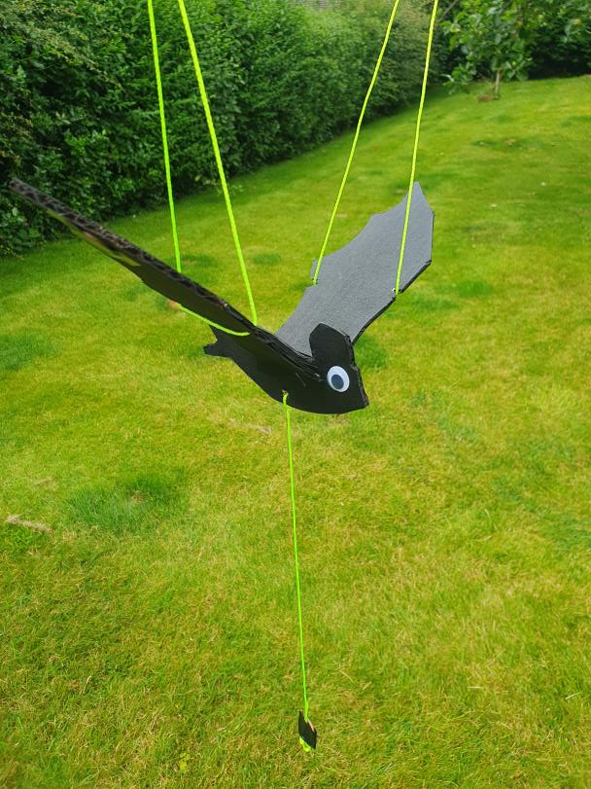
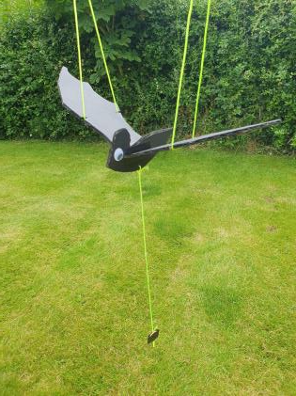
Notes:
Finished example in use.

