Slide 1
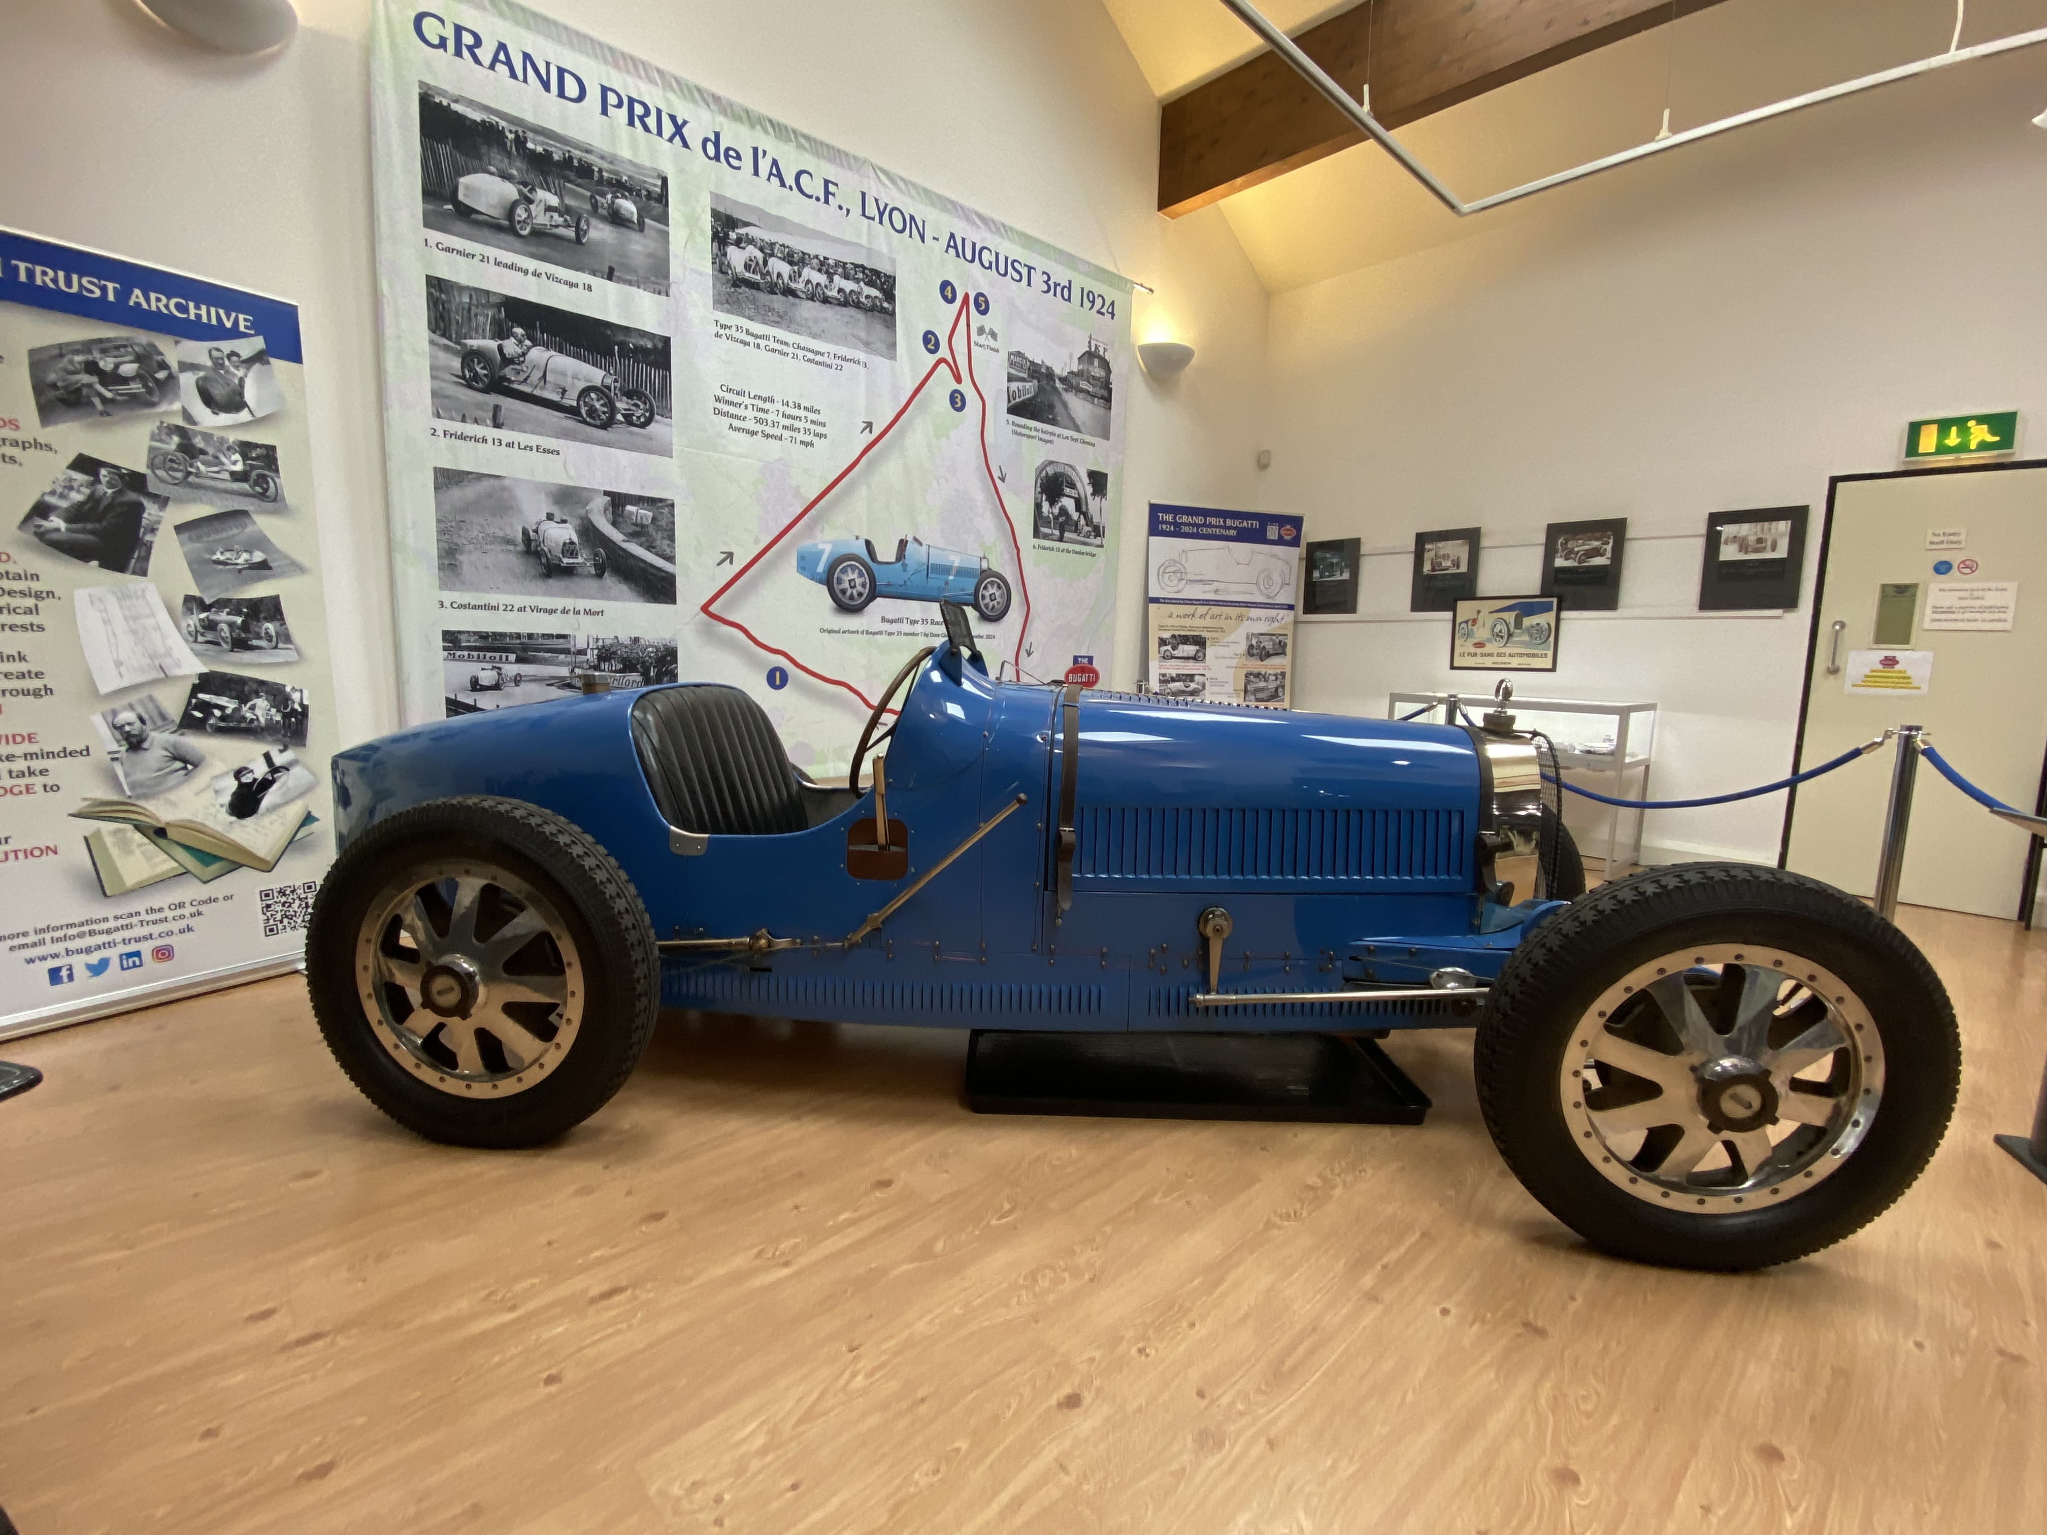
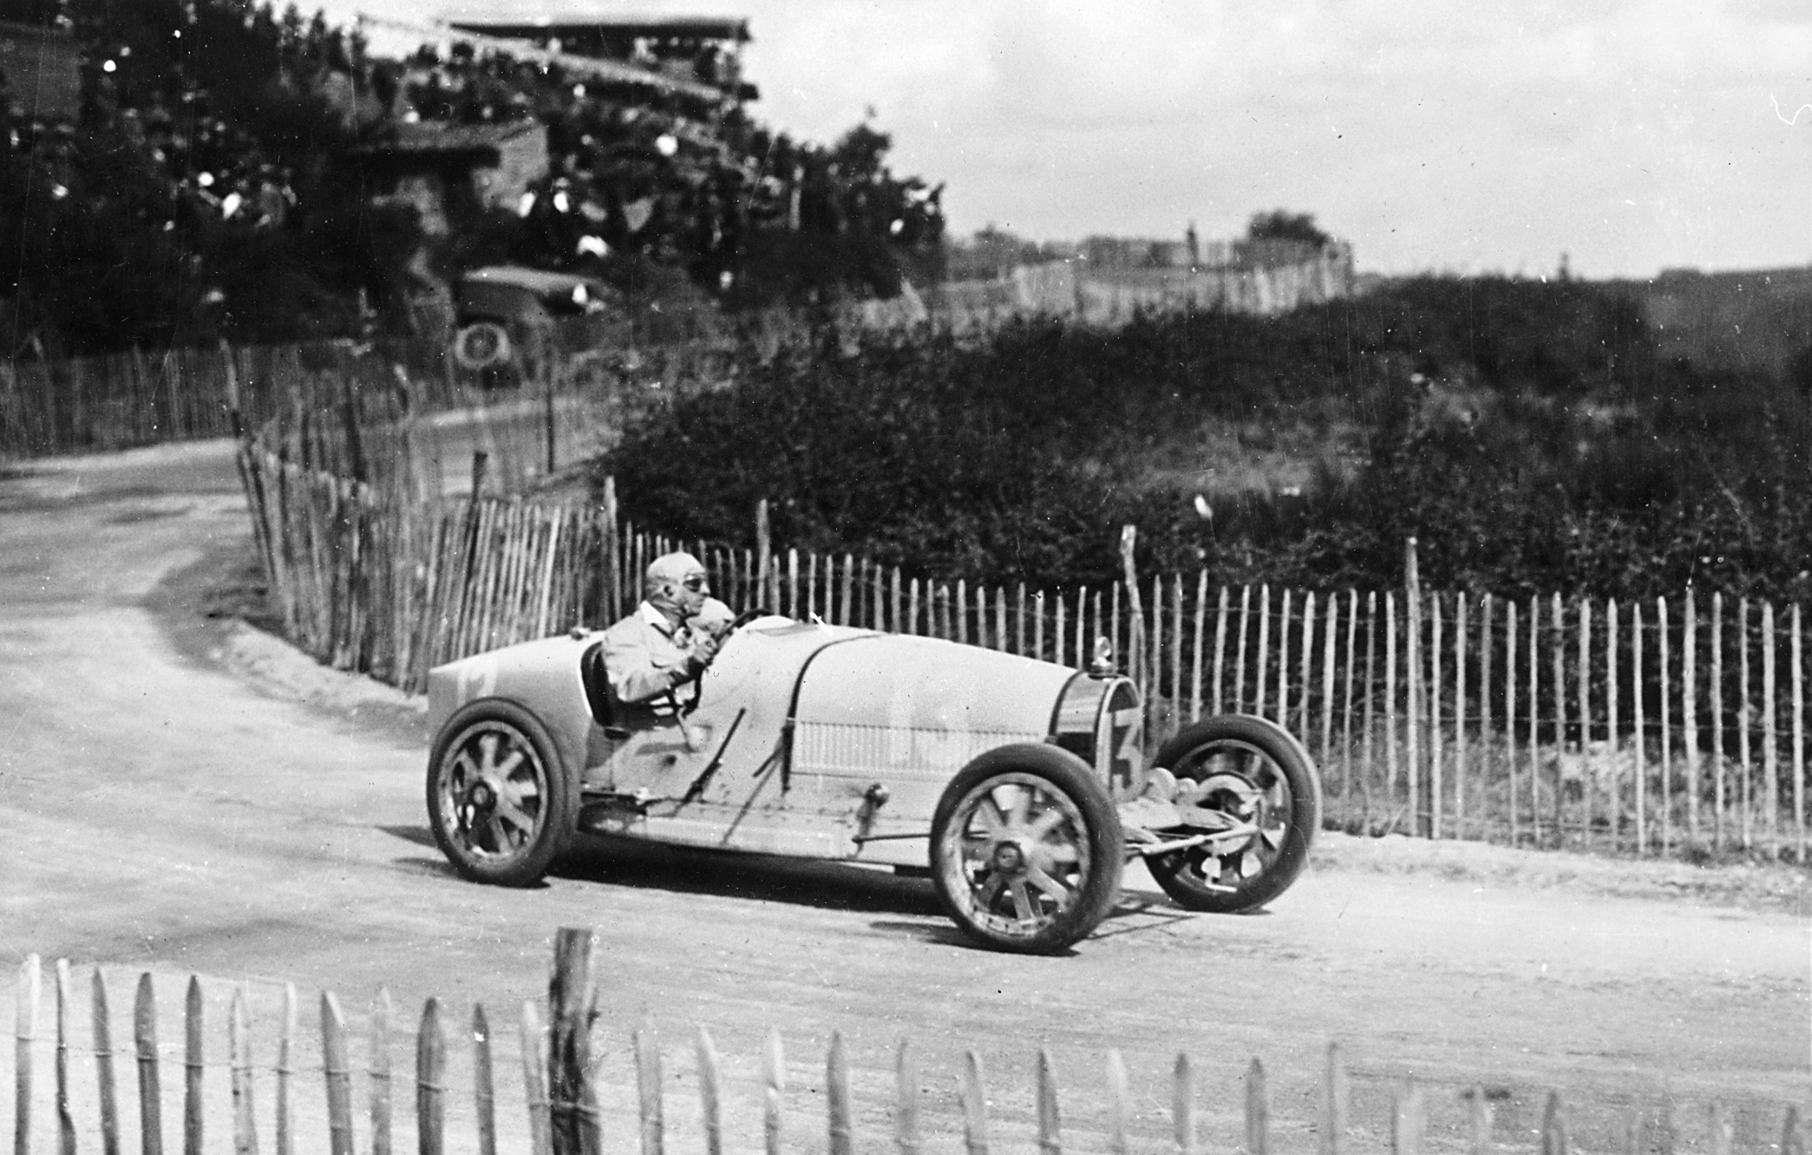
Bugatti – Speed and Distance
Bugatti Type 35 on loan from The National Motor
Museum Beaulieu
Bugatti Type 35 Photo: The Bugatti Trust Archives
Calculating the distance travelled by the Bugatti Type 35, and other cars, in a set time

Slide 2
Stay safe
Whether you are a scientist researching a new medicine or an engineer solving climate change, safety always comes first. An adult must always be around and supervising when doing this activity. You are responsible for:
ensuring that any equipment used for this activity is in good working condition
behaving sensibly and following any safety instructions so as not to hurt or injure yourself or others
Please note that in the absence of any negligence or other breach of duty by us, this activity is carried out at your own risk. It is important to take extra care at the stages marked with this symbol: ⚠
Notes:
Safety Warning

Slide 3
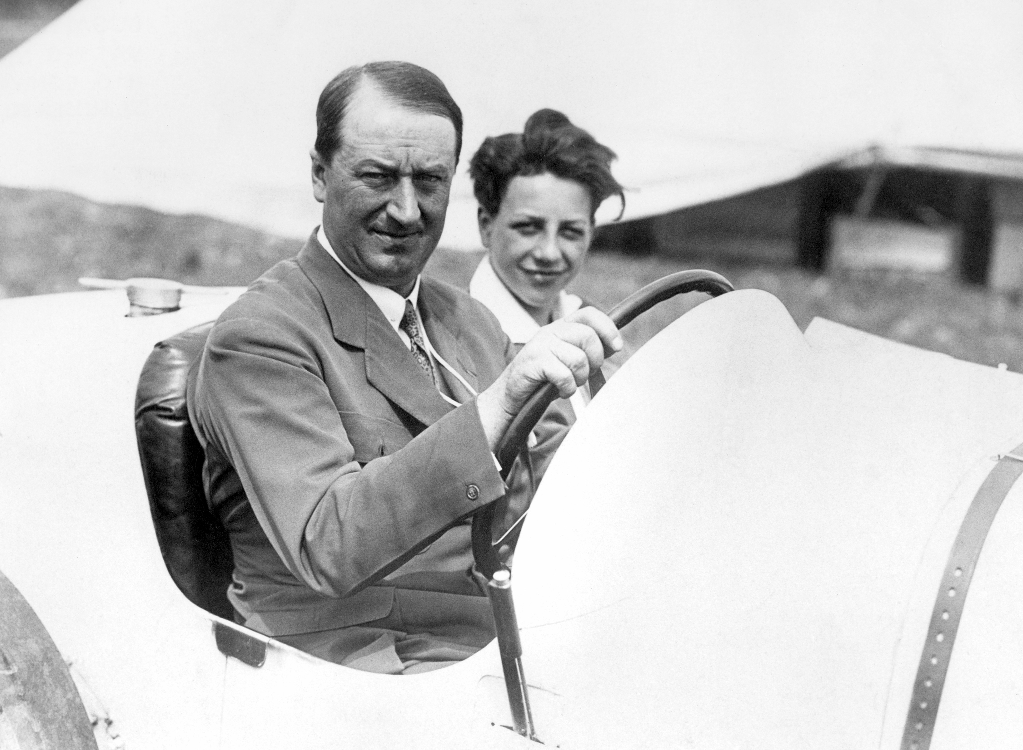
Ettore Bugatti
Ettore Bugatti was a famous designer, manufacturer and engineer
He was born in Italy, but received French citizenship in 1946
He is best known for his racing car designs and for forming Bugatti Automobiles
Ettore Bugatti with son Jean at the wheel
of a Bugatti Type 35, 1924.
Notes:
Discuss the designs and achievements of Ettore Bugatti with the class.
As a starter or additional main activity learners could use the internet to research the vehicles that he designed.
They could also produce a mood board of his designs.

Slide 4
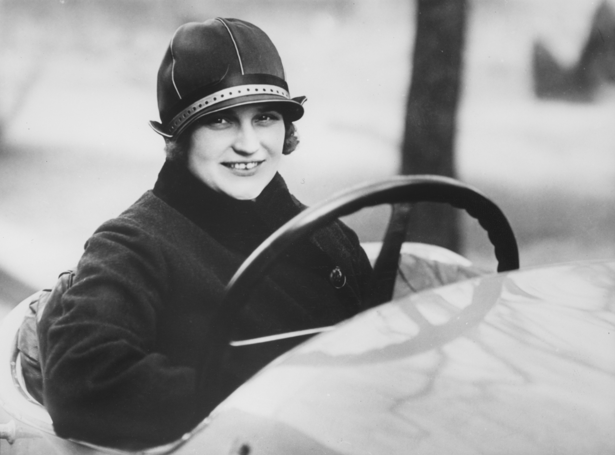
Elisabeth Junek
The most famous female racing driver of the 1920s, dubbed the ‘queen of the steering wheel’
Born in 1900 in the Czech Republic
Drove several Bugatti racing cars, including the Type 35B
In four years she mastered hill climbs, circuit racing and long-distance driving
Her biggest success was at the Targa Florio in Sicily, winning several prizes including best amateur performance
She is also credited for introducing the use of road books researching tracks and circuits before racing.
Notes:
Discuss the achievements of Elisabeth Junek with the class.
As a starter or additional main activity learners could use the internet to research her life in racing and her wider influence on females in motorsport.

Slide 5
Speed, Distance and Time
We can calculate the distance travelled by an object in a set time if we know its speed
Speed = Distance / Time
Or Distance = Speed x Time
Use the triangle to help – cover up the quantity that you want to work out
D
S
T
1 mph = 0.44704 m/s
Mph = Mile per hour m/s = metre per second

Slide 6

Example 1 – Distance walked in 0.5 seconds
If we want to calculate the distance travelled by walking for 0.5 seconds:
Normal walking speed is about 3 miles per hour (mph) = 1.341 metres per second (m/s)
Distance = Speed x Time
Distance = 1.341 m/s x 0.5 seconds
Distance = 0.671 metres to 3dp
Notes:
1 mph = 0.44704 m/s

Slide 7
Example 2 – Bugatti 1924 Type 35
If we want to calculate the distance travelled in 0.5 seconds at top speed:
Top speed of 118 mph = 52.7507 m/s
Distance = Speed x Time
Distance = 52.7507 m/s x 0.5 seconds
Distance = 26.375 metres to 3dp
Notes:
1 mph = 0.44704 m/s
This car was one of the vehicles driven by Elisabeth Junek.
It is believed that the 1924 Type 35 Bugatti had a top speed of 90-100 mph, possibly up to 118 mph with some attention.
This and subsequent questions in this presentation assume that the vehicles are starting the time period having already reached their stop speed.

Slide 8
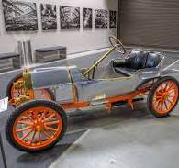
Your tasks
The next few slides show different Bugatti vehicles in order of when they were designed
Calculate the distance travelled by each vehicle in a time of 0.5 seconds at top speed
Other questions to think about:
What is the relationship of weight to top speed?
How fast did these ideas develop and what factors were influential?
Notes:
1 mph = 0.44704 m/s
Discuss the relationship of weight to top speed.
Discuss the pace of development and the factors that were influential.

Slide 9
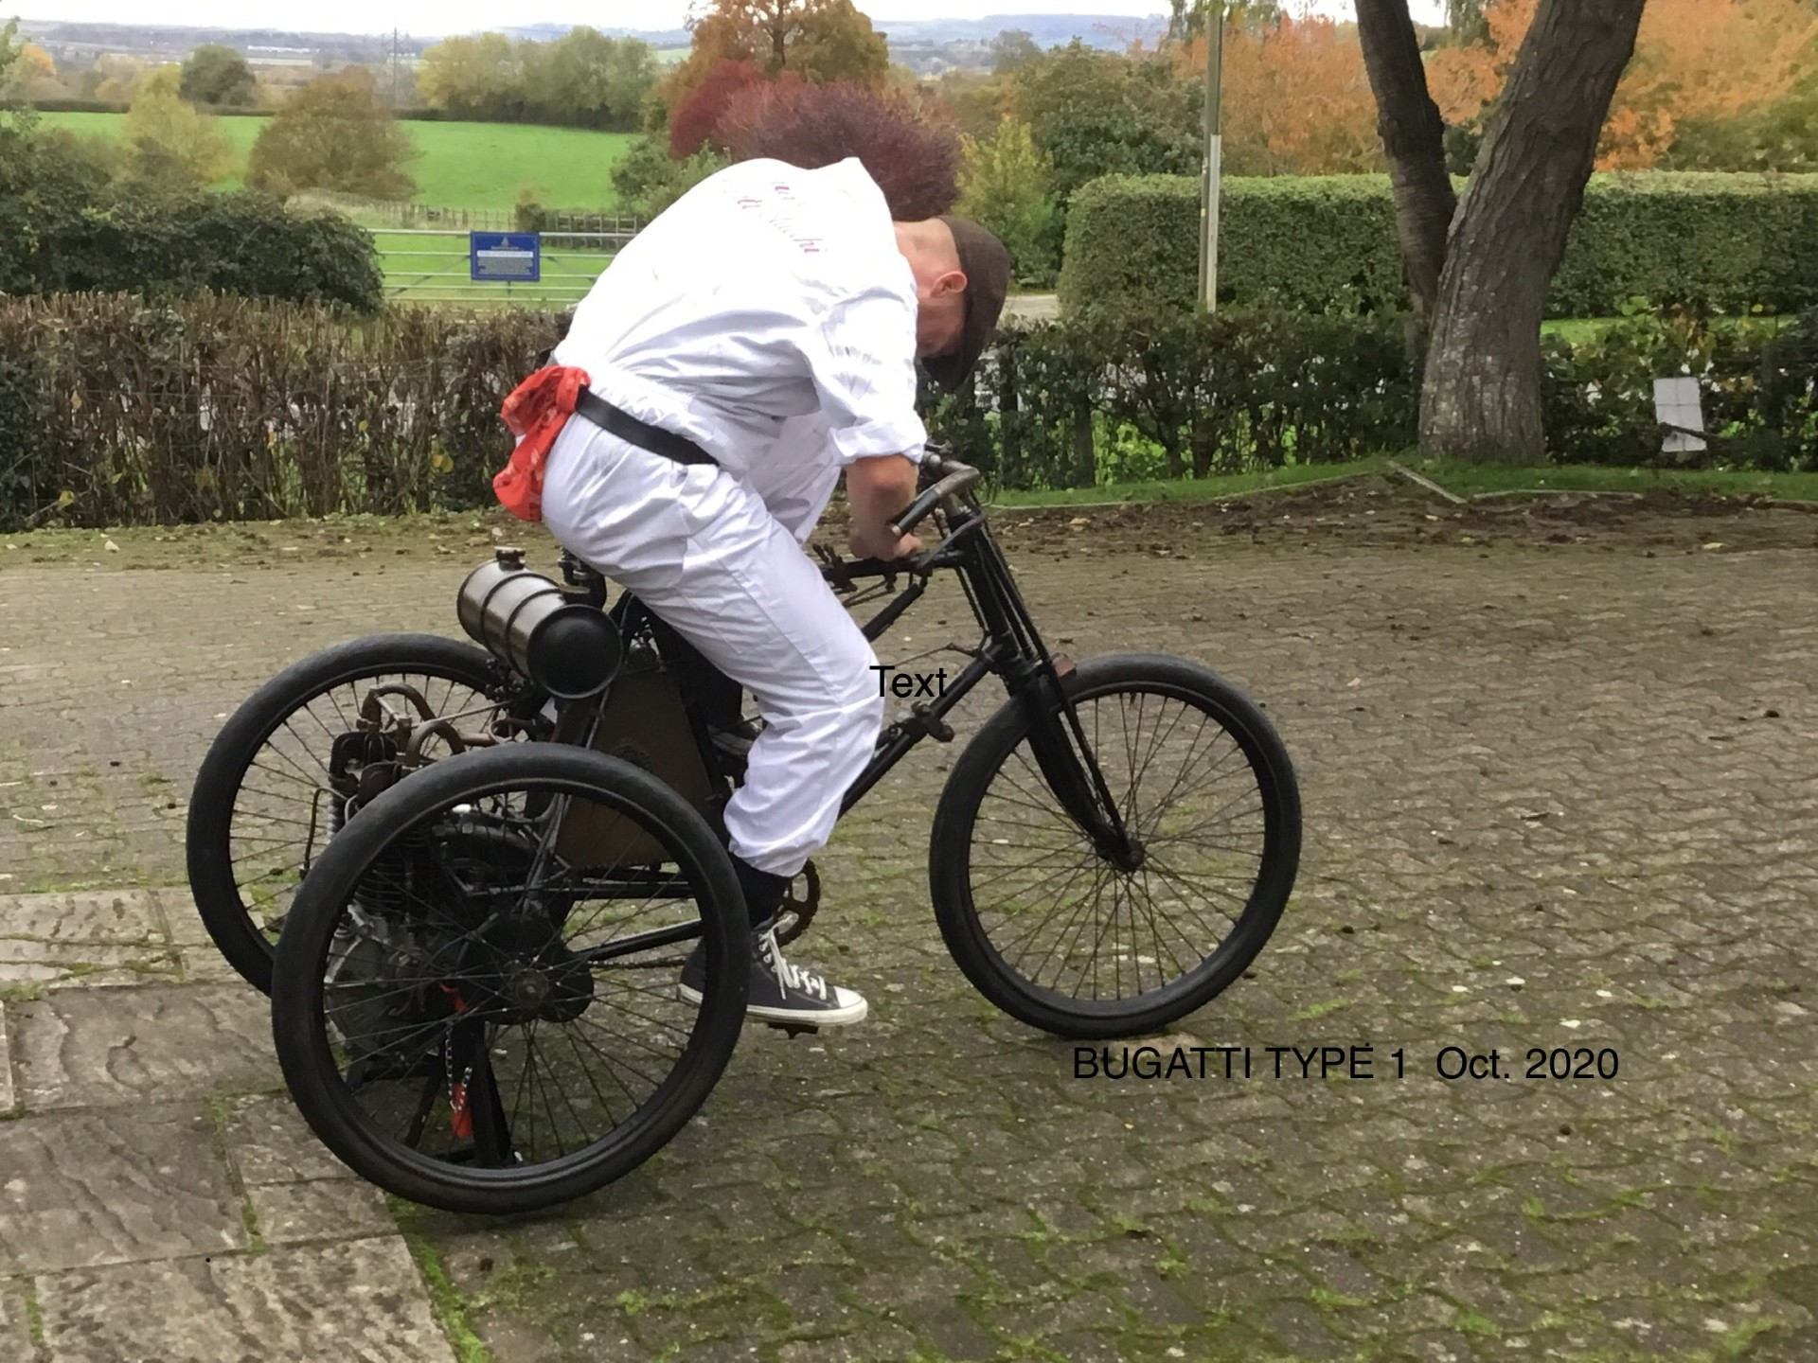
1899 Prinetti & Stucchi Tricycle designed by Bugatti
The first vehicle designed by Bugatti
2 cylinder engine
Top speed of 75 mph (33.528 m/s) on dirt roads (tarmac roads did not appear until 1902)
Where are the brakes?!
Notes:
1 mph = 0.44704 m/s, so 75 mph = 33.528 m/s
Distance travelled = 16.764 m (0.0104 Miles)
Discuss the relationship of weight to top speed.
Discuss the pace of development and the factors that were influential.

Slide 10
1909 Bugatti Type 10
The first car made by Bugatti in his own factory
22 brake horsepower (bhp) or 21.7 HP (horsepower)
Top speed of 47 mph (21.0109 m/s)
No front brakes
Notes:
1 mph = 0.44704 m/s, so 47 mph = 21.0109 m/s
Distance travelled = 10.505 m (0.0065 Miles)
Discuss the relationship of weight to top speed.
Discuss the pace of development and the factors that were influential.

Slide 11
1924 Bugatti Type 35
2 litre engine (0.4399 Imp. Gallons)
90 bhp (88.77 HP) then later models up to 130bhp (128.222 HP)
Weight 750 kg (117st 15.43lb)
Top speed of 90 mph (40.2336 m/s)
A modern Vauxhall Astra has about the same bhp, but weighs a lot more and is faster
Notes:
1 mph = 0.44704 m/s, so 90 mph = 40.2336 m/s
Distance travelled = 20.117 m (0.0125 Miles)
Discuss the relationship of weight to top speed.
Discuss the pace of development and the factors that were influential.

Slide 12
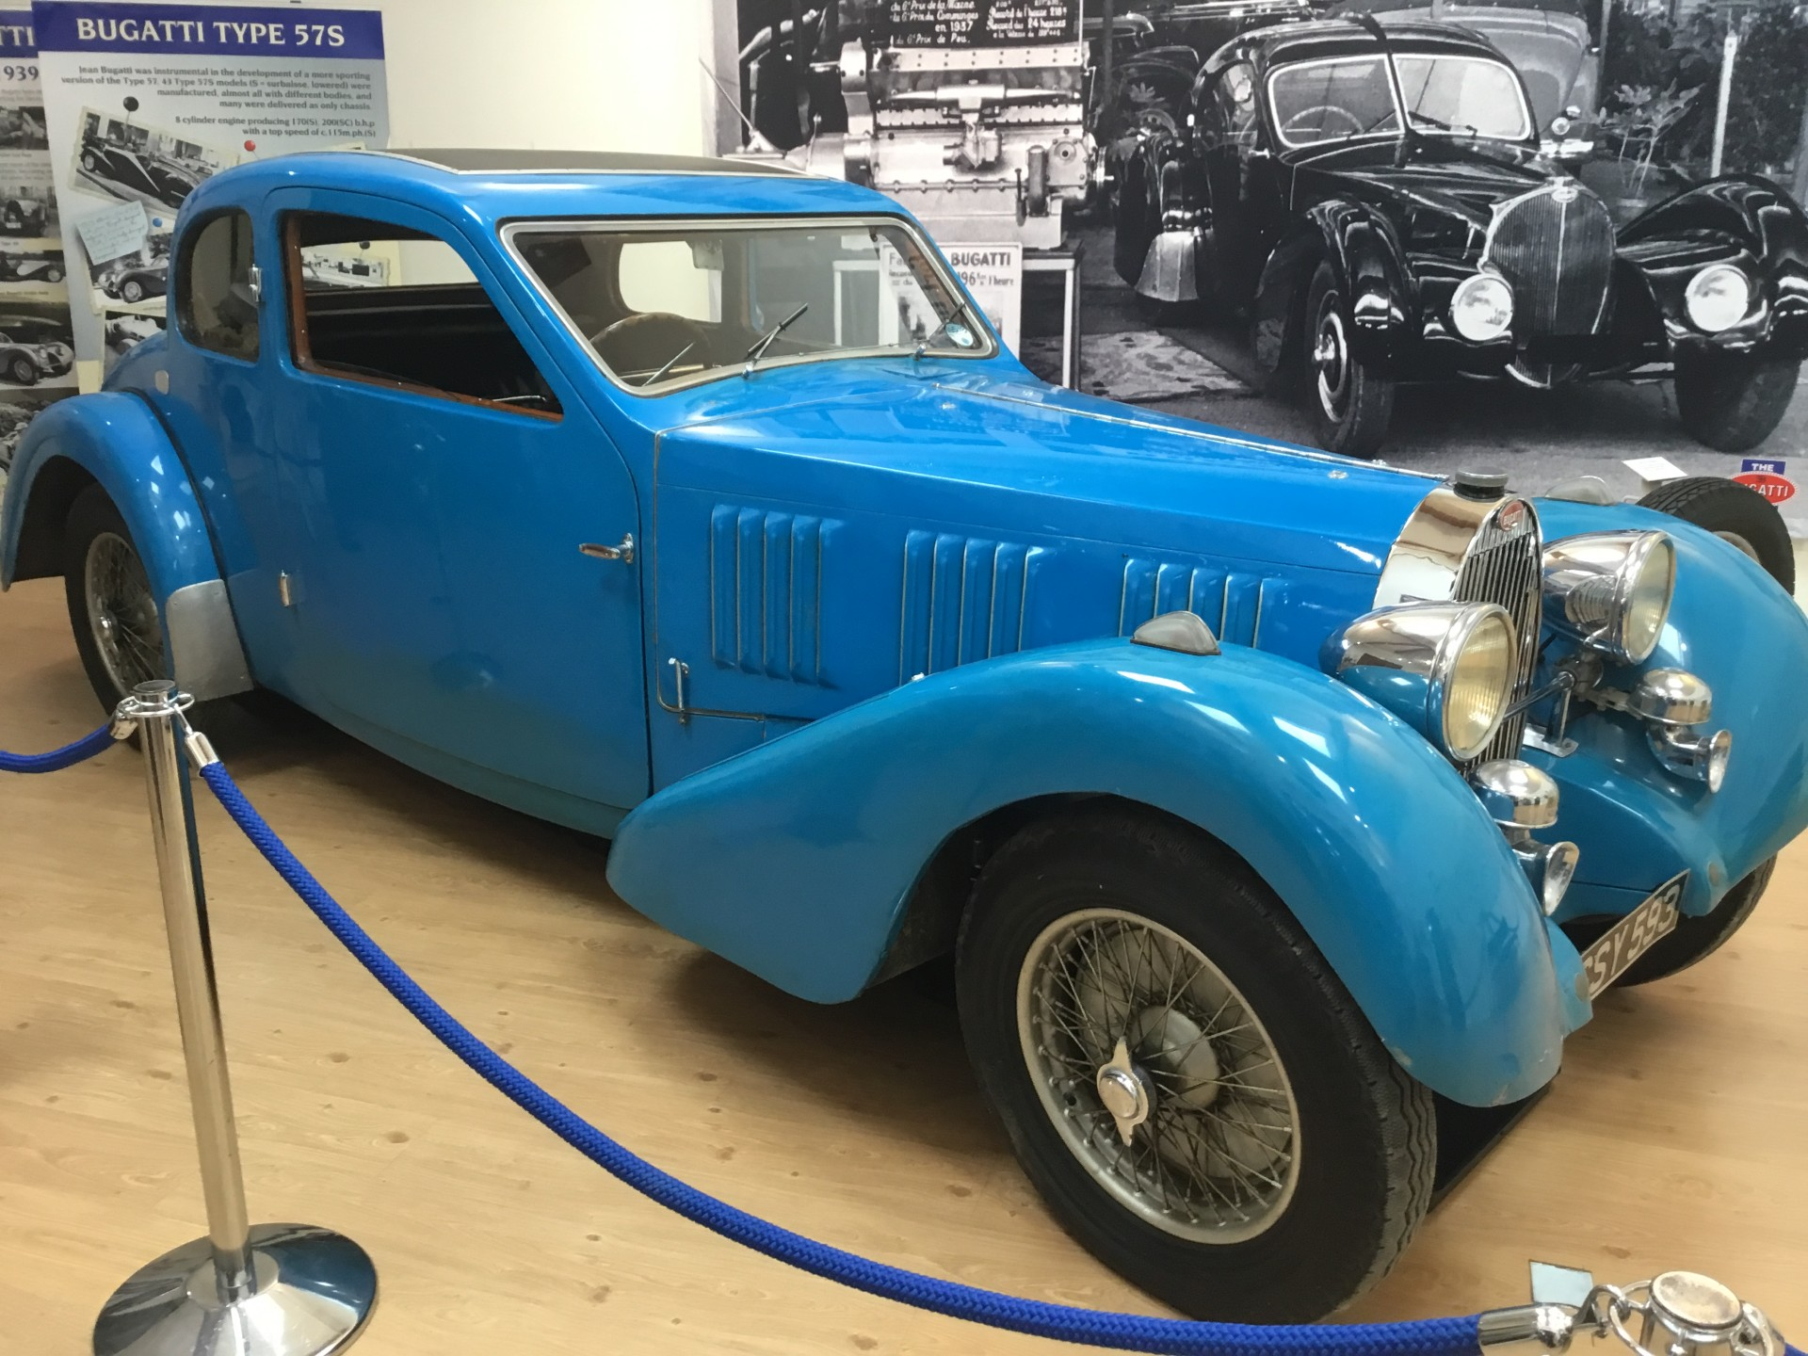
1939 Bugatti Type 57
3.3 litre (0.7258 Imp. Gallon), 8-cylinder engine
135 bhp (133.15 HP)
Chassis weight 1,200kg (188st 13.53lb)
Top speed of 95 mph (42.4688 m/s)
Notes:
1 mph = 0.44704 m/s, so 95 mph = 42.4688 m/s
Distance travelled = 21.234 m (0.0131 Miles)
Discuss the relationship of weight to top speed.
Discuss the pace of development and the factors that were influential.

Slide 13
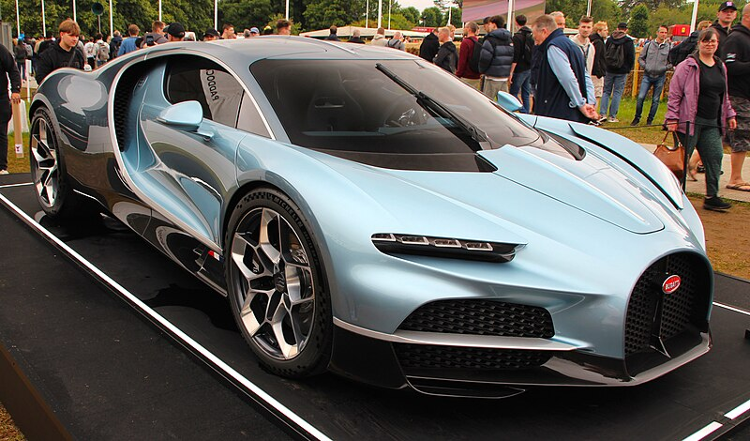
2024 Bugatti Tourbillon
8.3 litre (1.8257 Imp. Gallon), Cosworth V16 engine
1775 bhp (1750.68 HP)
Weight 1995 kg (314st 1.43 lb)
Top speed of 276 mph (123.383 m/s) (with speed key)
0-60 mph (0-26.8224 m/s) in 2 seconds
0.439938
Image initially produced by MrWalkr https://commons.wikimedia.org/wiki/File:Bugatti_Tourbillon.jpg used under the following licence https://creativecommons.org/licenses/by-sa/4.0/deed.en , no modifications made.
Notes:
1 mph = 0.44704 m/s, so 276 mph = 123.383 m/s
Distance travelled = 61.692 m (0.0383 Miles)
Discuss the relationship of weight to top speed.
Discuss the pace of development and the factors that were influential.

Slide 14
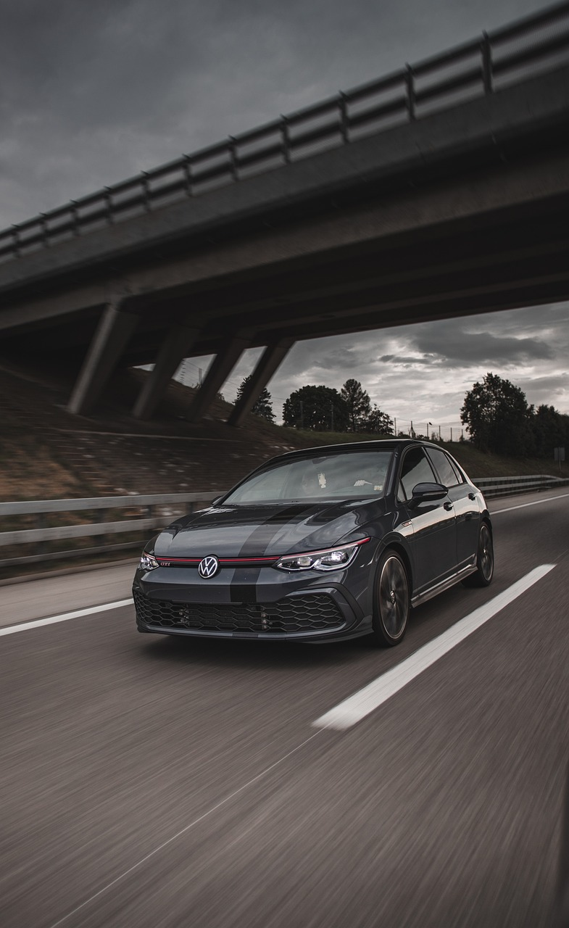
How Bugatti cars compare to other cars
Complete the worksheet to work out how Bugatti cars compare to everyday cars seen today, such as:
Volkswagen Golf
Vauxhall Corsa
Ford Fiesta
Formula 1 car

Slide 15
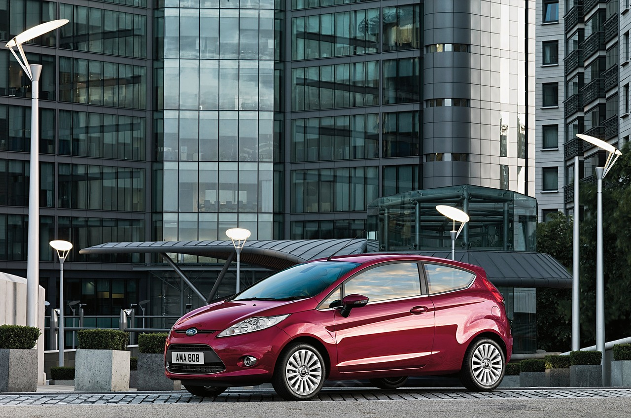
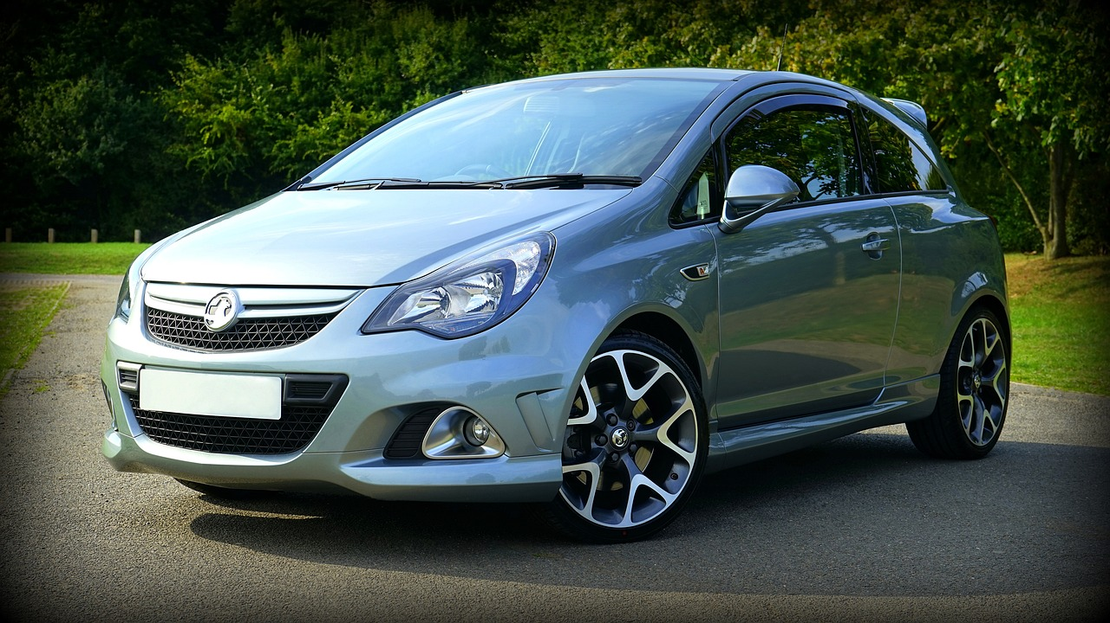
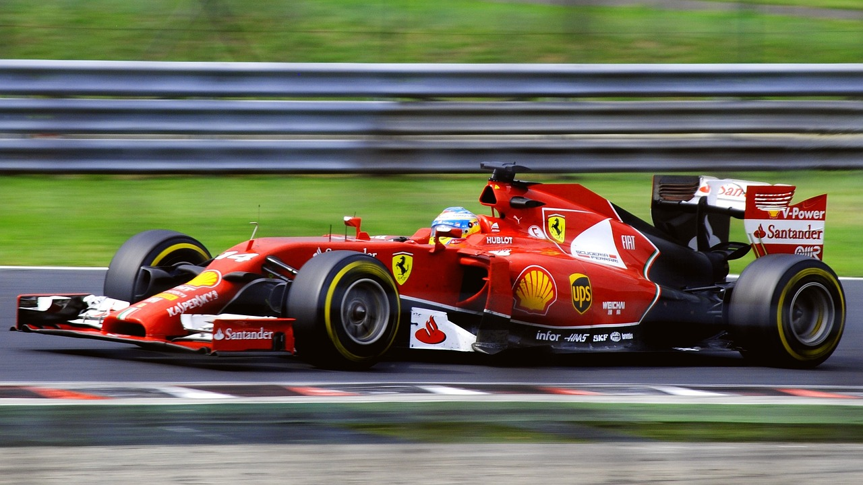
Worksheet – How Bugatti cars compare to other cars
Car | Top speed | Distance travelled in 0.5 seconds at top speed
Ford Fiesta | 102 mph 45.5981 m/s
Vauxhall Corsa | 108 mph 48.2803 m/s
Bugatti Type 35 | 118 mph 52.7507 m/s
Volkswagen Golf | 139 mph 62.1386 m/s
Formula 1 car | 220 mph 98.3488 m/s
Bugatti Tourbillon | 276 mph 123.383 m/s
Notes:
Please note, top speeds of non-Bugatti cars are taken from information available via manufacturer websites, and only represents the data from one particular model of that car.
Image of Bugatti Tourbillon initially produced by MrWalkr https://commons.wikimedia.org/wiki/File:Bugatti_Tourbillon.jpg used under the following licence https://creativecommons.org/licenses/by-sa/4.0/deed.en , no modifications made.

Slide 16
Worksheet – How Bugatti cars compare to other cars
Car | Top speed | Distance travelled in 0.5 seconds at top speed
Ford Fiesta | 102 mph 45.5981 m/s | 22.7991 m (23 m to nearest metre) or 0.0141 miles
Vauxhall Corsa | 108 mph 48.2803 m/s | 24.1402 m (24 m to nearest metre) or 0.015 miles
Bugatti Type 35 | 118 mph 52.7507 m/s | 26.3754 m (26 m to nearest metre) or 0.0163 miles
Volkswagen Golf | 139 mph 62.1386 m/s | 31.0693 m (31 m to nearest metre) or 0.0193 miles
Formula 1 car | 220 mph 98.3488 m/s | 49.1744 m (49 m to nearest metre) or 0.0305 miles
Bugatti Tourbillon | 276 mph 123.383 m/s | 61.692 m (62 m to nearest metre) or 0.0383 miles
Notes:
Please note, top speeds of non-Bugatti cars are taken from information available via manufacturer websites, and only represents the data from one particular model of that car.
Image of Bugatti Tourbillon initially produced by MrWalkr https://commons.wikimedia.org/wiki/File:Bugatti_Tourbillon.jpg used under the following licence https://creativecommons.org/licenses/by-sa/4.0/deed.en , no modifications made.

Slide 17
Extension
Work how far each car would travel in 2, 10, 30 and 60 seconds
Compare the performance of Bugatti’s cars to other manufacturers not previously looked at, such as Škoda, Toyota, Audi, SEAT, Kia or Dacia
Explain the difference between maximum speed and maximum velocity, and perform relevant calculations for different Bugatti cars

