Slide 1
Nuclear energy debate
Nuclear power role play

Slide 2
Stay safe
Whether you are a scientist researching a new medicine or an engineer solving climate change, safety always comes first. An adult must always be around and supervising when doing this activity. You are responsible for:
• ensuring that any equipment used for this activity is in good working condition
• behaving sensibly and following any safety instructions so as not to hurt or injure yourself or others
Please note that in the absence of any negligence or other breach of duty by us, this activity is carried out at your own risk. It is important to take extra care at the stages marked with this symbol: ⚠

Slide 3
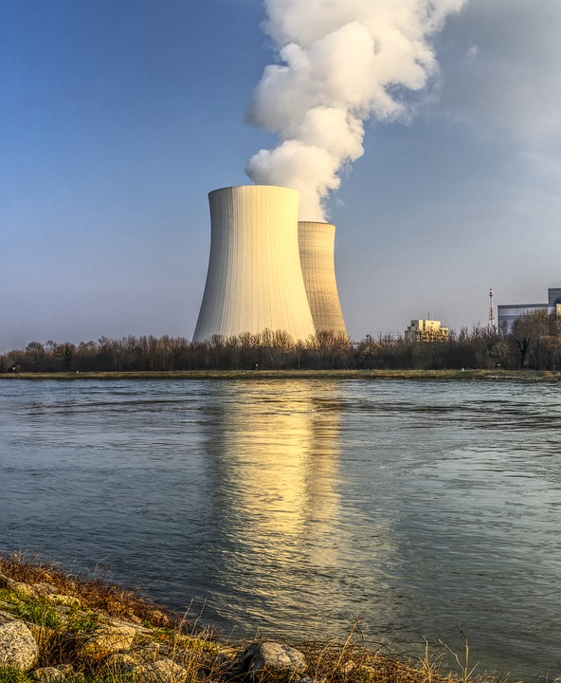
What is nuclear power?
A nuclear reaction (nuclear fission) is used to generate heat, which in turn creates steam.
The steam turns turbines, which drive generators to create electricity.
This reduces reliance on fossil fuels.
Nuclear waste remains radioactive for thousands of years.
Although accidents are very rare, they can result in large areas becoming uninhabitable for a long time (e.g. Chernobyl, Fukishima).

Slide 4
Situation
It has been proposed that a new nuclear power station is constructed and opened close to a local town. This will provide enough electrical energy for the whole of the nearby county, but local resident groups have expressed concern about the dangers of having the facility so close to their homes.
A meeting has been called where a representative from the power company and a resident group leader will debate the proposal.

Slide 5
Role play
Get into groups of three.
One person will chair the meeting. They must remain neutral and ensure everybody has a fair chance to make their points. They will then decide if the proposal is to go ahead.
One person will represent the power company. They must make the case for the proposal.
One person will represent concerned residents. They must make the case against the proposal.
You have 20 minutes to discuss. Your group will then feed back to the whole class.

Slide 6
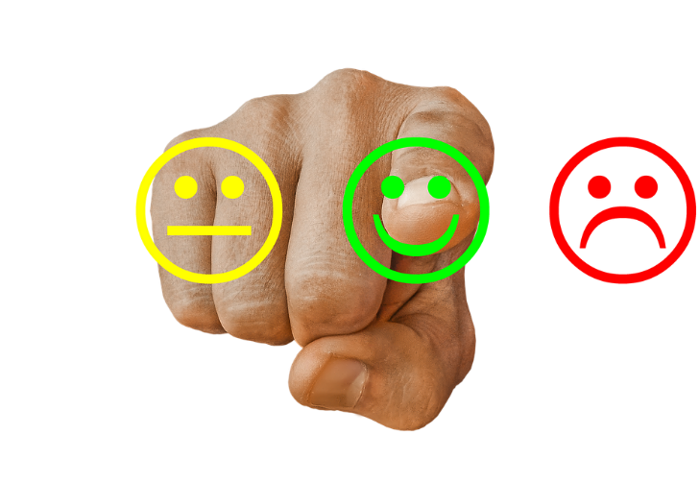
Class feedback
What is the overall decision regarding the proposal?
What are the main reasons for this?
What would need to happen for you to change your mind?

