Slide 1
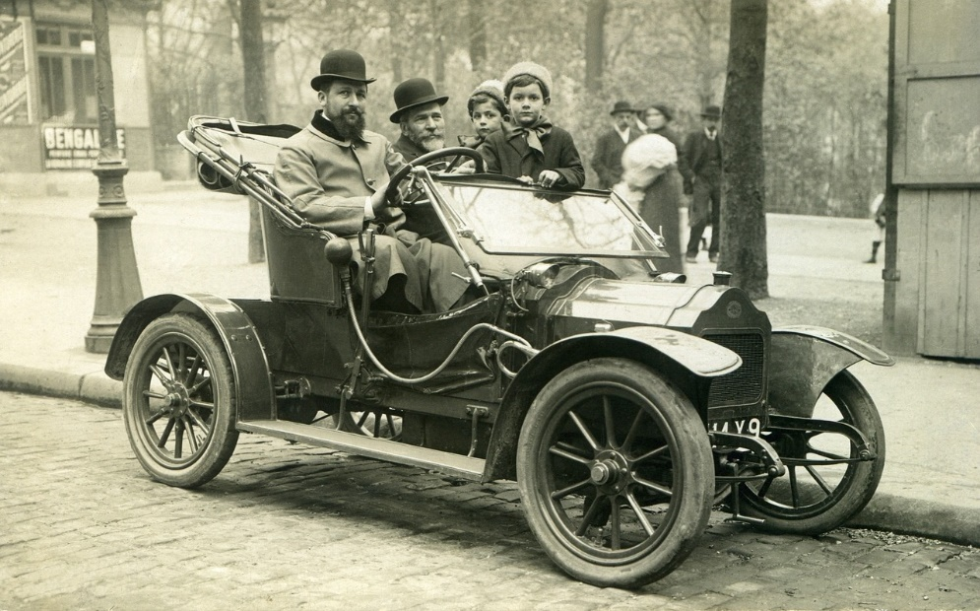
Making a Pinhole Camera
Making a pinhole camera inspired by the early photography of the Victorian era

Slide 2
Stay safe
Whether you are a scientist researching a new medicine or an engineer solving climate change, safety always comes first. An adult must always be around and supervising when doing this activity. You are responsible for:
ensuring that any equipment used for this activity is in good working condition
behaving sensibly and following any safety instructions so as not to hurt or injure yourself or others
Please note that in the absence of any negligence or other breach of duty by us, this activity is carried out at your own risk. It is important to take extra care at the stages marked with this symbol: ⚠
Notes:
Safety Warning

Slide 3
The Victorians
The Victorian age was a period in time in the United Kingdom where Queen Victoria reigned
This was between June 1837 and January 1901
There were huge changes to how people lived and worked during this period
In this project you will make a pinhole camera inspired by the technology used by the Victorians!
Notes:
Explain the theme of the Victorians to learners.
Teacher could ask learners to write down five things that that they already know about the Victorians and/or the Victorian era.
The Victorian era is sometimes also defined as being between around 1820 and 1914, based on the defining characteristics of society at the time, rather than the exact dates of Queen Victoria’s reign as monarch. Either definition, or a mixture of the two, is historically accurate to use.

Slide 4
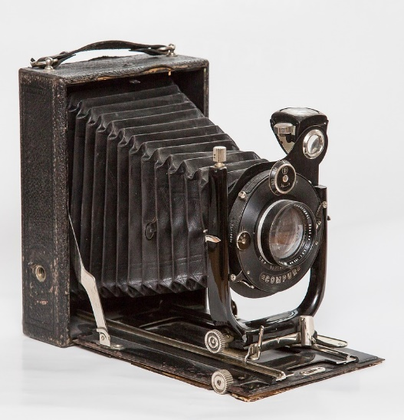
Camera Obscuras
Camera obscuras were first used to safely study the Sun without looking at it
Thomas Wedgewood came up with the idea of using these to create pictures in 1800
In 1839 William Henry Fox Talbot exhibited the first photographs to be taken in Britain
In Victorian times many women took up taking photos as a hobby
Notes:
Pinhole cameras are a type of camera obscura with a very small hole instead of a lens.
Learners could research the camera obscura and how it was developed.
History of the camera: https://www.adorama.com/alc/camera-history/
https://en.wikipedia.org/wiki/Thomas_Wedgwood_(photographer)
https://en.wikipedia.org/wiki/Camera_obscura

Slide 5
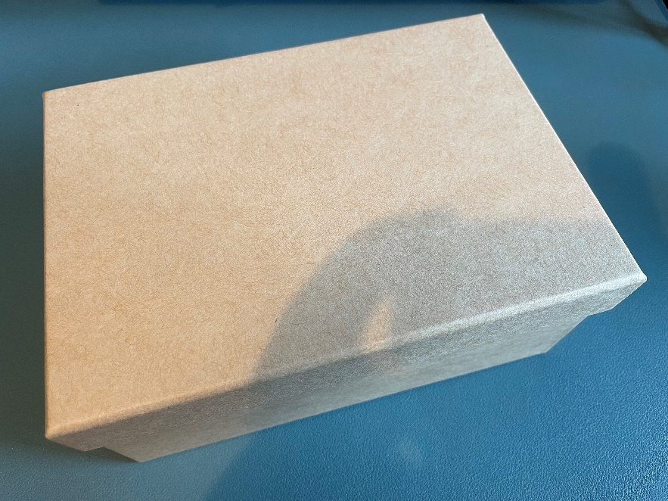
Equipment and Resources
⚠
Shoebox or cardboard box
Wax paper
Parcel tape
Craft knife
Scissors
Pin or thumb tack to make the pinhole
Pencil
Ruler
Notes:
Take care when using sharp objects such as a craft knife, scissors and pins.
The measurements given in these steps are based on a small 170 mm (L) x 120 (W) x 75 mm (D) shoebox – these could be adjusted for a bigger box (e.g. for a bigger window – steps 1-4).
Maths based extension: calculate the volume of the box used.
Alternative ways to make a pinhole camera/camera obscura:
https://www.youtube.com/watch?v=miuNl-O05Wo
https://www.youtube.com/watch?v=IJ2cUh0N1RI
https://www.youtube.com/watch?v=mqvwqweDk1I

Slide 6
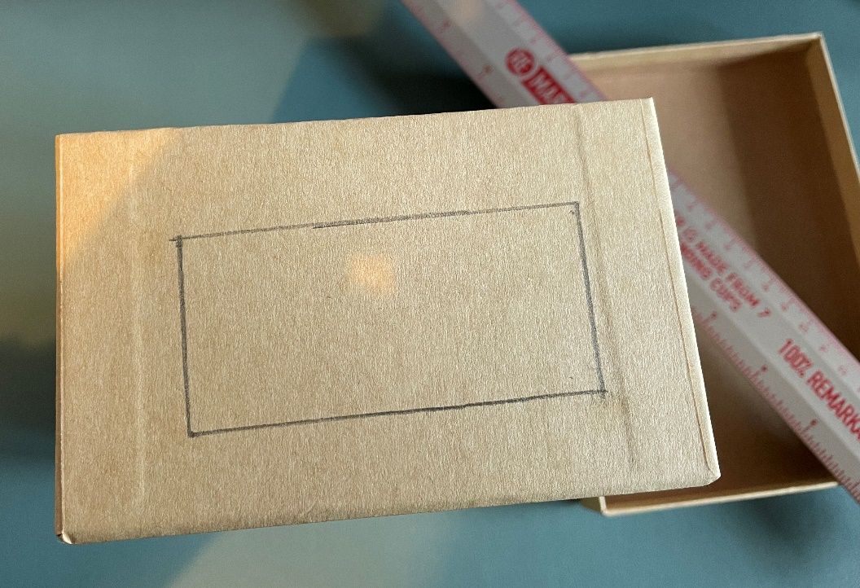
Pinhole Camera – Step 1
Remove the top of the shoebox
Mark out an 80 mm x 35 mm window on one end of the box
Notes:
The following slides show how to make a pinhole camera.

Slide 7
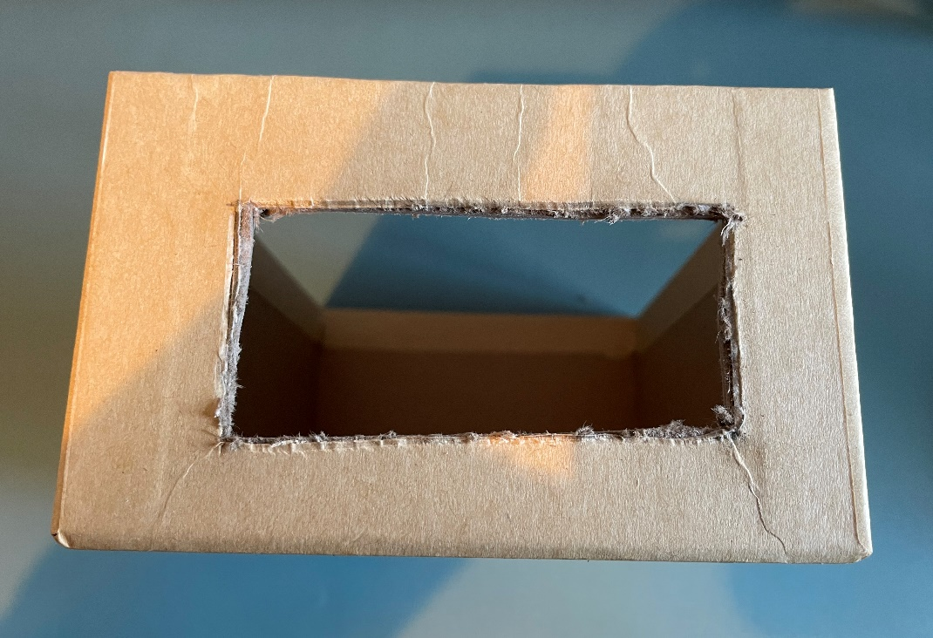
Pinhole Camera – Step 2
⚠
Use a craft knife to cut out the window
Notes:
Take care when using a craft knife.
Learners may need assistance with this stage.

Slide 8
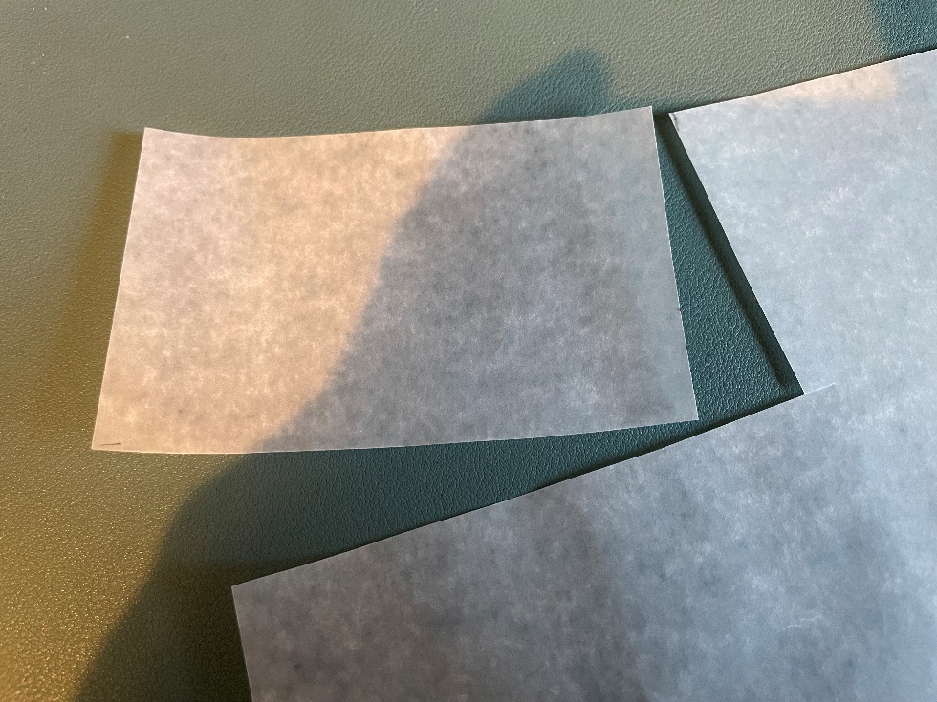
Pinhole Camera – Step 3
⚠
Use scissors to cut out a 95 mm x 50 mm piece of wax paper for the camera screen
Cut from the top corner to avoid waste
Notes:
Take care when using scissors.
Teacher could discuss sustainability issues when cutting to avoid wasting wax paper.

Slide 9
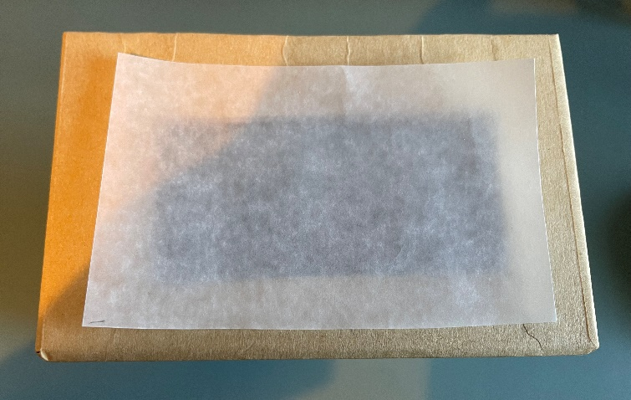
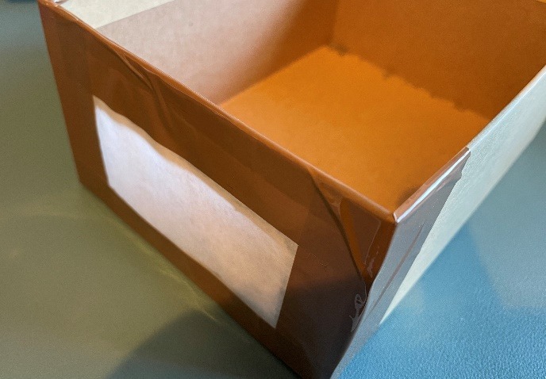
Pinhole Camera – Step 4
⚠
Place the cut piece of wax paper over the window
Use parcel tape to stick it into place
Notes:
Take care when using scissors.
This creates the camera screen.

Slide 10
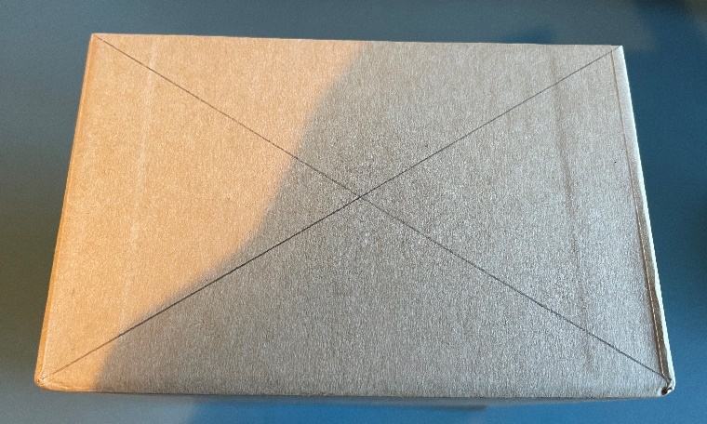
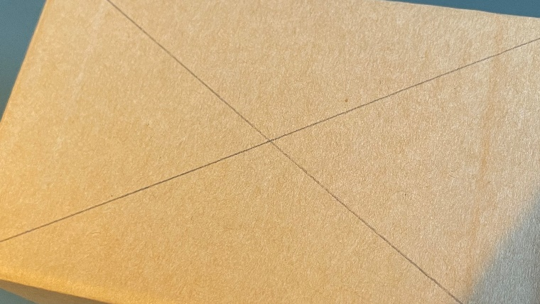
Pinhole Camera – Step 5
Turn the box around to the other end
Draw two lines, corner to corner, to find the middle point

Slide 11
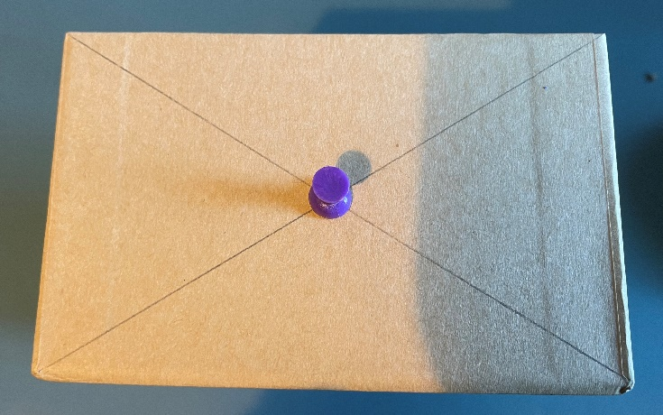
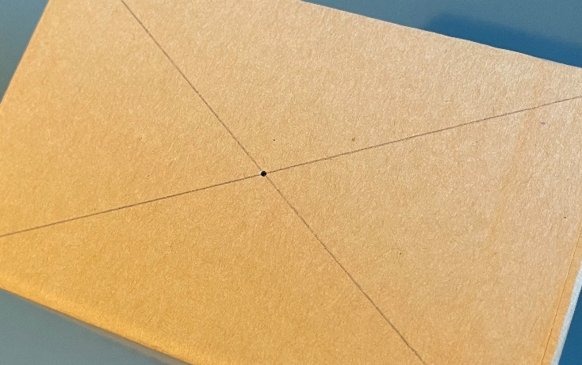
Pinhole Camera – Step 6
⚠
Push a pin through the middle point to make a small hole
Keep this as straight as you can
Notes:
Take care when using the pin to make the hole as it will be sharp.
This creates the lens for the front of the camera.

Slide 12
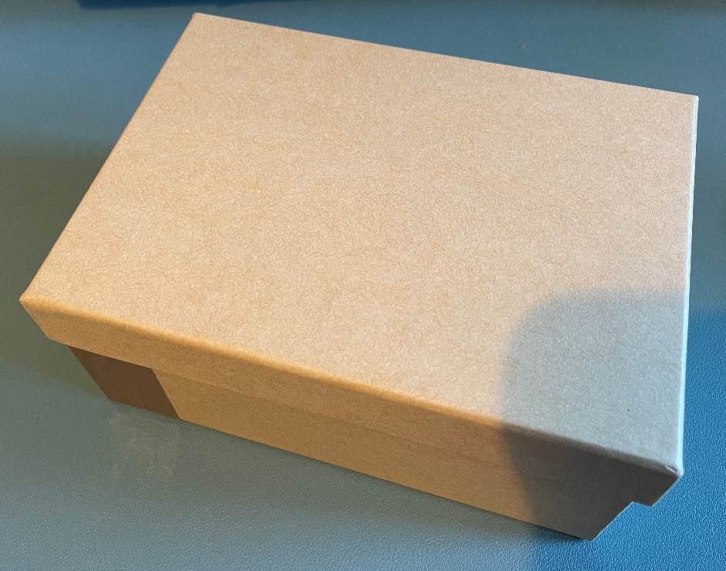
Pinhole Camera – Step 7
Put the lid back onto the shoebox
You are now ready to test your pinhole camera!

Slide 13
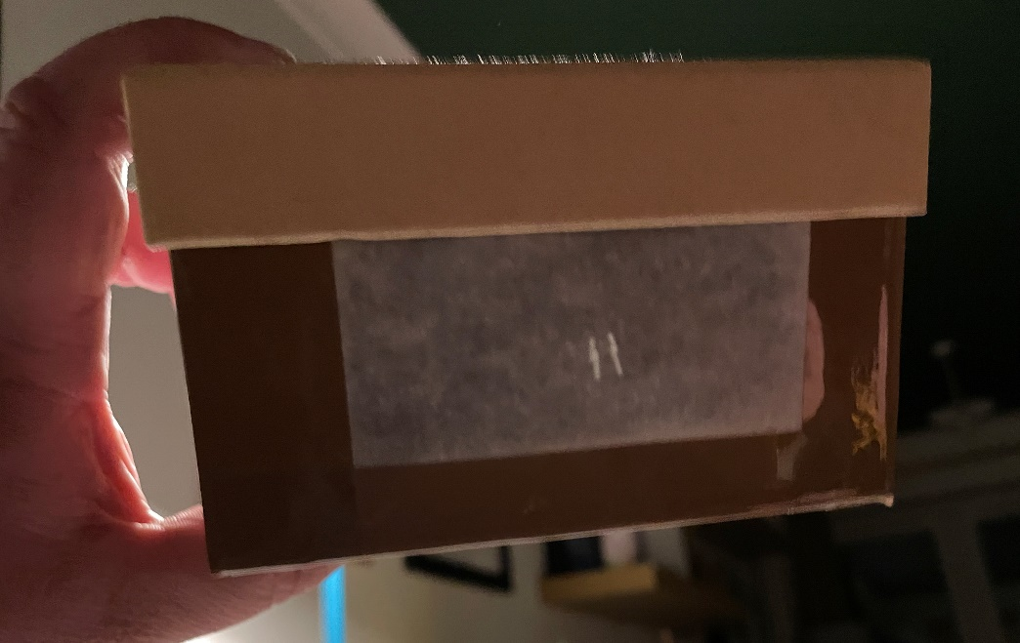
Pinhole Camera – Testing
⚠
Make sure you are in a dark room
Turn on a lamp and point your camera towards it
You should see the light on the screen – it will be upside down!
Notes:
Explain that the pinhole acts as a tiny camera lens. This allows the light to enter the shoebox which is then focussed and projected onto the screen, creating an inverted image.
Do not look directly into a light source.
Demonstrate the camera working to partner or classmate.

Slide 14
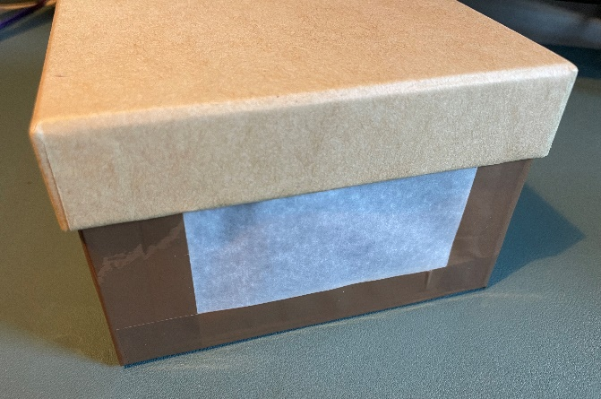
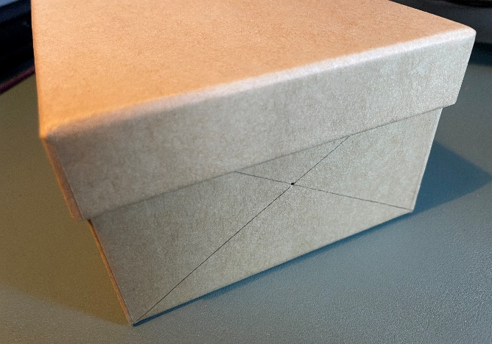
Finished Pinhole Camera
Notes:
Example of finished pinhole camera.

Slide 15
Extension
Calculate the volume of the box used for the pinhole camera
Make an improved camera obscura with an adjustable lens and cover

