Slide 1
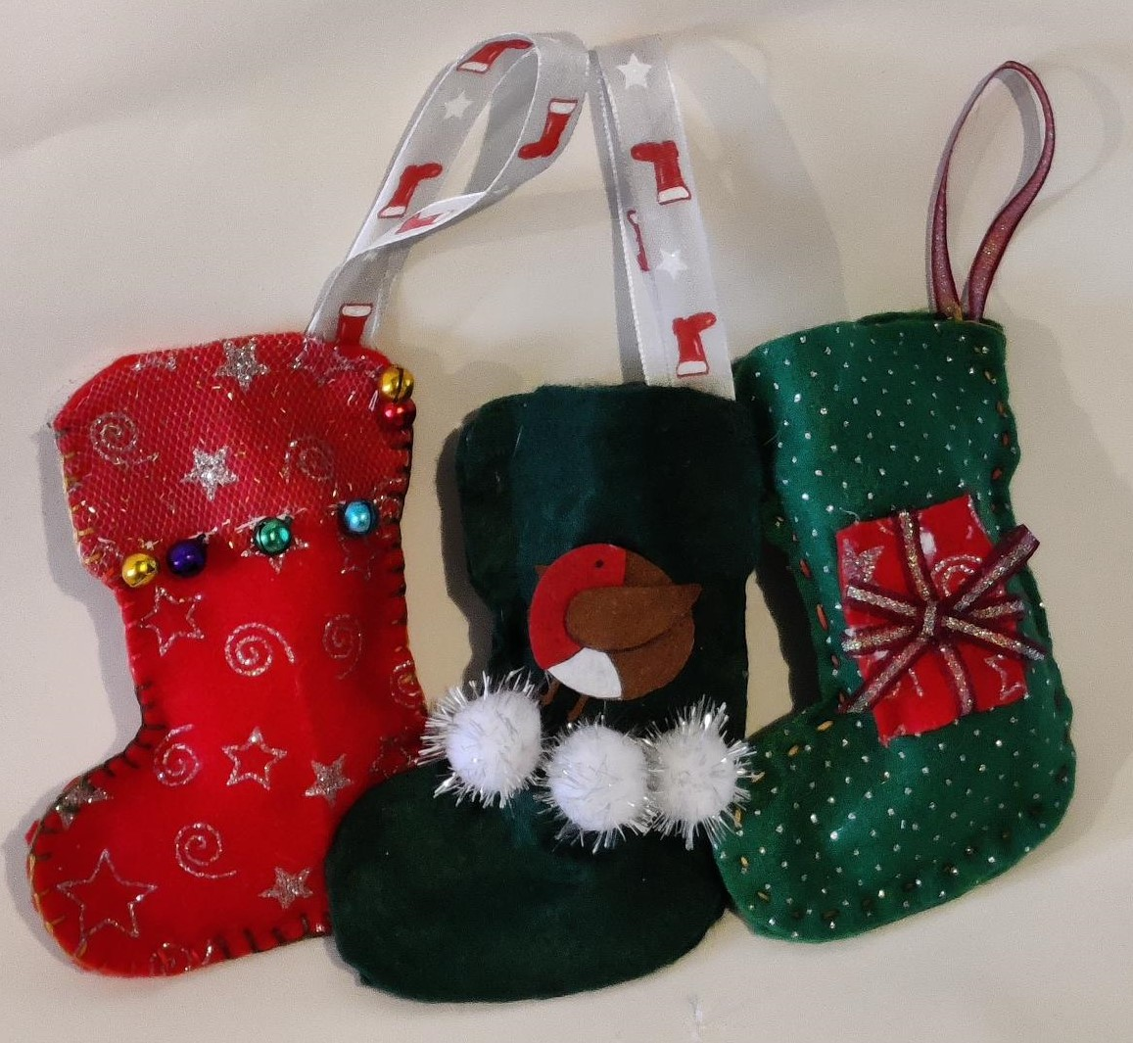
Sew your own Christmas Stockings
Designing and making a Christmas stocking
Notes:
Stay safe
Whether you are a scientist researching a new medicine or an engineer solving climate change, safety always comes first. An adult must always be around when doing this activity, and please note that this is carried out at your own risk. It is important to take extra care at the stages marked with this symbol: ⚠

Slide 2
Stay safe
Whether you are a scientist researching a new medicine or an engineer solving climate change, safety always comes first. An adult must always be around and supervising when doing this activity. You are responsible for:
ensuring that any equipment used for this activity is in good working condition
behaving sensibly and following any safety instructions so as not to hurt or injure yourself or others
Please note that in the absence of any negligence or other breach of duty by us, this activity is carried out at your own risk. It is important to take extra care at the stages marked with this symbol: ⚠
Notes:
Stay safe
Whether you are a scientist researching a new medicine or an engineer solving climate change, safety always comes first. An adult must always be around when doing this activity, and please note that this is carried out at your own risk. It is important to take extra care at the stages marked with this symbol: ⚠

Slide 3
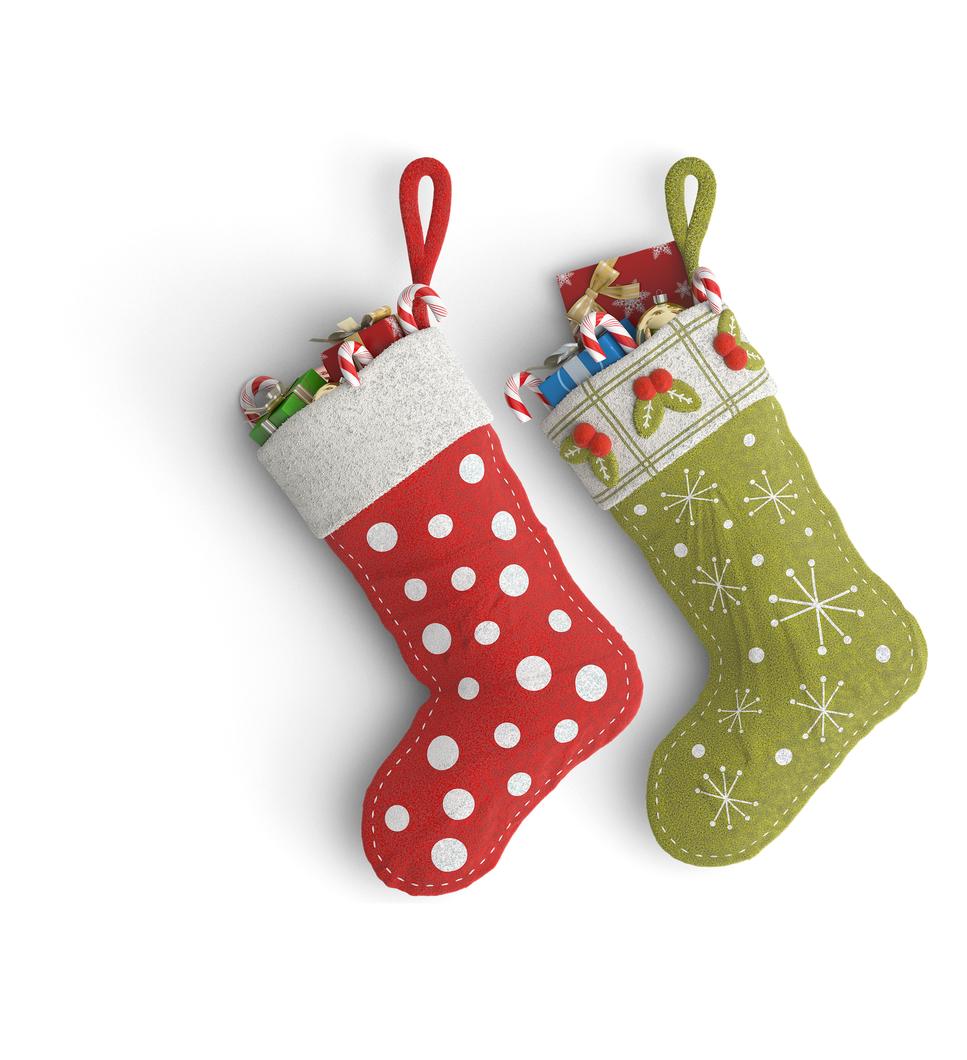
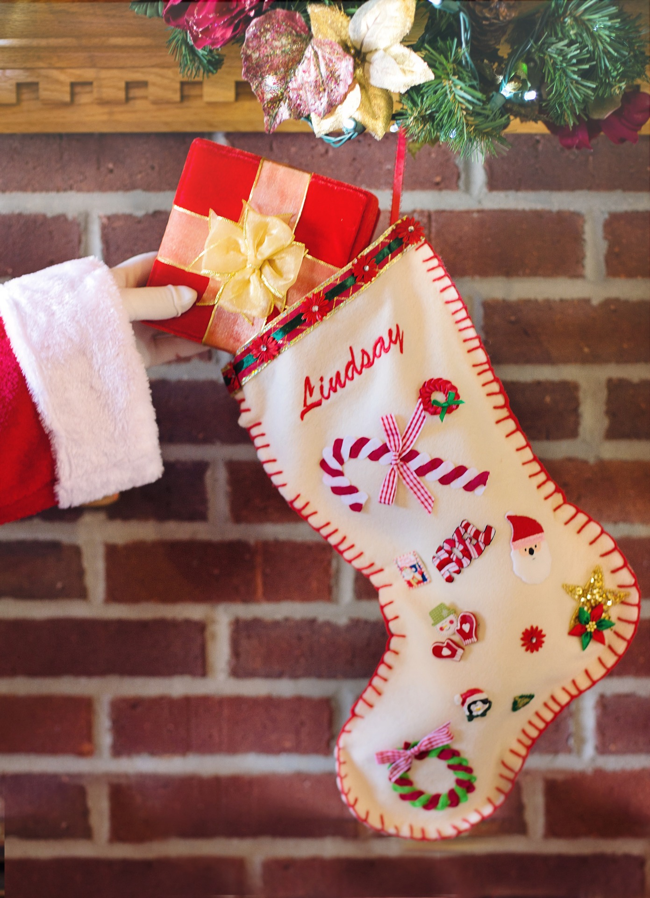
Examples of Christmas Stockings
Notes:
These could act as inspiration for the learners’ own designs.
All images public domain from https://pixabay.com/

Slide 4
Main points to consider:
Colour
Decoration
Use of hand stitching
Other things to consider:
Size
Durability
Recyclable/recycled fabric
Notes:
This slide could be used to give learners criteria to consider for their design. You could also use your own school design criteria for this process.

Slide 5
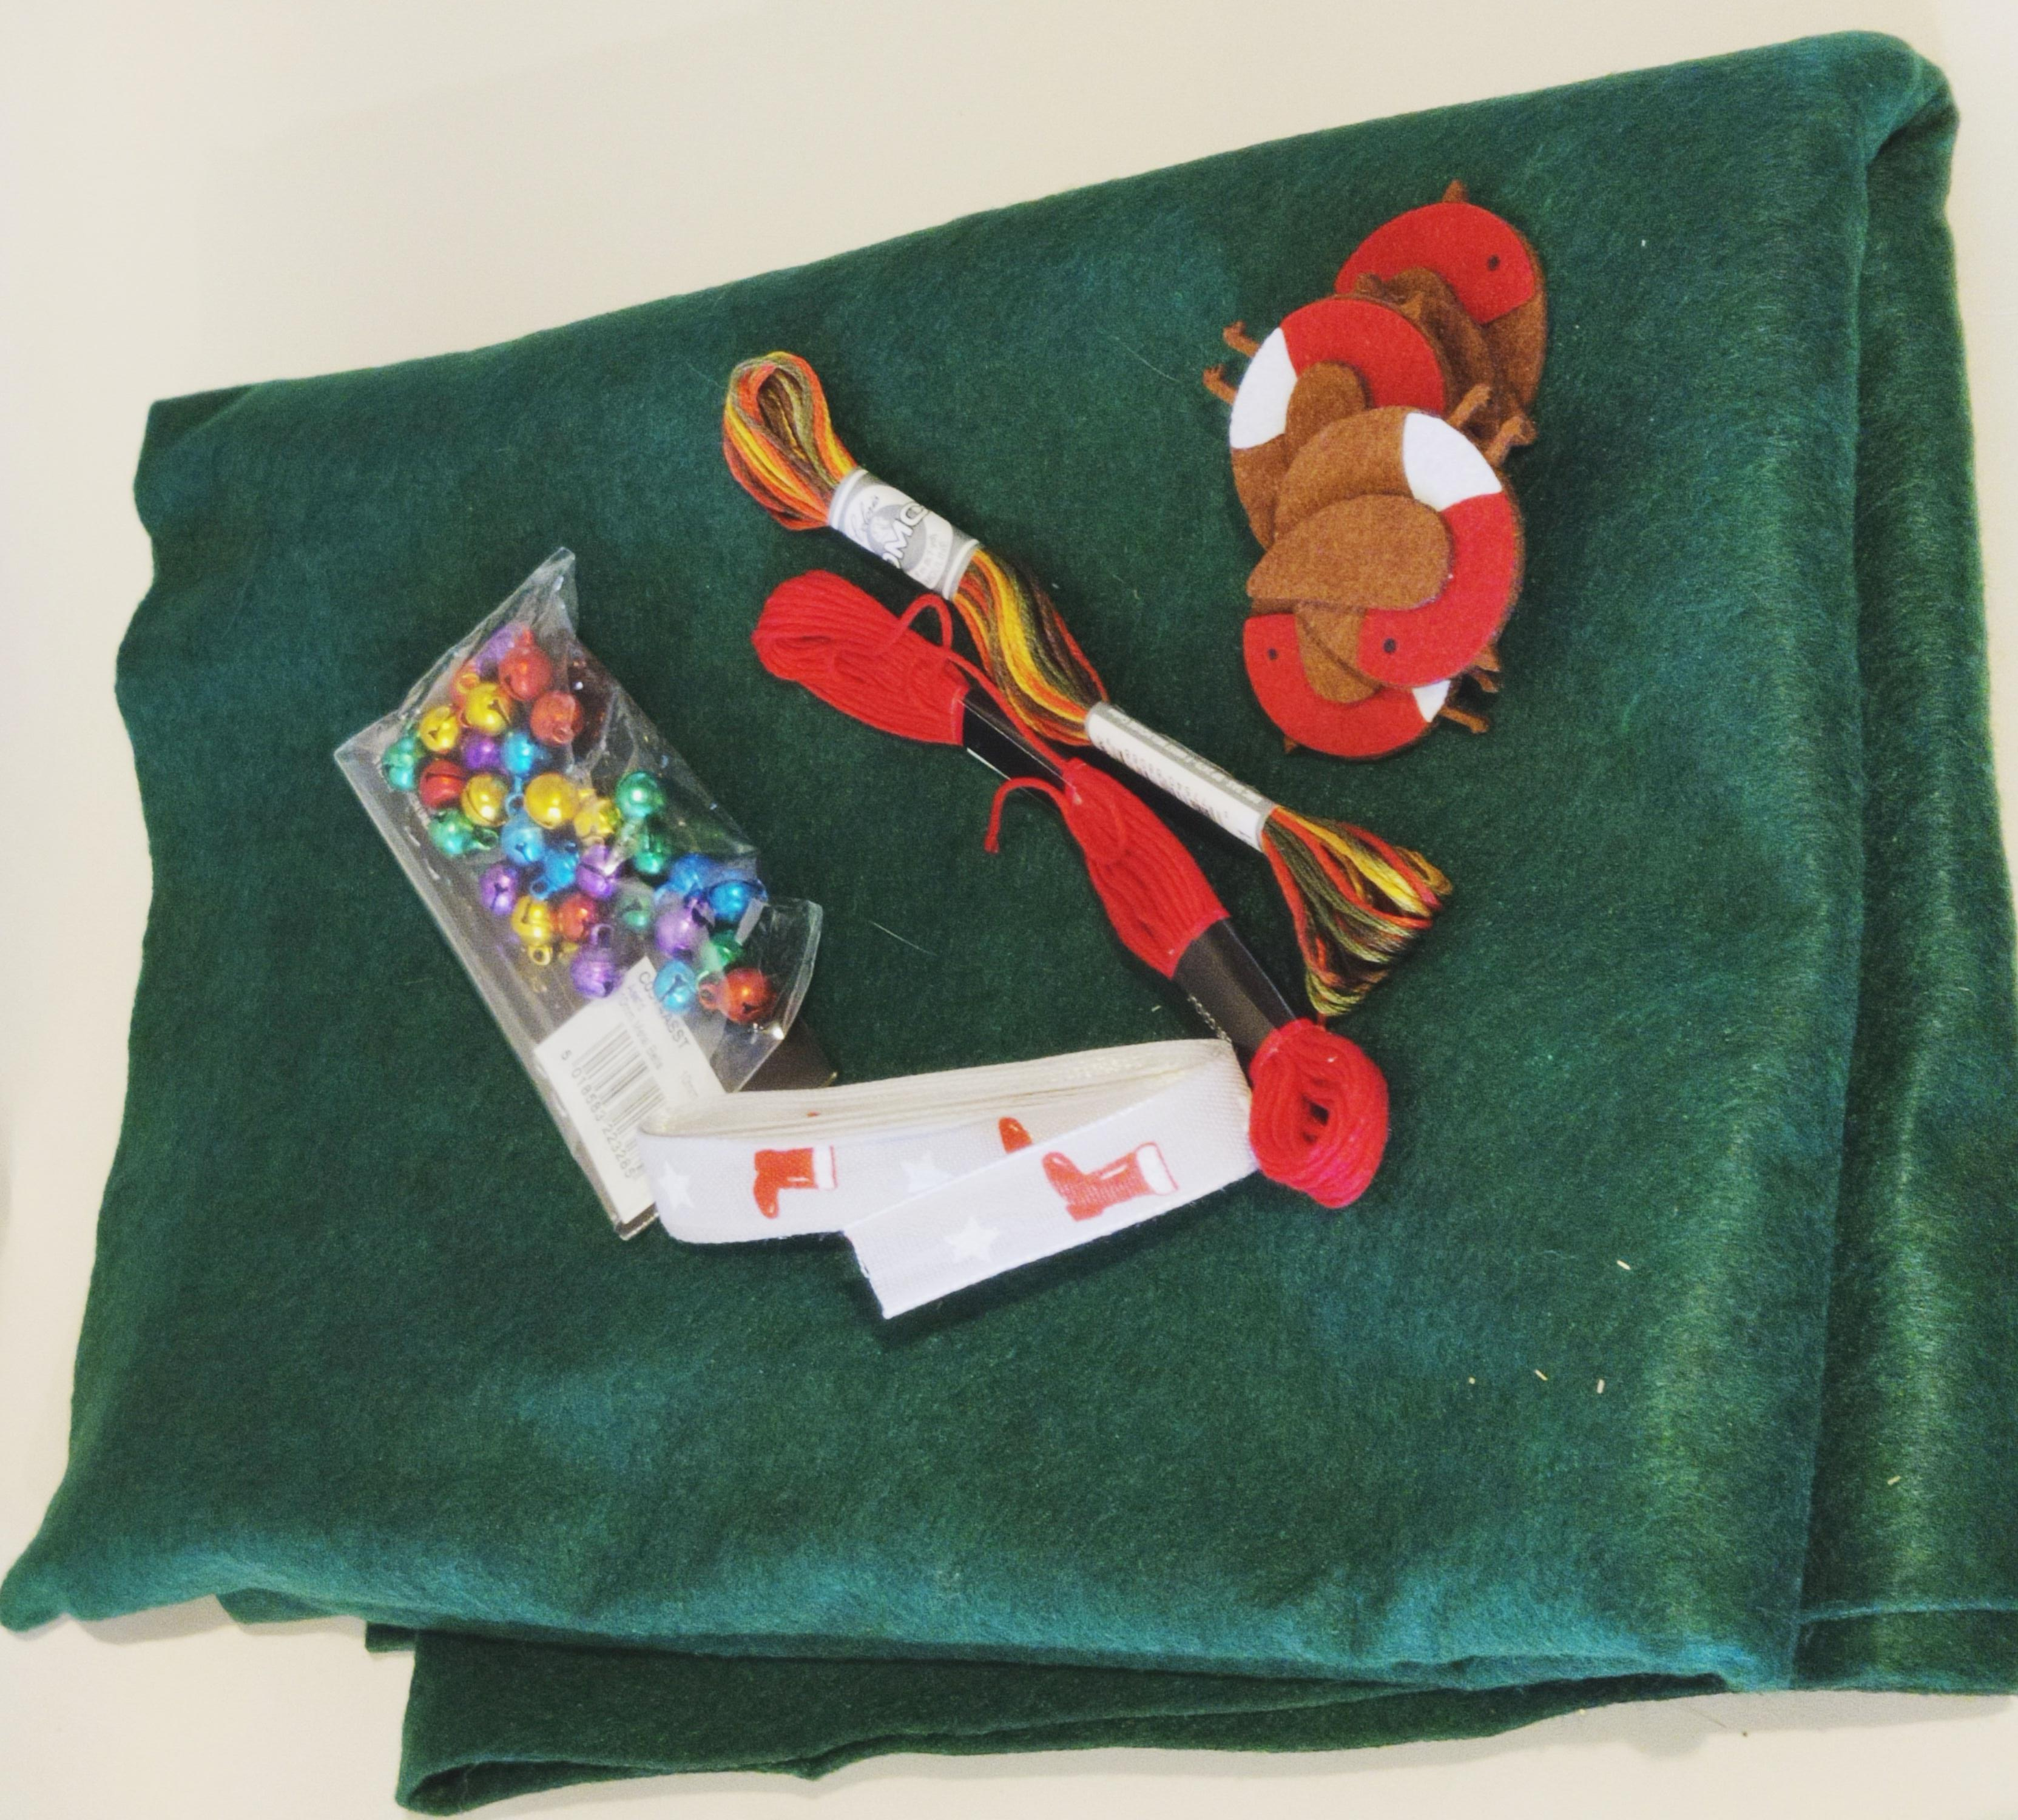
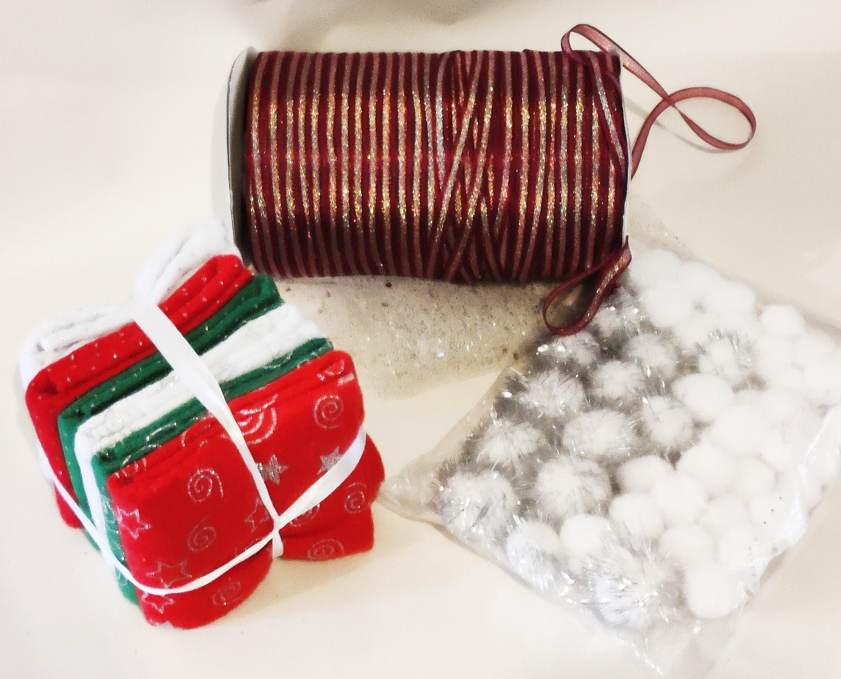
Equipment ⚠
Felt
Embroidery thread
Sewing needle
Ribbon
Decorations
Notes:
Scrap pieces of felt and other materials can be used instead of new material; recycle what is available.
Students can be very inventive/creative when faced with this challenge, e.g. use the materials you have to create a Christmas decoration.

Slide 6
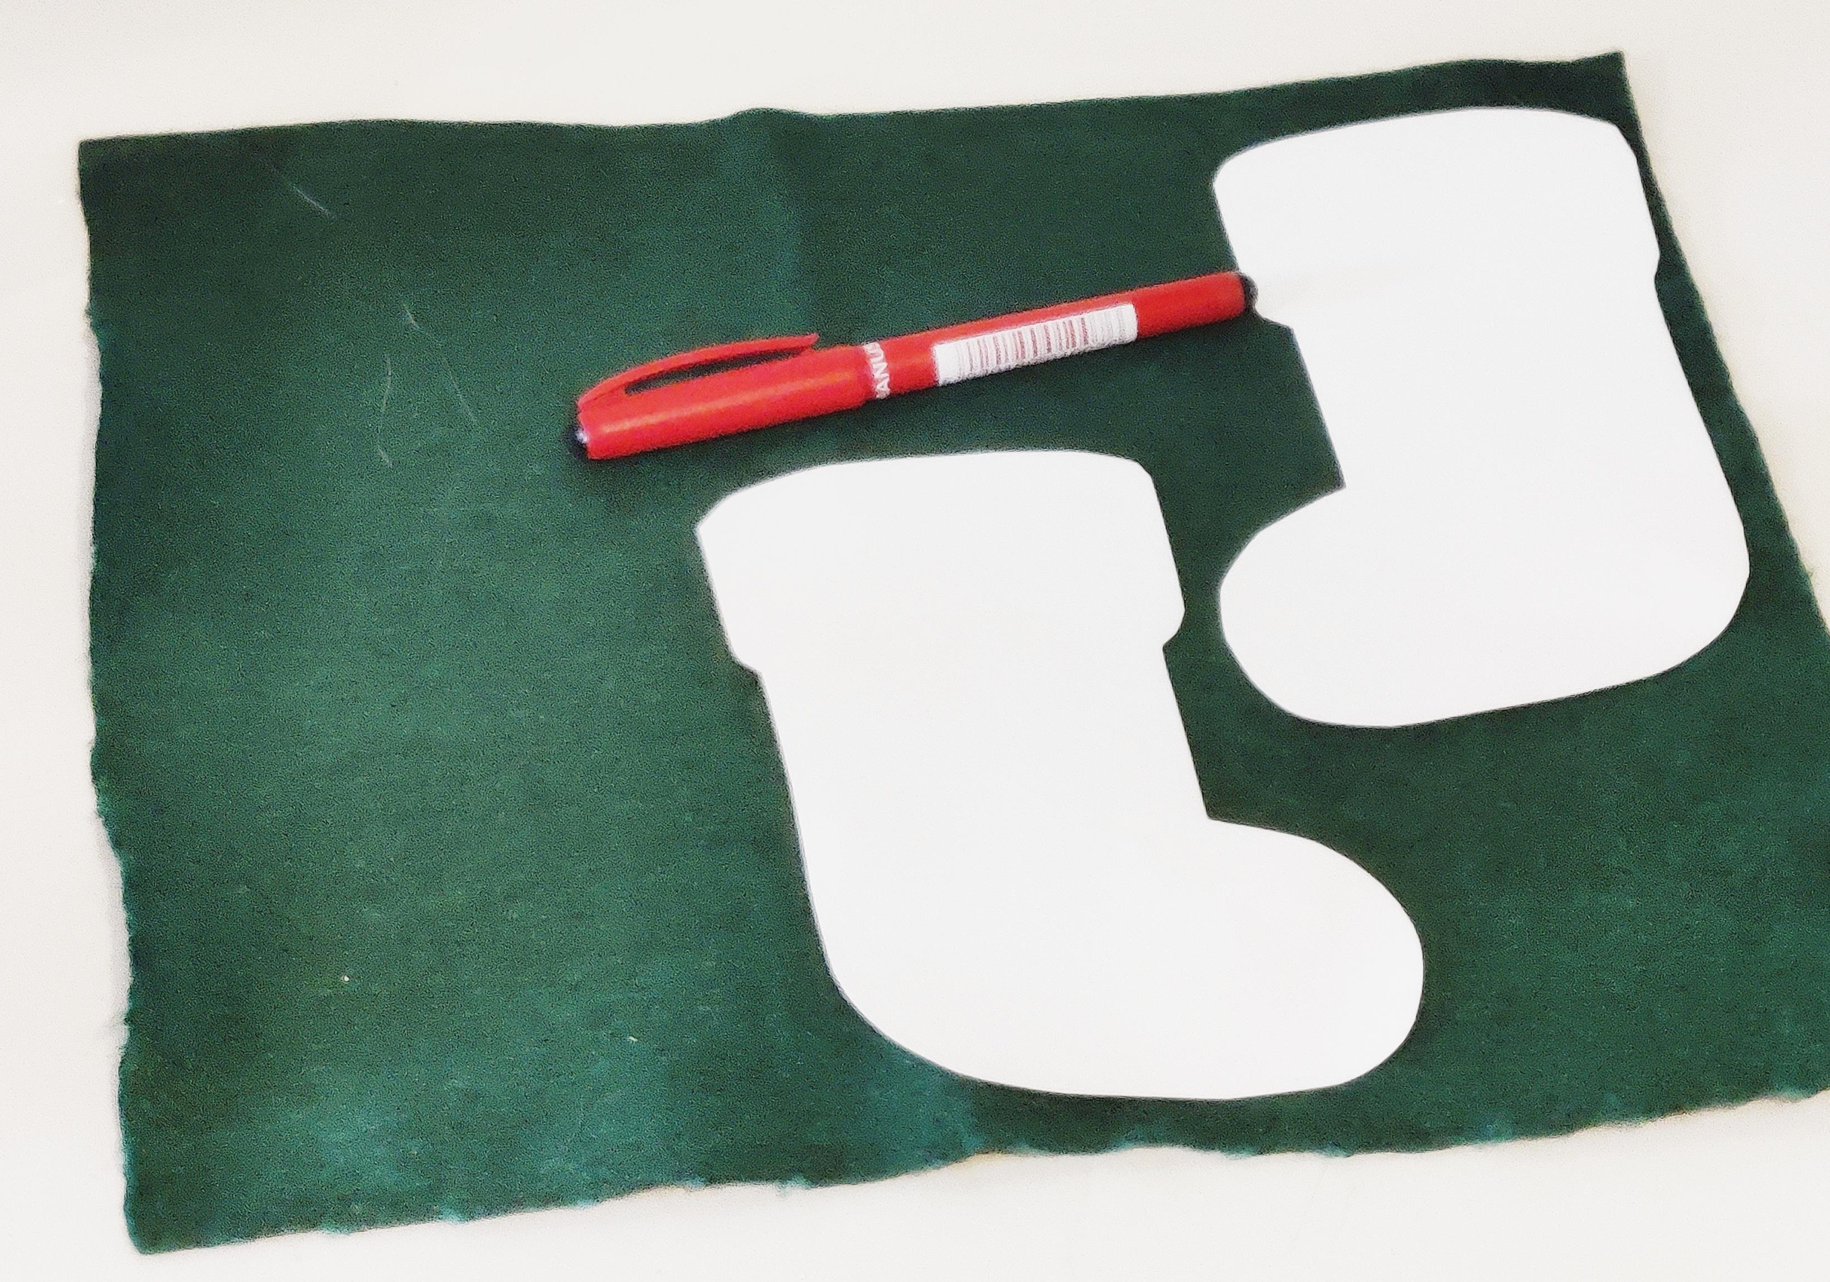
Step 1
Make yourself a stocking template to the size you wish to create.
Place the template onto the felt and draw around it using a black felt tip pen
Turn the template over and repeat, so that there are two stockings which are mirror images of each other
Notes:
Differentiation:
Pre-cut template pieces.
Draw round the templates and allow students to cut them out.

Slide 7
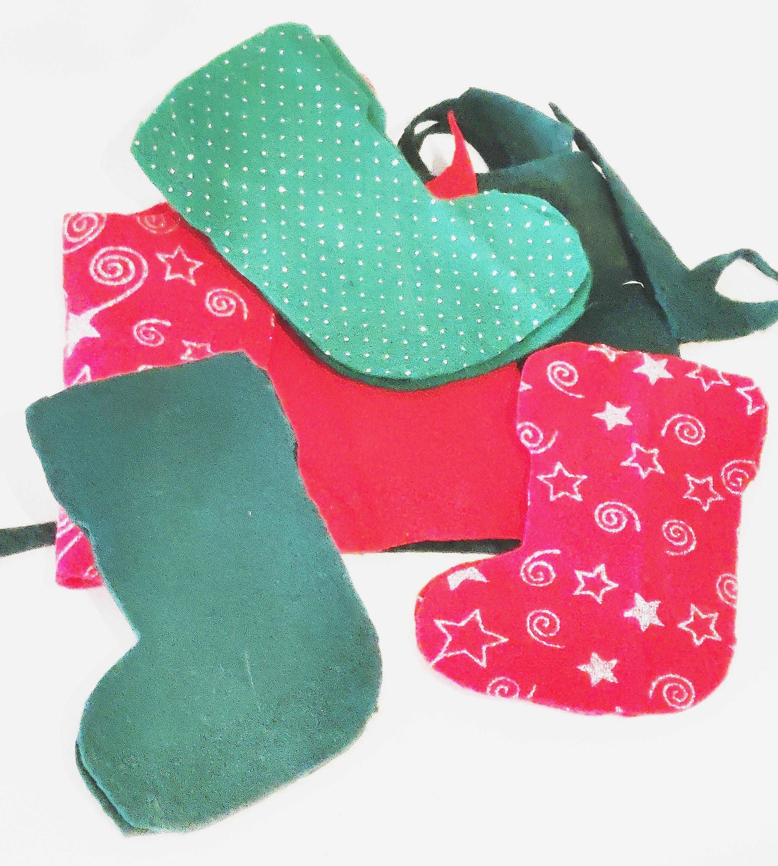
Step 2
⚠
Cut around the outlines of the stocking shapes
Then, place one stocking shape on top of the other so that they are both facing the same way
Notes:
Pre-cut pieces if required.

Slide 8
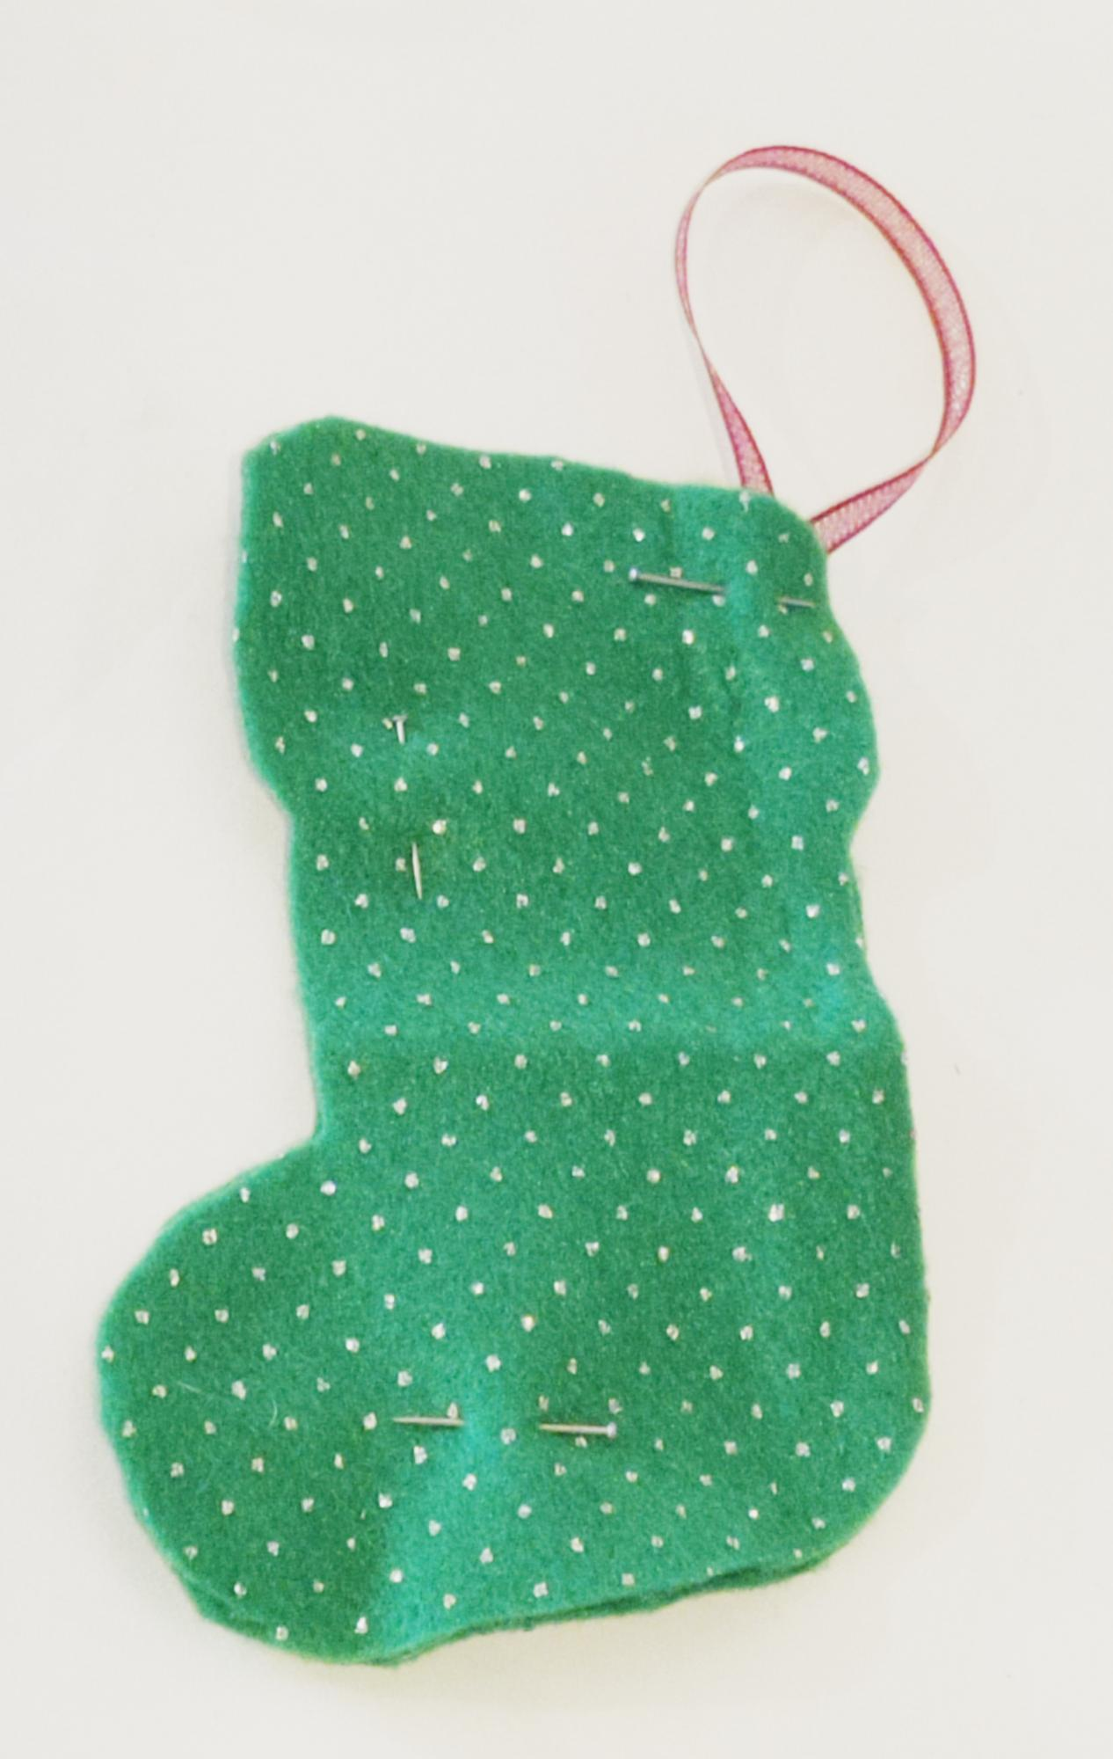
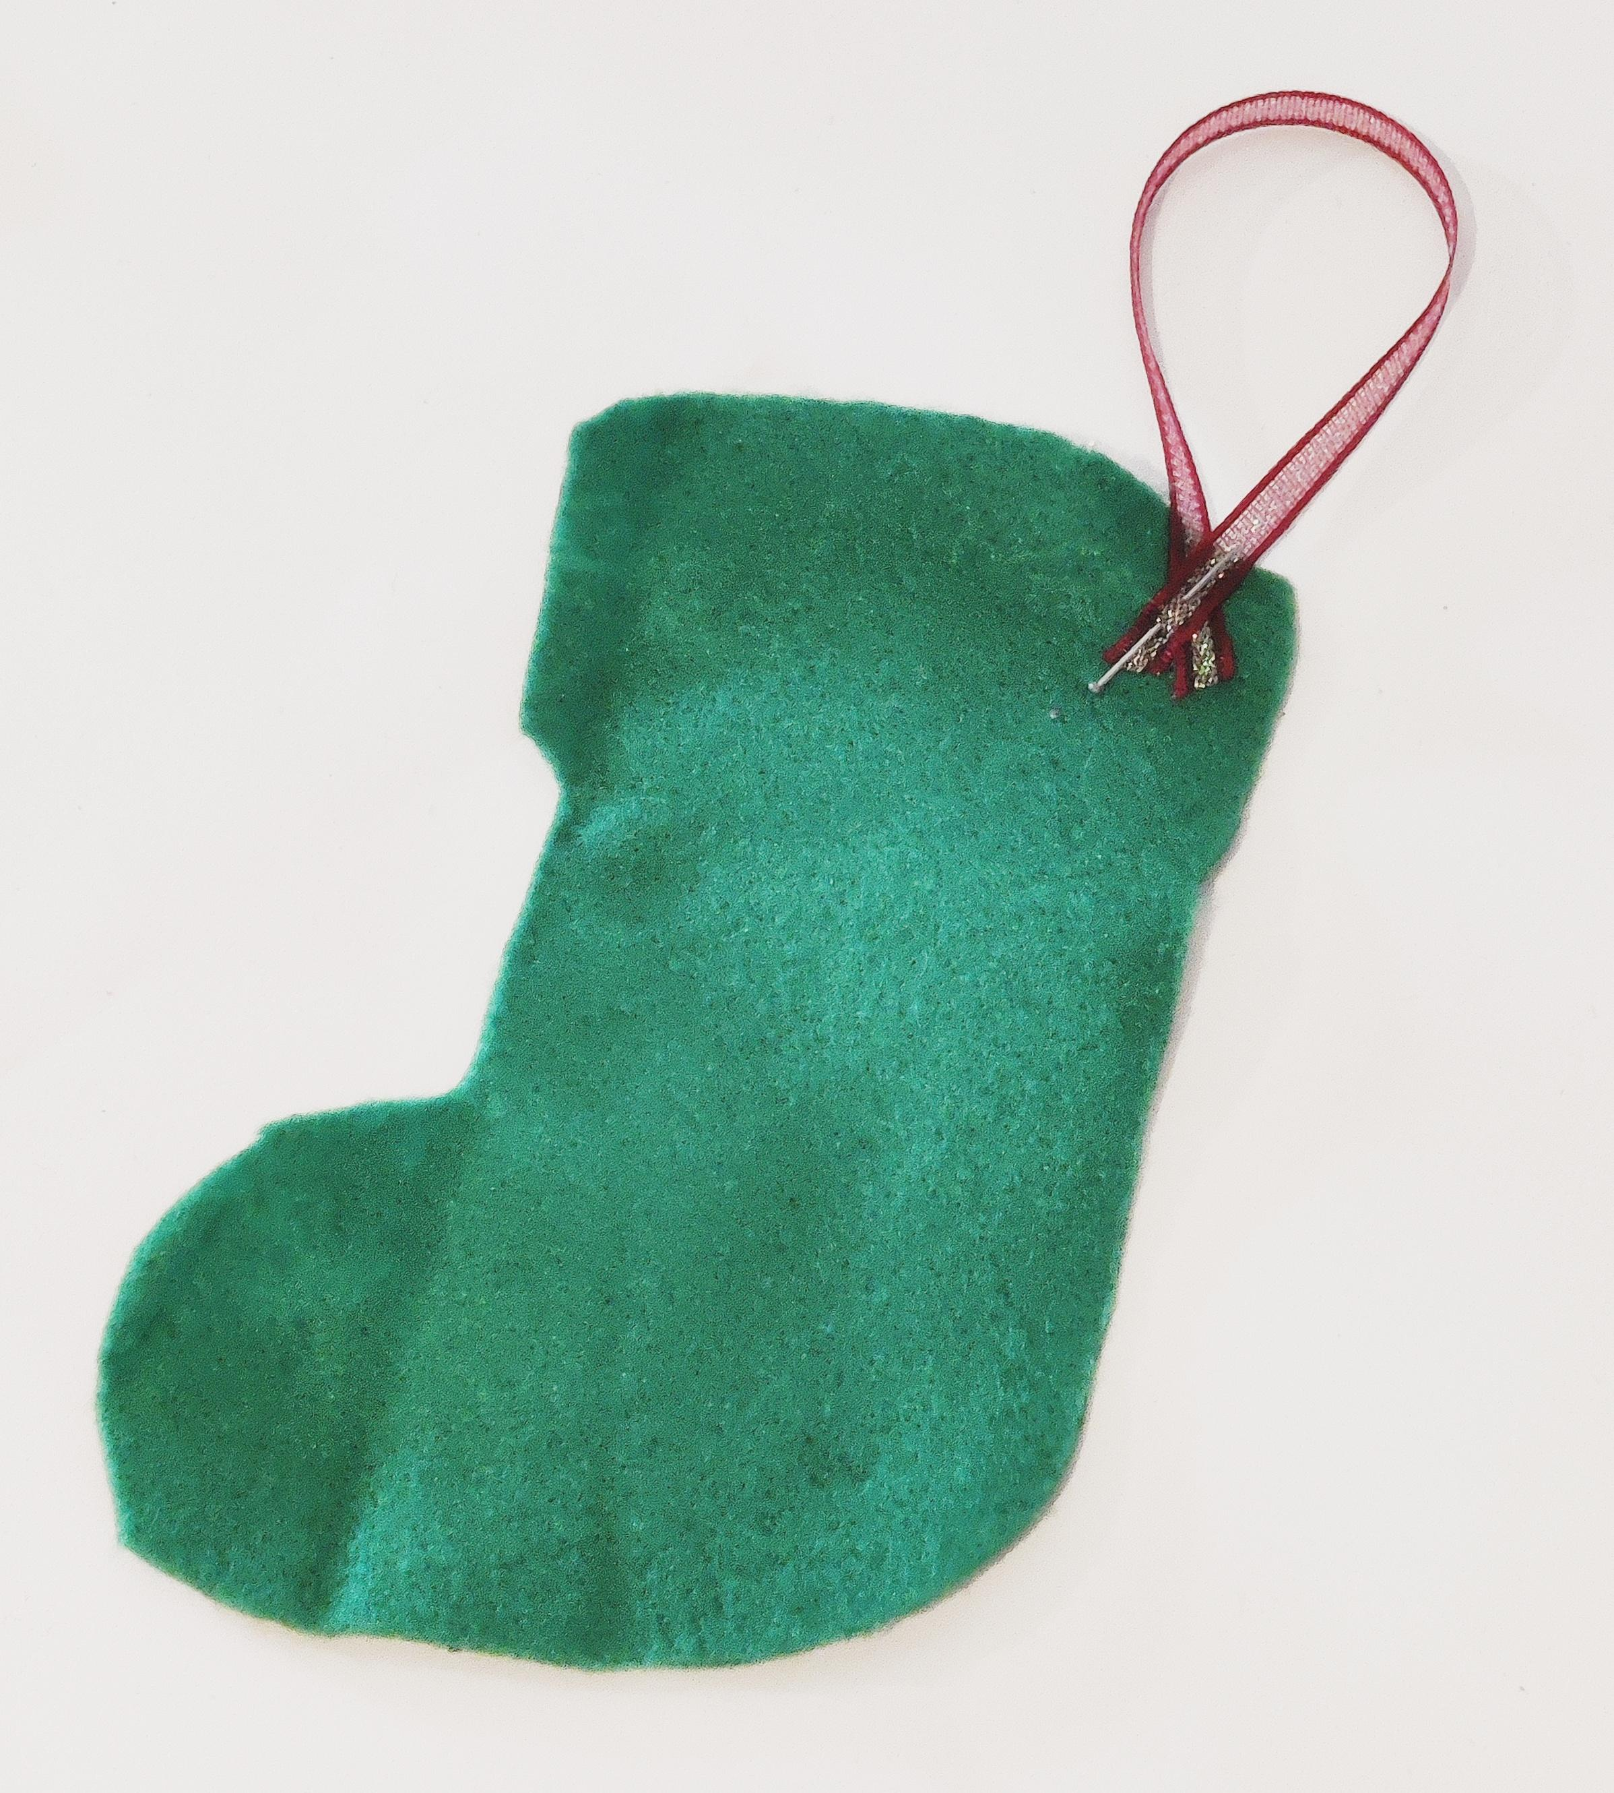
Step 3
⚠
Pin the pieces together, include the ribbon to hang the decoration
Notes:
Learners could single stitch or glue the ribbon in place before they begin.
Pin material pieces together to ensure they stay in place.

Slide 9
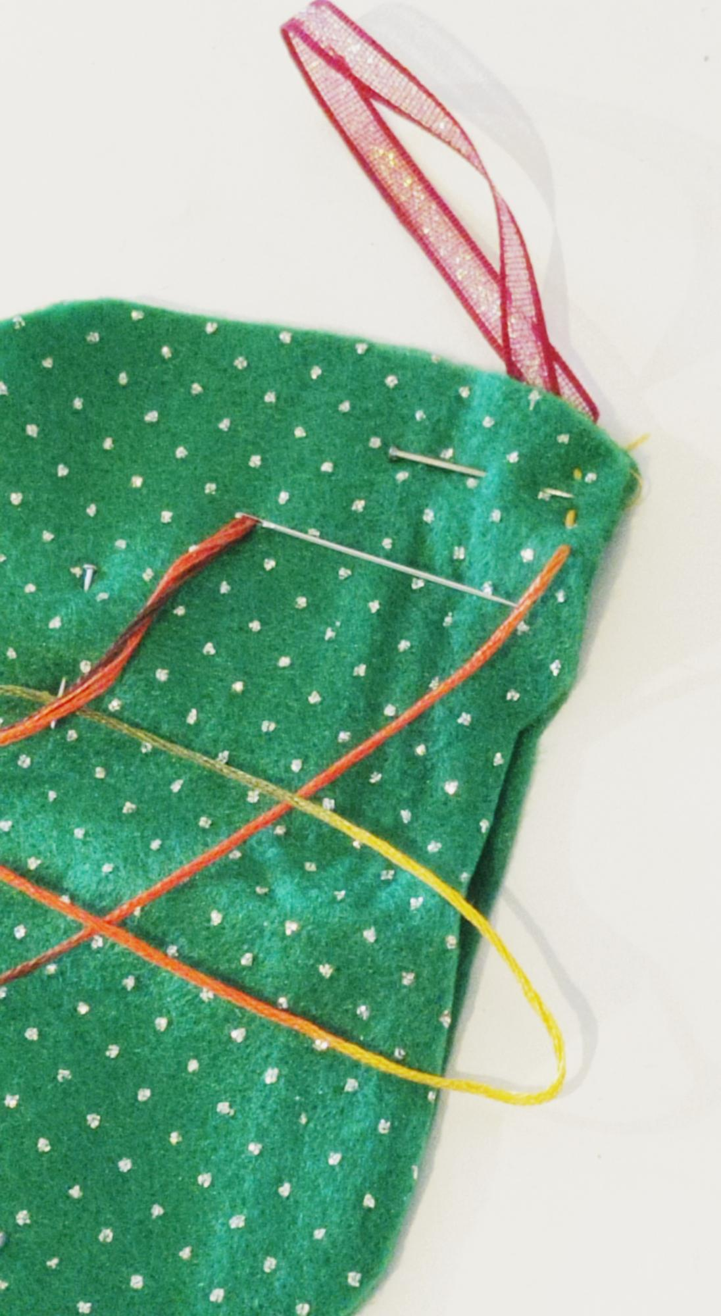
Step 4
⚠
Starting at the top on one side of the stocking, sew a simple running stitch
Push the needle down through the felt, then back up again
Follow the outside edge of the stocking. Stop once you reach the top of the stocking on the opposite corner to where you started
Notes:
1. Lower ability: use glue to stick the two pieces together
2. Higher ability: blanket stitch
Use thread, embroidery thread or wool depending on availability/skills of students.

Slide 10
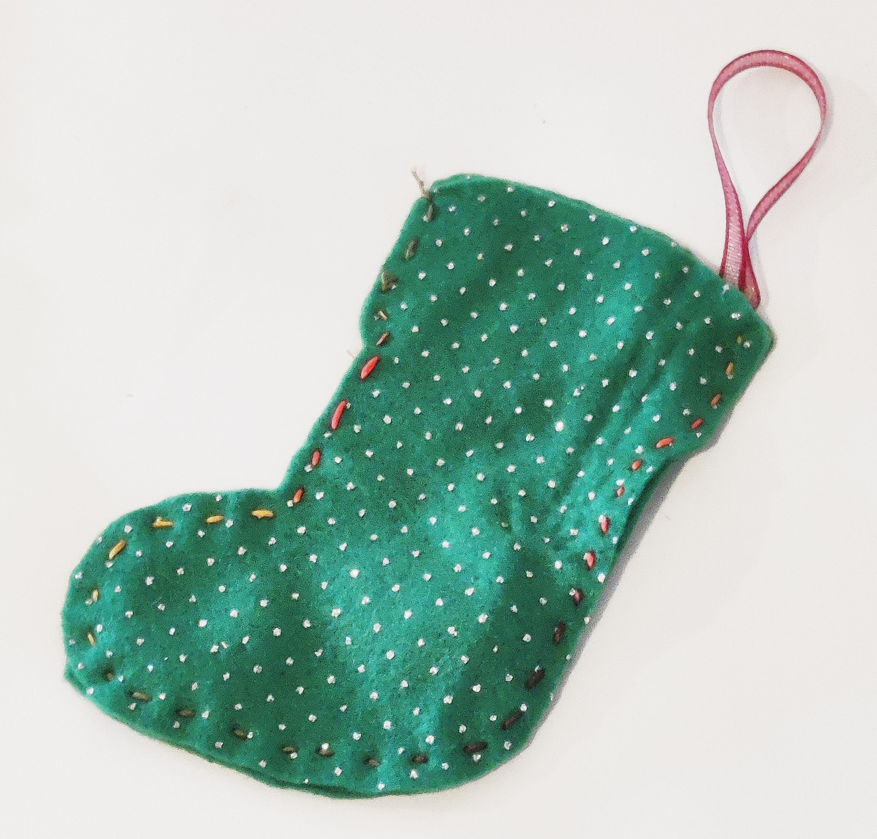
Step 5
⚠
Tie the end of the cotton in a knot and then cut the excess off using scissors
This should leave you with a pocket inside the felt stocking

Slide 11
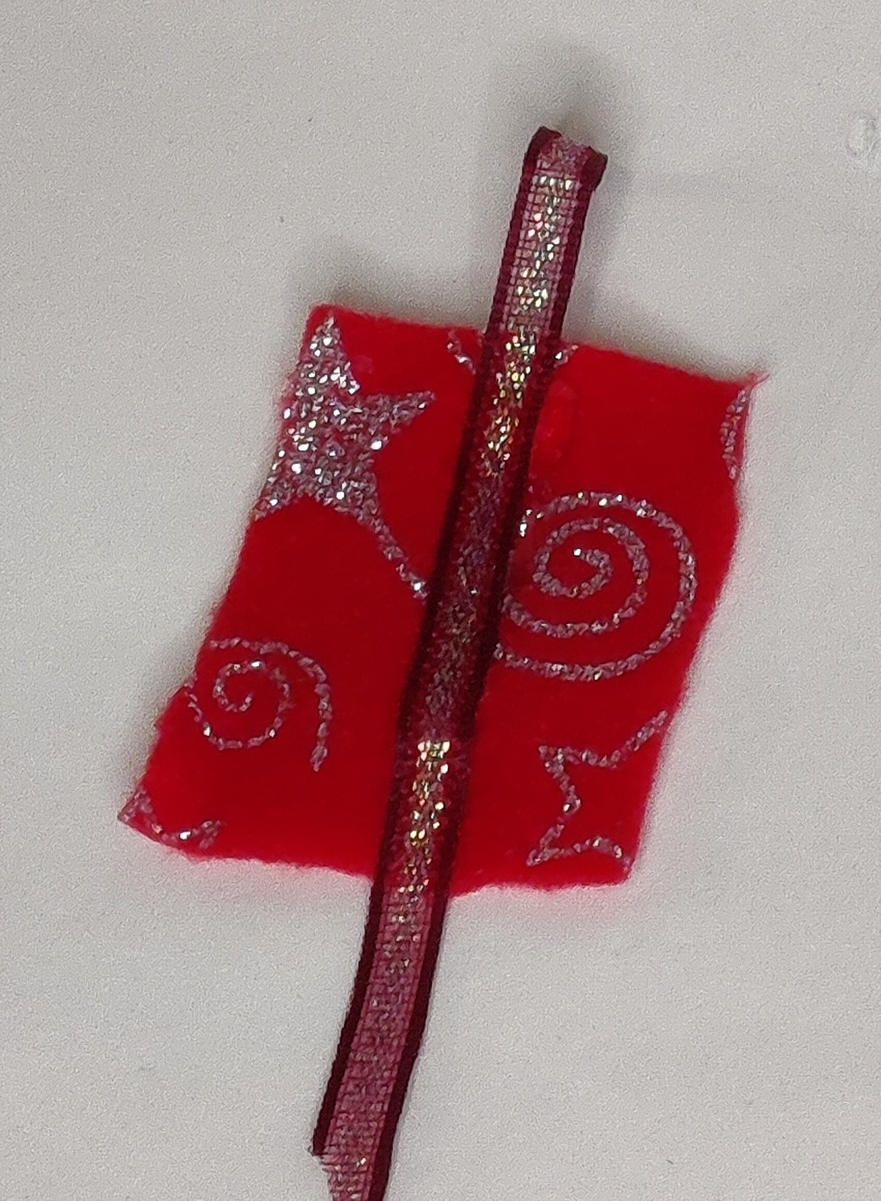
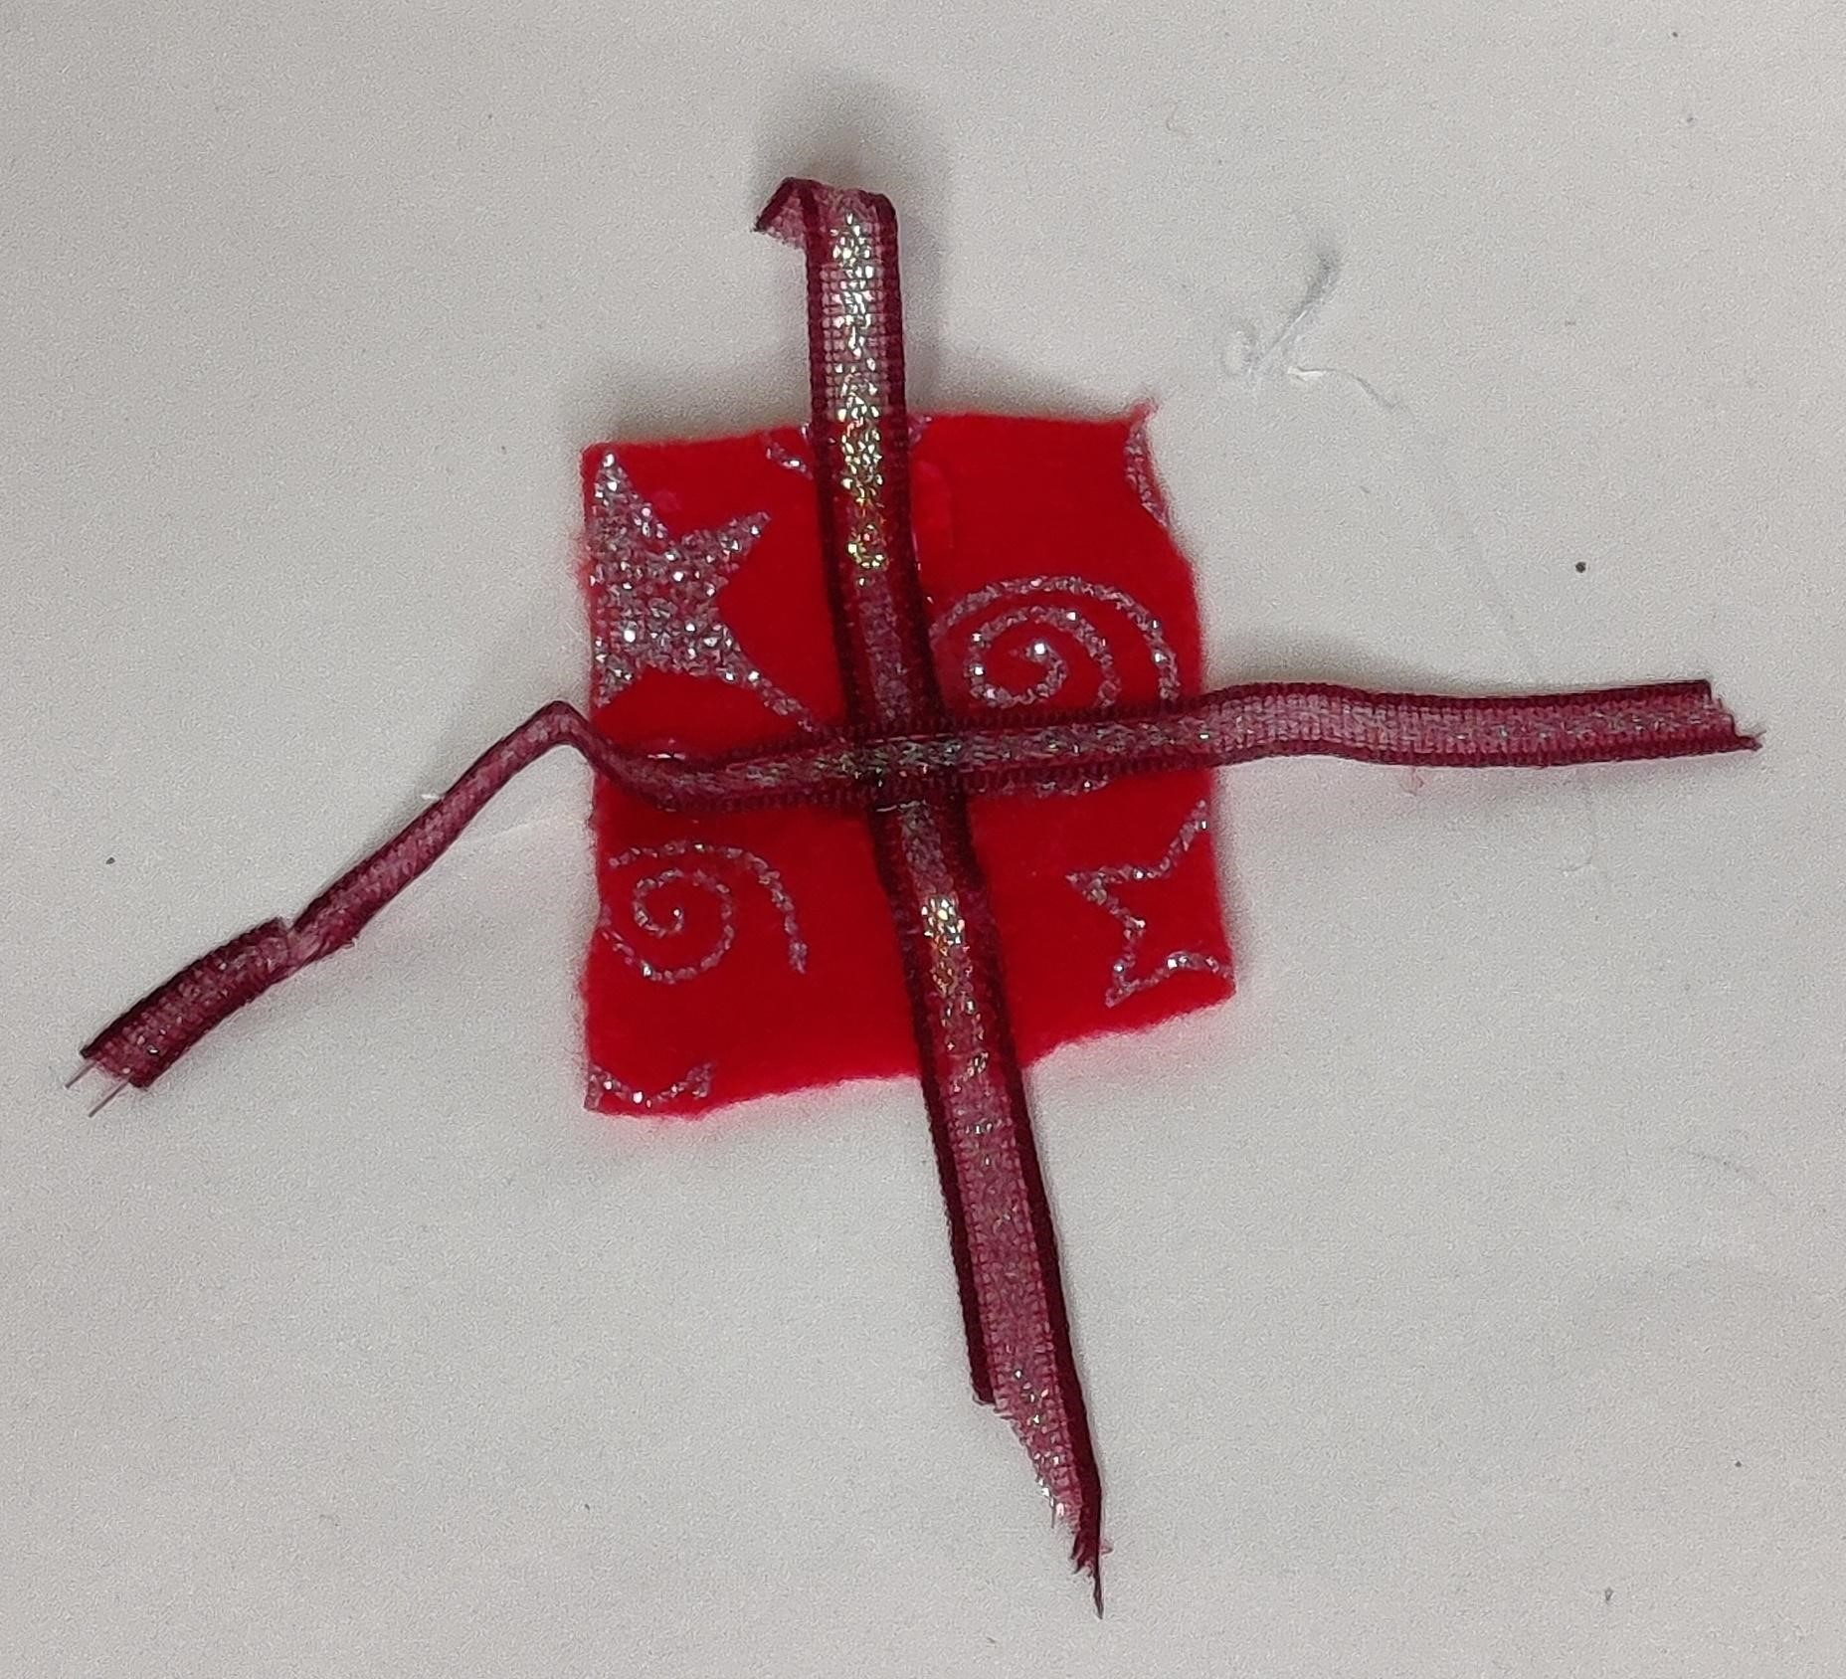
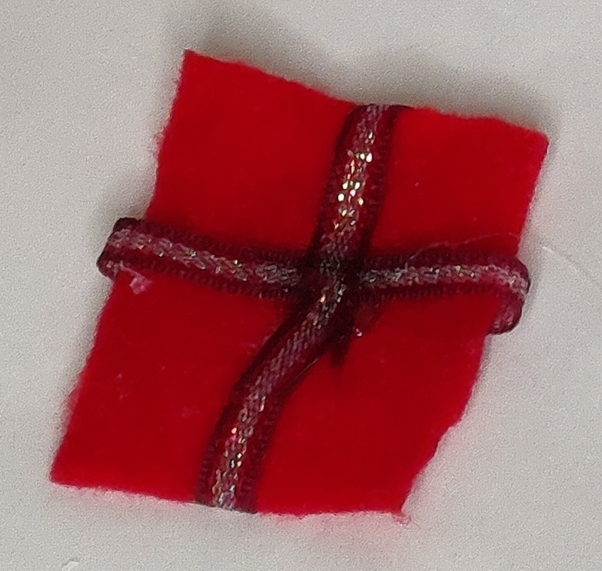
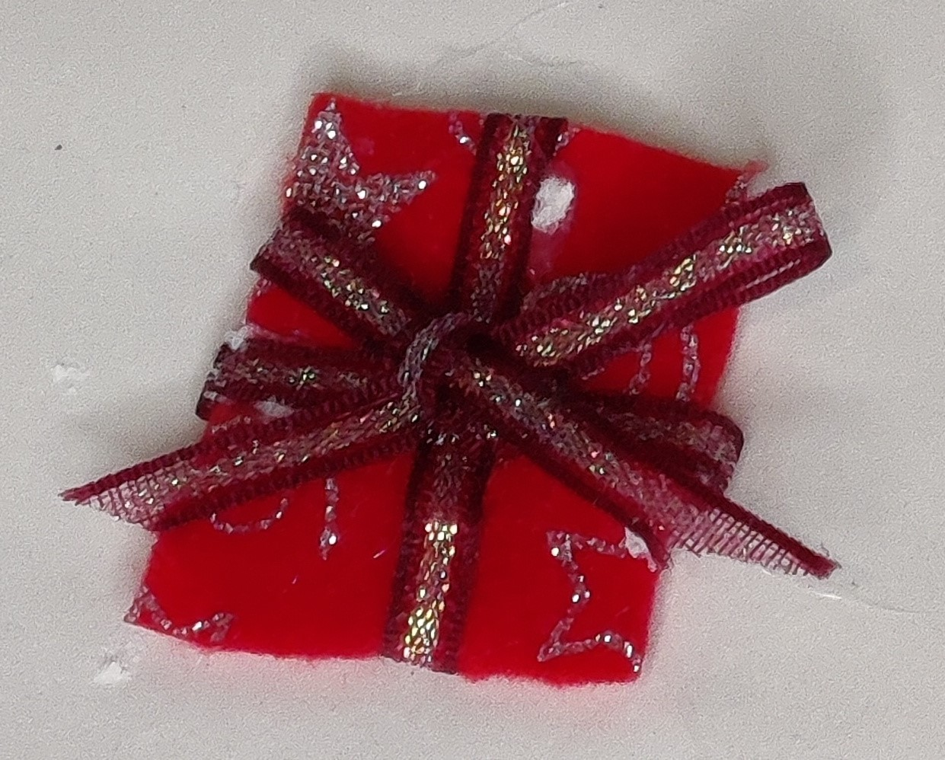
Step 6
Now, you can decorate your stocking!
Felt parcel and ribbon,
using glue to fix the ribbon to the felt
⚠
Notes:
Cut out felt piece in shape of parcel.
Glue/stitch ribbons in place to create parcel effect, securing on the reverse.
Learners can decorate their stockings with any design they wish, using sequins, buttons, beads, pieces of material and hand stitching. See alternate finishing.

Slide 12
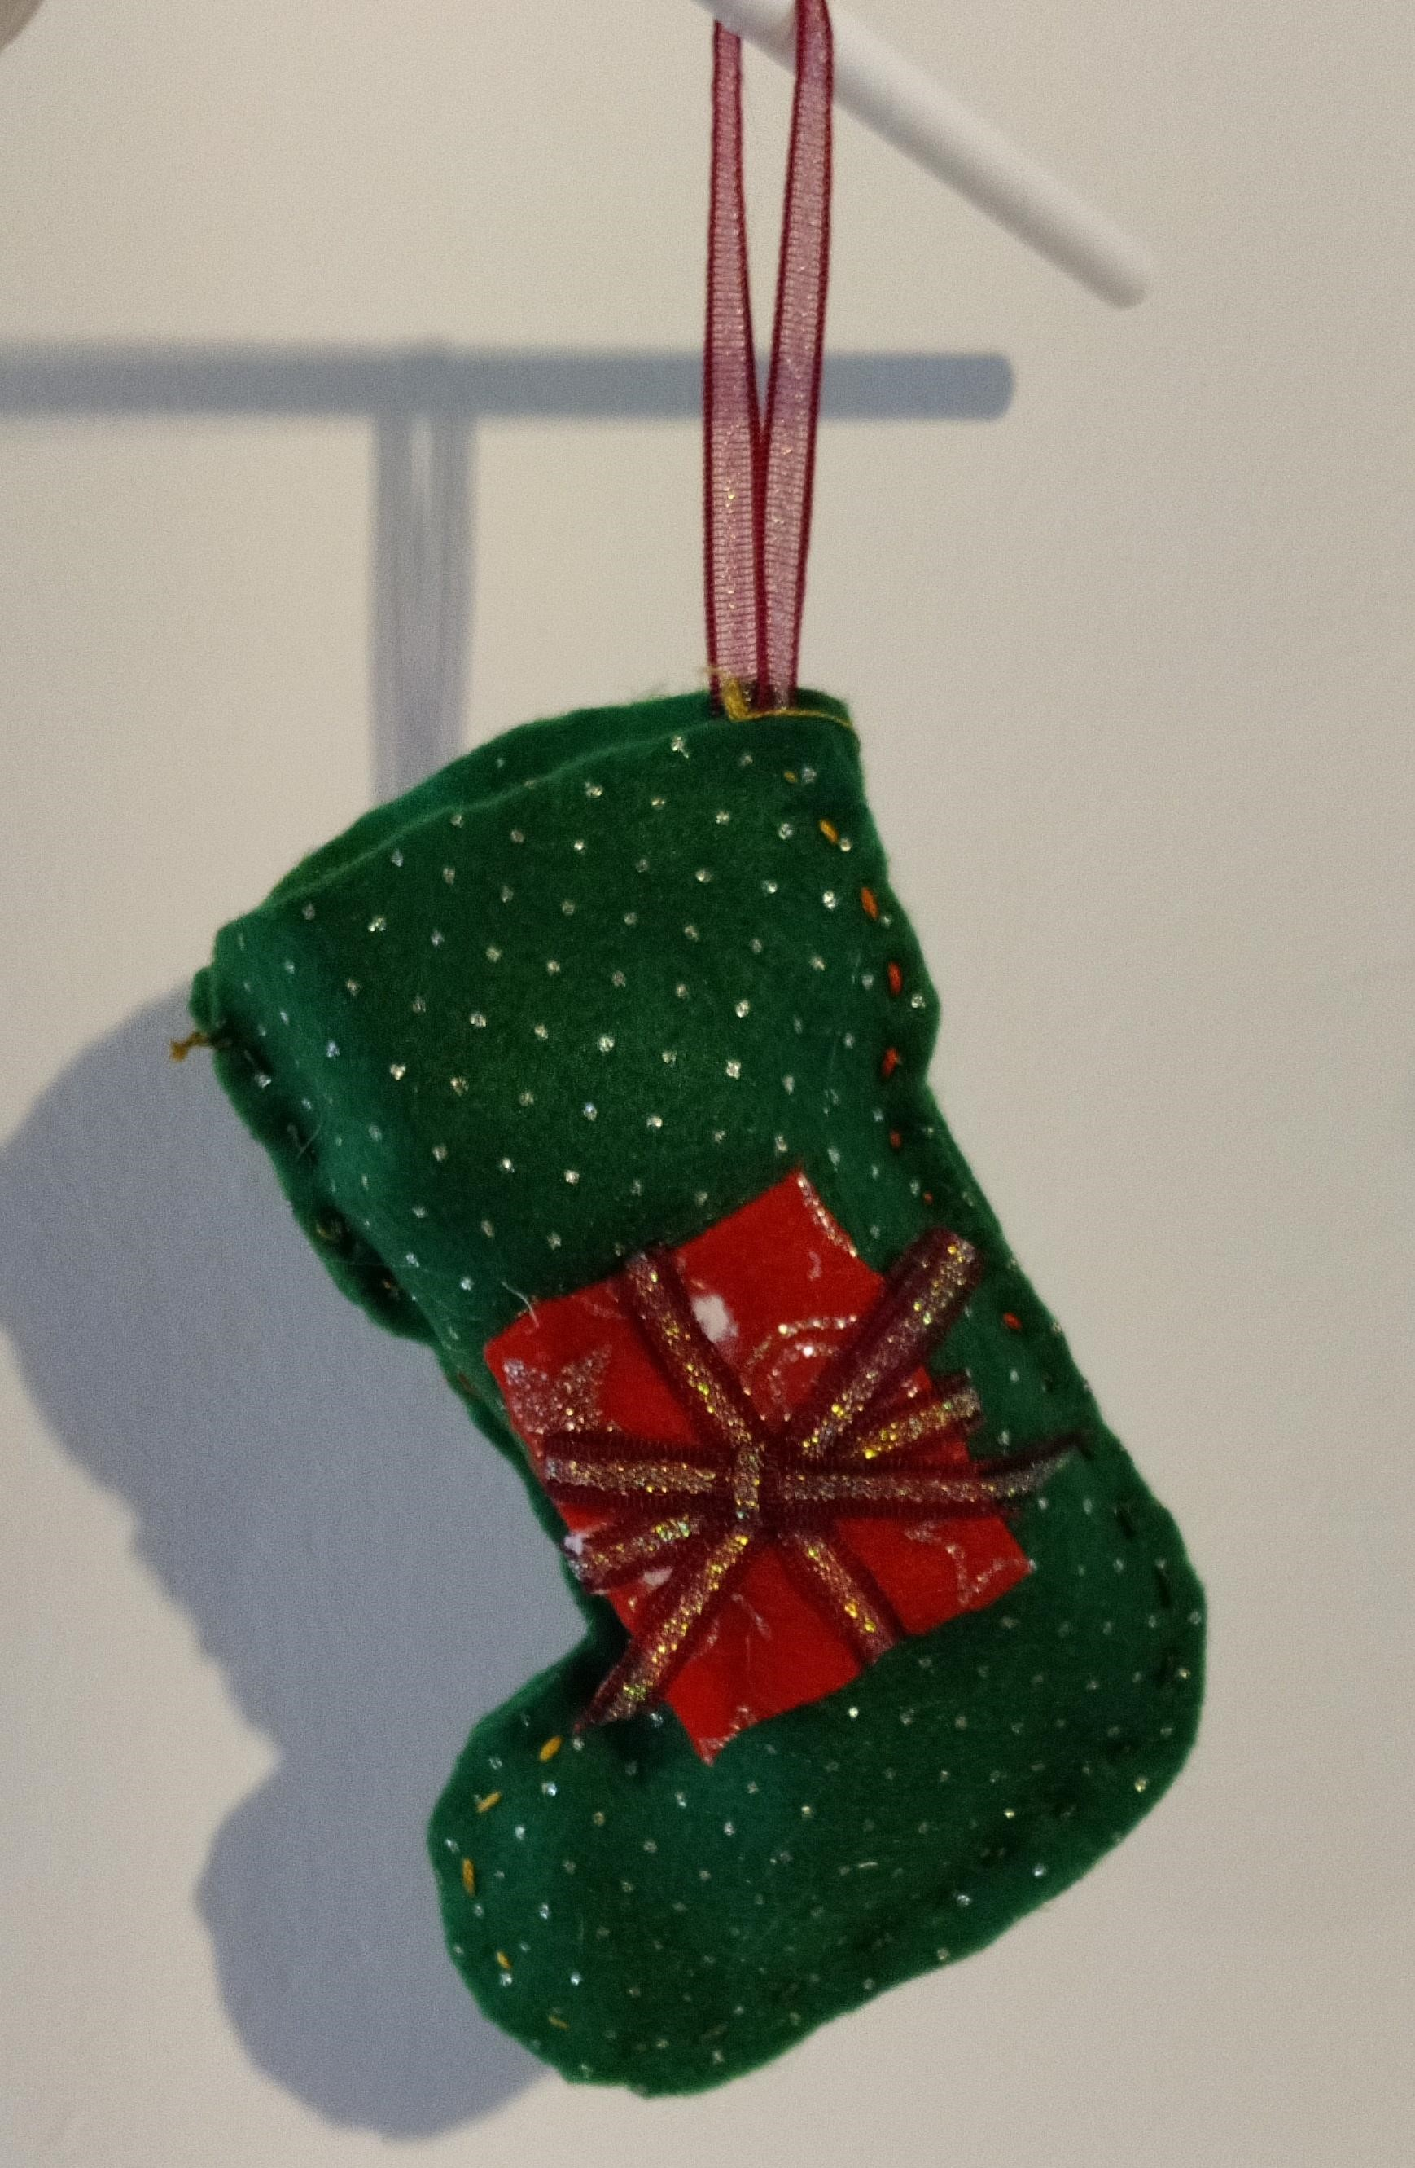
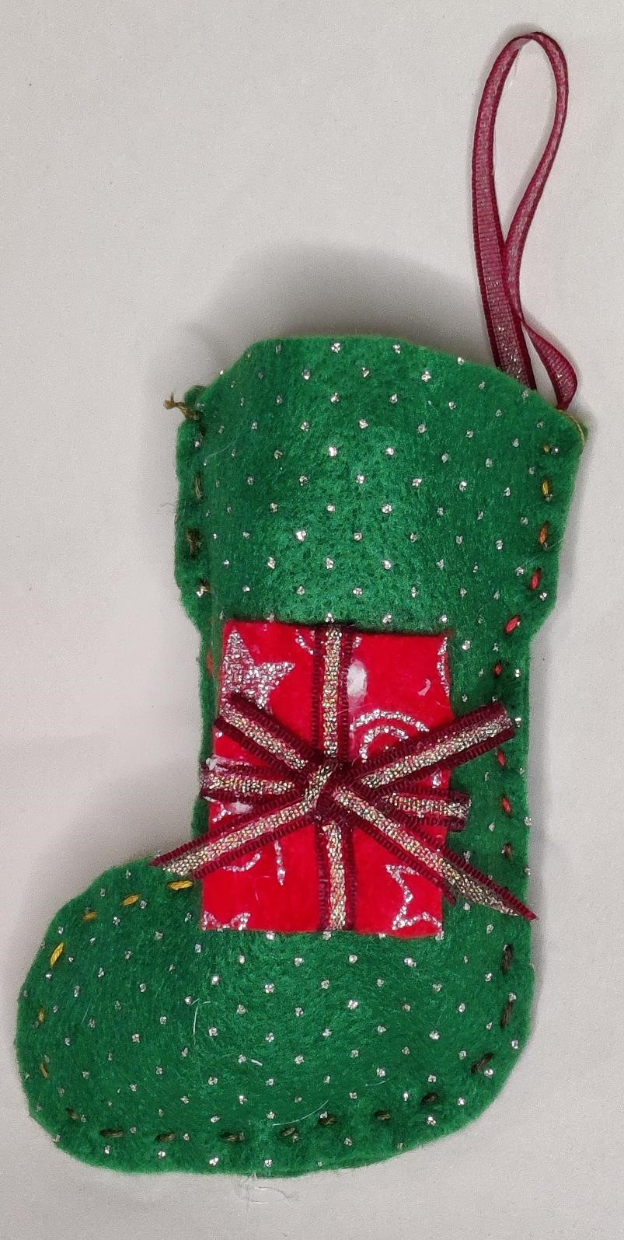
Notes:
Finished stocking using running stitch and glued on decoration.

Slide 13
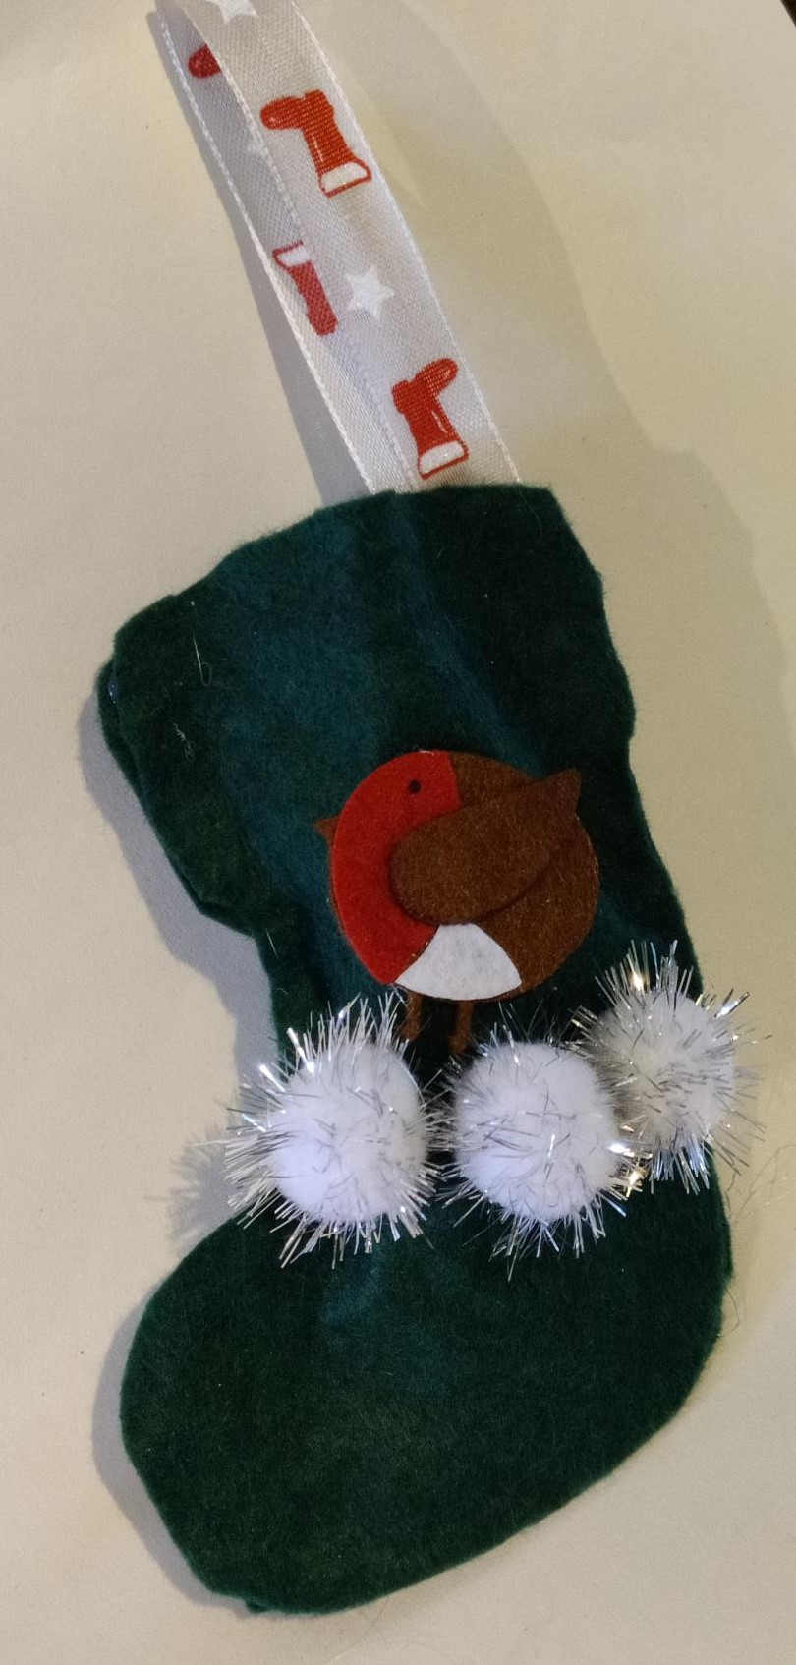
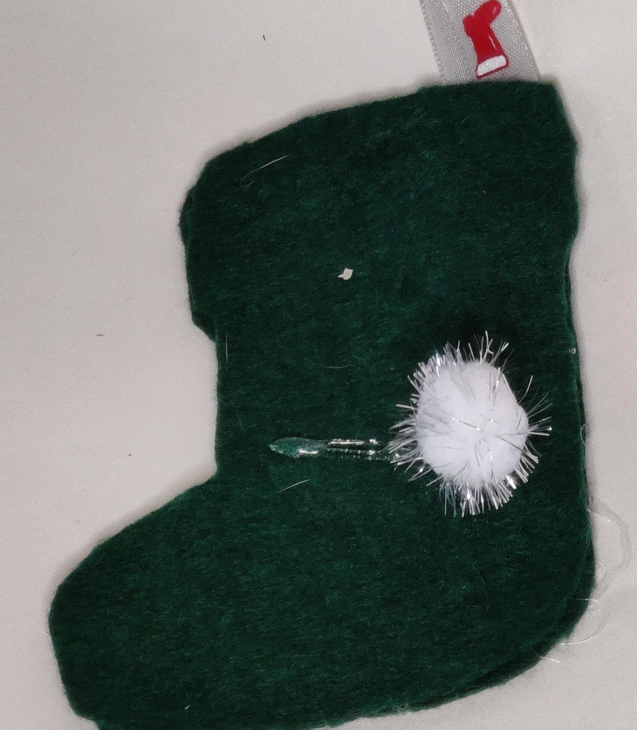
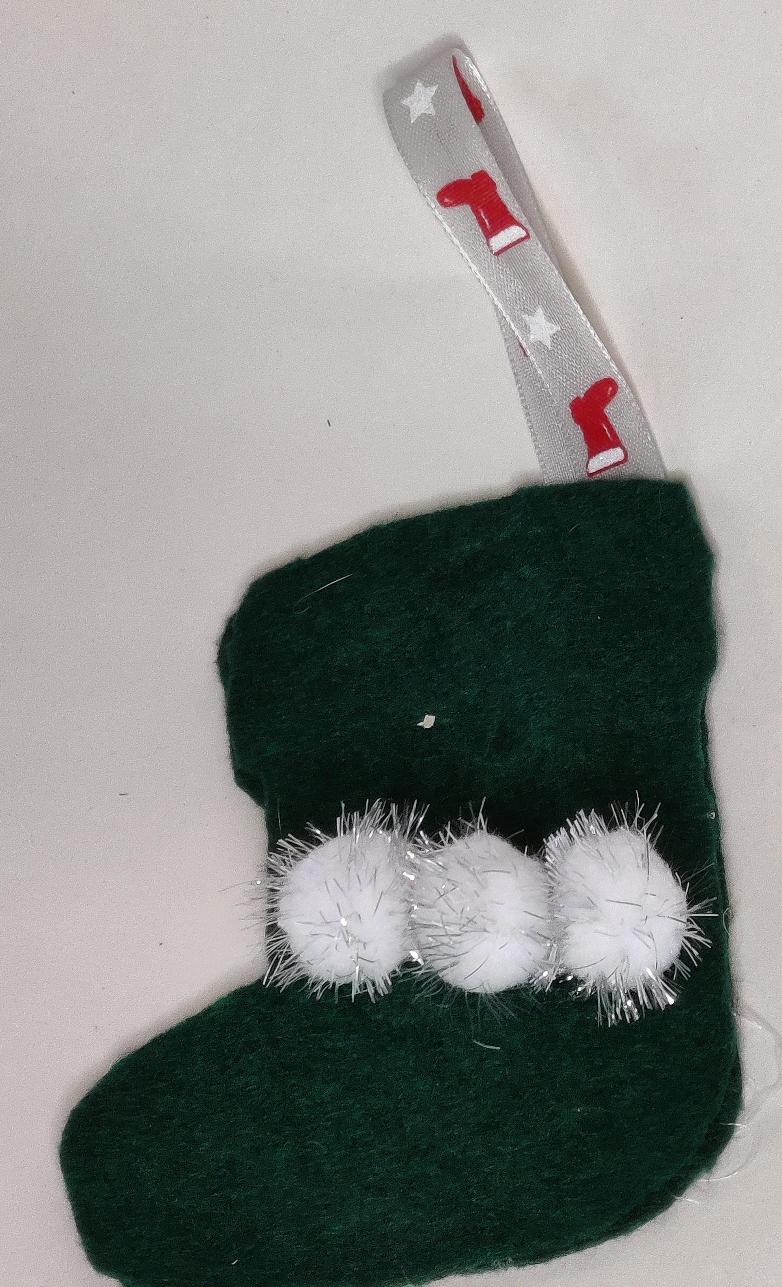
Step 6(b)
⚠
Now, you can decorate your
stocking!
Use glue to attach decorations to the felt
Notes:
DIFFERENTIATION
Glue on cottonwool/pom poms.
Attach Robin above the pom poms to make it look like it is in the snow.

Slide 14
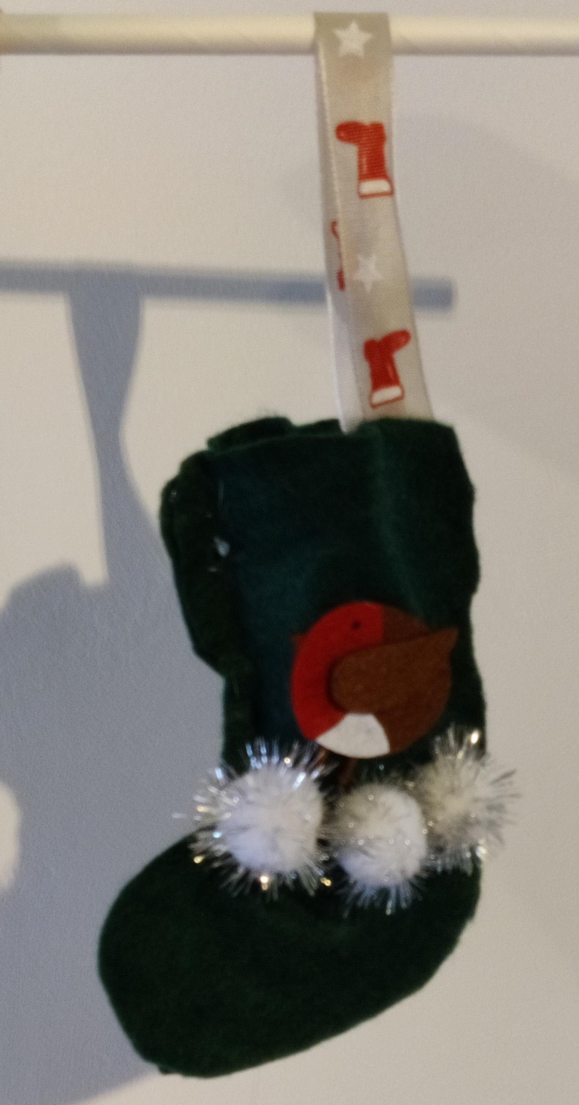
Notes:
Glued stocking with glued on decorations.

Slide 15
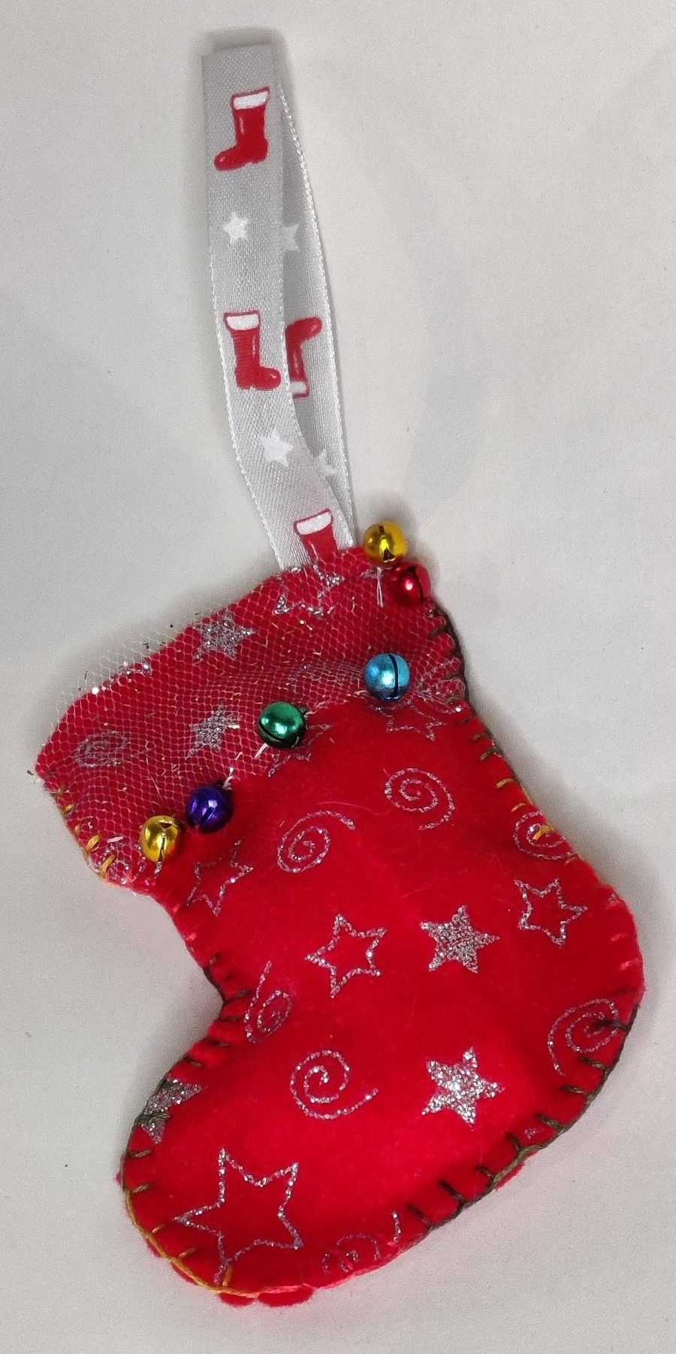
Step 6(c)
⚠
Ribbon to hang decoration, stitched in
Now, you can decorate your stocking!
Mini bells, hand sewn on
Ribbon overlay, hand stitched on
Blanket stitch
Notes:
DIFFERENTIATION - higher ability
Sheer ribbon overlaid the top of the stocking to create a gold trimming, held in place with white running stitch.
Blanket stitch the edges of the sticking with embroidery thread.
Small bells handstitched on to the ribbon so that it jingles when moved.

Slide 16
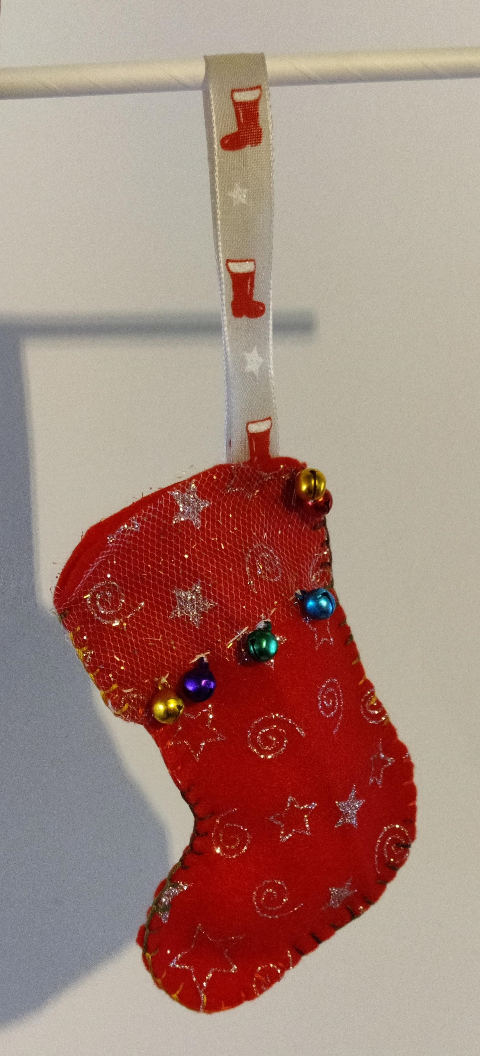

Slide 17
Notes:
All three finished example Christmas stockings.

Slide 18
Extension
Consider different sizes and styles of stockings that could be sold in a Christmas shop
Create a social media advertisement for your designs

