Slide 1




Design and make a
Cookie Cutter
Designing and making a cookie cutter using CAD and 3D printing

Slide 2
Stay safe
Whether you are a scientist researching a new medicine or an engineer solving climate change, safety always comes first. An adult must always be around and supervising when doing this activity. You are responsible for:
ensuring that any equipment used for this activity is in good working condition
behaving sensibly and following any safety instructions so as not to hurt or injure yourself or others
Please note that in the absence of any negligence or other breach of duty by us, this activity is carried out at your own risk. It is important to take extra care at the stages marked with this symbol: ⚠

Slide 3
Design Brief
Cookie cutters are used to make shaped biscuits
Your task is to design a cookie cutter and make it using 3D printing
To do this you are going to use TinkerCAD

Slide 4

CAD
CAD = Computer Aided Design

Slide 5

⚠
What you will need:
Computer with TinkerCAD
3D printer
Filament for printer
⚠ Be careful when using the printer

Slide 6
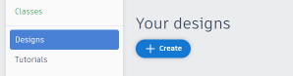
TinkerCAD Instructions
Log into TinkerCAD
Click on Design, then +Create, 3D Design

Slide 7
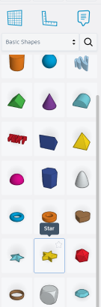
TinkerCAD Instructions
3. Click on Basic Shapes in the Shapes library
4. Choose the 5-pointed star

Slide 8
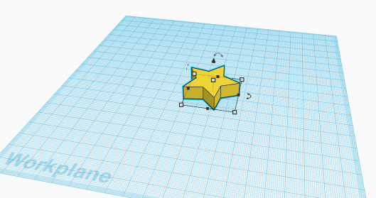
TinkerCAD Instructions
5. Drag the star onto the drawing sheet as shown here (the drawing sheet is called a workplane)

Slide 9
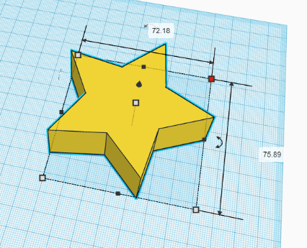
TinkerCAD Instructions
6. Hold shift, click on a corner handle and drag out
7. Try to get sizes to close to 72 x 76 mm as shown – use the red dot in the corner and drag it with your mouse

Slide 10
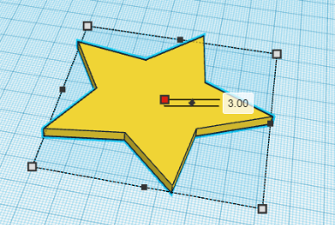
TinkerCAD Instructions
8. Click and hold the square in the middle – drag down to 3 mm

Slide 11
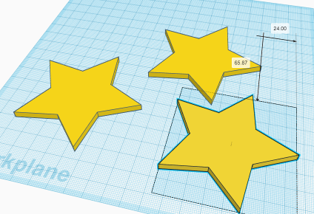
TinkerCAD Instructions
9. We need 3 stars
Press CTRL and D to copy – do this 2 times
The stars will sit on top of each other
10. Drag the stars apart as shown

Slide 12
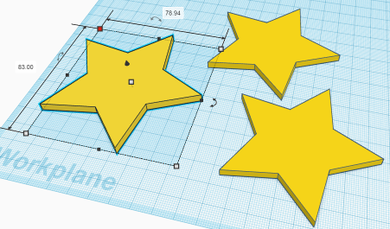
TinkerCAD Instructions
11. Select star number 1 by clicking on it
12. Holding Shift, drag out to be 5 mm bigger – it should now be about 79 x 83 x 3 mm

Slide 13
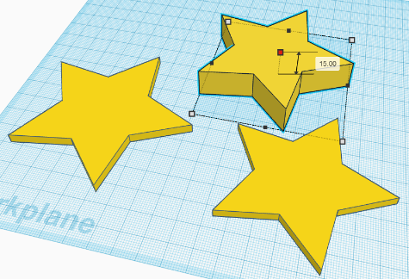
TinkerCAD Instructions
13. Click on star number 2
14. Drag to 15 mm high using the centre square

Slide 14
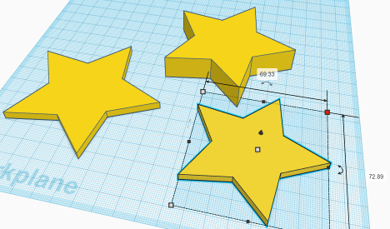
TinkerCAD Instructions
15. Click on star number 3
16. Drag a corner to make it 2 mm smaller in the x and y directions – if you hold shift, this makes it reduce equally in size

Slide 15
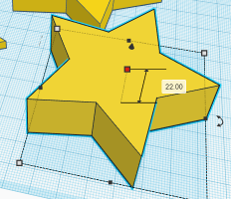
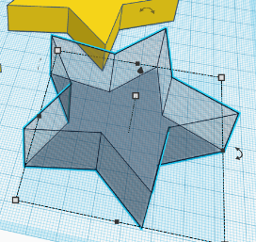

TinkerCAD Instructions
17. Make star 3 20 mm tall
18. Click to make it into a hole

Slide 16
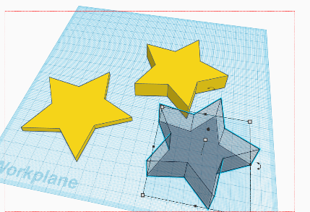
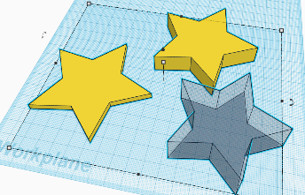
TinkerCAD Instructions
19. Click on the workplane and drag a box to select all the stars
All selected

Slide 17

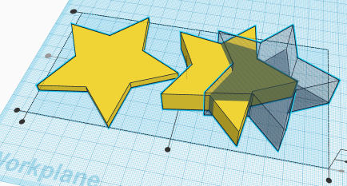
TinkerCAD Instructions
  20. Click to align 3 stars
  21. Click centre circle

Slide 18
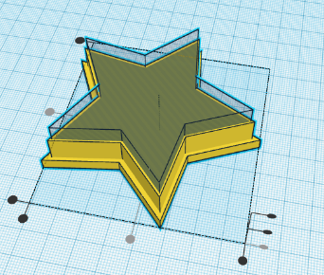
TinkerCAD Instructions
22. Click here to align the three stars

Slide 19
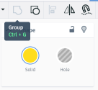
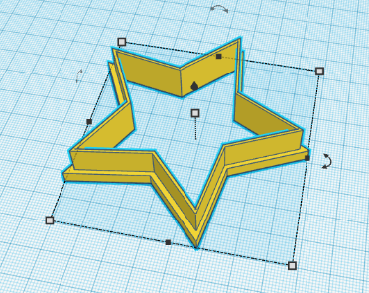
TinkerCAD Instructions
23. Click to group the stars – this makes them 1 object

Slide 20
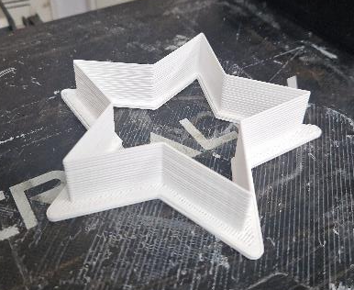

Printing
⚠
Now 3D print your cookie cutter!
Be careful – the printer nozzle is very hot when it is depositing the polymer
Remove from the printer and put it to use!
Notes:
Depending upon the printer available, it may be possible to print directly from the CAD software. However, with some printers it may be necessary to save the image as a .stl file, then use the software supplied with the printer to slice the image, producing a .gx file or similar. This can then be sent to the printer (by a direct connection or by using a USB memory stick, as appropriate for the printer available).
The images show two different prints of the same item, produced with different colours of pla polymer.

Slide 21
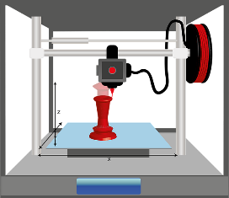
How 3D Printing Works
You create a 3D CAD model
Your model is sent to a piece of software that ‘slices’ it into thin layers
The printer prints the first layer on the base
It then adds layers to build the model – much like a house with bricks, starting at the bottom and working upwards

Slide 22
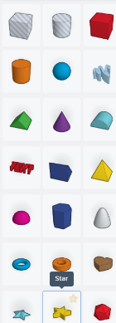
Design Your Own Cookie Cutter
⚠
What other shapes can you make?
Keep the basic principles the same:
three similar shapes
one larger but thin
one taller
one taller as a hole
⚠ Be careful when using the printer

Slide 23
Examples of Learner Work

