Slide 1
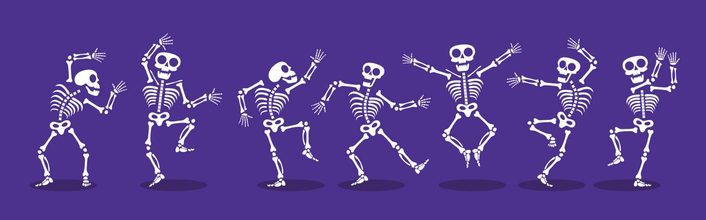
Make a dancing skeleton
Making a dancing skeleton with movable arms and legs

Slide 2
Stay safe
Whether you are a scientist researching a new medicine or an engineer solving climate change, safety always comes first. An adult must always be around and supervising when doing this activity. You are responsible for:
ensuring that any equipment used for this activity is in good working condition
behaving sensibly and following any safety instructions so as not to hurt or injure yourself or others
Please note that in the absence of any negligence or other breach of duty by us, this activity is carried out at your own risk. It is important to take extra care at the stages marked with this symbol: ⚠
Notes:
Safety Warning

Slide 3
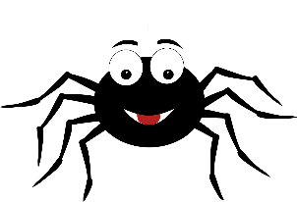
Where does Halloween come from?
Halloween is an old festival that dates back many centuries
First observed by the Scottish and Irish as ‘All Hallows Eve’, when it was believed the souls of the dead returned home
All Hallows Day is the 1st of November - it is a date that the Christian church uses to celebrate and honour the Saints of the church
So, All Hallows Eve is the 31st October, Halloween
Notes:
Explain the theme and origins of Halloween to learners.
Learners could be asked what they already know about Halloween and what they would like to learn about it during this activity.

Slide 4
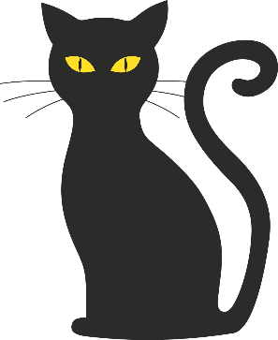
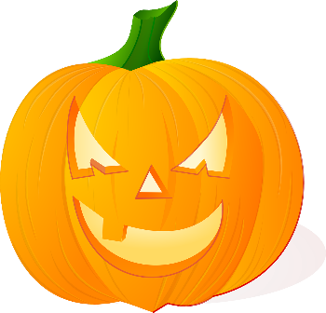
Halloween today
Halloween was taken to the United States of America when many families moved there in the 19th Century
It was then expanded to include ‘Trick or Treat’ and dressing up
Across the world, people now decorate their houses with Halloween decorations such as pumpkin lanterns, witches’ cauldrons, bats, spiders’ webs and skeletons
Notes:
Explain the theme and origins of Halloween to learners.
Learners could be asked what they already know about Halloween and what they would like to learn about it during this activity.

Slide 5
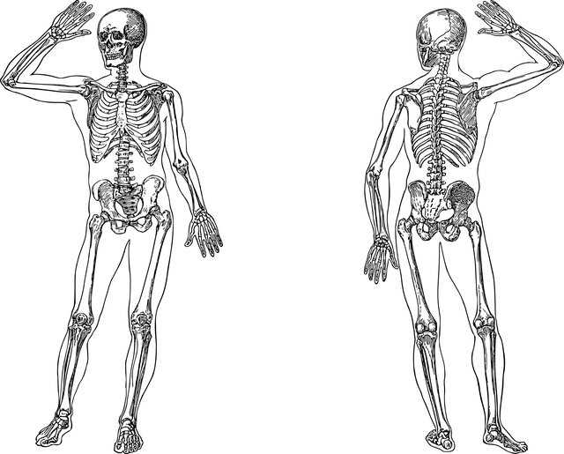
What is a Skeleton?
The skeleton is the frame that supports the body of most animals
It is made from lots of different bones

Slide 6
There are 206 bones in the human body
These are the main ones to remember
Bones!

Slide 7
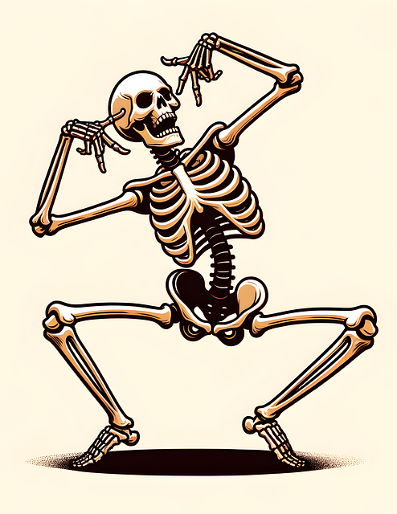
The Challenge
You are going to make a skeleton that can dance
You will use your knowledge of bones and the body to develop it further

Slide 8
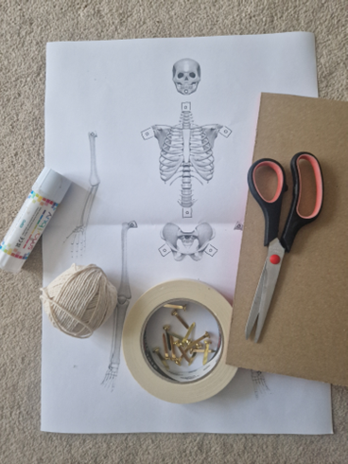
Resources
You will need:
The dancing skeleton template
Scissors
Card or cardboard
Glue
Paper fasteners
String
Drinking straws
Tape
Eraser or ball of sticky tack

Slide 9
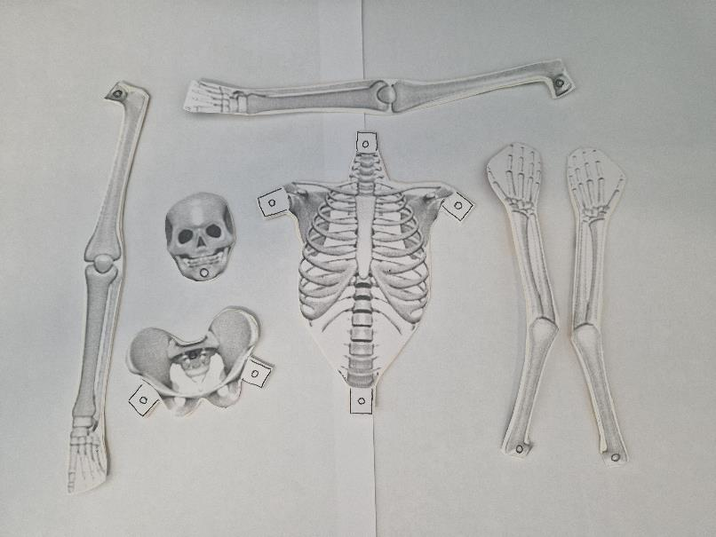
Step 1 – Cut out the skeleton parts
⚠
Carefully cut along all the solid outlines
Glue onto card or cardboard
When the glue is dry, cut out the cardboard

Slide 10

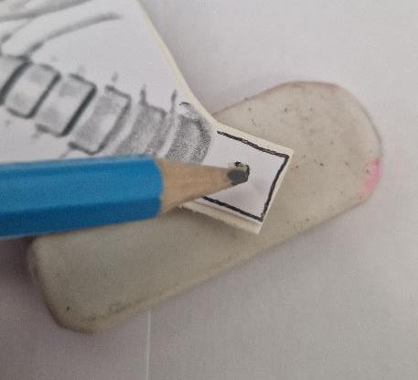
Step 2 – Make the holes
⚠
Put an eraser (or a ball of sticky tack or thick card) behind the hole, then push a sharp pencil in to make a hole for the paper fastener.
Repeat for all 12 holes!
12 Holes

Slide 11
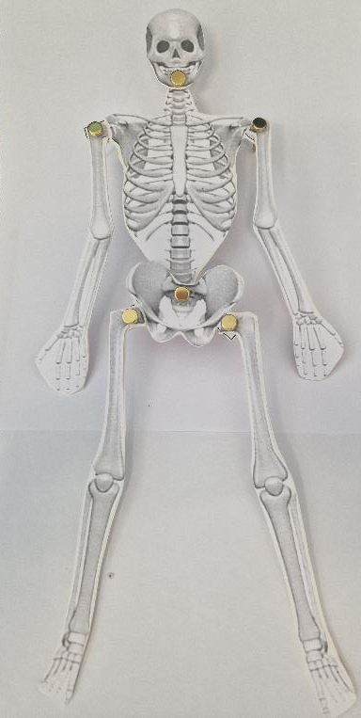
⚠
Step 3 – Connect the skeleton
Add joints to the skeleton with the paper fasteners
A joint is where two bones meet, but move
These make it move like your body does

Slide 12
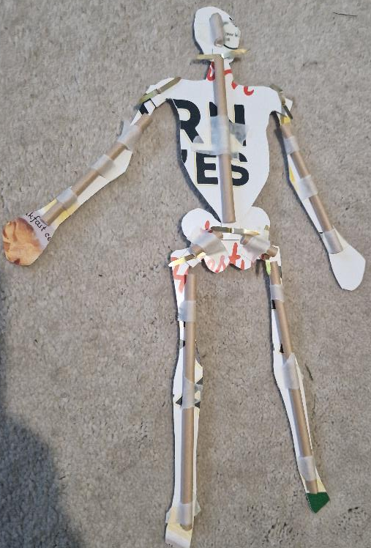
Step 4 – Add straws
⚠
Cut straws that are slightly shorter than each arm, leg and the chest
Cut three short straws to attach to the pelvis and head
Tape the straws to the back of each bone as shown - leave a small gap between each straw
Hints:
Be careful not to crush the straws.
Make sure the sticky tape does not cover the end of the straw.

Slide 13
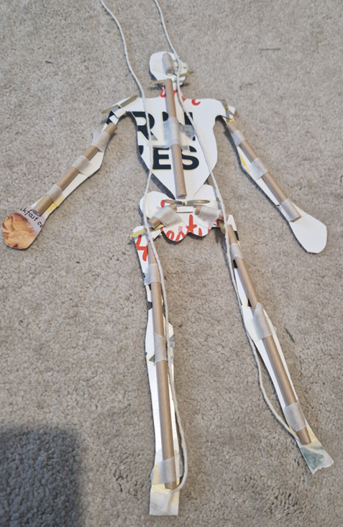
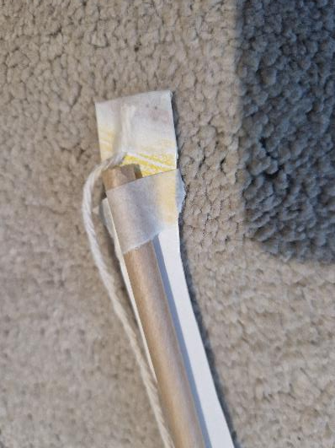
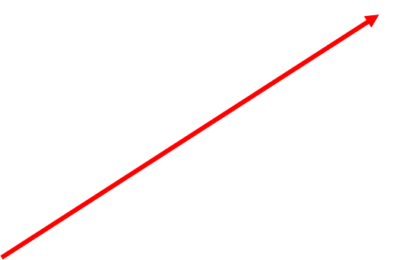
Step 5 – Secure the feet
Attach a piece of string to the base of each foot using sticky tape

Slide 14
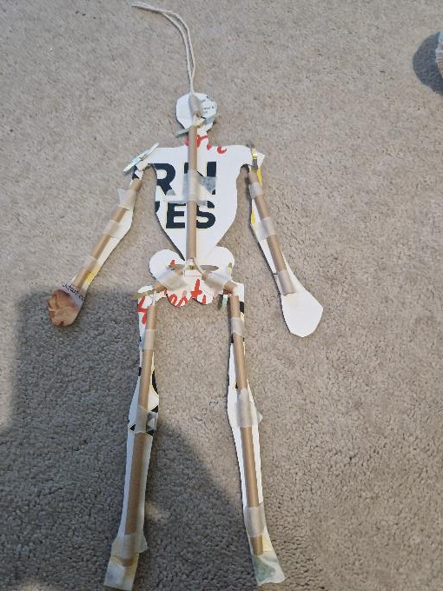
Step 6 – Thread it through
Thread the string through the straws for the legs, pelvis, spine and head
Leave a length to pull on at the top

Slide 15
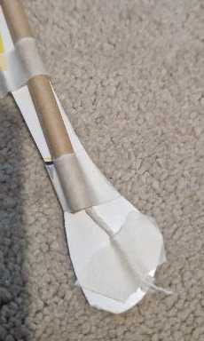
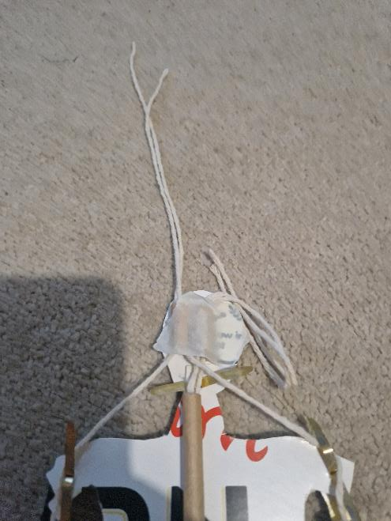
Step 7 – Make it move
Attach string to the hands, hips and spine using sticky tape
Thread the string through the straws above it and out of the head
Leave a length to pull on at the top

Slide 16
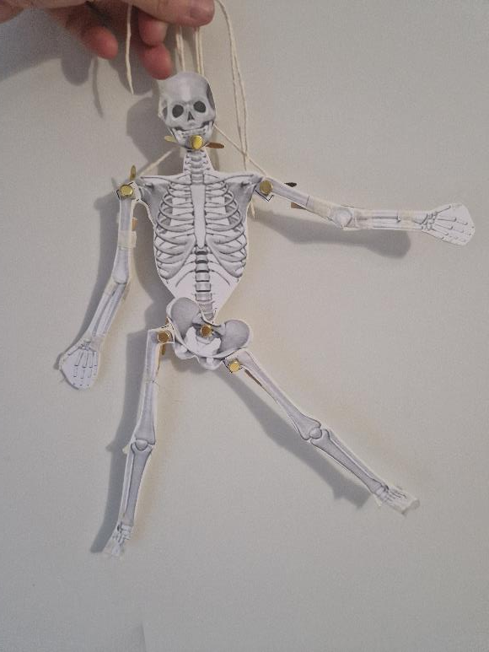
Step 8 – Dance!
Pull the strings individually or together
Experiment with your dancing skeleton

Slide 17

Extension
Can you add linkages to make the body move differently? Or make more than one limb move at the same time?
Can you make the arms and legs bend at the elbows and knees?

