Slide 1
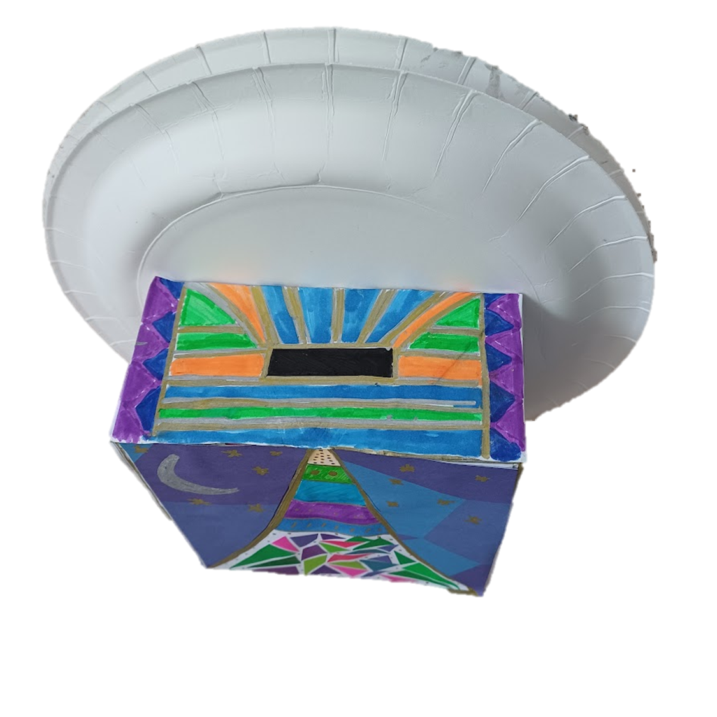
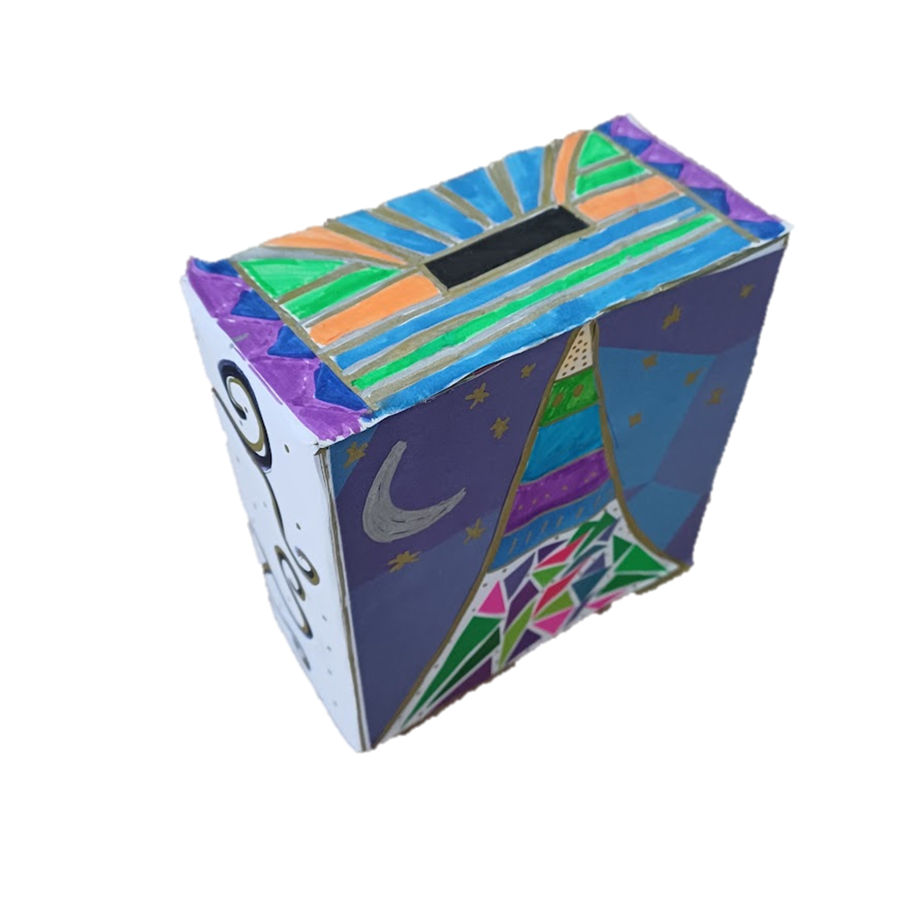
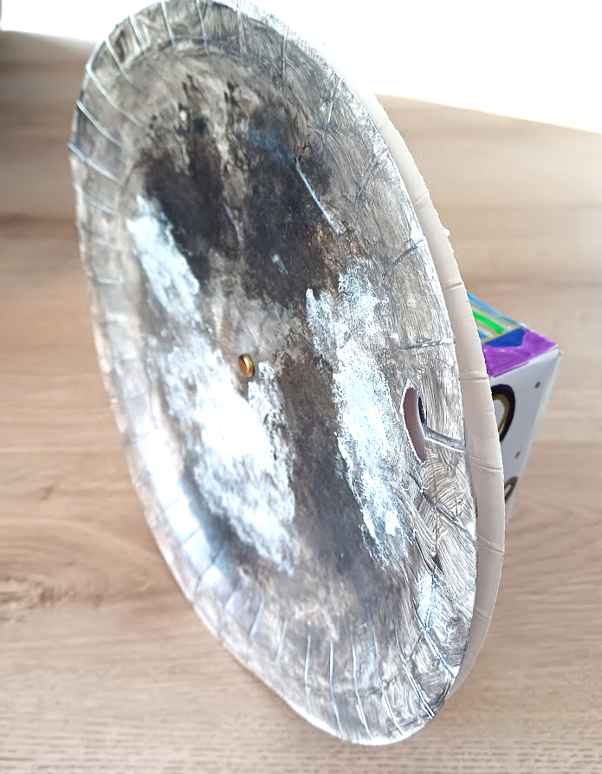
Design and Make a Charity Box
Design and make a charity box
that counts down the days of Ramadan

Slide 2
Stay safe
Whether you are a scientist researching a new medicine or an engineer solving climate change, safety always comes first. An adult must always be around and supervising when doing this activity. You are responsible for:
ensuring that any equipment used for this activity is in good working condition
behaving sensibly and following any safety instructions so as not to hurt or injure yourself or others
Please note that in the absence of any negligence or other breach of duty by us, this activity is carried out at your own risk. It is important to take extra care at the stages marked with this symbol: ⚠

Slide 3
Design Brief
Your task is to design and make a charity box
that counts downs the days of Ramadan

Slide 4
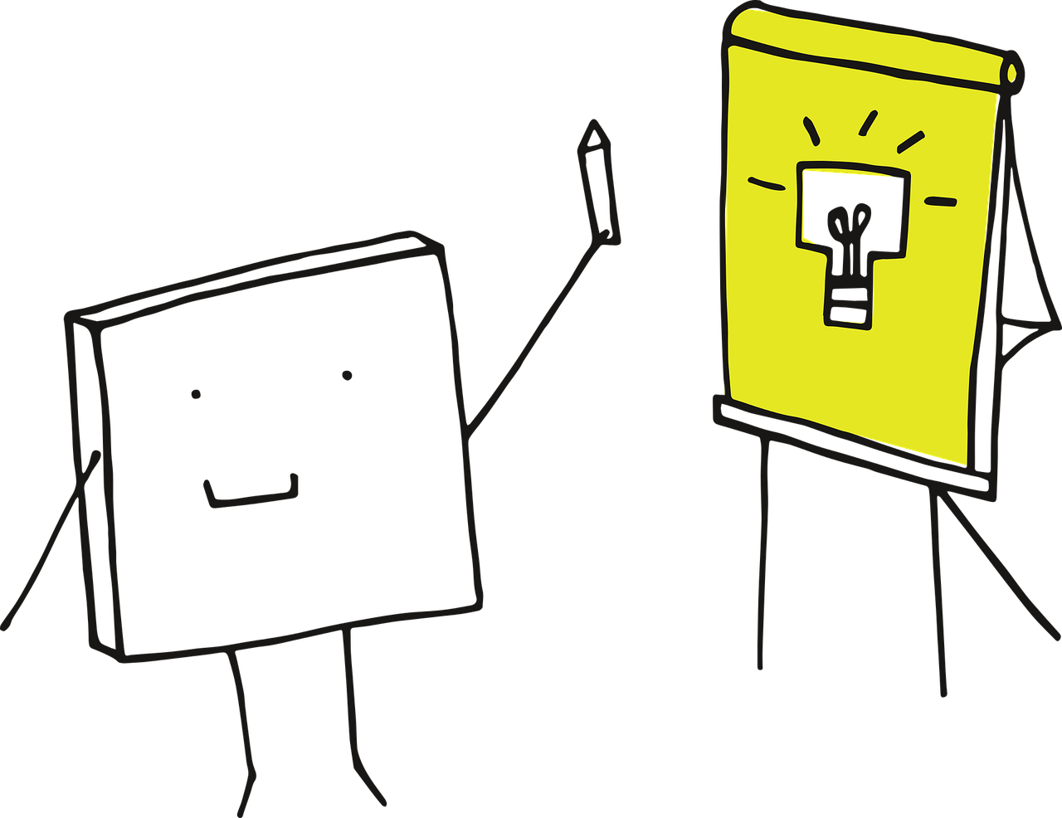
What you need to think about…
You must think about the following when creating your design:
What is Ramadan? How long does it last?
Why is the moon cycle important to Ramadan? How can this be included in your design?

Slide 5
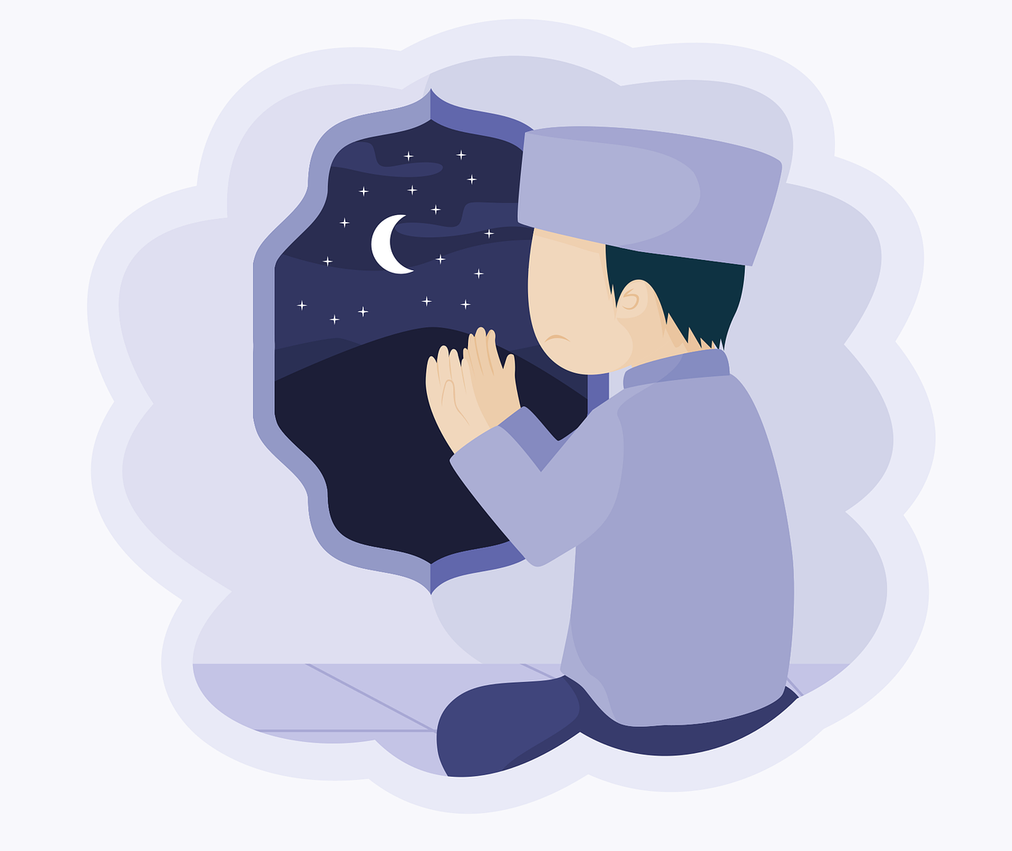
Facts About Ramadan
What is Ramadan?
Ramadan lasts for a month. It is when Muslims all over the world fast between dawn and sunset.
What does fasting mean?
Someone who is fasting chooses not to eat or drink.
When is Ramadan?
It is in the ninth month of the Islamic calendar. It changes each year as it is based on a calendar that uses cycles of the moon.
Notes:
Introduction
Discuss what is Ramadan and who celebrates Ramadan.
Ask the class what they know about Ramadan.

Slide 6
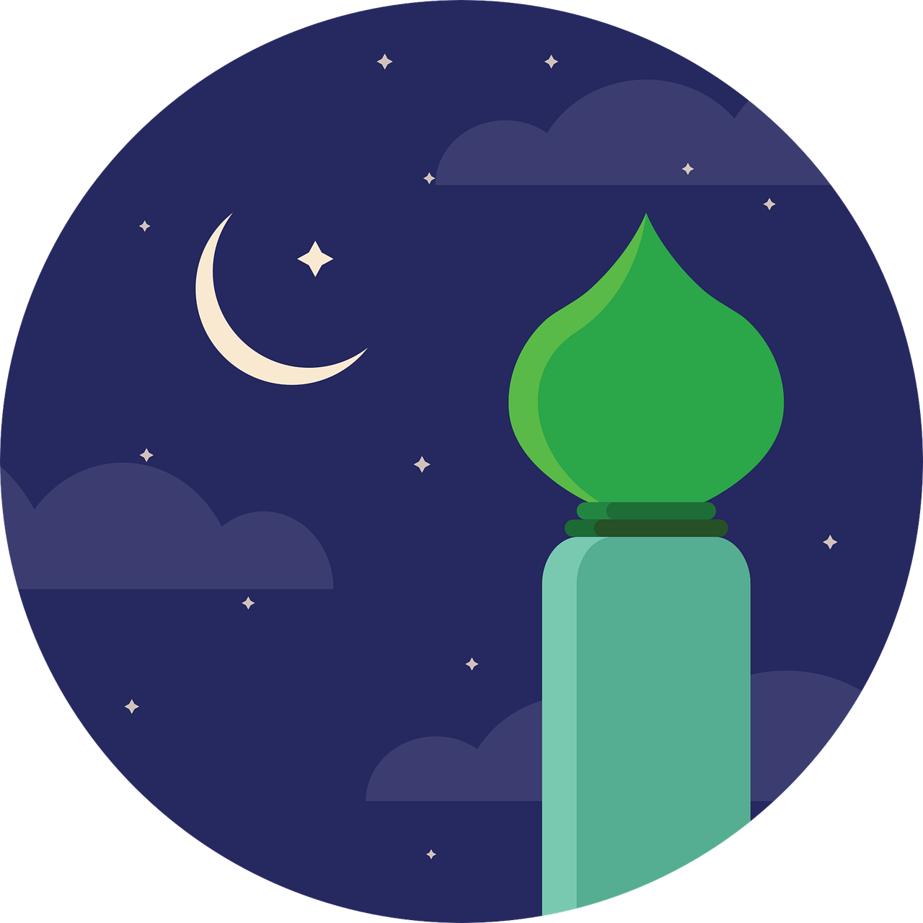
When is Ramadan in 2024?
Ramadan starts on Sunday 10th March
and ends on Monday 8th April

Slide 7
The Cycle of the Moon
Ramadan is based on a calendar that uses cycles of the moon.
Start of Ramadan
Ramadan starts with the new moon - a crescent shape will be seen. This is a very small part of the moon that can be seen.
Middle of Ramadan
A full moon is seen
End of Ramadan
29-30 days depending on the moon.
Notes:
Cycle of the moon.
Explain that Ramadan is based on the moon cycle. Explain each stage of the stages of the moon. Additional resources are available online on lots of websites about Ramadan. Links provided in the lesson plan.
Discuss that because Ramadan is based on this each year when Ramadan is changes.
Ask learners if they know when it is in 2024. Answer in slide 6.
Extension - how could the moon be linked to the charity box design.
Link to maths - shapes, what is a crescent?

Slide 8
The 5 Pillars of Islam
Muslims follow the 5 pillars of Islam.
These are 5 duties Muslims should follow to live a good life.
Notes:
Extension - could go in to further details of what the 5 Pillars are of Islam.
https://www.bbc.co.uk/bitesize/guides/zhbpfcw/revision/1 for further information.

Slide 9
The 3rd Pillar of Islam
The 3rd pillar of Islam is all about charity and is known as Zakat.
Muslims give a certain amount of money to charity and support the less fortunate in the community.
Notes:
Extension - could go in to further details of what the 5 Pillars are of Islam.
https://www.bbc.co.uk/bitesize/guides/zhbpfcw/revision/1 for further information.

Slide 10
Why do you think giving to charity is an important part of Ramadan for Muslims?
Notes:
Class discussion on why given to charity is important during Ramadan.
Self reflection/discipline
Good deeds
Time with friends and Family
Giving to others, helping others
Helping less fortunate
Community

Slide 11
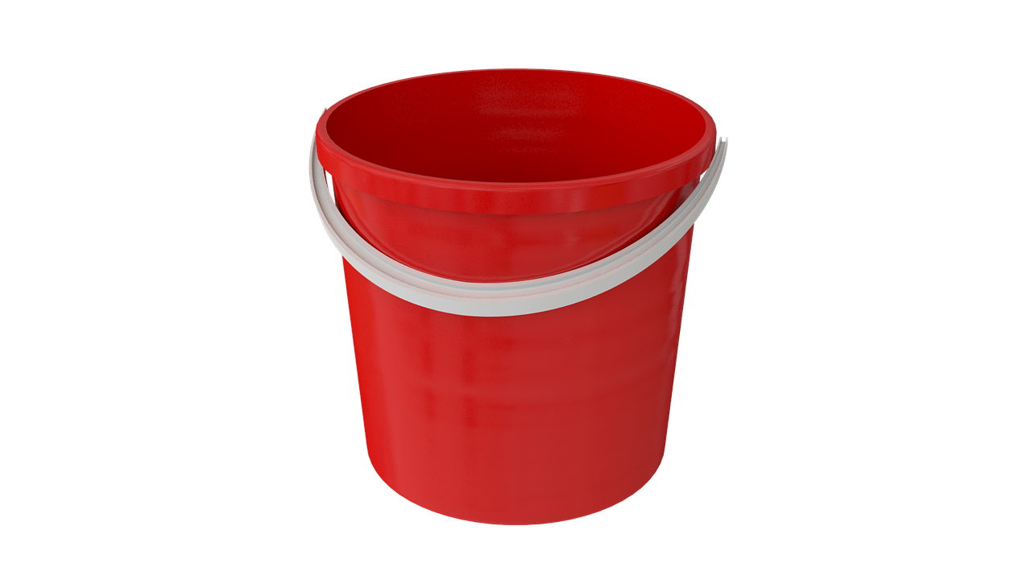
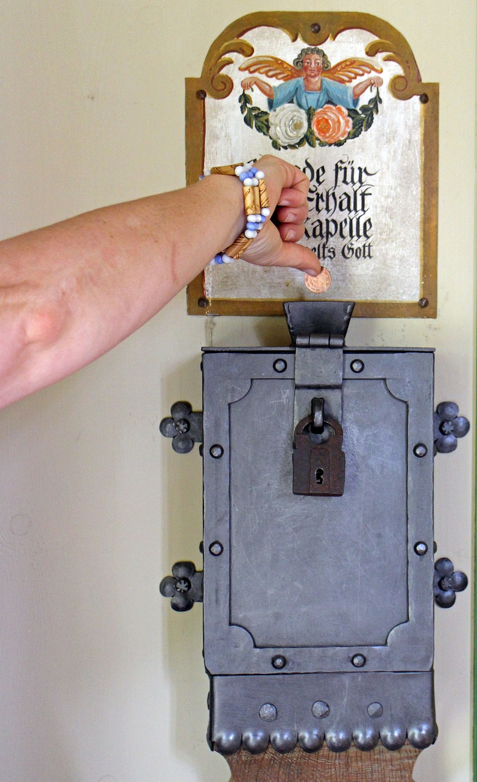
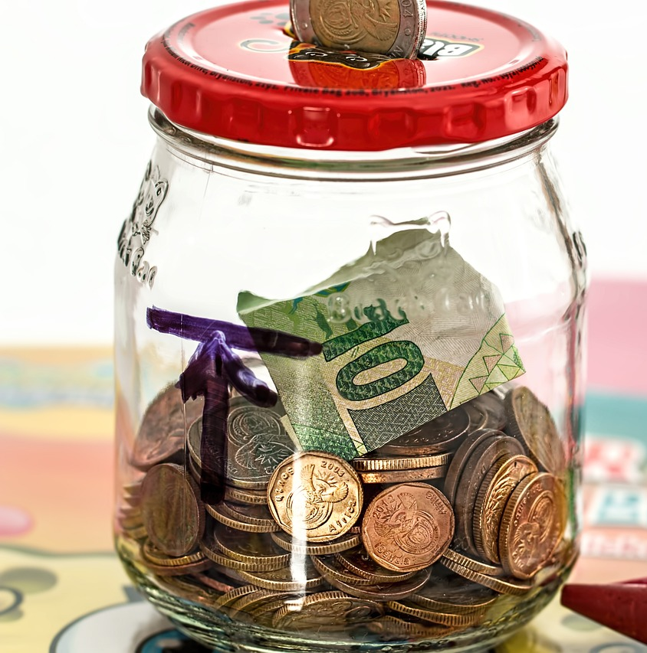
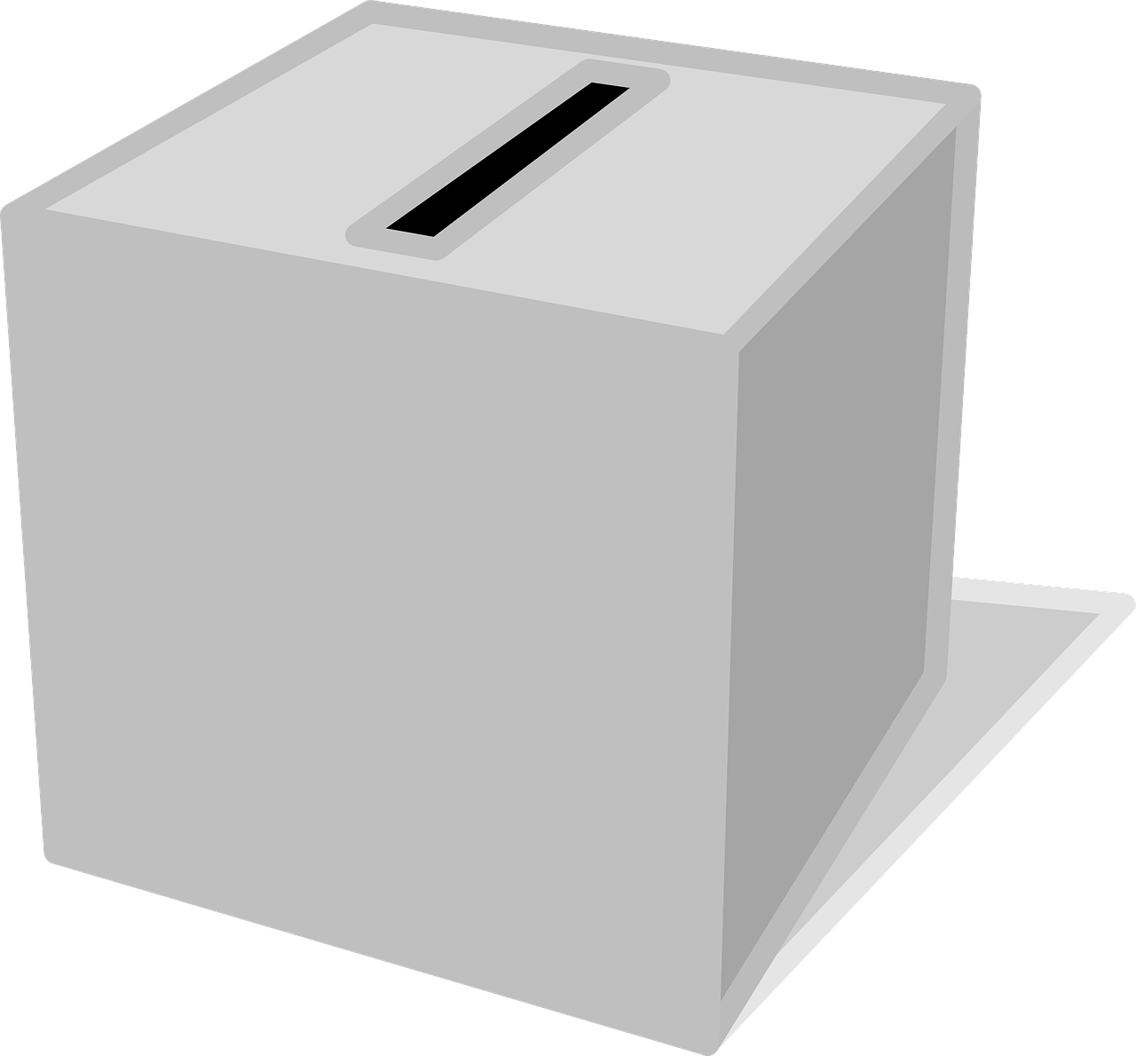
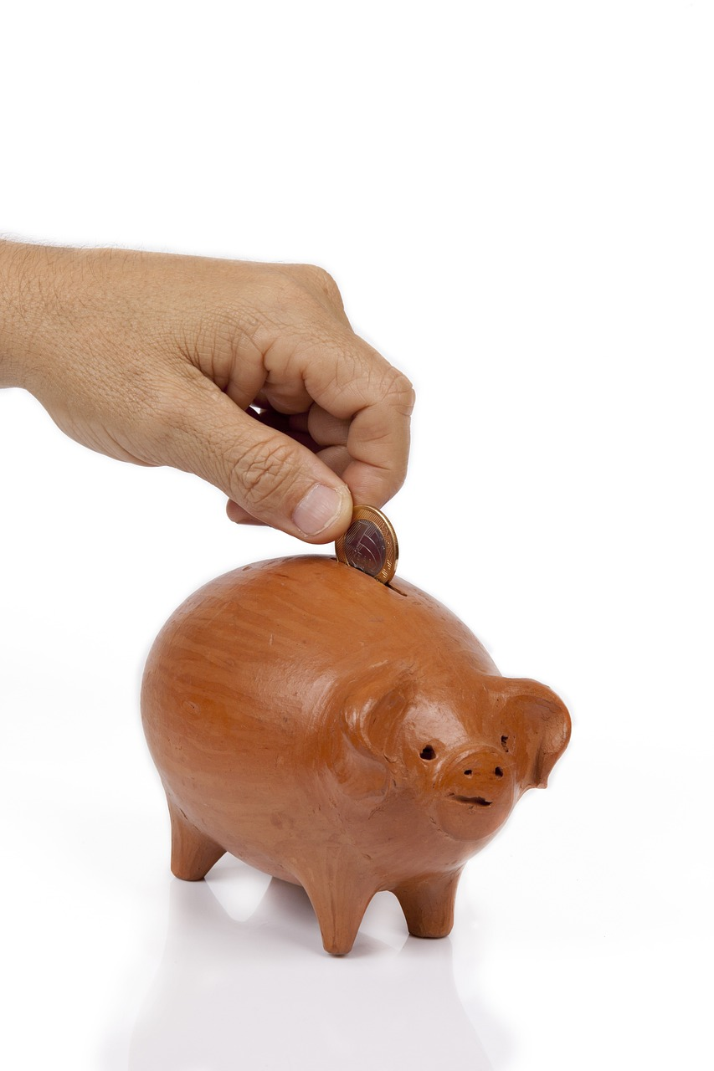
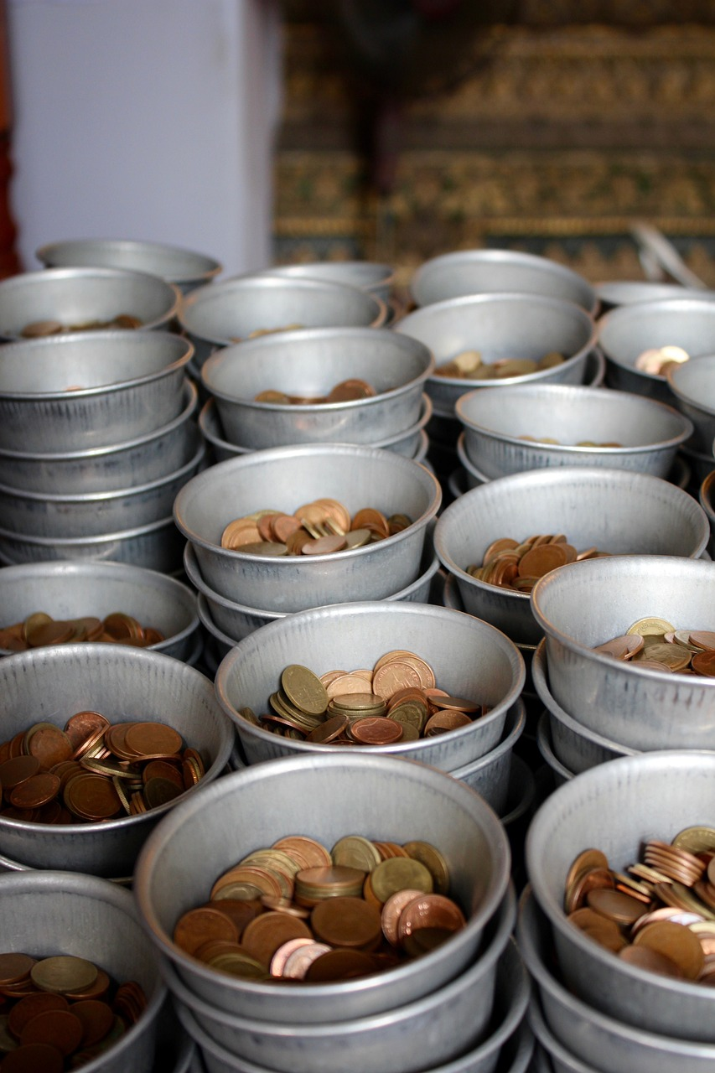
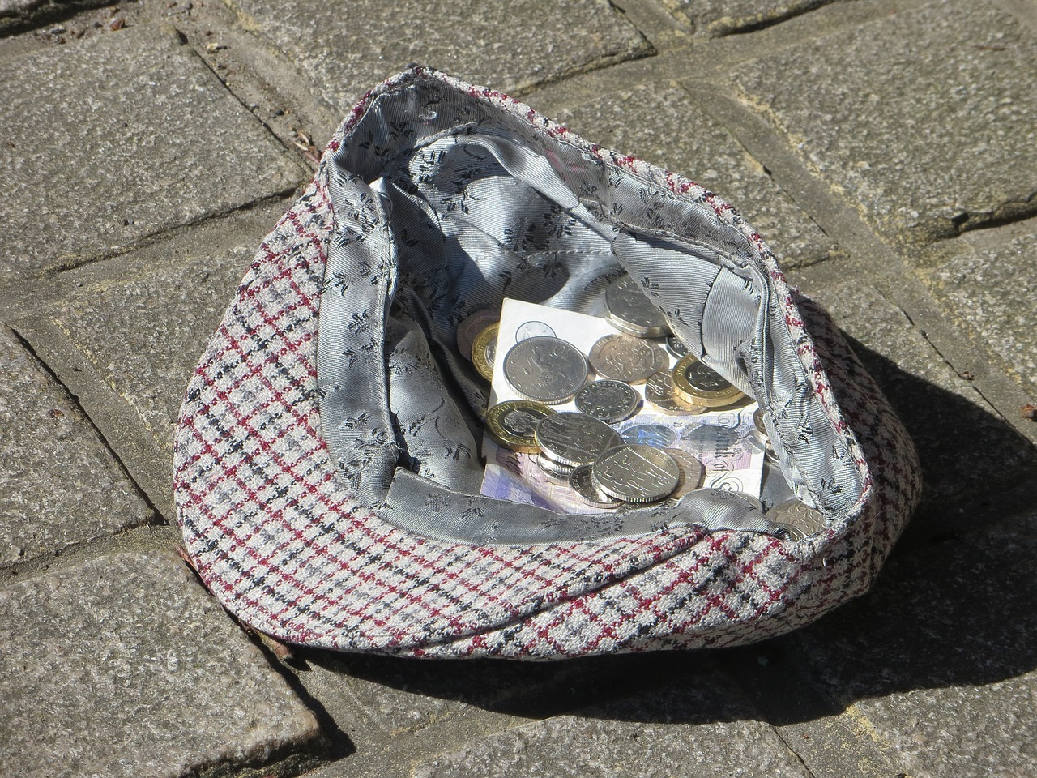
Ways to Collect for Charity
Notes:
Discuss what existing charity boxes might look like. Class discussion. Where can they be found, has the learner every put money on one. Buckets, collection tubs, ones where coins spiral, boxes that make a noise, animal shaped ones.

Slide 12
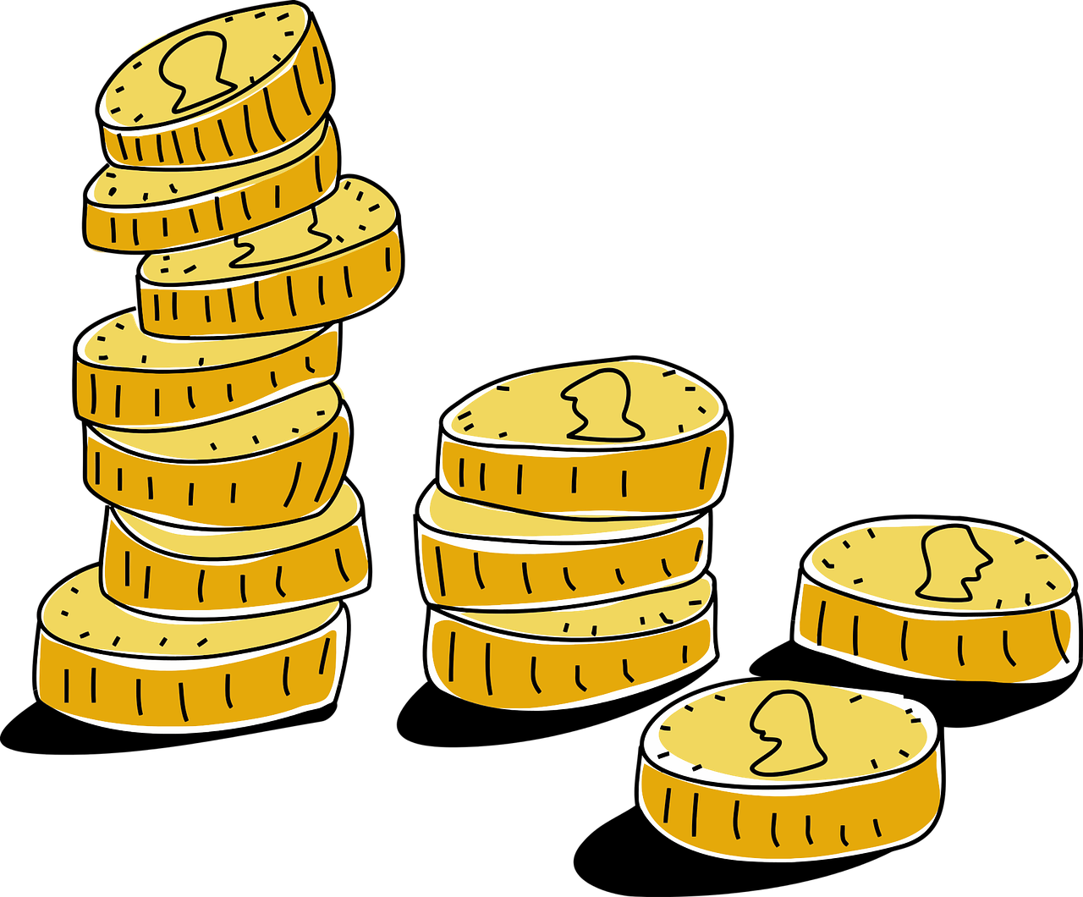
Creating a Charity Collection Box
Your challenge is to make a charity collection box that counts down of the days of Ramadan.
Key features of the design:
A feature of the design needs to be the cycle of the moon
It needs a slot for the coins to go in.
It should count down the days/nights in Ramadan
There must be some way to get the coins out of the box.

Slide 13
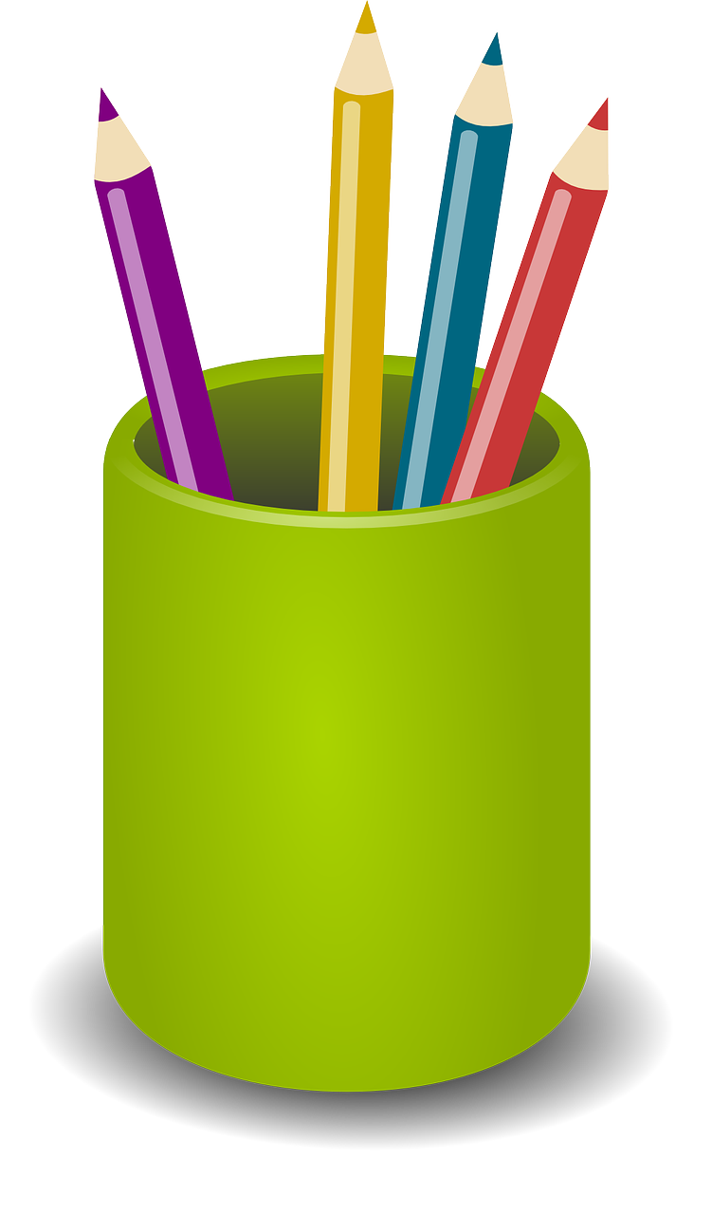
What you might need:
⚠
Charity box template or cardboard box
Moon cycle print out sheet
2 paper plates/discs of card
Drawing implements: pencils, erasers, felt tip pens
Scissors
Tape or glue
Card
Paper fastener/split pin
Adhesive Tack
Card/paper/resources for decorations
⚠ Be careful when using the scissors

Slide 14
Instructions – Step 1
⚠
You need two paper plates or two circles of card the same size.
A diameter of 23 cm is about the right size.
You also need to cut out the moon cycle template printed and cut out.
23 cm
Plate/card circle x 2
Moon cycle template
⚠ Be careful when using the scissors
Notes:
Teacher can have a ready made one to show the learners. 10cm radius of card discs will be the right size. Pre-measured and cut for students.

Slide 15
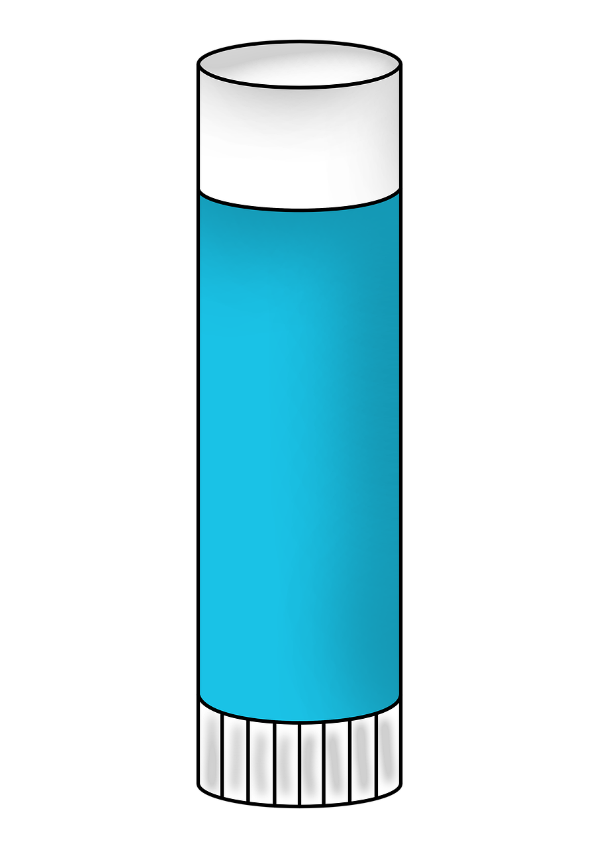
Instructions – Step 2
⚠
Cut out and glue the moon cycle template to one of the card circles or plates.
This will go underneath the other circle/plate.
⚠ Be careful when using the scissors
Notes:
Teacher can have a ready made one to show the learners

Slide 16
Instructions – Step 3
⚠
On the second card circle or plate a hole needs to be cut out in line with one of the moon images on the first plate.
This will go on top of your other circle with the moon cycle on it.
⚠ Be careful when using the scissors
Notes:
The hole could be pre cut to help, learner may need help with this step depending on confidence with stickers.

Slide 17
Instructions – Step 4
⚠
Line up the circles/plates on top of each other.
The circle/plate with the moons on needs to be underneath.
Carefully make a small hole through both circle/plates in the middle of them.
You could use a ball of adhesive tack under the circles and a pencil make the hole through the card.
Circle 1
Circle 2
⚠ Be careful when making the hole
Adhesive Tack
Notes:
The hole could be pre cut to help, learner may need help with this step depending on confidence with stickers. Teacher to demo making a hole. A pin could also be used.

Slide 18
Instructions – Step 5
⚠
Make sure the circles/plates line up and push a split pin through both holes. This should allow the plates to spin.
As the top circle/plate spins, the hole you cut in the top one should reveal images of the moon on the bottom plate.
Split pin x 1
Split Pin goes through both
Top (with cut out hole in)
⚠ Be careful when putting the split pin through the holes
Bottom (with the moon cycle on)
Notes:
Learners may need help making the hole

Slide 19
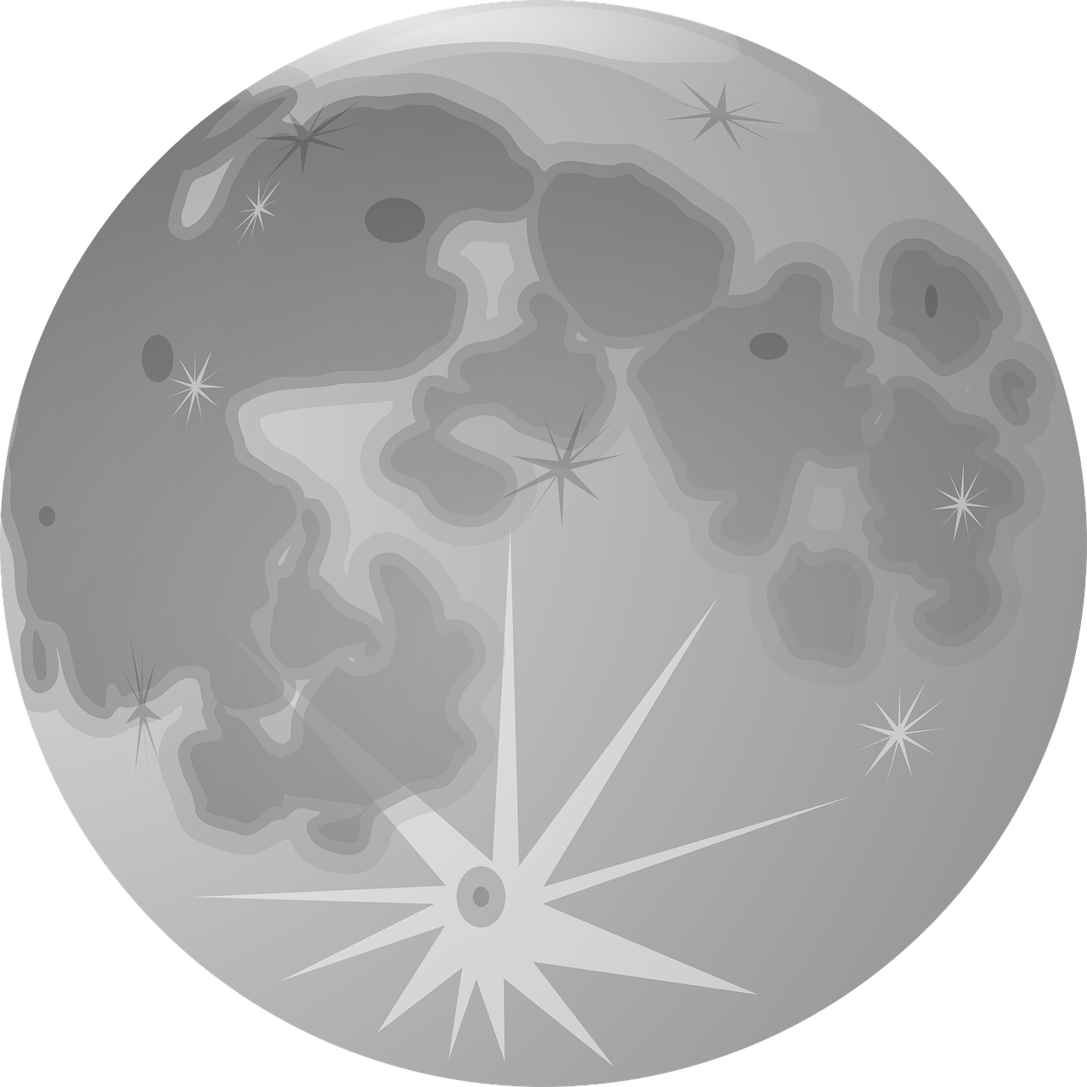
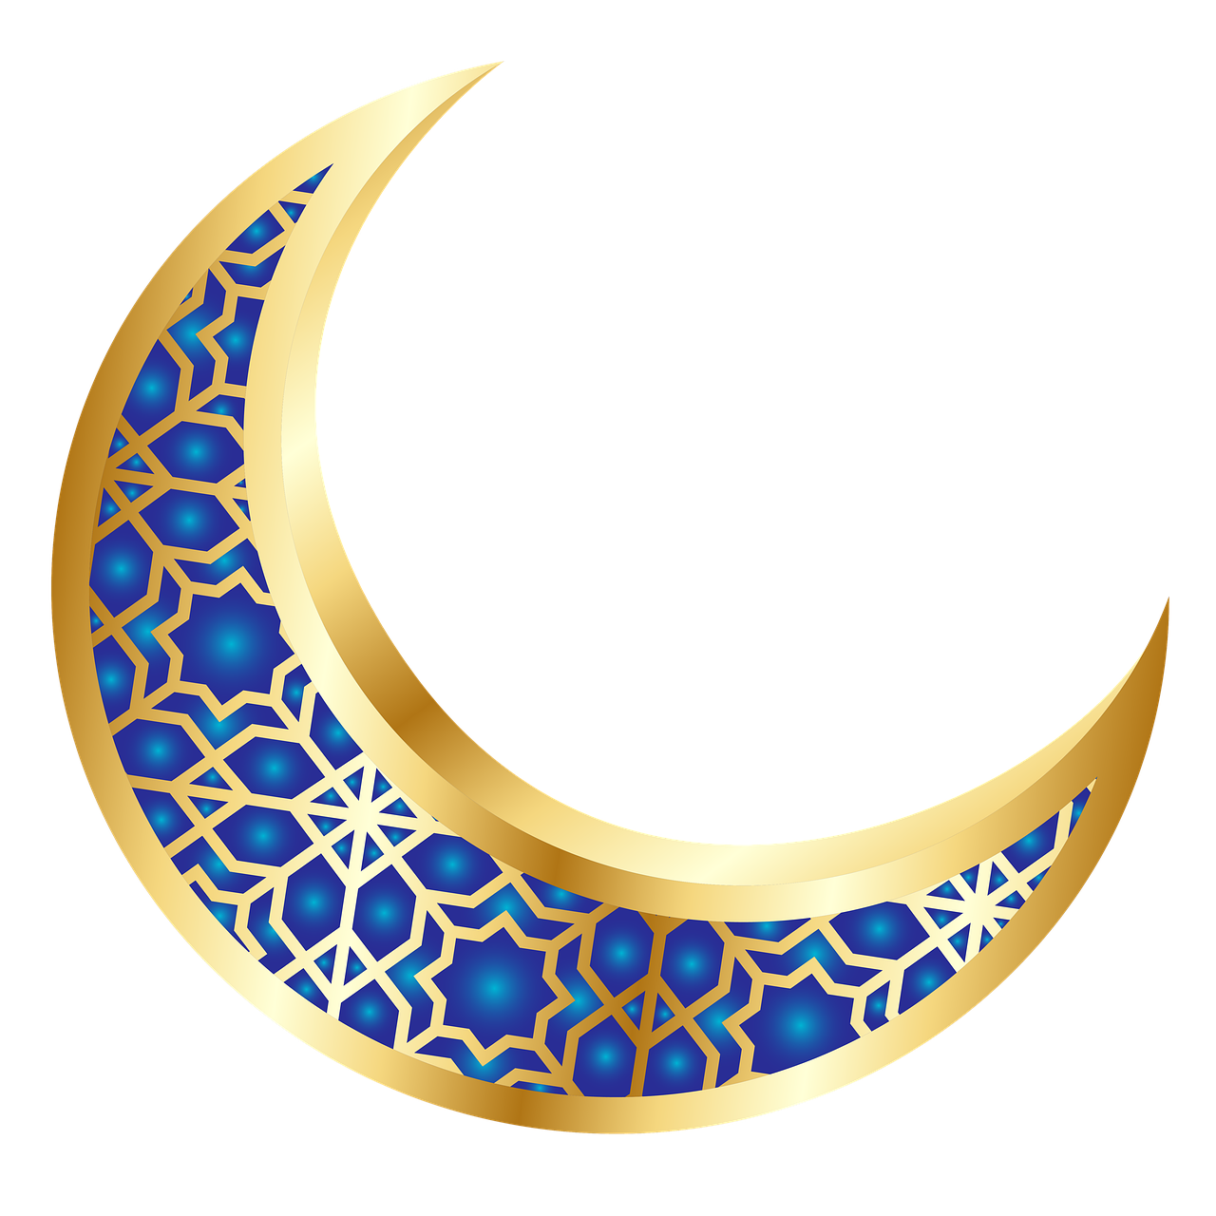
Instructions – Step 6
Decorate the top plate to look like the moon or add patterns, shapes, colours or words that are important to Muslims and Ramadan.
Notes:
Different images of the moon could be discussed, how might the top plate be decorated. Colours, patterns, shapes.

Slide 20
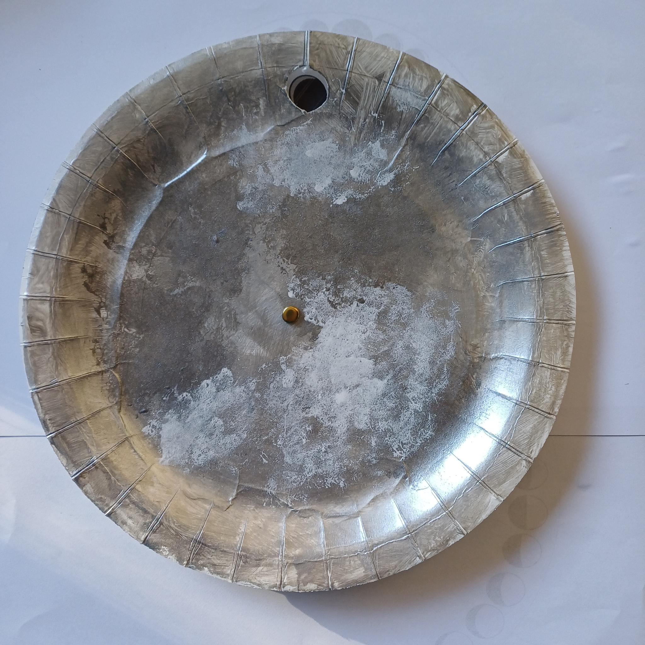
Example: Completed Countdown
As it spins it reveals the different moons of Ramadan.
There are 30 moons. Maybe you could number them?
Notes:
The design applied to this plate represents the image of the moon.

Slide 21
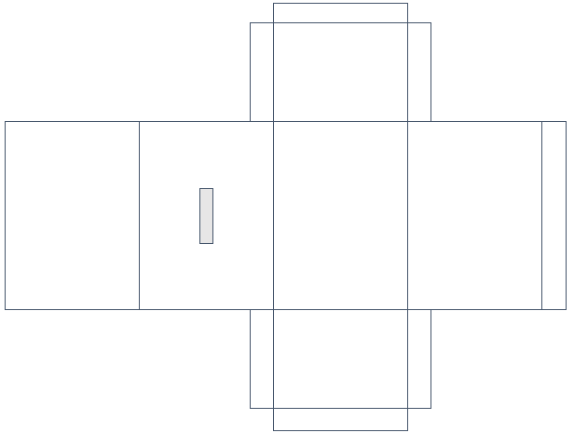
Making the charity box
1. To make the charity collection box part you can either use the net template to cut out, fold and glue together to make the box or
2. Use an existing box, such as a cereal box.

Slide 22
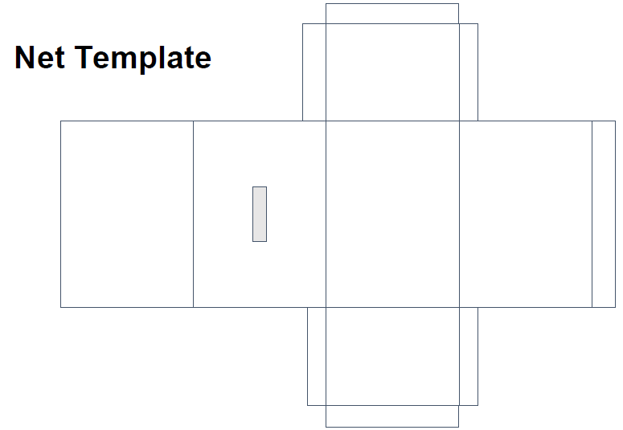
Option 1 - Cutting out the template
⚠
Making a box out of a net
1. Draw round the net template on a piece of card. Cut out the lines around the outside.
2. Cut out the slot for the coin.
3. Assemble the box by folding along the lines and gluing the tabs.
4. Decorate your charity box.
5. Attach the countdown (plates) to your box, using glue, tape or a split pin.
Coin slot
⚠ Be careful when using the scissors

Slide 23
Option 2 - Using an existing box
⚠
1. Decide where you are going to cut a coin slot and carefully cut this out. The coin slot should be on the top of your box so money does not fall out.
2. Glue down any parts that need gluing.
3. Cover your box with white paper using glue.
4. Decorate your charity box.
5. Attach the countdown (plates) to your
box, using glue, tape or a split pin.
Coin slot
⚠ Be careful when using the scissors

Slide 24
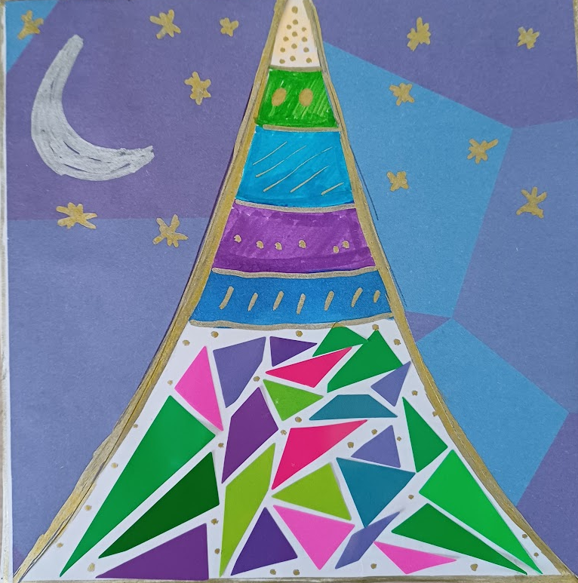
Example

Slide 25
Example

Slide 26
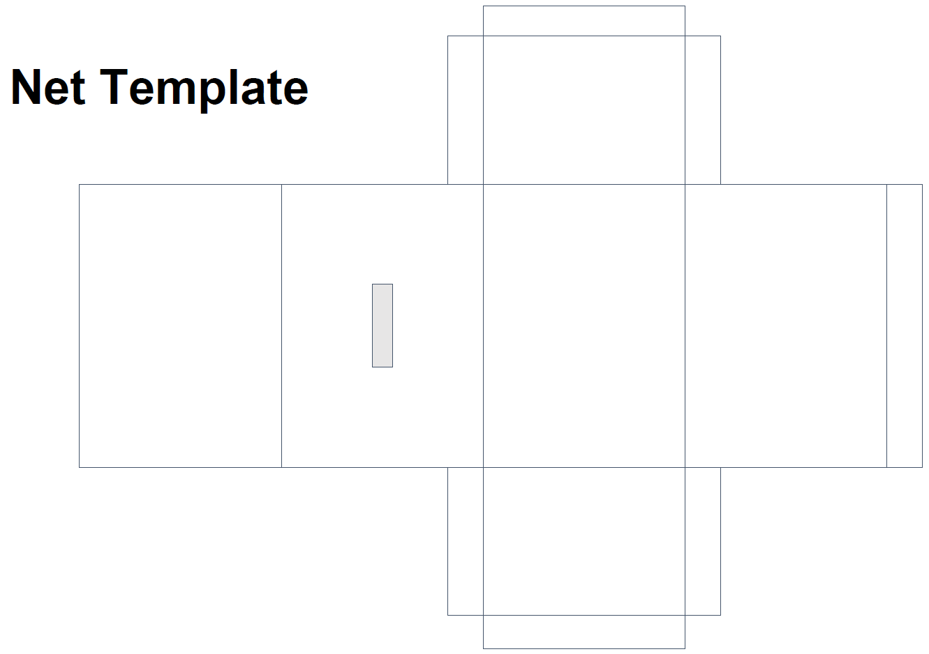
Notes:
Print out on A3 or A4

