Slide 1
Starry Lights
A graphics project that makes a wonderful Christmas star lantern

Slide 2
Stay safe
Whether you are a scientist researching a new medicine or an engineer solving climate change, safety always comes first. An adult must always be around and supervising when doing this activity. You are responsible for:
ensuring that any equipment used for this activity is in good working condition
behaving sensibly and following any safety instructions so as not to hurt or injure yourself or others
Please note that in the absence of any negligence or other breach of duty by us, this activity is carried out at your own risk. It is important to take extra care at the stages marked with this symbol: ⚠

Slide 3
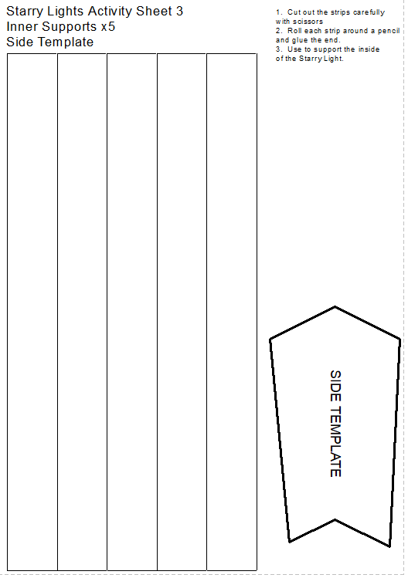
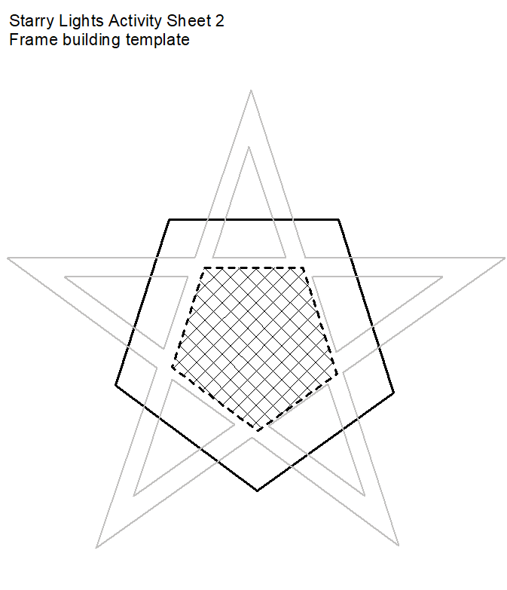
Templates

Slide 4
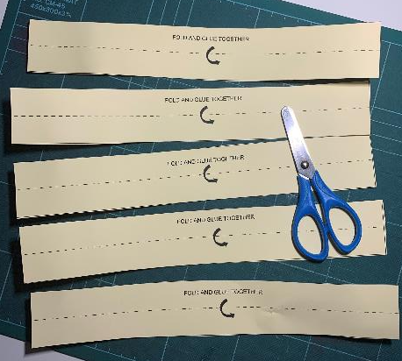
Step 1a – Star Lantern Frame
You need two templates for the star lantern sides
⚠ Cut out the ten frame strips on the solid lines

Slide 5
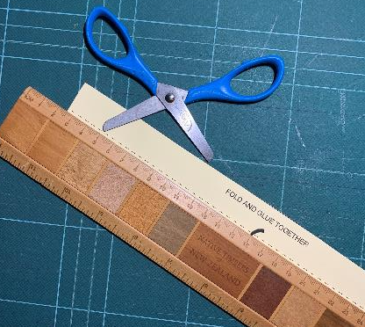
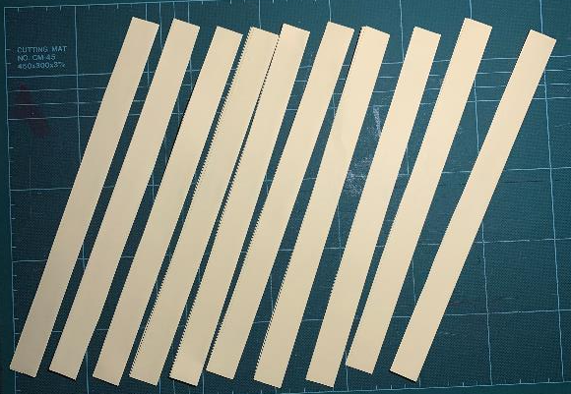
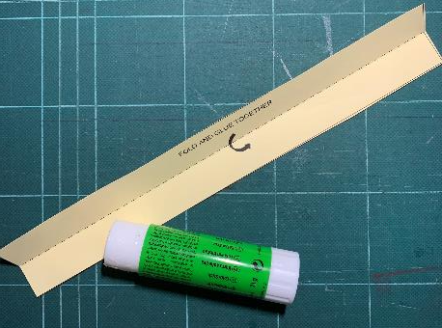
Step 1b – Star Lantern Frame
Score each strip on the dotted line
Fold in half and glue the two halves of each strip together.
You should have ten double-thickness strips

Slide 6
Step 2a – Build the Frames
Use the frame building template
Place the strips onto the template following the guide

Slide 7
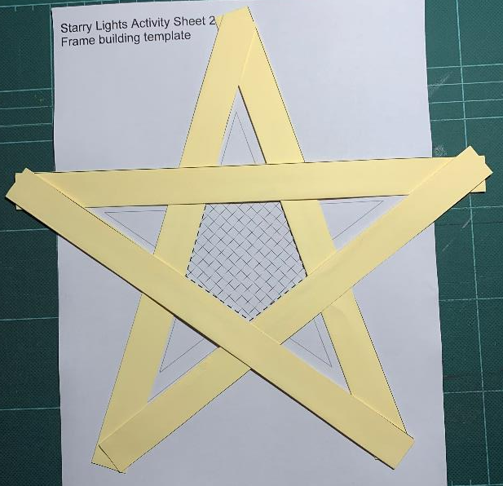
Step 2b – Build the Frames
When complete, glue each strip together at the red s
Repeat steps 1-2 to make the second frame

Slide 8
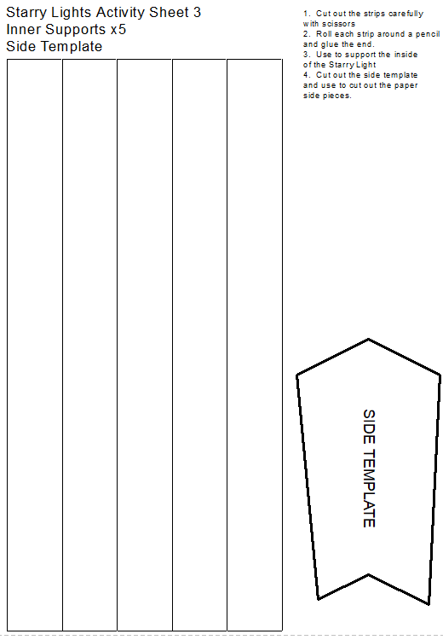
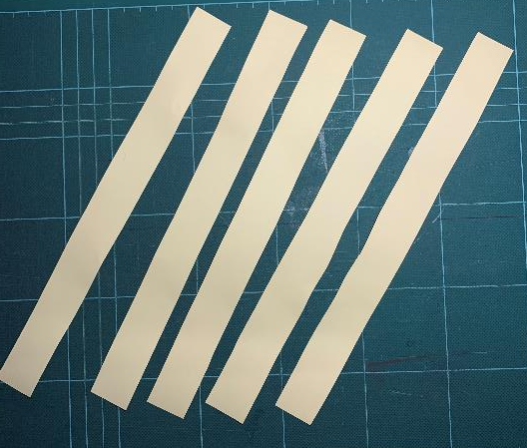
Step 3a – Inner Supports
⚠ Carefully cut the solid line for the five supports

Slide 9
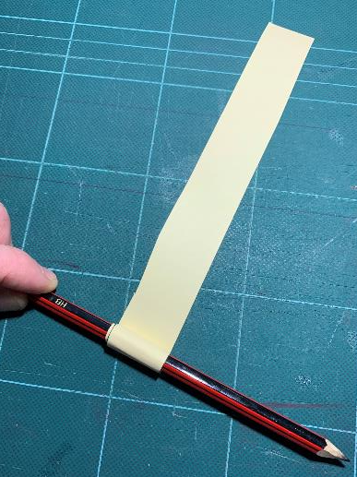
Step 3b – Inner Supports
Roll each strip tightly around a pencil and glue at the end, to make rolled up pieces as shown in the picture below.

Slide 10
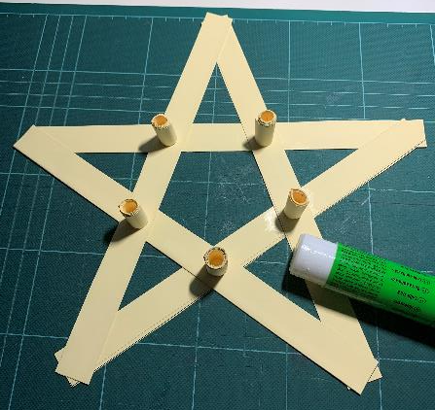
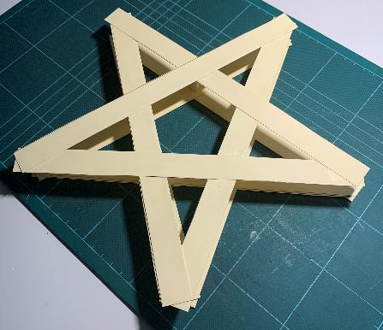
Step 4 – Join Lantern Frames Together
Glue the five supports into position
Glue the second frame on top of the supports

Slide 11
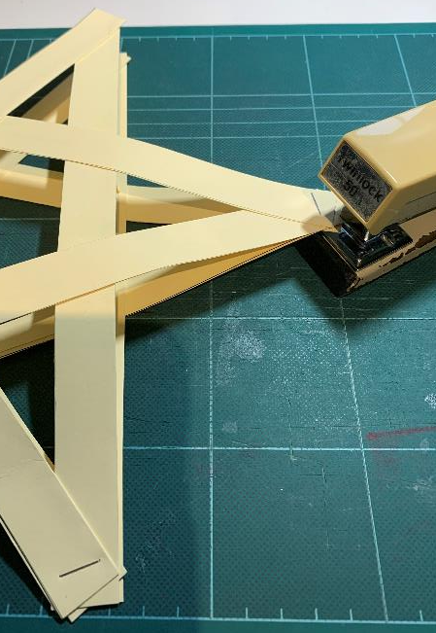
Step 5 – Attach the Points of the Star Together
Staple four of the points together
Leave one point open
You can also use paperclips, sticky tape or glue the tips

Slide 12
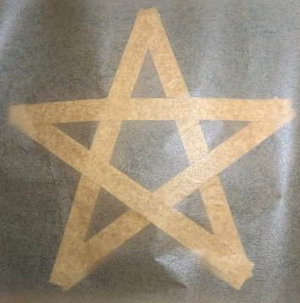
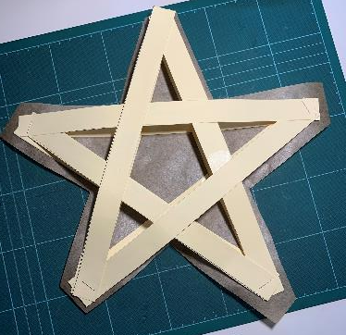
Step 6 – Cover Lantern with Paper
Cover one side of the frame with paper
Glue the paper to the frame
Use either: baking, greaseproof or tracing paper
Let the glue dry
⚠ Trim the paper leaving a small overlap about the star
Save the off-cuts for later

Slide 13
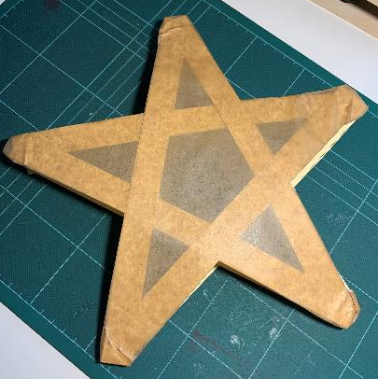
Step 7 – Covering
Glue the paper overlap onto the inside of the frame
The first side is now covered
Repeat steps 6 to 7 to cover the second side
The second side is now covered

Slide 14
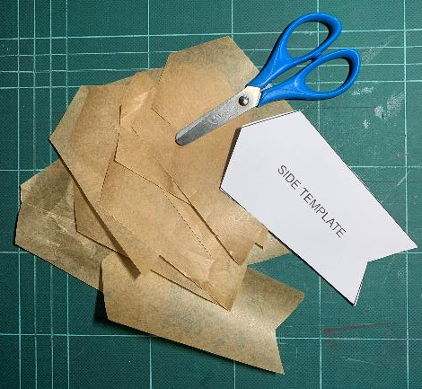
Step 8 – ⚠ Cut out sides
Cut out the side template from Handout 3
Use this to cut out ten side pieces

Slide 15
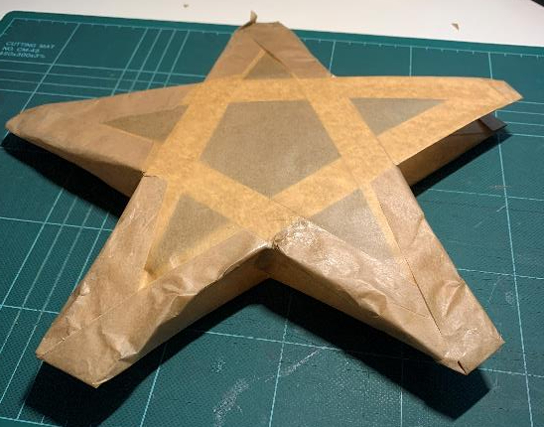
Step 9 – Cover the sides
Glue eight side strips onto the sides of the lantern
Leave the top gap open

Slide 16
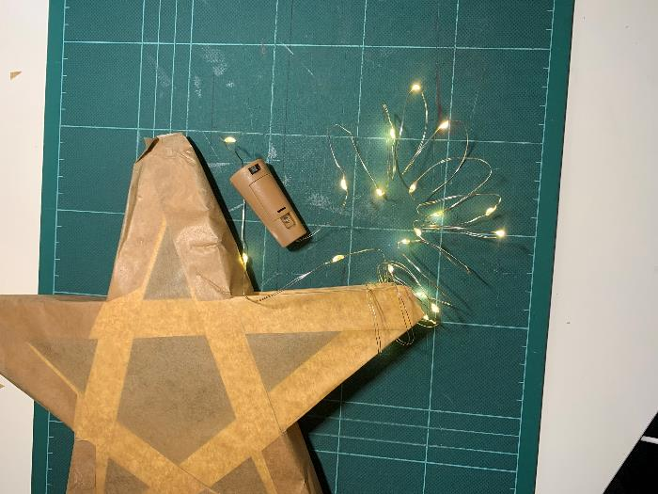
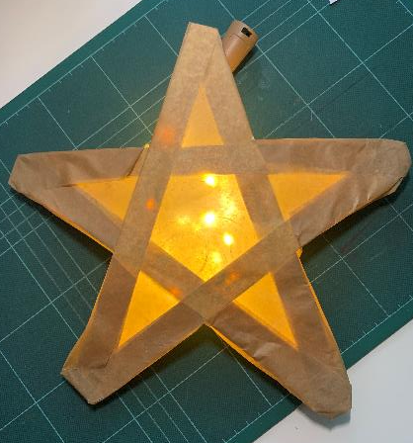
Step 10 – Insert Lights
Insert LED lights into the body of the lantern
Instead of this you could use a small torch or a PP3 9V battery with an LED attached to the terminals - these could be stuck to a piece of string with sticky tape
Bottle fairy string lights

Slide 17
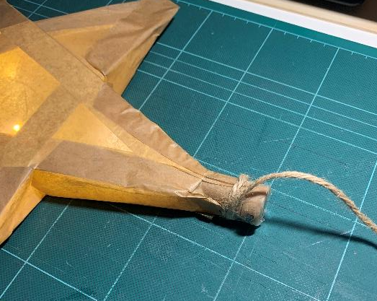
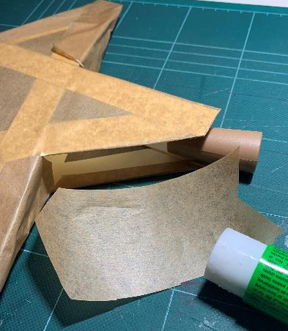
Step 11
Glue on the top side pieces
Use sticky tape to attach string to the top point
Hang up the Star Lantern

Slide 18
Peer Review
Ask three people to suggest one improvement each to your lantern
Select one of these suggested improvements and discuss how you could modify or improve your lantern

Slide 19
Extension
Create your own designs to add to the lantern or use coloured paper to create different effects

