Slide 1

Session 6
Visual Effects

Slide 2
Guiding Questions
How do you change the program so the LEGO robot moves differently?
Can you modify the robot so that it drives with four wheels?
Outcomes
The team will build the LEGO® model from the lesson and code the robot to drive.
The team will apply their coding and building skills to change the existing robot into a vehicle with a camera.
What kind of technology is used to create visual effects?
How can you modify the robot design so that it hold a camera?
Can you code the robot to stop at specific icon on the mat?
Can you code the robot to drive at different speeds?
Notes:
Each session has Guiding Questions that can be shared to frame the session.
Session Tips
The team will create their first mobile robot. Make sure the team watches where the robot drives so that it does not fall if placed on a table.
The team could code the robot to drive to different icons on the mat.
The team could practice coding the robot to turn.
You may want to limit the team to only using pieces from the LEGO® Education SPIKE™ Essential set.
The team can practice positioning the robot so that it reaches a specific icon.
You could place an obstacle on the mat to encourage teams to code their robot to turn.
​

Slide 3



Introduction – Have an Impact
Examples of Impact
Ask the students to provide examples of Impact and record them here
Example of Impact
Example of Impact
We applied what we learned to improve our world.
Extension
Notes:
Introduction - Have an Impact (5-10 minutes)
Read the definition for impact to the team. (see TMG page 5)
Talk about what impact is. Have the team provide examples of this Core Value.
Extension: Have everyone draw a picture of an example of impact on the Core Values page in their Engineering Notebook.

Slide 4
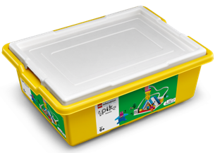

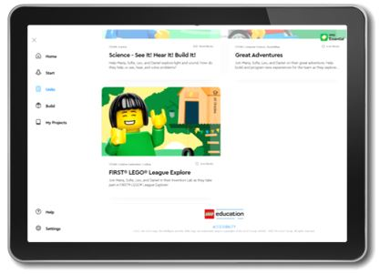
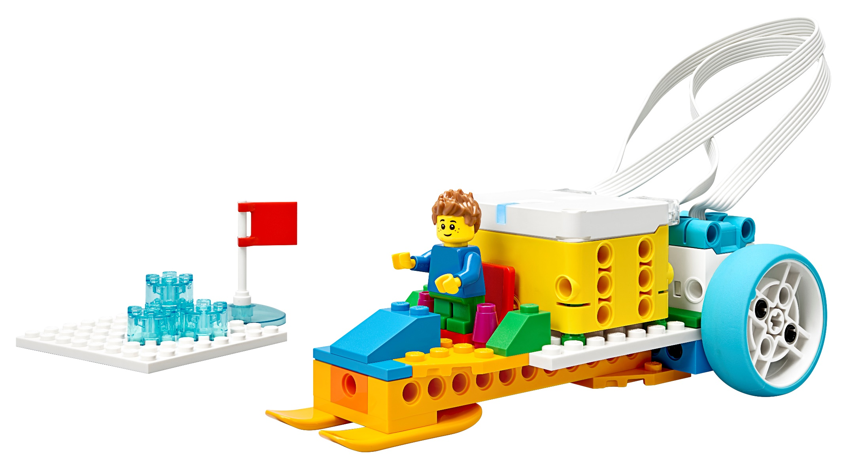


Activity 1 – Do Code
You need…
Open the SPIKETM Essential app. Complete your lesson.
Notes:
Activity 1 Tasks – Do Code Lesson 3 (15-20 minutes)
Open the SPIKE™ Essential app. Complete your lesson.
Code the model to move backward.
Write down your ideas for how to change the program below.
Change the existing program based on your ideas. Test it out!
Challenge
Modify the model so that it has four wheels.
Session Tips
The team will create their first mobile robot. Make sure the team watches where the robot drives so that it does not fall if placed on a table.
The team could code the robot to drive to different icons on the mat.
The team could practice coding the robot to turn.

Slide 5
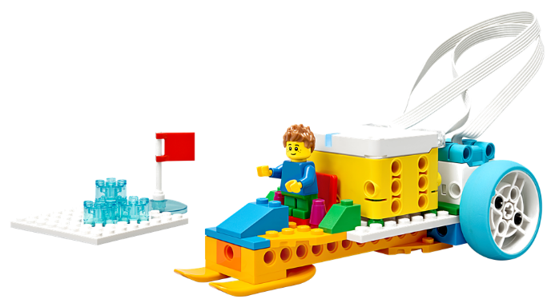
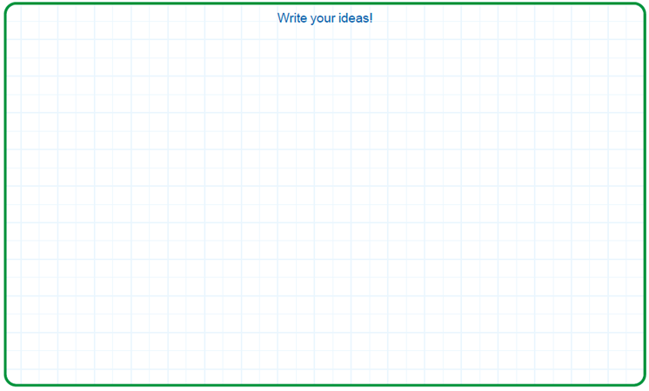
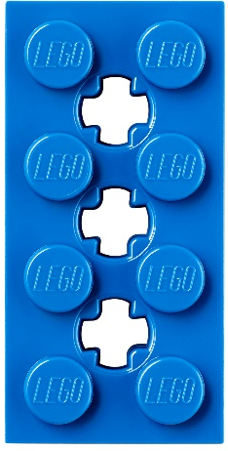
Activity 1
You need…
Code the model to move backward.
Write down your ideas for how to change the program below.
Notes:
Activity 1 Tasks – Do Code Lesson 3 (15-20 minutes)
Open the SPIKE™ Essential app. Complete your lesson.
Code the model to move backward.
Write down your ideas for how to change the program below.
Change the existing program based on your ideas. Test it out!
Challenge
Modify the model so that it has four wheels.
Session Tips
The team will create their first mobile robot. Make sure the team watches where the robot drives so that it does not fall if placed on a table.
The team could code the robot to drive to different icons on the mat.
The team could practice coding the robot to turn.

Slide 6
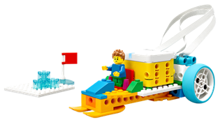
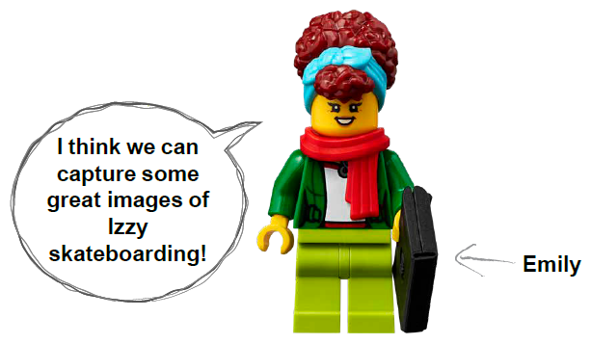

Activity 1
You need…
Change the existing program based on your ideas. Test it out!
Notes:
Activity 1 Tasks – Do Code Lesson 3 (15-20 minutes)
Open the SPIKE™ Essential app. Complete your lesson.
Code the model to move backward.
Write down your ideas for how to change the program below.
Change the existing program based on your ideas. Test it out!
Challenge
Modify the model so that it has four wheels.
Session Tips
The team will create their first mobile robot. Make sure the team watches where the robot drives so that it does not fall if placed on a table.
The team could code the robot to drive to different icons on the mat.
The team could practice coding the robot to turn.

Slide 7

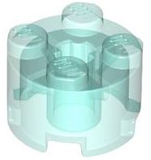
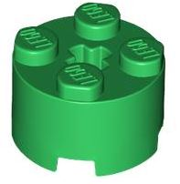
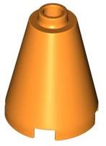
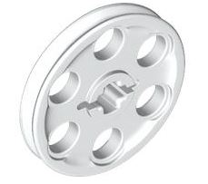

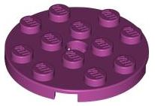
Activity 1
Challenge
Modify the model so that it has four wheels.
Notes:
Activity 1 Tasks – Do Code Lesson 3 (15-20 minutes)
Open the SPIKE™ Essential app. Complete your lesson.
Code the model to move backward.
Write down your ideas for how to change the program below.
Change the existing program based on your ideas. Test it out!
Challenge
Modify the model so that it has four wheels.
Session Tips
The team will create their first mobile robot. Make sure the team watches where the robot drives so that it does not fall if placed on a table.
The team could code the robot to drive to different icons on the mat.
The team could practice coding the robot to turn.

Slide 8
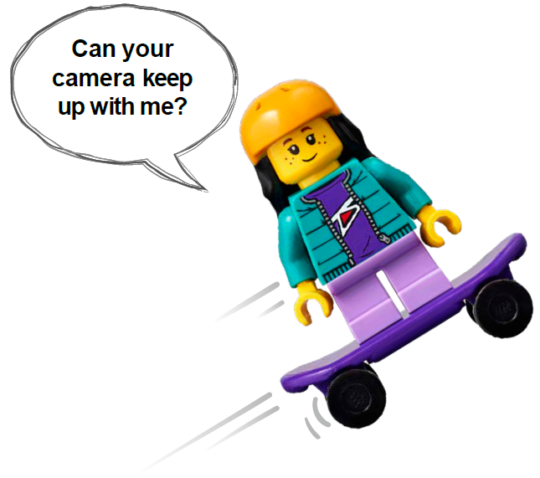

Activity 2 – Build a Moving Camera
Modify the SPIKE model from the previous task so that it represents a vehicle with a camera.
You need…
Notes:
Activity 2 Tasks – Build a Moving Camera (15-20 minutes)
Modify the SPIKE model from the previous task so that it represents a vehicle with a camera.
Open the SPIKE™ Essential app.
Change the program so that the vehicle drives slowly. Try it out!
Challenge
Pick two icons on the mat that Izzy should skate between.
Change the program for your vehicle to move between the two icons.
Share how you coded your moving camera.
Session Tips
You may want to limit the team to only using pieces from the LEGO® Education SPIKE™ Essential set.
The team can practice positioning the robot so that it reaches a specific icon.
You could place an obstacle on the mat to encourage teams to code their robot to turn.

Slide 9
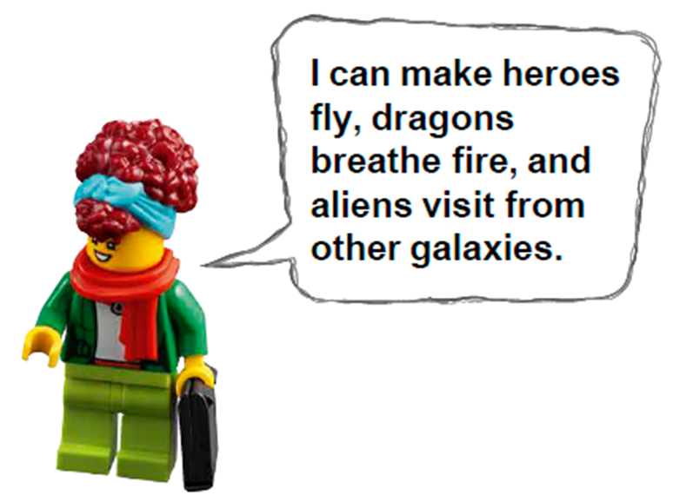
Activity 2
Open the SPIKE™ Essential app.
Change the program so that the vehicle drives slowly. Try it out!
Notes:
Activity 2 Tasks – Build a Moving Camera (15-20 minutes)
Modify the SPIKE model from the previous task so that it represents a vehicle with a camera.
Open the SPIKE™ Essential app.
Change the program so that the vehicle drives slowly. Try it out!
Challenge
Pick two icons on the mat that Izzy should skate between.
Change the program for your vehicle to move between the two icons.
Share how you coded your moving camera.
Session Tips
You may want to limit the team to only using pieces from the LEGO® Education SPIKE™ Essential set.
The team can practice positioning the robot so that it reaches a specific icon.
You could place an obstacle on the mat to encourage teams to code their robot to turn.

Slide 10
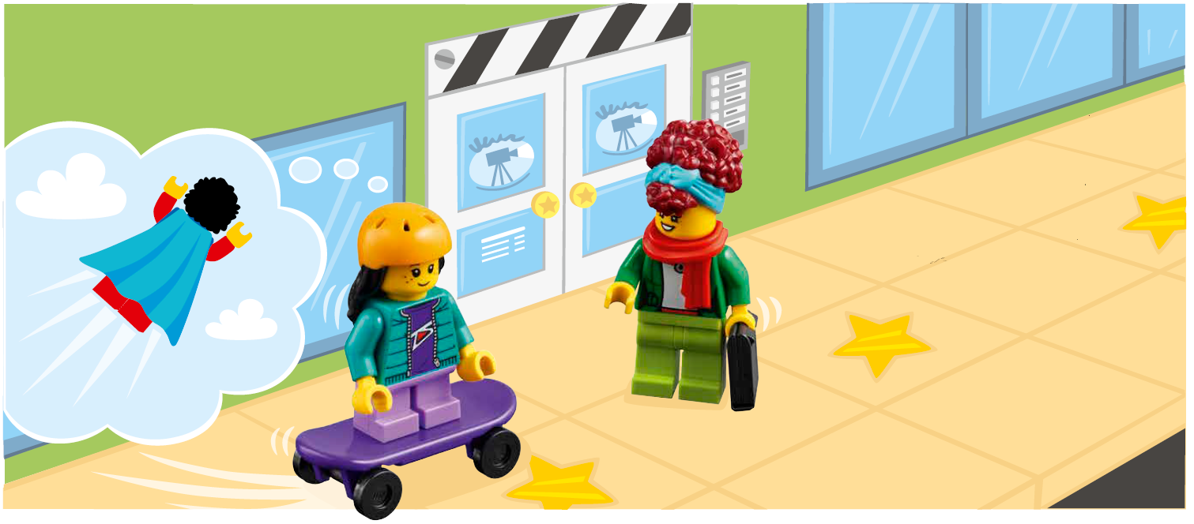
Activity 2
Challenge
Pick two icons on the mat that Izzy should skate between.
Notes:
Activity 2 Tasks – Build a Moving Camera (15-20 minutes)
Modify the SPIKE model from the previous task so that it represents a vehicle with a camera.
Open the SPIKE™ Essential app.
Change the program so that the vehicle drives slowly. Try it out!
Challenge
Pick two icons on the mat that Izzy should skate between.
Change the program for your vehicle to move between the two icons.
Share how you coded your moving camera.
Session Tips
You may want to limit the team to only using pieces from the LEGO® Education SPIKE™ Essential set.
The team can practice positioning the robot so that it reaches a specific icon.
You could place an obstacle on the mat to encourage teams to code their robot to turn.

Slide 11
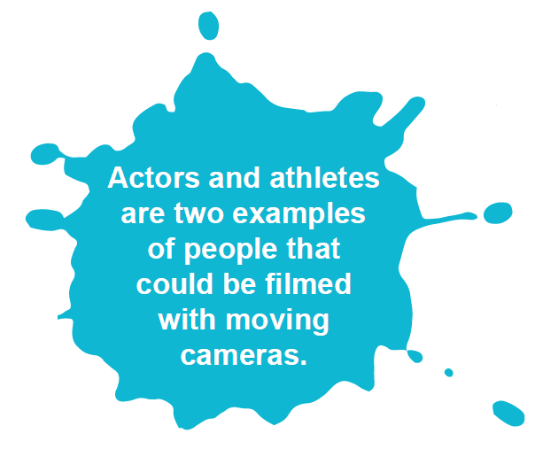

Activity 2
Challenge
Change the program for your vehicle to move between the two icons.
Share how you coded your moving camera.
Notes:
Activity 2 Tasks – Build a Moving Camera (15-20 minutes)
Modify the SPIKE model from the previous task so that it represents a vehicle with a camera.
Open the SPIKE™ Essential app.
Change the program so that the vehicle drives slowly. Try it out!
Challenge
Pick two icons on the mat that Izzy should skate between.
Change the program for your vehicle to move between the two icons.
Share how you coded your moving camera.
Session Tips
You may want to limit the team to only using pieces from the LEGO® Education SPIKE™ Essential set.
The team can practice positioning the robot so that it reaches a specific icon.
You could place an obstacle on the mat to encourage teams to code their robot to turn.

Slide 12

Share
Share what you did in the session.
Show how they have applied coding skills learned in previous sessions to make a moving camera.
Share how their moving camera was built.
What have you discovered? Share with your team!
Notes:
Share (10 minutes)
Have the team:
• Share what they did in the session.
• Show how they have applied coding skills learned in previous sessions to make a moving camera.
• Share how their moving camera was built.

Slide 13

Optional Video:
You may wish to embed a relevant, age-appropriate video for your students here. See the Notes for an example.
Notes:
Choose a relevant, age-appropriate video for your students.
Here is one example: https://youtu.be/NnnuleYz8vU
How are movies made? | The movie making process explained Movie University

Slide 14
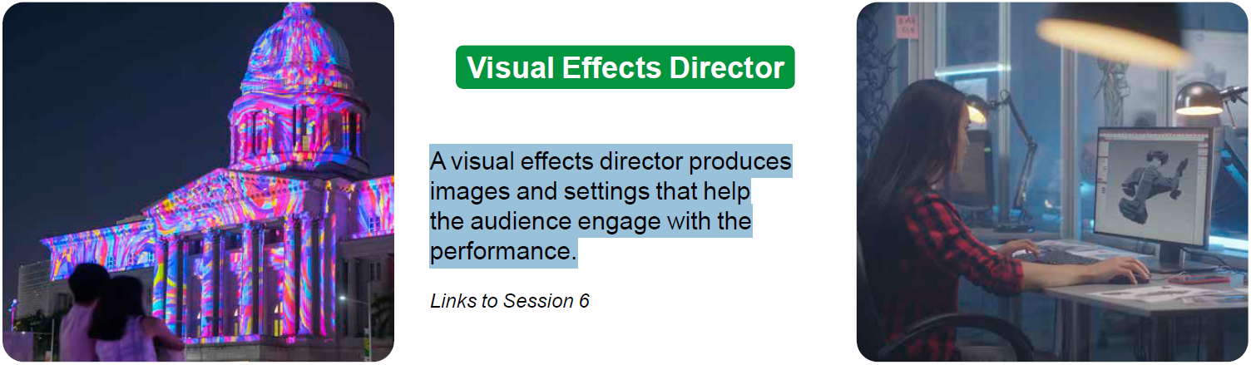
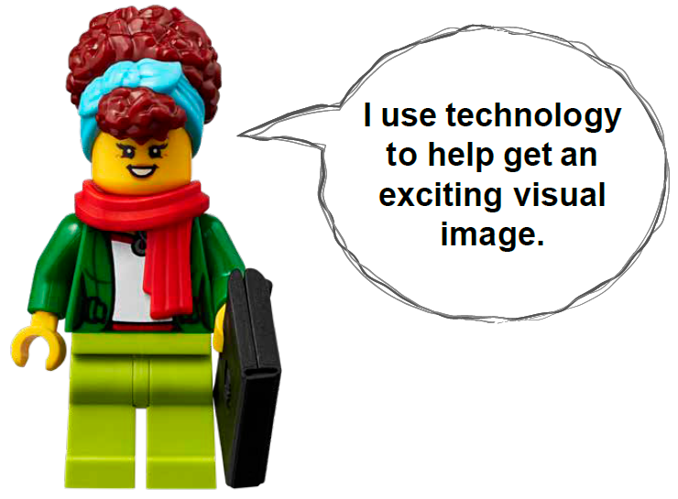
Career Connections
Visual Effects Director
Role:
A visual effects director produces images and settings that help the audience engage with the performance.
Notes:
Ask the children to reflect on what a visual effects director does.
Explain the job. What are some of this job’s daily tasks?
What is this job’s yearly salary?
What education or training is required?
What companies could people in this job work for?

Slide 15
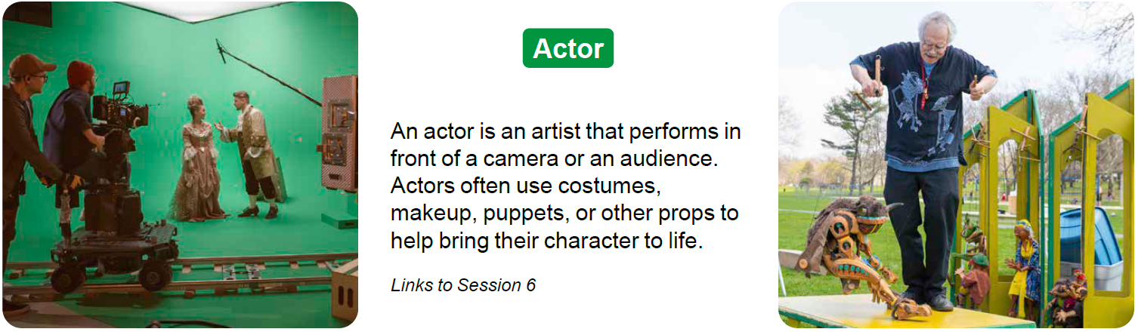
Career Connections
Actor
Role:
An actor is an artist that performs in front of a camera or an audience. Actors often use costumes, makeup, puppets, or other props to help bring their character to life.
Notes:
Ask the children to reflect on what an actor does.
Explain the job. What are some of this job’s daily tasks?
What is this job’s yearly salary?
What education or training is required?
What companies could people in this job work for?

Slide 16
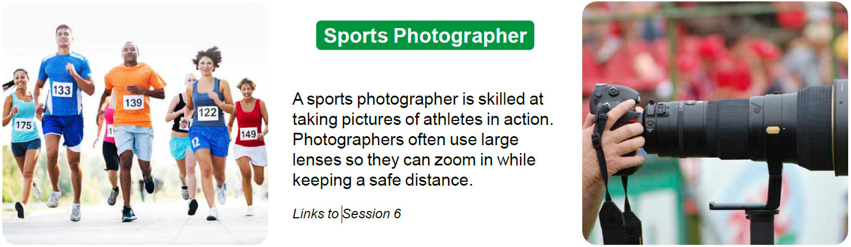
Career Connections
Sports Photographer
Role:
A sports photographer is skilled at taking pictures of athletes in action. Photographers often use large lenses so they can zoom in while keeping a safe distance.
Notes:
Ask the children to reflect on what a sports photographer does.
Explain the job. What are some of this job’s daily tasks?
What is this job’s yearly salary?
What education or training is required?
What companies could people in this job work for?

Slide 17

Clean Up
Notes:
Clean Up Pointers
Make sure the pieces used from the LEGO Education SPIKE Essential set are returned.
If any materials from the Explore set were used, make sure they are returned.
You may wish to play a video or song during clean up time Link on
GoNoodle: https://family.gonoodle.com/activities/clean-up
Link on YouTube Kids: https://www.youtubekids.com/watch?v=ZJFk87ZsHn0
Link on Youtube: https://youtu.be/ZJFk87ZsHn0

Slide 18

LEGO, the LEGO logo and the SPIKE logo are trademarks of the/sont des marques de commerce du/son marcas registradas de LEGO Group. ©2023 The LEGO Group. All rights reserved/Tous droits réservés/Todos los derechos reservados. FIRST®, the FIRST® logo, and FIRST® in SHOWSM are registered trademarks of For Inspiration and Recognition of Science and Technology (FIRST). LEGO® is a registered trademark of the LEGO Group. FIRST® LEGO® League and MASTERPIECESM are jointly held trademarks of FIRST and the LEGO Group. ©2023 FIRST and the LEGO Group. All rights reserved.

