Slide 1
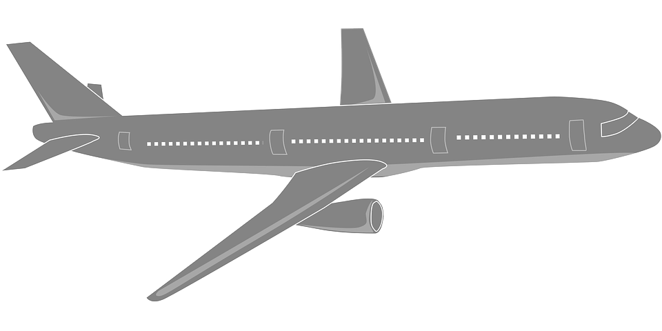
Flying by Numbers with the lift equation
Using and rearranging the lift calculation

Slide 2
Stay safe
Whether you are a scientist researching a new medicine or an engineer solving climate change, safety always comes first. An adult must always be around and supervising when doing this activity. You are responsible for:
• ensuring that any equipment used for this activity is in good working condition
• behaving sensibly and following any safety instructions so as not to hurt or injure yourself or others
Please note that in the absence of any negligence or other breach of duty by us, this activity is carried out at your own risk. It is important to take extra care at the stages marked with this symbol ⚠

Slide 3
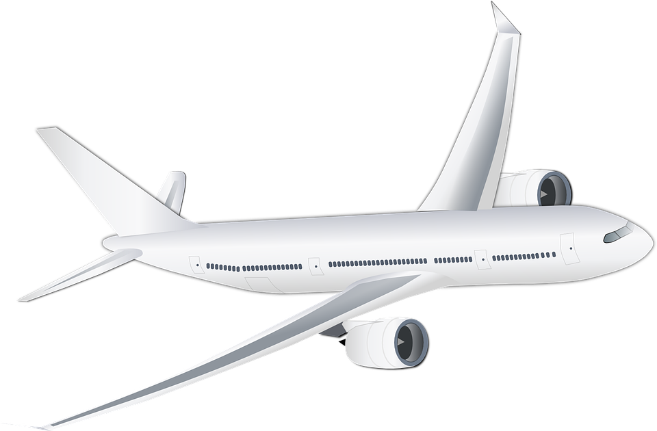
What is Lift?
Lift is the force that holds an airplane in the air
For level flight, the lift must equal the weight of the aircraft
Making an aircraft lift off the ground needs careful calculations
Which factors do you think influence the lift of an airplane?

Slide 4
The Lift Formula
L = d x v² x s x C_{L} / 2
Where:
L = lift; for level flight this equals the weight of the aircraft
d = density of the air. This changes with altitude – the higher you get, the ‘thinner’ (less dense) the air is
v = velocity of the aircraft
s = wing area of the aircraft
C_{L} = coefficient of lift. This is read from a graph

Slide 5
Changing the subject of the Lift Formula: Wing area
Wing area:
s = 2 L / (d x v² x C_{L})
How might this be used?

Slide 6
Changing the subject of the Lift Formula: Velocity
Velocity:
v = √(2L / (d x s x C_{L} ))
What will happen if the velocity is higher than, lower than or equal to this value?

Slide 7
How Air Density Changes with Altitude
Altitude, meters | Air density, kg m⁻³
0 | 1.225
1,000 | 1.112
5,000 | 0.7365
10,000 | 0.4136
15,000 | 0.1948
Note: altitude is based on zero = mean sea level; figures were adapted to metric values from an International Standard Atmosphere table

Slide 8
Coefficient of Lift
The coefficient of lift, CL, depends on the angle of attack
In simple terms, the angle of attack is the angle that the wing is at to the air flowing against its front edge
Different wing shapes give different graphs – we are using this graph to give a general approximation
C_{L}
Angle of Attack, degrees

Slide 9
Characteristics of Selected Aircraft
Airplane: | Maximum Take off Weight, kg | Wing area, m² | Top speed, m s⁻¹
Airbus A380 | 550,000 | 850 | 280
Airbus A340 | 280,000 | 360 | 250
Boeing 747 | 400,000 | 510 | 270
Boeing 777 | 350,000 | 430 | 260
Concorde | 190,000 | 360 | 600
Supermarine spitfire | 3,000 | 22 | 160
Note: exact values will vary depending upon different models of the aircraft;
figures are shown to two significant figures only

Slide 10
Now do this:
Using the data provided, answer the questions on the worksheet
For one of the listed aircraft, produce a graph showing how changing the angle of attack affects the velocity needed to achieve level flight
Identify the design characteristics in a typical aircraft that you can change to improve the lift. Explain, in detail, the changes that you could make to improve the lift.

