Slide 1
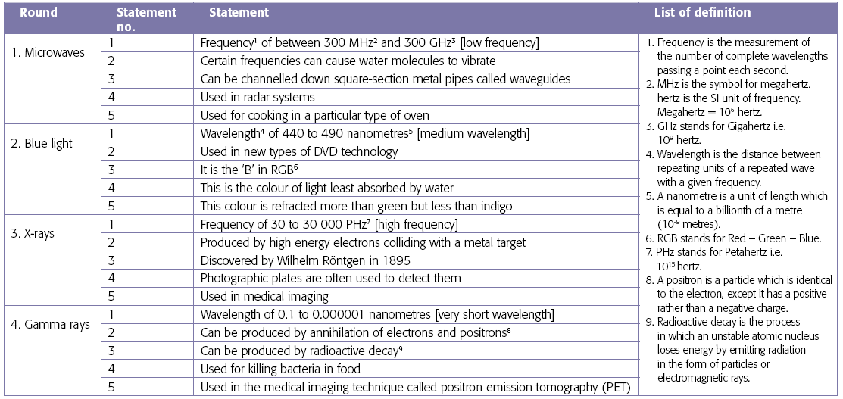
Electromagnetic waves - quiz

