Slide 1
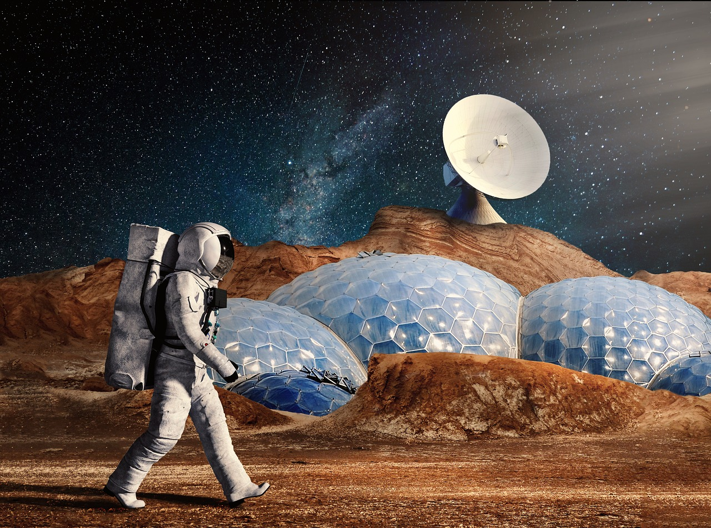
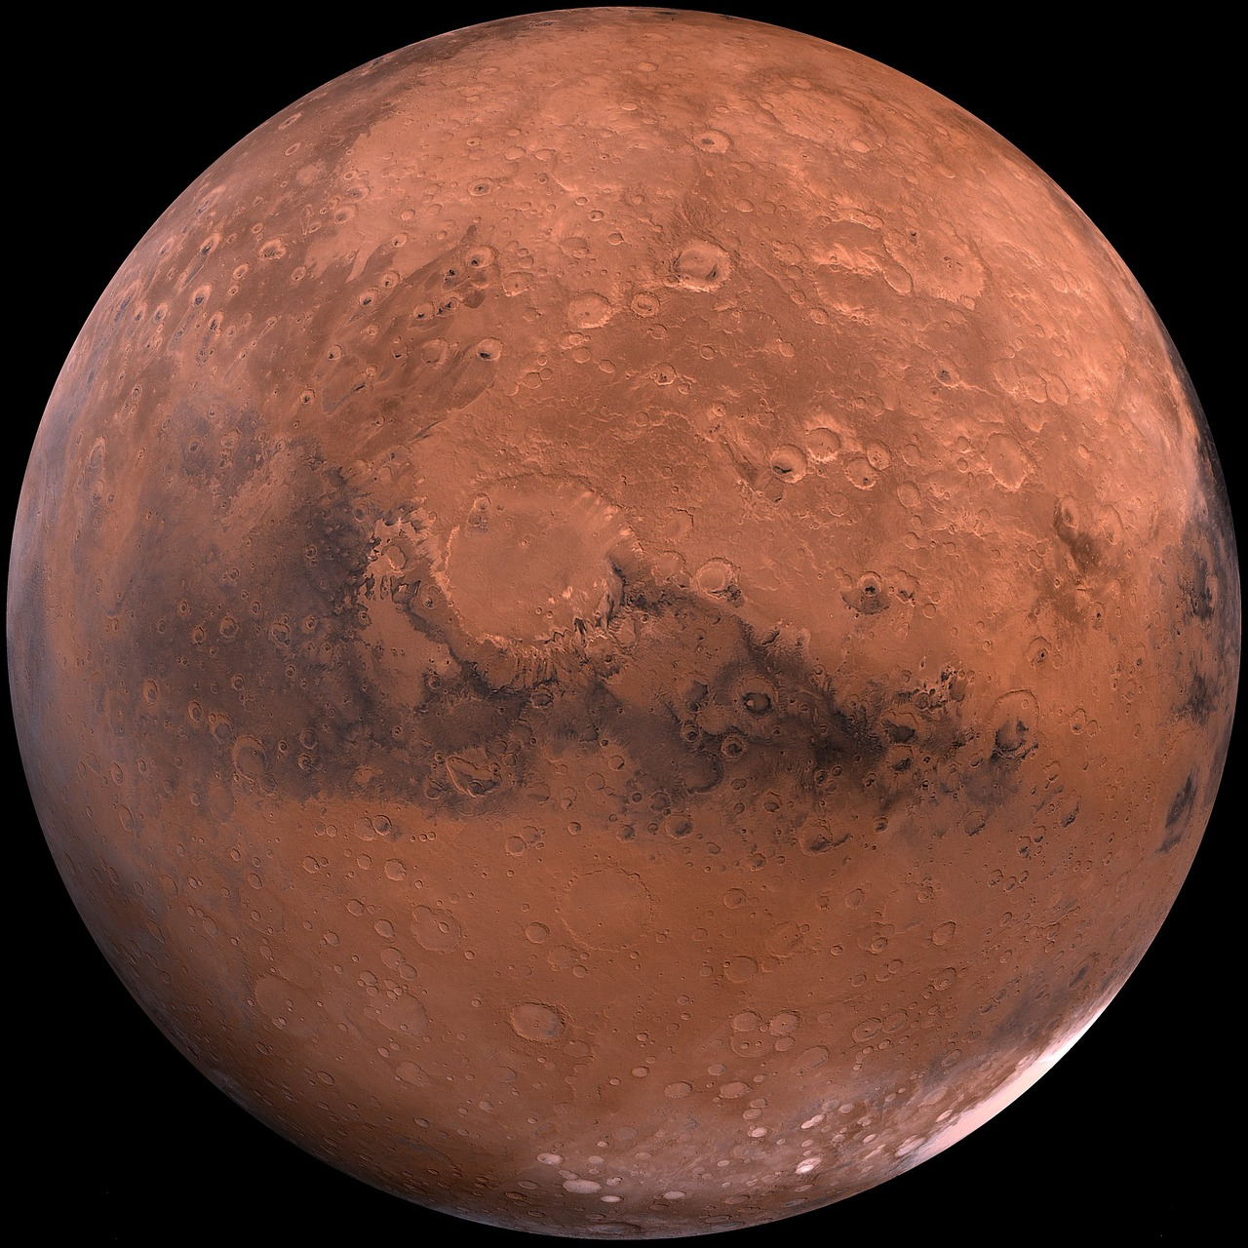
Learning to live on mars
with the BBC micro:bit
Designing and programming a device that can help an astronaut living on the surface of Mars

Slide 2
Stay safe
Whether you are a scientist researching a new medicine or an engineer solving climate change, safety always comes first. An adult must always be around and supervising when doing this activity. You are responsible for:
ensuring that any equipment used for this activity is in good working condition
behaving sensibly and following any safety instructions so as not to hurt or injure yourself or others
Please note that in the absence of any negligence or other breach of duty by us, this activity is carried out at your own risk. It is important to take extra care at the stages marked with this symbol: ⚠
Notes:
Safety Warning

Slide 3
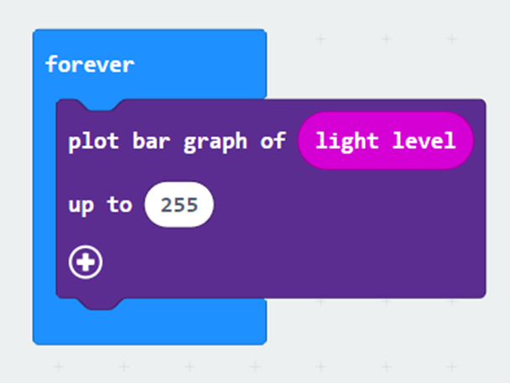
Starter
Look at the code
What do you think it does?
Run the code and see what it really does
Notes:
Teacher could deliver this starter using the PR of the PRIMM (Predict-Run-Investigate-Modify-Make) process:
Predict – show the code and ask students what it does.
Run – enter the code and run it in the simulator and then on the micro:bit and observe what it actually does.
The starter program leads into the main activity. It shows how a light reading can be taken and displayed in graphical form, in real-time.
The ‘plot bar graph’ block is used for this program, but in some projects the whaleysans font extension is used to show a 2 digit number on the display - teachers might choose to use the whaleysans extension here instead, although note that it only shows 2 digits, so the light reading would have to be scaled and rounded to be of use, and that might be too much detail for a starter.

Slide 4
Design context
Mars is a very different planet to the Earth
If we are to live there, we will need to understand its environment
What would we need to know about Mars to live there? How could we get this data?
Notes:
Explain to learners that the design context is what sets the scene for the project that they will be working on.
In response to the questions asked, the teacher could discuss how we would need to know information about temperature, light levels, oxygen, gravity etc. We could use sensors and programmable systems to gather and log this data.

Slide 5
Design brief
Using the BBC micro:bit:
Design a programmable device that an astronaut can use on a mission to gather information about the planet Mars
The device will also need to keep track of how much oxygen is left in their space suit whilst away from base camp
Notes:
Explain that the design brief describes what it is they are going to do in their project.
Discuss the brief with learners and check they understand it.
Learners could analyse the design brief and/or criteria by producing a mind map or spider chart of their initial thoughts on how to solve the problem given.

Slide 6
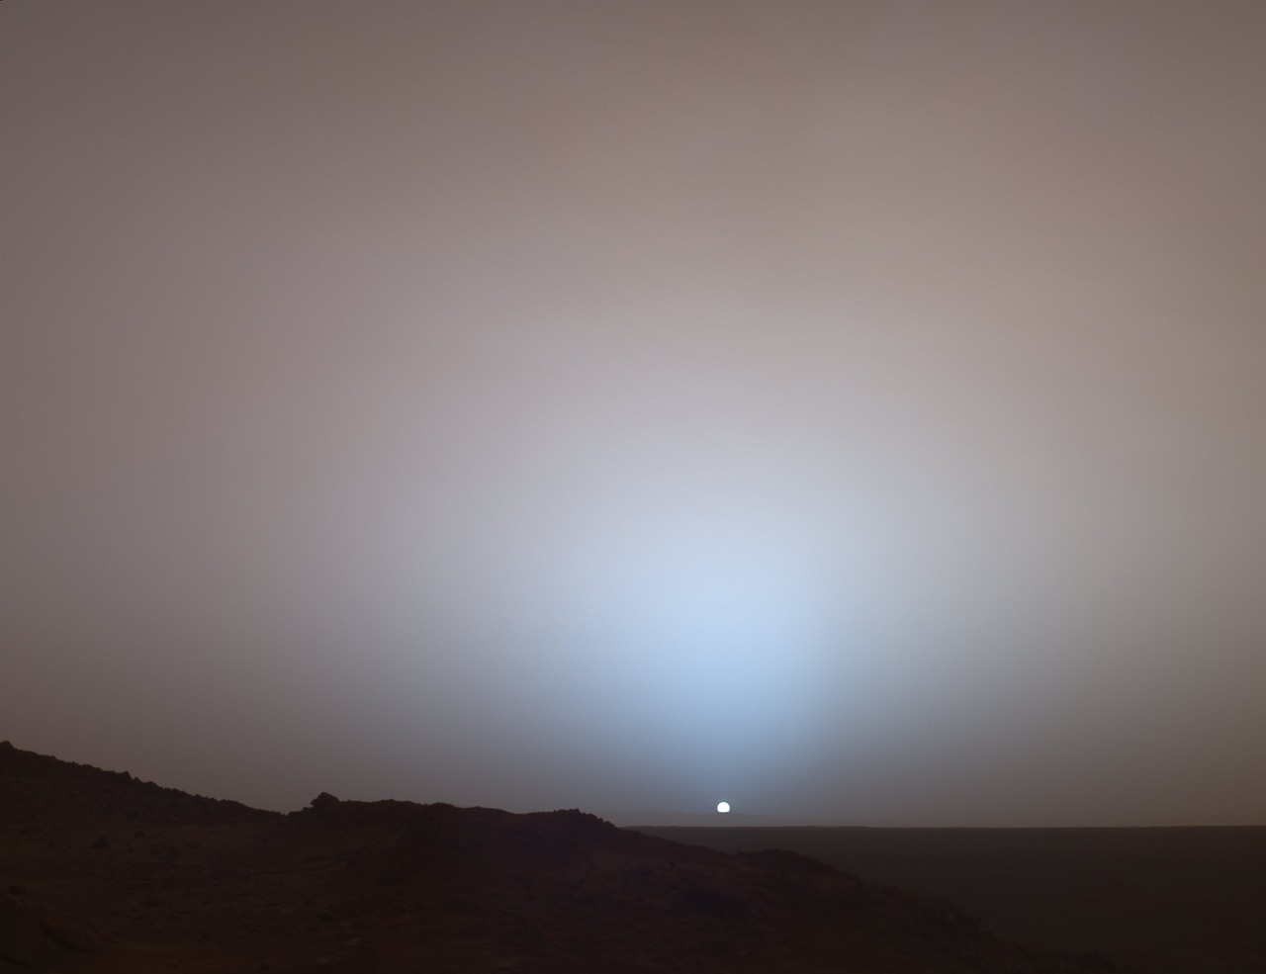
Design criteria
Your device must be able to:
Record the light and temperature levels on the planet
Track the amount of oxygen left in the space suit whilst away from base camp
It could also:
Help the astronaut to find their way back to base camp once they have collected their data
Log the data collected
Notes:
Assessment advice – learners could be assessed on how many of the design criteria they have managed to fulfil with their devices.
The ‘it could also’ criteria is intended to be harder and provide more challenge.
Learners could analyse the design brief and/or criteria by producing a mind map or spider chart of their initial thoughts on how to solve the problem given.

Slide 7
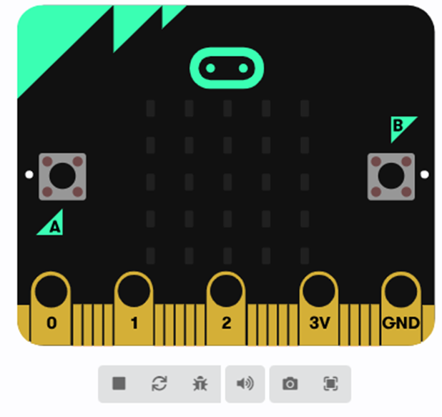
Your tasks (route 1)
⚠
Go to https://makecode.microbit.org
Drag the suit-template:bit HEX file into the project homepage to open it
Use the template to write your code to meet the brief
Download it to your micro:bit
Go on your mission!
View the data recorded on the MICROBIT drive
Notes:
Learners can be taken through this in one of two ways:
Option 1 – Learners themselves complete the suit-template file to create the code to meet the design brief, with help as required from the teacher. In this instance the main focus is the programming activity and completing a partially written program.
Option 2 – The example code is treated as pre-written and downloaded onto the micro:bits ‘as is’. In this instance the main focus is on the overall system and the use of the device in context.
Route option 1:
For lower ability learners the teacher could show the learners how to use the template to create the program step-by step.
The example suit:bit program can be used to help with this and to give an example for learners to follow as needed. This could be demonstrated working, prior to learners producing their own program, so they know what they are aiming to achieve.
Safety – always take care when using electrical or electronic devices. If something does not seem right, e.g. the circuit board is getting hot, take the power off and tell an adult immediately.

Slide 8
Your tasks (route 2)
⚠
Go to https://makecode.microbit.org
Drag the suit:bit HEX file into the project homepage to open it
Download it to your micro:bit
Go on your mission!
View the data recorded on the MICROBIT drive
Notes:
Learners can be taken through this in one of two ways:
Option 1 – Learners themselves complete the suit-template file to create the code to meet the design brief, with help as required from the teacher. In this instance the main focus is the programming activity and completing a partially written program.
Option 2 – The example code is treated as pre-written and downloaded onto the micro:bits ‘as is’. In this instance the main focus is on the overall system and the use of the device in context.
Route option 2:
Teacher will need to place the suit:bit example program in a shared drive for learners to access and drag on screen, or have it opened and ready on screen for them in advance.
Safety – always take care when using electrical or electronic devices. If something does not seem right, e.g. the circuit board is getting hot, take the power off and tell an adult immediately.

Slide 9
The mission!
Your challenge is to:
Leave base camp with a full oxygen tank
Explore the Martian surface
Take light and temperature readings
Get back to base camp when your oxygen runs low!
Notes:
The mission challenge is for learners to leave the base camp with a full oxygen tank, explore the terrain, take light and temperature readings, and get back to base camp before the oxygen runs out. This can be set up as role play within the classroom. The teacher could also add some extra tasks to complete along the way as desired.
Explain that if it is hotter, oxygen is spent faster. Also if the learner is active, oxygen is spent faster. If learners are a long way from base camp, it will take longer to get back to camp when the oxygen runs low. If learners get the X and the alarm signal, the oxygen has run out and they have failed the challenge. Explain that learners can use the logo-press to measure the distance to base camp, but if they are too far from camp they won't get a signal, and they will need to leave some 'breadcrumbs' along the way to find their way back. The beeping of the beacon will stop if they are out of range of the base camp, so this would alert them to the fact that they are a long way away. Explain that when oxygen is getting low, learners must decide whether to continue with their tasks and collect more readings and samples, or head back to basecamp and recharge their oxygen tanks, then do another run when recharged.

Slide 10
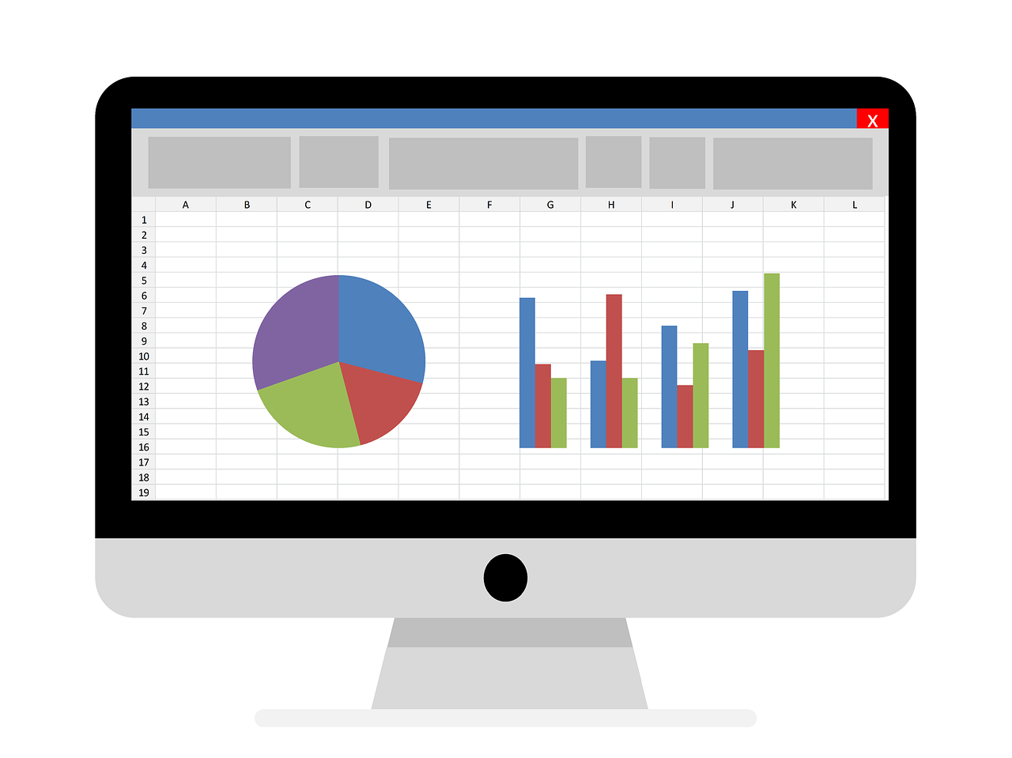
Extension
Download the CSV file of your data and load into Excel - use the data to plot graphs for scientists back on Earth
Think about how you could complete the mission challenges faster
Notes:
Extension 1:
Teachers could ask students to download and save the CSV file of their data and load it into Excel; there they can plot graphs that could be shown to the other astronauts back at base camp, or scientists on Earth.
Extension 2:
Ask learners how long it took to complete all the challenges and can if they could do it faster and with less trips than their classmates? A score could be attached to the time used, the number of challenges completed, and whether they run out of oxygen or not.

Slide 11
Starter example program
Notes:
This program is for the starter activity (slide 3).
To open this program:
Open https://makecode.microbit.org in a new browser window.
Click on ‘import’ and select ‘import file’. Then choose the HEX file to upload.
Or, drag the HEX file from your computer into the edit window or project homepage.
https://support.microbit.org/support/solutions/articles/19000065686
Versions of this program are provided for both Windows and Mac operating systems.

Slide 12
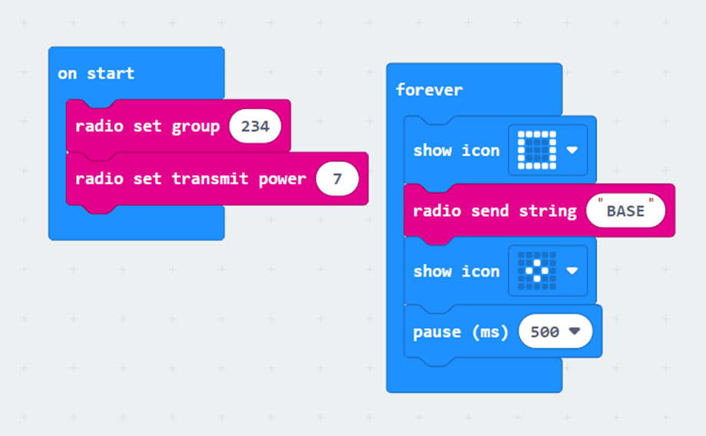
basecamp:bit program
Notes:
The basecamp program is provided for teachers to download onto the micro:bit acting as the ‘base camp’. It provides a range measurement feature if the challenge is posed to get
back to base camp before the oxygen runs out. Teachers should place this micro:bit at the location of the base camp. This will work well within a typically sized classroom.
To open this program:
Open https://makecode.microbit.org in a new browser window.
Click on ‘import’ and select ‘import file’. Then choose the HEX file to upload.
Or, drag the HEX file from your computer into the edit window or project homepage.
https://support.microbit.org/support/solutions/articles/19000065686
Versions of this program are provided for both Windows and Mac operating systems.

Slide 13
suit:bit example program – full program
Notes:
This program is for the main activity and for the learners to use when gathering data and then finding their way back to base camp. The micro:bit is to be worn on the suit (or on their arm like a watch). Some aspects of this program are pre-provided as part of the suit-template HEX file, so learners can fill in the gaps. E.g. the oxygen simulator and value display code.
The simplest version of this program will make the micro:bit into a sensing device that can take readings whilst the astronaut is out on a mission. Holding A shows the temperature, holding B shows a light reading. Both use the whaleysans package built in to avoid scrolling the two digits. Teachers should explain that whaleysans only shows 2 digits and a light reading is between 0 and 255; students could either divide by 10 and round it, or use the 'map' block to map it from 0..255 to 0..99 for display as 2 digits.
The activity monitor is easy to add and acts like a step counter – every time a shake is detected, add 1 to the movement variable. This variable is used by the oxygen simulator in the template, to 'spend' oxygen at a higher rate when moving more. The oxygen level is automatically displayed when nothing else is on the screen. Teachers should get learners to use our showValue function, as that deals with the difficulty of only displaying the oxygen reading if nothing else is on the display. Teachers could explain here that as coders in industry, they could often be expected to modify and improve existing programs, and not always be able to start from an empty page.
For more challenge the program can be modified to include radio messaging. This requires learners to store the radio range in a variable every time a new message is received and convert it using the MAP block into a distance 0..9. Then, when the logo is touched they use our showValue function to show the range to basecamp.
The most level of challenge can be found by building in the data logging feature to log the data recorded. The data must be logged at regular intervals, multiple columns must be logged, and an A+B delete-log feature must be added. Teachers could get students to try the standard micro:bit data logging video on the microbit.org website to understand how this works, or demonstrate clicking on data.htm on the MICROBIT drive, and looking at the numbers and the graph preview.
It is recommended that when showing the program to learners the teacher loads this onto the micro:bit makecode editor and zooms into the different groups of code so learners can see them clearly, or use the following slides which break this down into more manageable chunks.
To open this program:
Open https://makecode.microbit.org in a new browser window.
Click on ‘import’ and select ‘import file’. Then choose the HEX file to upload.
Or, drag the HEX file from your computer into the edit window or project homepage.
https://support.microbit.org/support/solutions/articles/19000065686
Versions of this program are provided for both Windows and Mac operating systems.

Slide 14
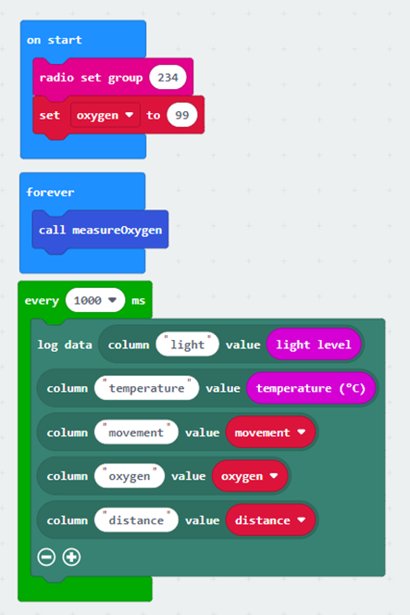
suit:bit example program

Slide 15
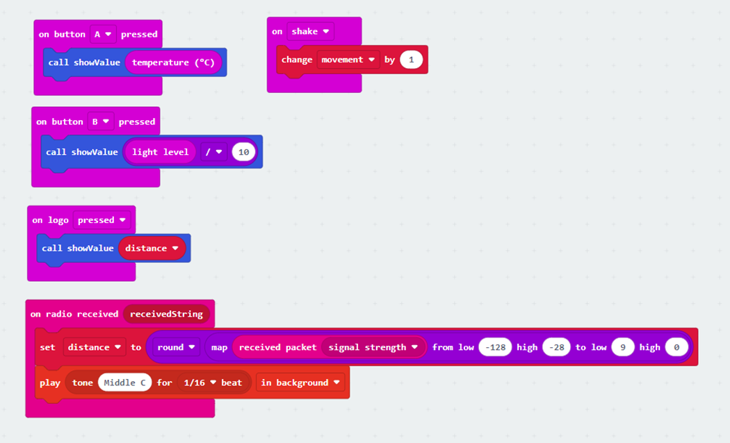
suit:bit example program

Slide 16
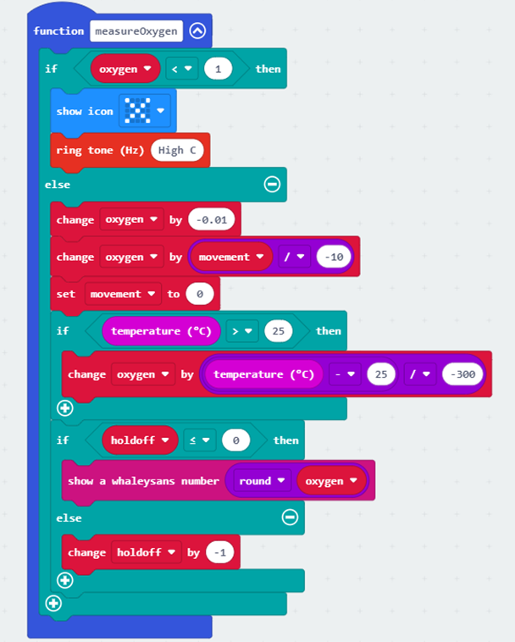
suit:bit example program

Slide 17
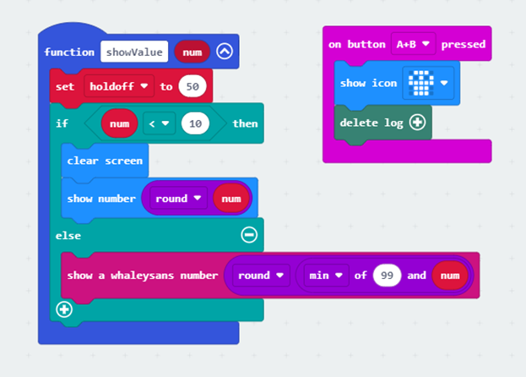
suit:bit example program

Slide 18
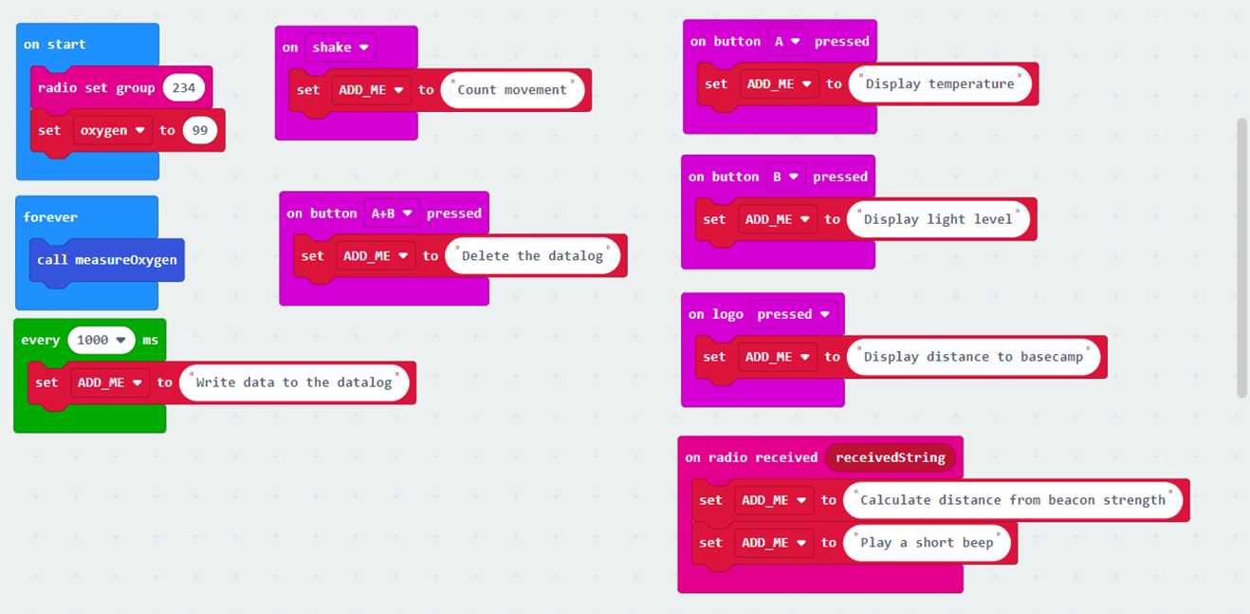
Suit-template program
Notes:
This is the first part of the template program. It has an ADD_ME comment against each part of the code that learners will need to work out what code to add for each interactive part of the project.

Slide 19
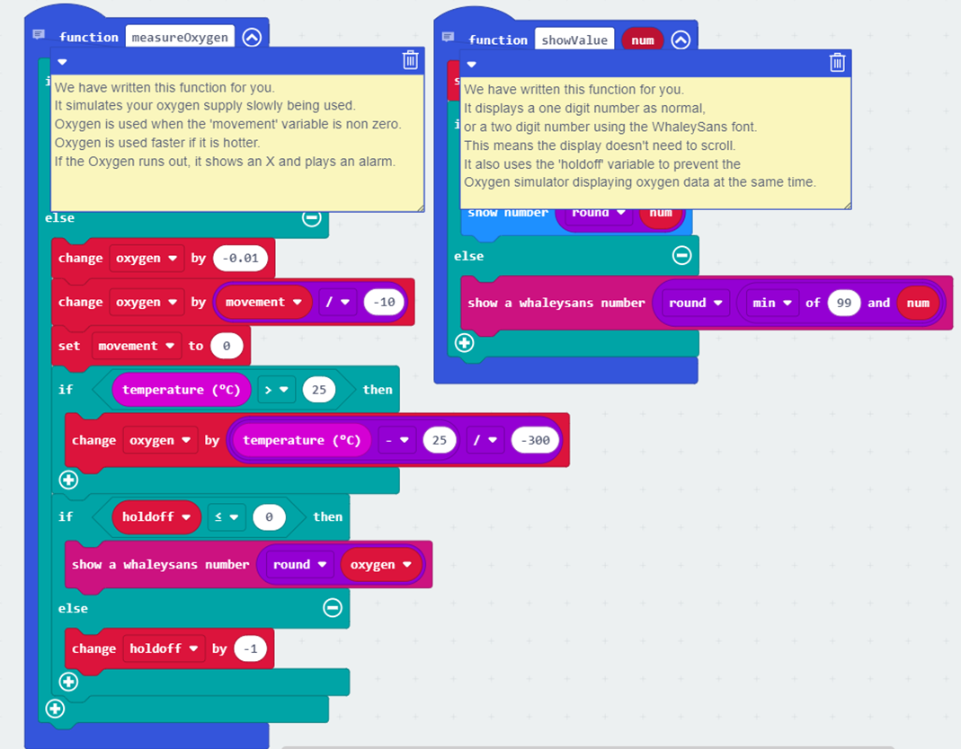
Suit-template program
Notes:
This is the second part of the template program. This has a yellow comment block for the two provides functions, that explains what the functions do.

