Slide 1
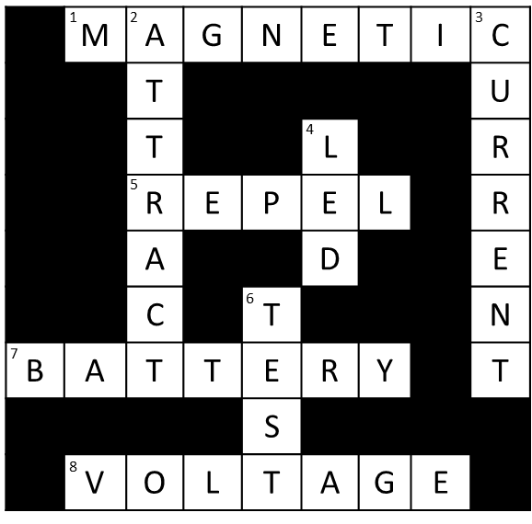
Design and technology crosswords
Creating a crossword using
key terms from Design and Technology

Slide 2
Step 1 – Choosing your words
Think of eight key words from the topics you have been studying.
Write them down in a list. These are the answer words for the crossword.
For example:
Magnets and Electricity
Magnetic
Attract
Current
LED
Repel
Test
Battery
Voltage
Notes:
Example words have been given for magnets and electricity topics. These could, for example, be used to help students recap key terms following completion of the IET Faraday activities – Marvellous Magnets, Magnetic Materials, Magnet Maze, Not Newton’s Cradle, Exciting Electricity, Fruit Lights, Clever Circuits and Investigating Electricity. Teacher could create different example words for different topics studied, or learners could come up with their own.

Slide 3
Step 2 – Putting the words in a grid
Draw a 9 x 9 square grid.
Place your answer words in the grid going across or down. Try to connect the words together by using letters that are the same in each word.
 | M | A | G | N | E | T | I | C
 |  | T |  |  |  |  |  | U
 |  | T |  |  | L |  |  | R
 |  | R | E | P | E | L |  | R
 |  | A |  |  | D |  |  | E
 |  | C |  | T |  |  |  | N
B | A | T | T | E | R | Y |  | T
 |  |  |  | S
 | V | O | L | T | A | G | E
Notes:
For weaker learners, a template could be handed out with the grid pre-drawn. If the words selected by learners do not easily fit into the grid, they may need to go back and choose alternative words.

Slide 4
Step 3 – Adding the clue numbers
Write the clue numbers 1 – 8. These should be written in the top left of the box containing the first letter of each word. They should go upwards from left to right.
Colour any blank spaces in black.
1
2
3
 | M | A | G | N | E | T | I | C
 |  | T |  |  |  |  |  | U
 |  | T |  |  | L |  |  | R
 |  | R | E | P | E | L |  | R
 |  | A |  |  | D |  |  | E
 |  | C |  | T |  |  |  | N
B | A | T | T | E | R | Y |  | T
 |  |  |  | S
 | V | O | L | T | A | G | E
4
5
6
7
8

Slide 5
Step 4 – Removing the answer words and writing the clues
1
2
3
Redraw the crossword on a new grid but without the answer words.
Write clues for the words and number them.
Split the clues into two lists – ‘across’ and ‘down’.
4
5
6
7
8
Notes:
Number for the clues should match the numbers for the answers words. For example:
Clue: 7 across ‘powers electrical circuits’, answer: battery.
Encourage learners to come up with a mixture of simple clues and more challenging ones.

Slide 6
Step 5 – Try the crossword!
Give your crossword to a partner.
Ask them to try and solve your puzzle!
How well did they do?
1
2
3
 | M | A | G | N | E | T | I | C
 |  | T |  |  |  |  |  | U
 |  | T |  |  | L |  |  | R
 |  | R | E | P | E | L |  | R
 |  | A |  |  | D |  |  | E
 |  | C |  | T |  |  |  | N
B | A | T | T | E | R | Y |  | T
 |  |  |  | S
 | V | O | L | T | A | G | E
4
5
6
7
8
Notes:
Learners could peer assess each others’ responses. They could provide feedback, for example, on how well the clues matched the key words and how easy/difficult the puzzle was to solve.

