Slide 1
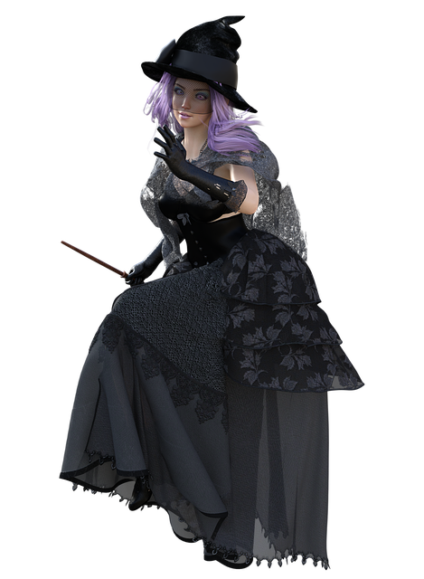
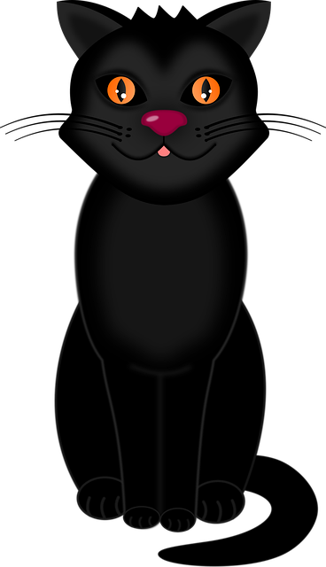
Balance the Broomstick
Using maths to balance a lever supporting different loads

Slide 2
Stay safe
Whether you are a scientist researching a new medicine or an engineer solving climate change, safety always comes first. An adult must always be around and supervising when doing this activity. You are responsible for:
ensuring that any equipment used for this activity is in good working condition
behaving sensibly and following any safety instructions so as not to hurt or injure yourself or others
Please note that in the absence of any negligence or other breach of duty by us, this activity is carried out at your own risk. It is important to take extra care at the stages marked with this symbol: ⚠
Notes:
Safety Warning

Slide 3
The witch and her broomstick
A witch is riding on her broomstick
The broomstick is an example of a simple lever
The witch is sat in the middle of the broomstick - this means she is the pivot
Back end of the lever
Front end of the lever
Witch - pivot
Broomstick - lever
Notes:
For the purpose of this activity, ignore the mass of the sticks on the back of the broomstick (assume this is 0 kg) and take the back end of the lever to be before these start.

Slide 4
Example 1 – the witch’s cat
The witch has picked up her cat
The cat has a mass of 3 kg and is sat on the back of the broomstick
Is the broomstick balanced? Why/why not?
3 kg

Slide 5
Example 1 – the witch’s cat (answer)
The broomstick is not balanced - it will tip backwards
How could you balance the broomstick?
3 kg
Notes:
The broomstick could be balanced by adding another cat with a mass of 3 kg on the front end of the broomstick.

Slide 6
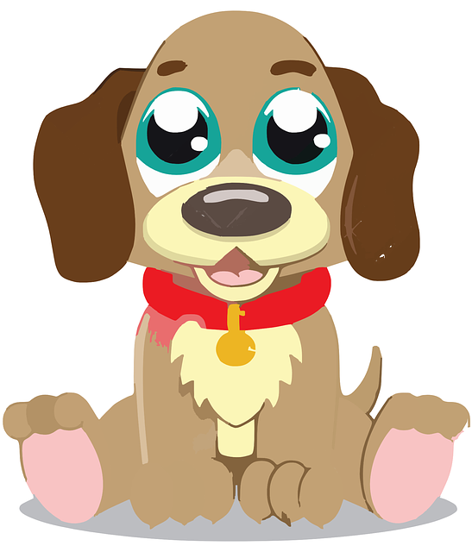
Example 2 – cat and dog
As well as her cat, the witch has now picked up a dog
The dog has a mass of 6 kg and is sat on the front of the broomstick
Is the broomstick balanced? Why/why not?
3 kg
6 kg

Slide 7
Example 2 – cat and dog (answer)
The broomstick is not balanced - it will tip forwards
How could you balance the broomstick?
3 kg
6 kg
Notes:
The broomstick could be balanced by having two cats sat on top of each other at the back end of the broomstick, or one dog instead of the cat.

Slide 8
Example 3 – two dogs
The cat has got off and the witch has picked up another 6 kg dog
There is now one dog on the front and one dog on the back of the broomstick
Is the broomstick balanced? Why/why not?
6 kg
6 kg

Slide 9
Example 3 – two dogs (answer)
The broomstick is balanced
The masses on both ends of the broomstick are the same
6 kg
6 kg
Notes:
There is a 6 kg mass at each end of the broomstick, so therefore it is balanced.

Slide 10
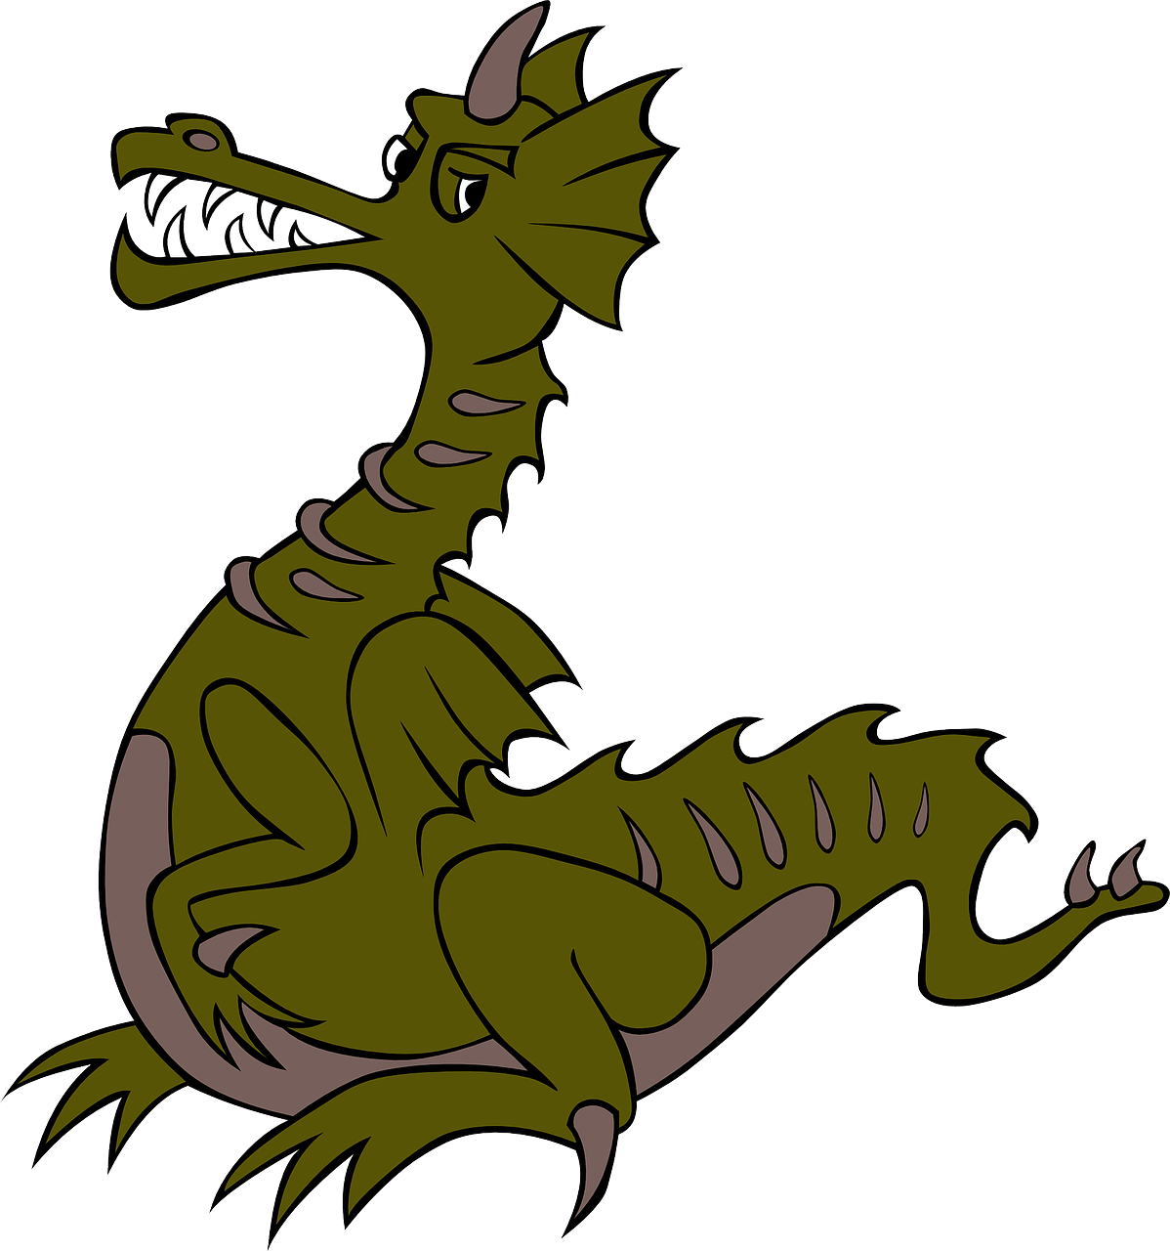
Example 4 – dog and dragon
A 12 kg baby dragon has jumped onto the front of the broomstick and replaced one of the dogs
Is the broomstick balanced? Why/why not?
12 kg
6 kg

Slide 11
Example 4 – dog and dragon (answer)
The broomstick is not balanced - it will tip forwards
How could you balance the broomstick?
12 kg
6 kg
Notes:
The broomstick could be balanced by having two dogs or four cats sat on top of each other, or one dragon, on the back end of the broomstick.

Slide 12
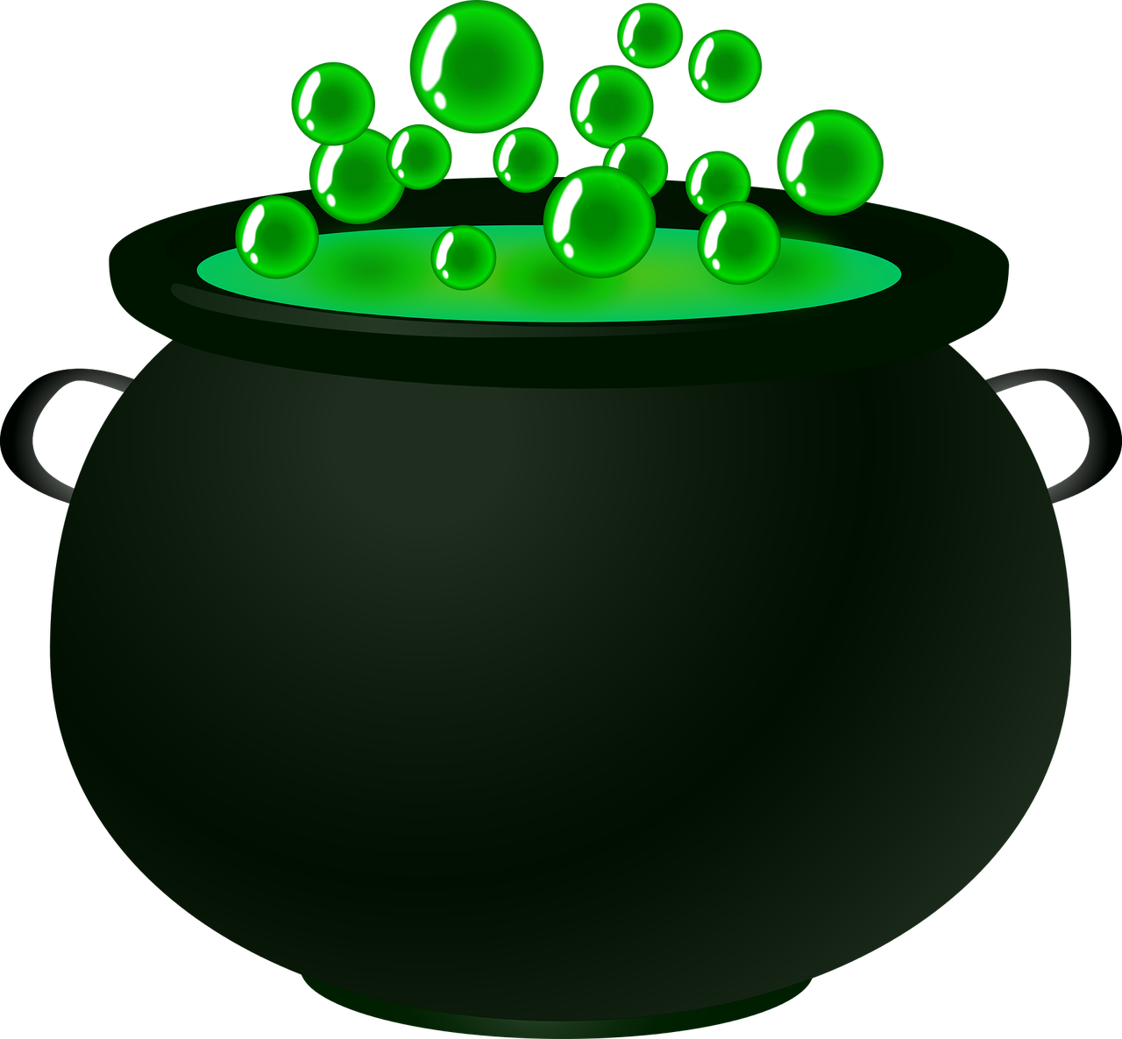
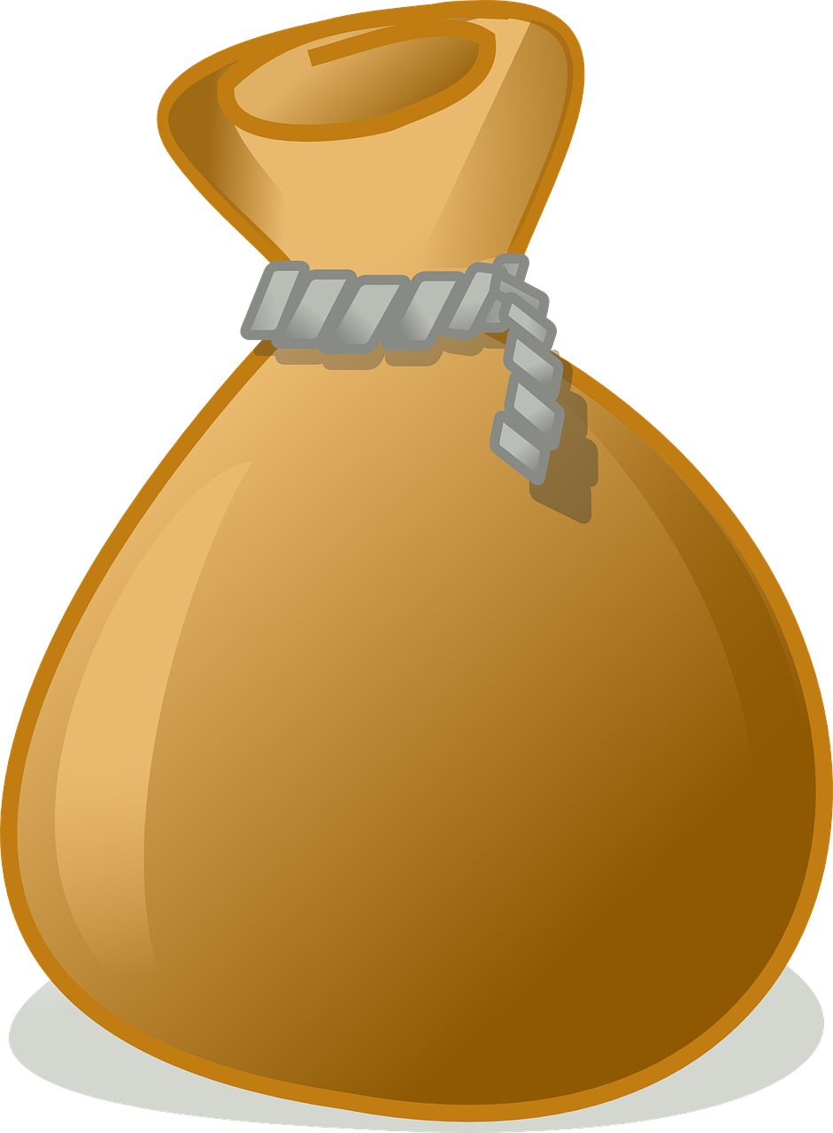
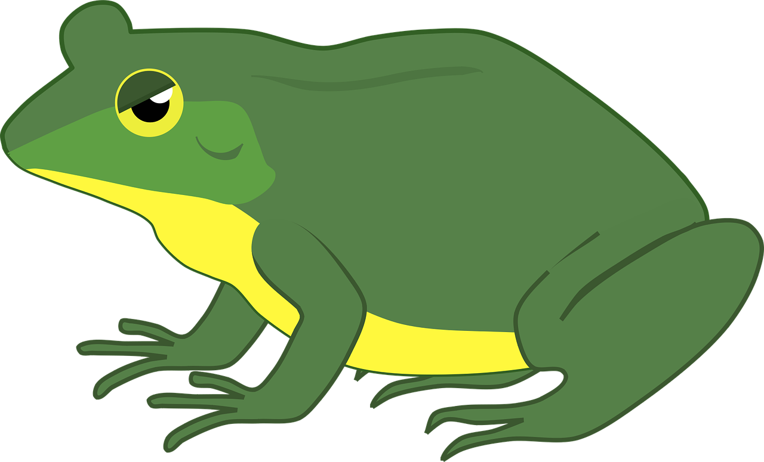
Balancing the broomstick
You now have the creatures, animals and objects shown below
Find as many ways as you can of balancing the broomstick with them - you can use each as many times as you like
Bag of ingredients
Dog
Cauldron
Spell book
Toad
1 kg
1.5 kg
6 kg
15 kg
3 kg
Notes:
Learners could draw or write down their responses on paper or in their exercise books. For weaker learners the teacher could print out sets of card broomsticks and the objects available, so that learners can complete by sorting visually.
This could be made into a competition to see who can find the most ways of balancing the broomstick in a set time, e.g. 20 minutes.

Slide 13
Extension
Investigate the effect of moving animals up and down the broomstick - for example:
With two 3 kg cats, what would happen if they moved different distances from the witch (pivot point)
3 kg
3 kg

