Slide 1
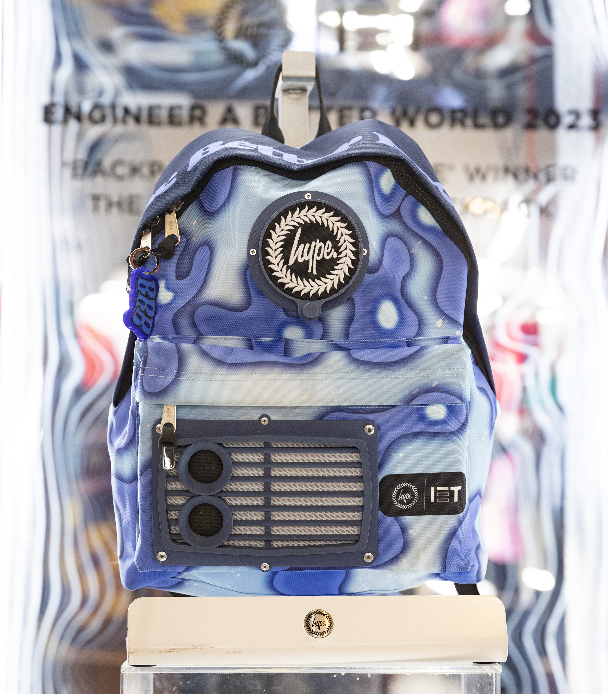
Backpack for the future
Designing the dream backpack of the future

Slide 2
Stay safe
Whether you are a scientist researching a new medicine or an engineer solving climate change, safety always comes first. An adult must always be around and supervising when doing this activity. You are responsible for:
ensuring that any equipment used for this activity is in good working condition
behaving sensibly and following any safety instructions so as not to hurt or injure yourself or others
Please note that in the absence of any negligence or other breach of duty by us, this activity is carried out at your own risk. It is important to take extra care at the stages marked with this symbol: ⚠

Slide 3
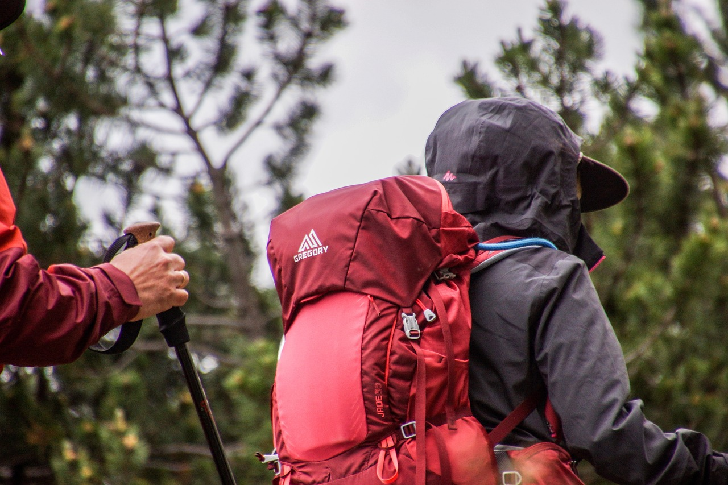
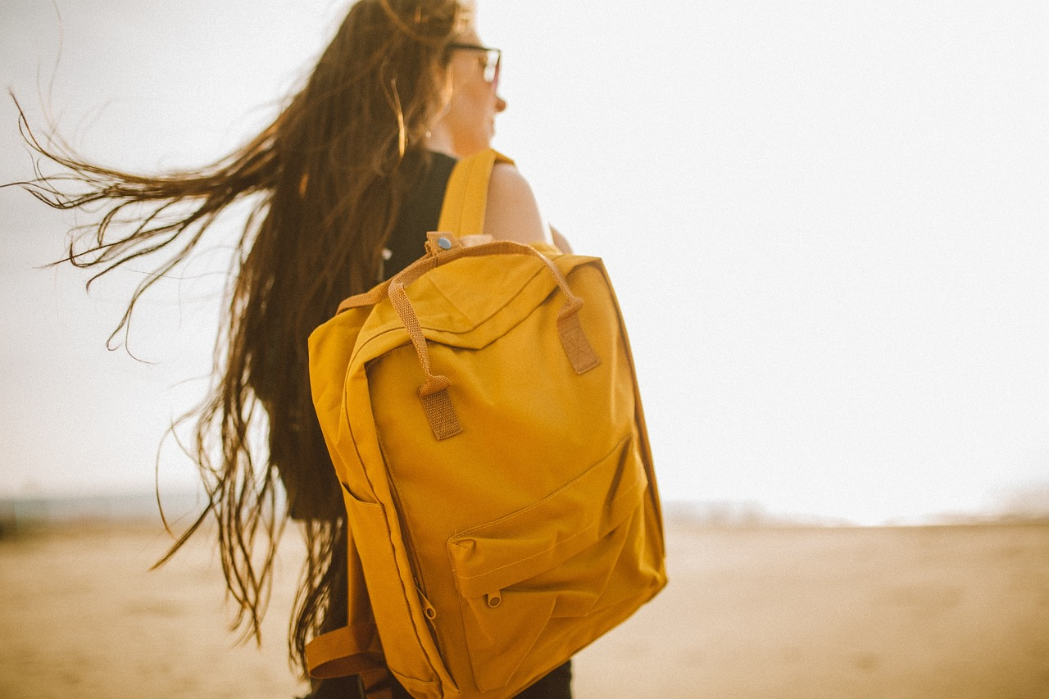
Backpacks
Backpacks are used to carry all sorts of items. For example:
  Books when going to and from school
  Food and water when out walking
  Clothes when going on holiday
Notes:
Discuss different uses of backpacks and why they are used.
Can learners think of any others?
How can STEM be used when designing backpacks?

Slide 4
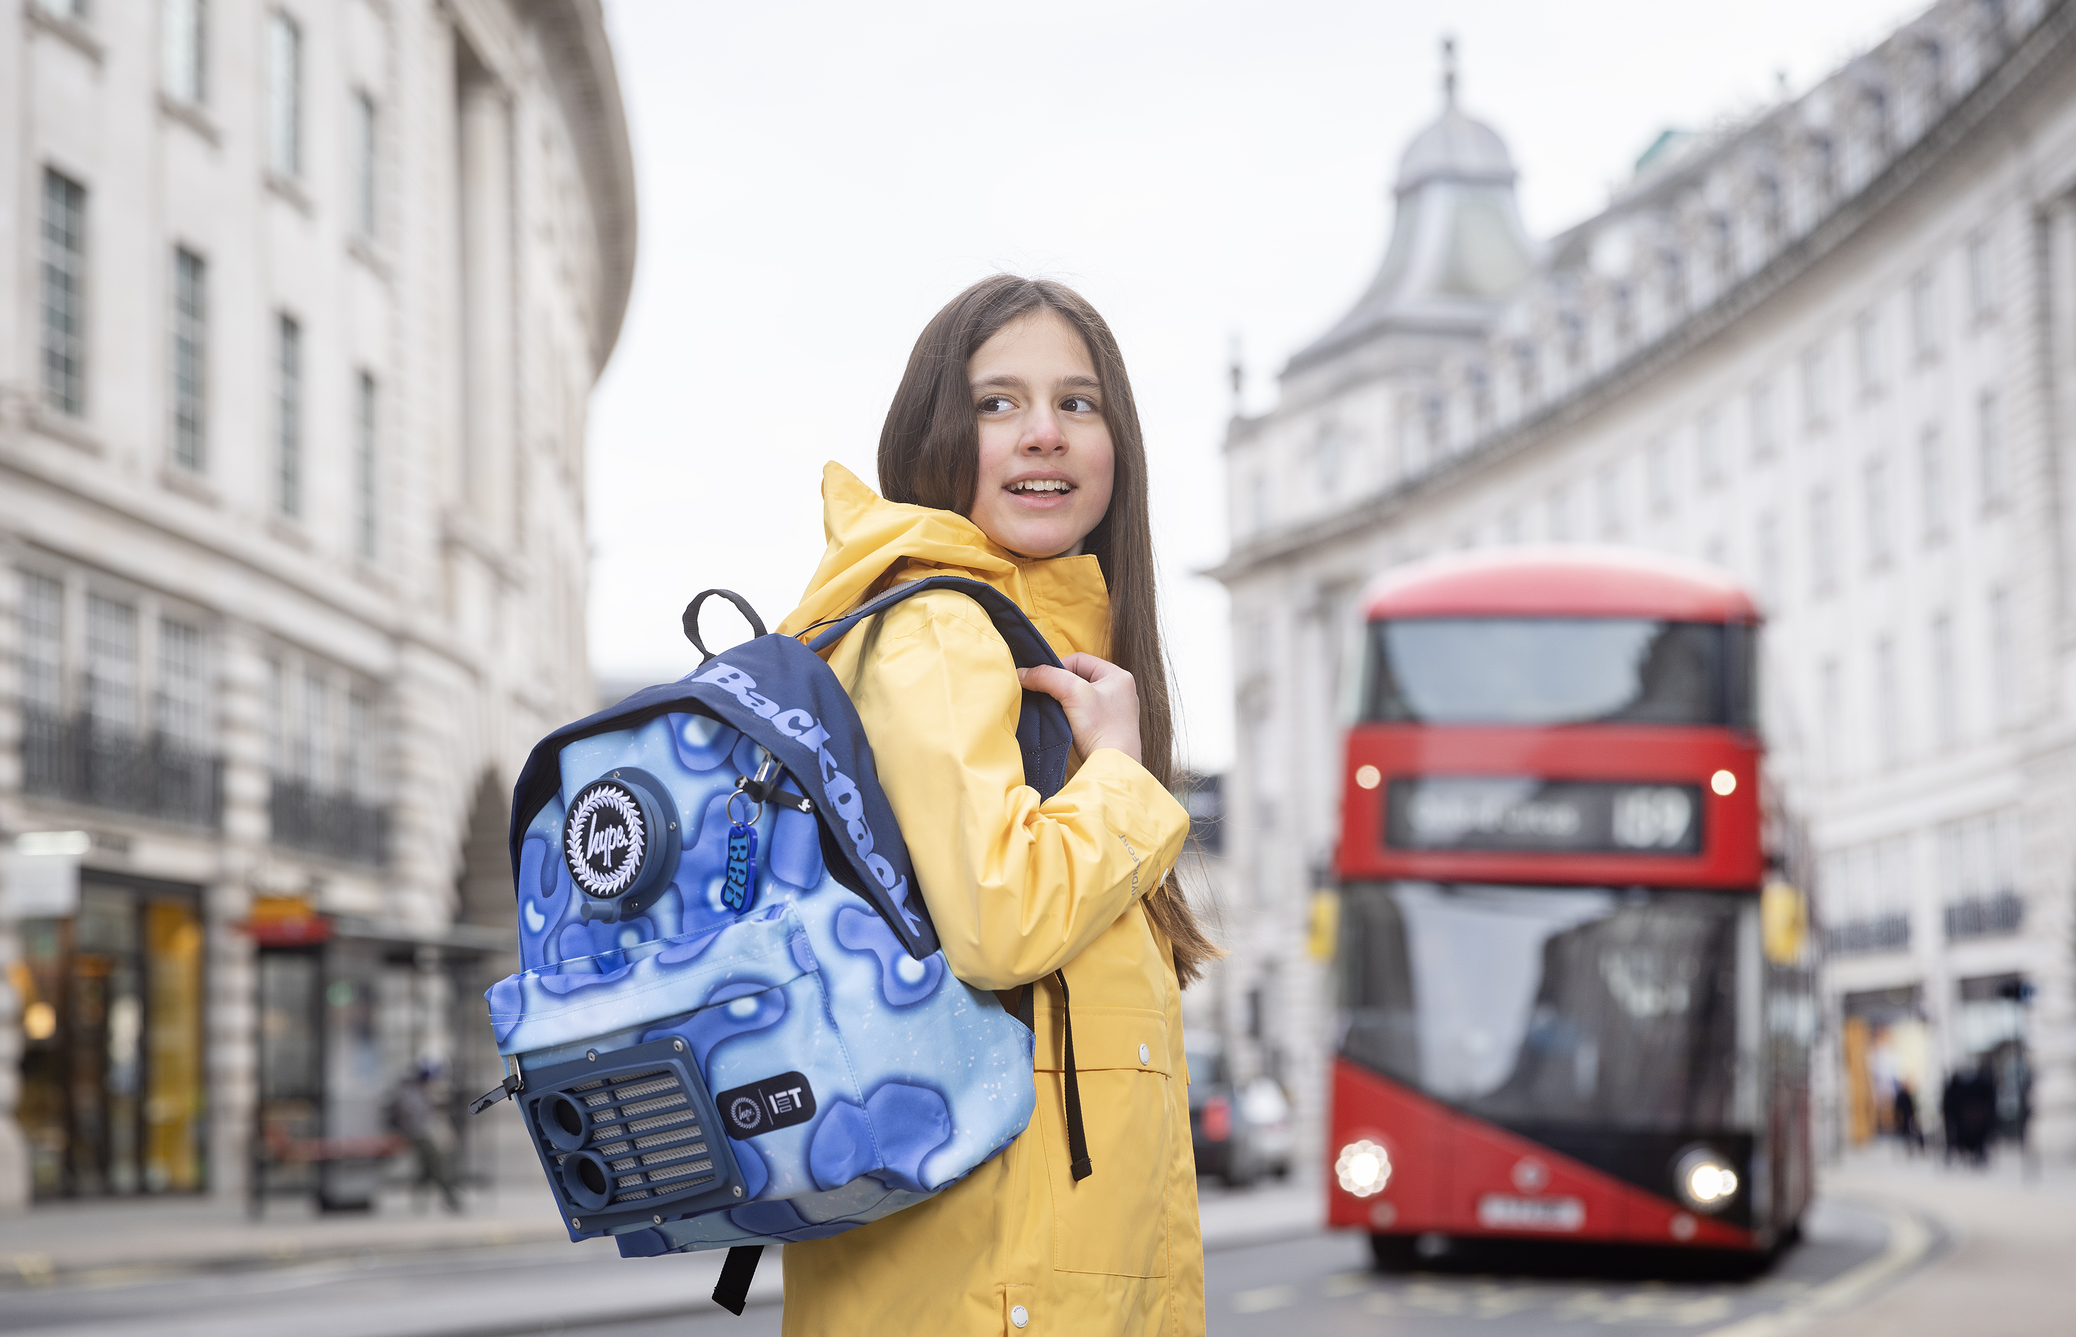
Design brief
Context
Backpacks are used to carry items for lots of different activities
They are often very colourful and stylish
Brief
Design your dream backpack of the future
Notes:
Discuss the design brief with learners.
The context sets the scene for the design problem, the brief gives the problem itself that is to be solved.

Slide 5
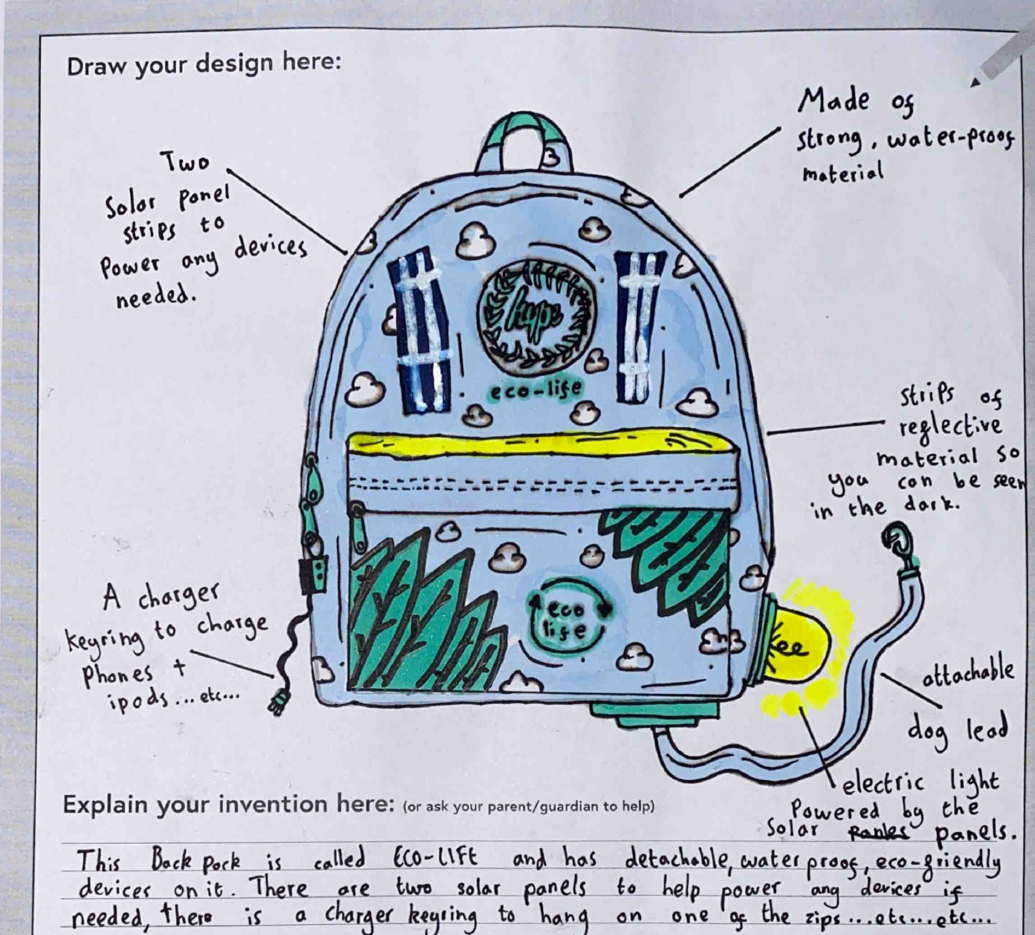
Design criteria
Your design must include:
A way of comfortably wearing on the back
Spaces to carry different items
Colours that show your personality
Clever gadgets and special tech that allow you to do incredible things
Notes:
Discuss the design criteria with learners.
The design criteria is a list of design points that the finished solution must meet.
Examples of clever gadgets etc could include:
A solar power system to help cycle extra fast on the way home from school
A special hive to help protect bees
A way of healing cuts if the wearer fell over
A way to instantly turn plastic rubbish into cool toys to play with at breaktime
Explain these examples to learners and ask them if they can think of any others.

Slide 6
Extra design considerations
Originality: How original is your idea?
Feasibility: How feasible is it that your design can be turned into a real-life prototype?
Creativity: How creative is your idea?
Engineering: What engineering processes have you used in your design?
Notes:
Teacher may need to explain the terms originality, creativity and feasibility.

Slide 7
Design specification
Use the design criteria and extra considerations to write a six point design specification for your backpack
Point 1
Point 2
Point 3
Point 4
Point 5
Point 6
Notes:
A design specification gives specific and measurable criteria that must be met by the design. It should therefore expand on the design criteria.
For example, what exact materials, colours and technologies will be used.
Extra points could also be added e.g. how the design could be sustainable, make use of solar energy etc.

Slide 8
Future backpack design
Notes:
Learners could use this space to produce their design – this could be printed on A4 or A3 paper.
Encourage them to use notes and labels to explain their idea and how it meets the design criteria.

Slide 9
Evaluation
Evaluate how well your design meets the design criteria:
Which points does it meet? How?
Which points does it not meet? Why?
How could you improve your design?
Notes:
Evaluation involves checking the design produced against the design criteria and identifying where improvements could be made.

Slide 10
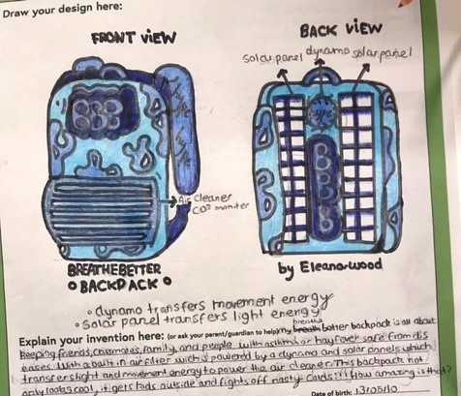
Example 1
Notes:
An example of a possible design.
Winners of IET Backpack to the future competition:
https://www.dailymail.co.uk/sciencetech/article-11691551/Girl-12-creates-backpack-filters-air-pollution-seeing-mother-suffer-asthma.html
https://kindredagency.com/our-work/backpack-to-the-future/
https://eabw.theiet.org/past-campaigns-and-activities/backpack-to-the-future/

Slide 11
Example 2
Notes:
An example of a possible design.
Winners of IET Backpack to the future competition:
https://www.dailymail.co.uk/sciencetech/article-11691551/Girl-12-creates-backpack-filters-air-pollution-seeing-mother-suffer-asthma.html
https://kindredagency.com/our-work/backpack-to-the-future/
https://eabw.theiet.org/past-campaigns-and-activities/backpack-to-the-future/

Slide 12
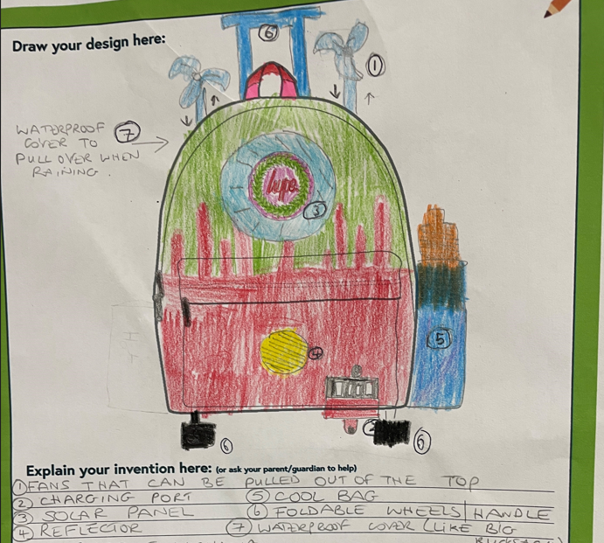
Example 3
Notes:
An example of a possible design.
Winners of IET Backpack to the future competition:
https://www.dailymail.co.uk/sciencetech/article-11691551/Girl-12-creates-backpack-filters-air-pollution-seeing-mother-suffer-asthma.html
https://kindredagency.com/our-work/backpack-to-the-future/
https://eabw.theiet.org/past-campaigns-and-activities/backpack-to-the-future/

Slide 13
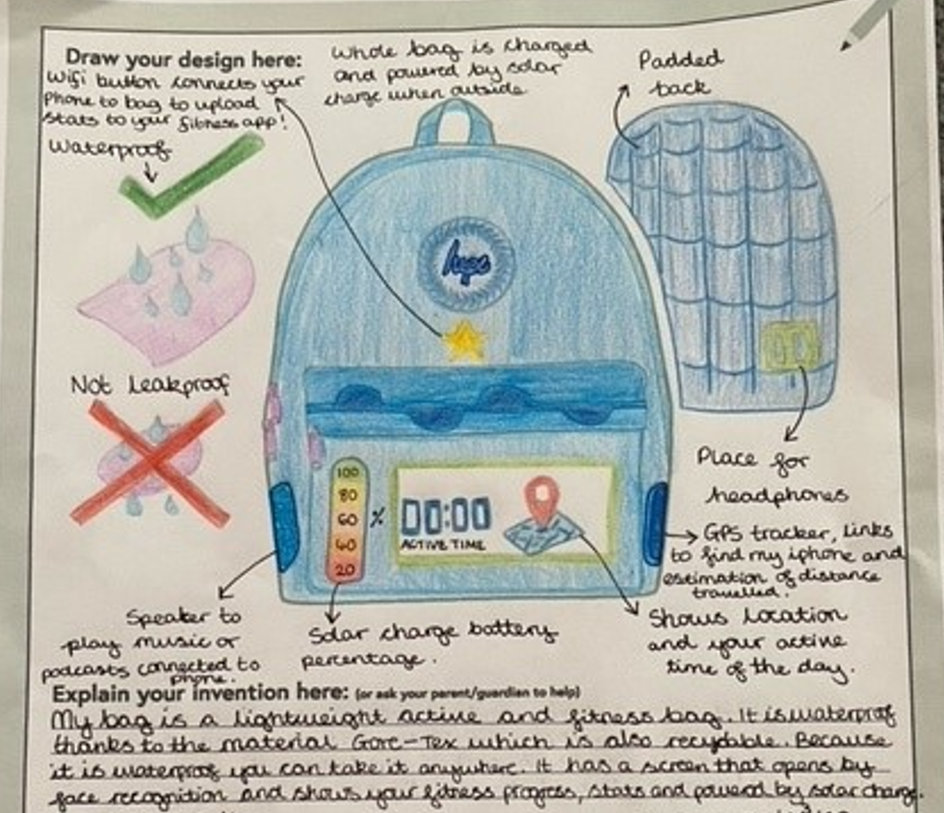
Example 4
Notes:
An example of a possible design.
Winners of IET Backpack to the future competition:
https://www.dailymail.co.uk/sciencetech/article-11691551/Girl-12-creates-backpack-filters-air-pollution-seeing-mother-suffer-asthma.html
https://kindredagency.com/our-work/backpack-to-the-future/
https://eabw.theiet.org/past-campaigns-and-activities/backpack-to-the-future/

Slide 14
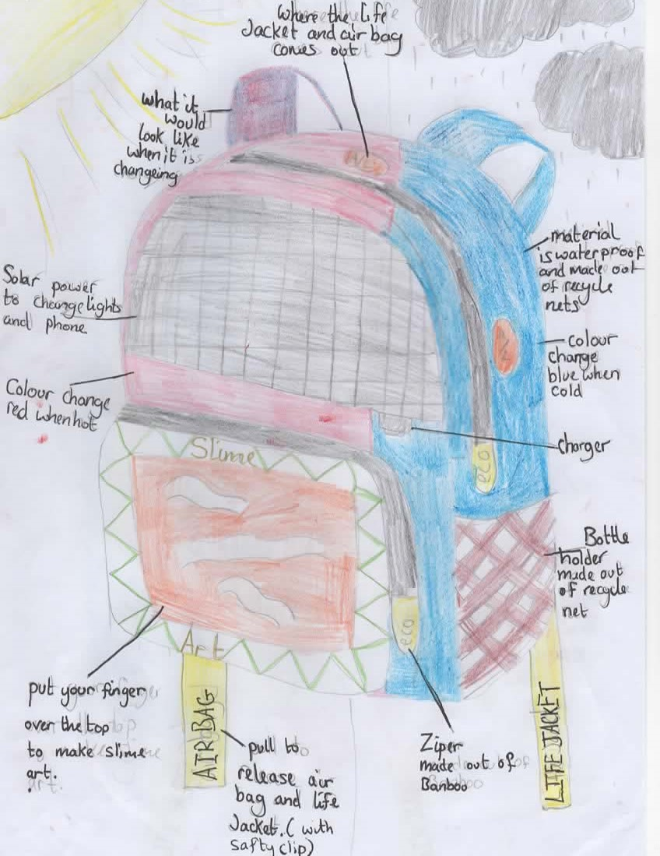
Example 5
Notes:
An example of a possible design.
Winners of IET Backpack to the future competition:
https://www.dailymail.co.uk/sciencetech/article-11691551/Girl-12-creates-backpack-filters-air-pollution-seeing-mother-suffer-asthma.html
https://kindredagency.com/our-work/backpack-to-the-future/
https://eabw.theiet.org/past-campaigns-and-activities/backpack-to-the-future/

Slide 15
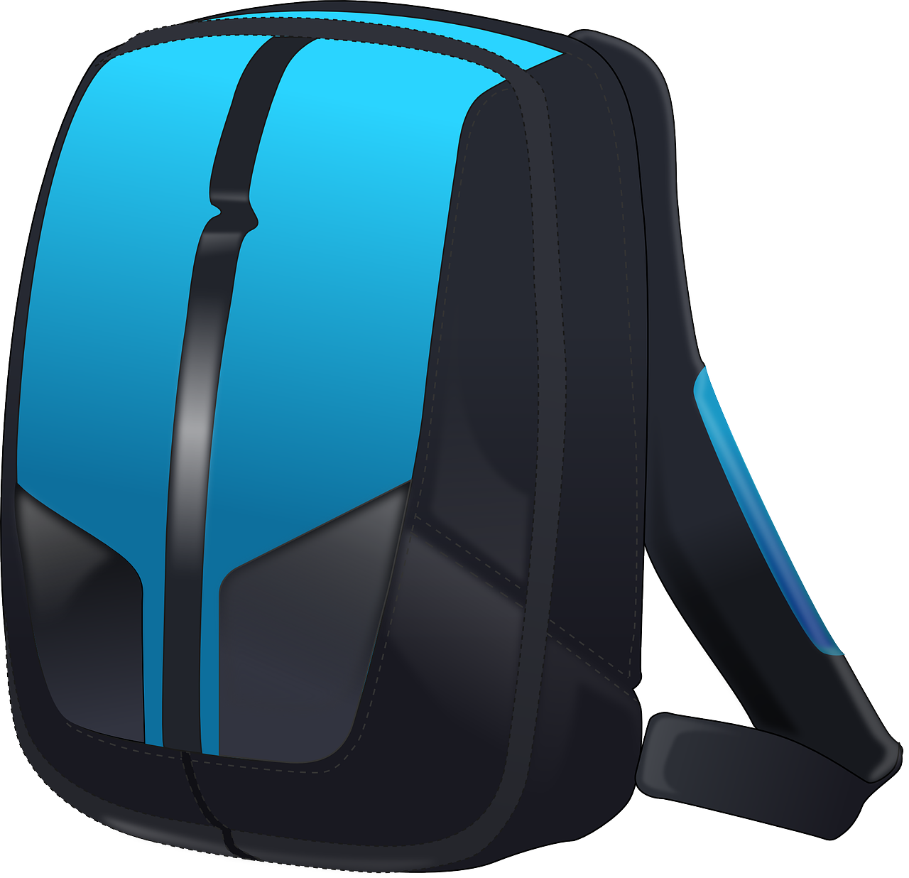
Extension
Make a prototype or model of your backpack design
Design a backpack for doctors or paramedics to carry their medical equipment
Design a backpack for your favourite sports star

