Slide 1
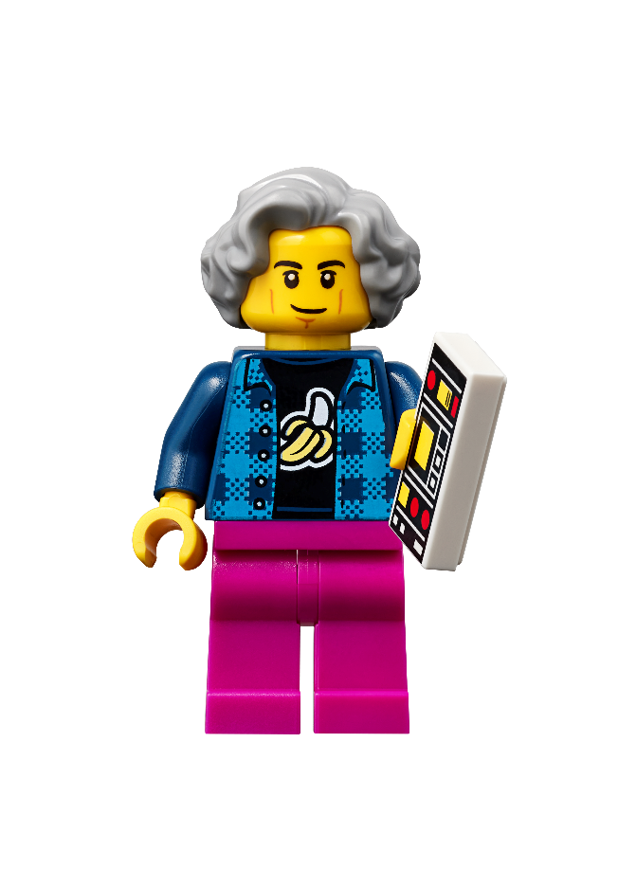
Session 4
Sound Engineer
Notes:
Facilitator Tips - Have the team pick a few mission models to highlight and learn about them. Provide resources to the team to learn more about the real-world examples and problems the mission models represent and solve.
Session 4 Tips =
Plug in the controller and open the app periodically to check for software and firmware updates.
Have the team choose lines on the mat that will help them navigate the robot to different missions.
Have the team follow the program on the screen to see how it matches the robot’s actions. This will help them debug their programs.
Try to start the robot in the same or a very similar place each time in one of the launch areas.
Robot Game Connection: Have the team adapt and test out their line-following program on the mat.

Slide 2
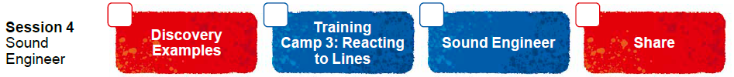
Session Overview
Outcomes
The team will code their driving base to follow a line using the color sensor.
The team will make connections from the mission models to the sound engineer Project Spark ideas.
Notes:
Facilitator Tips - Have the team pick a few mission models to highlight and learn about them. Provide resources to the team to learn more about the real-world examples and problems the mission models represent and solve.
Session 4 Tips =
Plug in the controller and open the app periodically to check for software and firmware updates.
Have the team choose lines on the mat that will help them navigate the robot to different missions.
Have the team follow the program on the screen to see how it matches the robot’s actions. This will help them debug their programs.
Try to start the robot in the same or a very similar place each time in one of the launch areas.
Robot Game Connection: Have the team adapt and test out their line-following program on the mat.

Slide 3
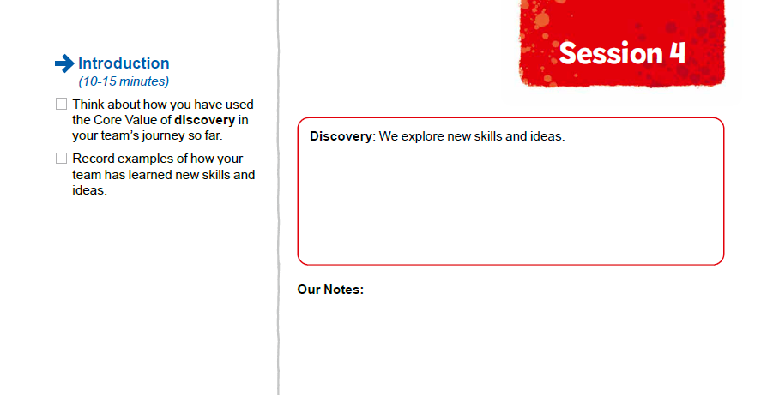

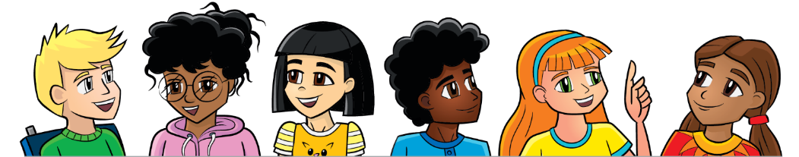
Introduction
Think about how you have used the Core Value of discovery in your team’s journey so far.
Record examples of how your team has learned new skills and ideas.
Notes:
Introduction (10-15 minutes)
Facilitator Tips
Plug in the controller and open the app periodically to check for software and firmware updates.
Have the team choose lines on the mat that will help them navigate the robot to different missions.
Have the team follow the program on the screen to see how it matches the robot’s actions. This will help them debug their programs.
Try to start the robot in the same or a very similar place each time in one of the launch areas.
Robot Game Connection: Have the team adapt and test out their line-following program on the mat.

Slide 4
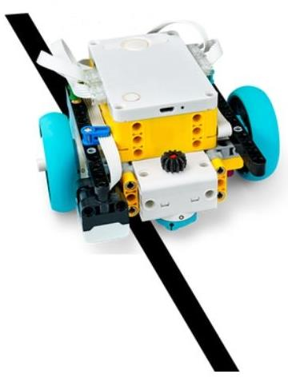

Robot Lesson 4
Open the SPIKE™ Prime app. Find your lesson.
Determine what building and coding skills will help you in the robot game.
Try it out! See if you can use the skills you learned to complete another mission.
Notes:
Team Tasks (100-120 minutes) - Training Camp 3: Reacting to Lines – https://education.lego.com/en-us/lessons/prime-competition-ready/training-camp-3-react-to-lines#lesson-plan
URL for SPIKE on-line: https://spike.legoeducation.com (remember to use a Chrome browser)
Facilitator Tips
Plug in the controller and open the app periodically to check for software and firmware updates.
Have the team choose lines on the mat that will help them navigate the robot to different missions.
Have the team follow the program on the screen to see how it matches the robot’s actions. This will help them debug their programs.
Try to start the robot in the same or a very similar place each time in one of the launch areas.
Robot Game Connection: Have the team adapt and test out their line-following program on the mat.

Slide 5
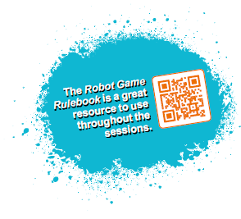
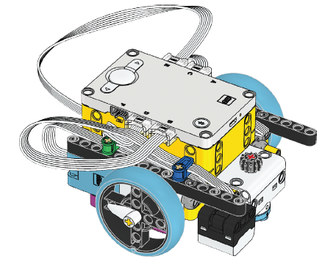
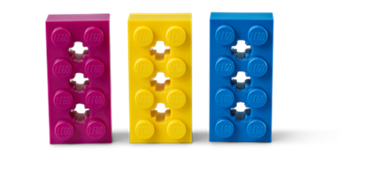

Reflection Questions
How did testing and debugging your program help make your robot more accurate?
Can your robot follow the line from the left launch area to the sound mixer model?
Notes:
Team Tasks (100-120 minutes)
Facilitator Tips
Plug in the controller and open the app periodically to check for software and firmware updates.
Have the team choose lines on the mat that will help them navigate the robot to different missions.
Have the team follow the program on the screen to see how it matches the robot’s actions. This will help them debug their programs.
Try to start the robot in the same or a very similar place each time in one of the launch areas.
Robot Game Connection: Have the team adapt and test out their line-following program on the mat.

Slide 6

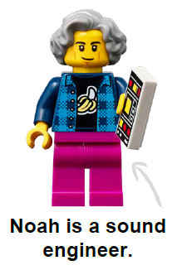
Sound Engineer Spark
Project Spark
Sound engineers use mixers and other audio equipment to enhance a listening experience. Whether you’re listening to your favorite artist sing a song or feeling the vibrations of a bass drum, sound can have a powerful impact.
Notes:
Team Tasks (100-120 minutes) Read the Project Spark.
Facilitator Tips
Provide the digital building instructions for the models for the team.
The team will need Bags 6 and 9 from the Challenge set.
This is the last session for building models. Finish building all the models and place them on the mat before the next session.
The team may need extra time before moving on to the next session to finish building the mission models.
The Project Sparks presented in Sessions 1-4 provide different ideas for the team for their final innovation project.

Slide 7
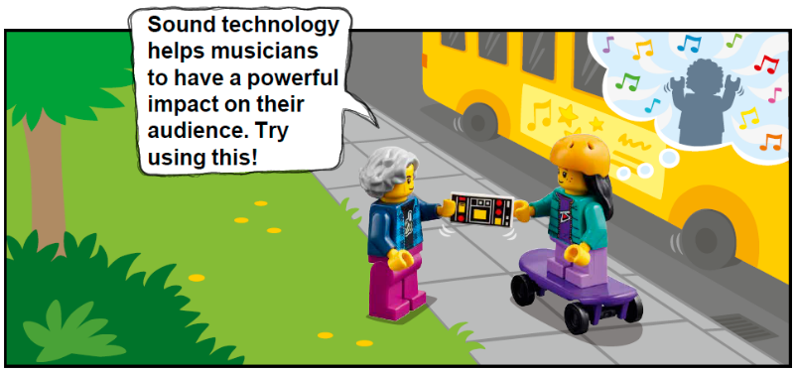
Sound Engineer Spark
Think about and research:
What kind of projects could a sound engineer work on?
How is sound used to change a listener’s experience?
What kind of training do you need to be a sound engineer?
How is sound used in museums or films?
Notes:
Team Tasks (100-120 minutes) Read the Project Spark.
Facilitator Tips
Provide the digital building instructions for the models for the team.
The team will need Bags 6 and 9 from the Challenge set.
This is the last session for building models. Finish building all the models and place them on the mat before the next session.
The team may need extra time before moving on to the next session to finish building the mission models.
The Project Sparks presented in Sessions 1-4 provide different ideas for the team for their final innovation project.

Slide 8

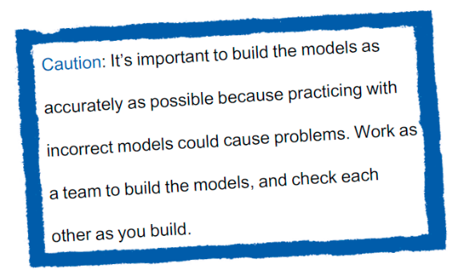

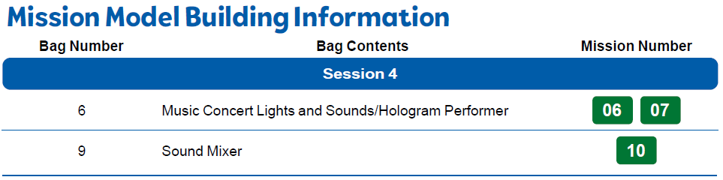
Sound Engineer Spark
Build the Sound Engineer models in Bags 6 and 9.
Notes:
Team Tasks (100-120 minutes)
Facilitator Tips
Provide the digital building instructions for the models for the team.
The team will need Bags 6 and 9 from the Challenge set.
This is the last session for building models. Finish building all the models and place them on the mat before the next session.
The team may need extra time before moving on to the next session to finish building the mission models.
The Project Sparks presented in Sessions 1-4 provide different ideas for the team for their final innovation project.

Slide 9
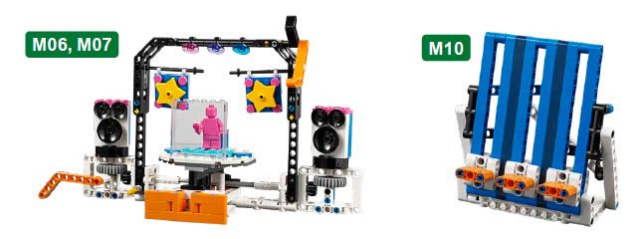
Sound Engineer Spark
Identify the missions that relate to the models you built.
Notes:
Team Tasks (100-120 minutes)
Facilitator Tips
Provide the digital building instructions for the models for the team.
The team will need Bags 6 and 9 from the Challenge set.
This is the last session for building models. Finish building all the models and place them on the mat before the next session.
The team may need extra time before moving on to the next session to finish building the mission models.
The Project Sparks presented in Sessions 1-4 provide different ideas for the team for their final innovation project.

Slide 10

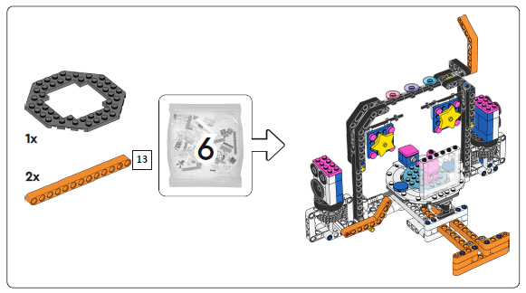
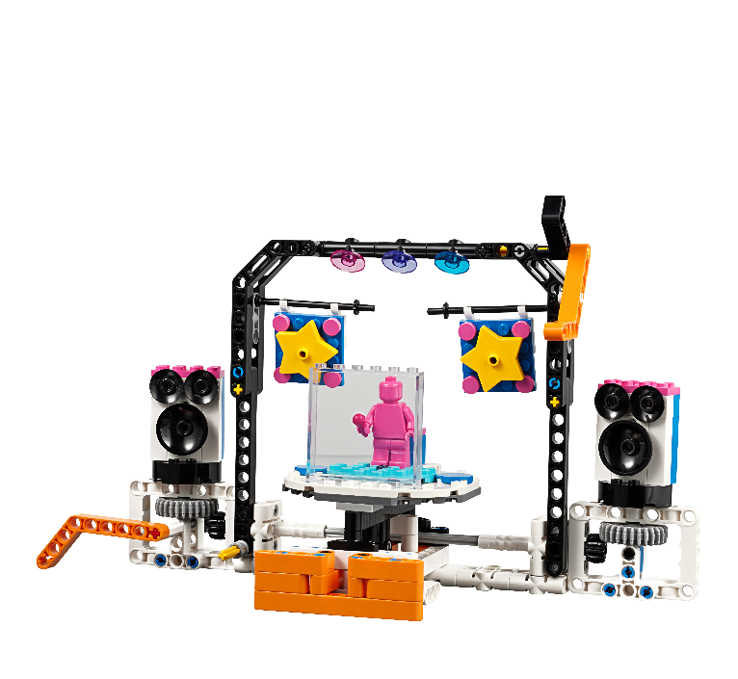
Music Concert Lights and Sounds
Hologram Performer
Notes:
Team Tasks (100-120 minutes)
Facilitator Tips
Provide the digital building instructions for the models for the team.
The team will need Bags 6 and 9 from the Challenge set.
This is the last session for building models. Finish building all the models and place them on the mat before the next session.
The team may need extra time before moving on to the next session to finish building the mission models.
The Project Sparks presented in Sessions 1-4 provide different ideas for the team for their final innovation project.

Slide 11
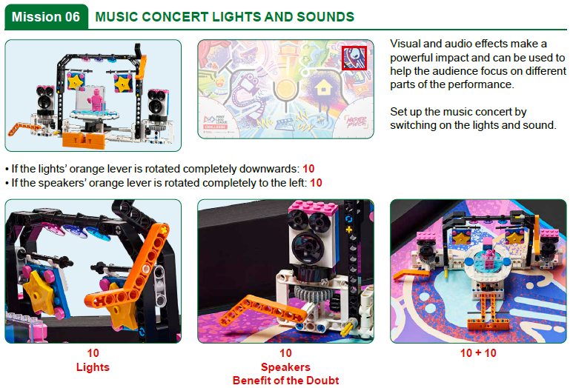
Notes:
Team Tasks (100-120 minutes)
Facilitator Tips
Provide the digital building instructions for the models for the team.
The team will need Bags 6 and 9 from the Challenge set.
This is the last session for building models. Finish building all the models and place them on the mat before the next session.
The team may need extra time before moving on to the next session to finish building the mission models.
The Project Sparks presented in Sessions 1-4 provide different ideas for the team for their final innovation project.

Slide 12
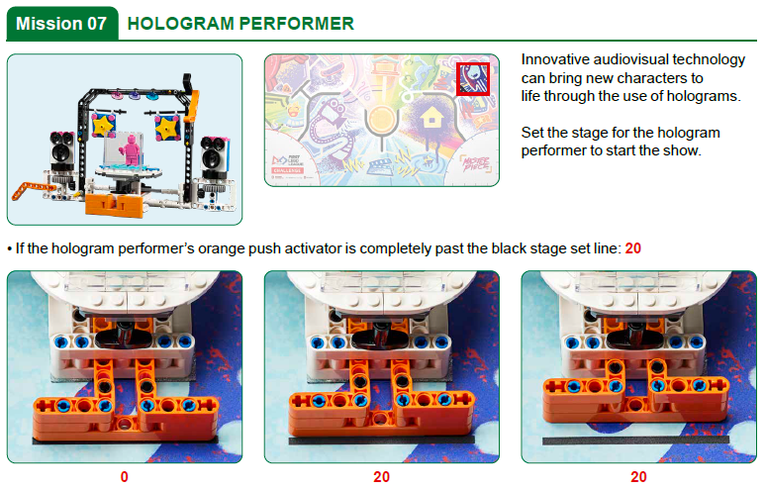
Notes:
Team Tasks (100-120 minutes)
Facilitator Tips
Provide the digital building instructions for the models for the team.
The team will need Bags 6 and 9 from the Challenge set.
This is the last session for building models. Finish building all the models and place them on the mat before the next session.
The team may need extra time before moving on to the next session to finish building the mission models.
The Project Sparks presented in Sessions 1-4 provide different ideas for the team for their final innovation project.

Slide 13

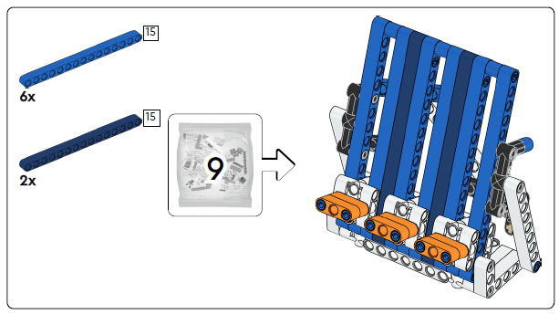
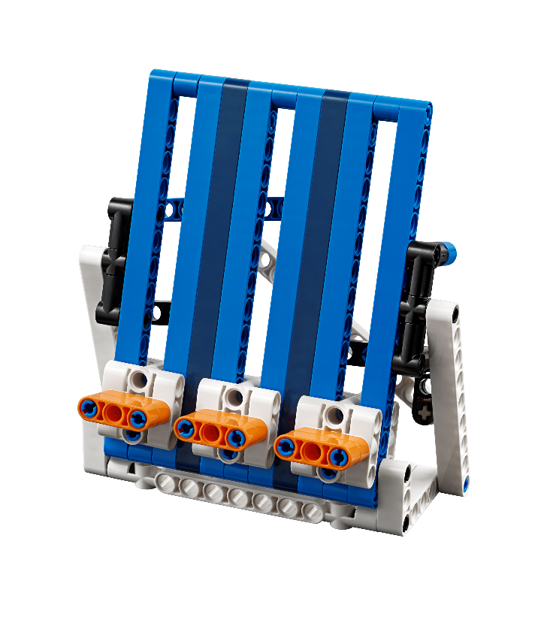
Sound Mixer
Notes:
Team Tasks (100-120 minutes)
Facilitator Tips
Provide the digital building instructions for the models for the team.
The team will need Bags 6 and 9 from the Challenge set.
This is the last session for building models. Finish building all the models and place them on the mat before the next session.
The team may need extra time before moving on to the next session to finish building the mission models.
The Project Sparks presented in Sessions 1-4 provide different ideas for the team for their final innovation project.

Slide 14
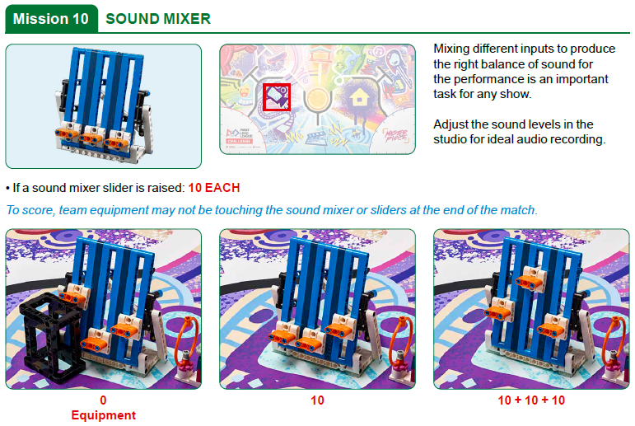
Notes:
Team Tasks (100-120 minutes)
Facilitator Tips
Provide the digital building instructions for the models for the team.
The team will need Bags 6 and 9 from the Challenge set.
This is the last session for building models. Finish building all the models and place them on the mat before the next session.
The team may need extra time before moving on to the next session to finish building the mission models.
The Project Sparks presented in Sessions 1-4 provide different ideas for the team for their final innovation project.

Slide 15

Sound Engineer Spark
Identify the missions that relate to the models you built.
Discuss how the Project Spark and models are linked.
Capture your ideas.
Notes:
Team Tasks (100-120 minutes)
Facilitator Tips
Provide the digital building instructions for the models for the team.
The team will need Bags 6 and 9 from the Challenge set.
This is the last session for building models. Finish building all the models and place them on the mat before the next session.
The team may need extra time before moving on to the next session to finish building the mission models.
The Project Sparks presented in Sessions 1-4 provide different ideas for the team for their final innovation project.

Slide 16


Share
Get together at the mat.
Put each model where it belongs.
Show how the models operate and their connection to the Project Spark.
Show the robot skills you have learned.
Discuss the reflection questions.
Clean up your space.
Notes:
Share (10-15 minutes)
Facilitator Tips
Provide the digital building instructions for the models for the team.
The team will need Bags 6 and 9 from the Challenge set.
This is the last session for building models. Finish building all the models and place them on the mat before the next session.
The team may need extra time before moving on to the next session to finish building the mission models.
The Project Sparks presented in Sessions 1-4 provide different ideas for the team for their final innovation project.

Slide 17
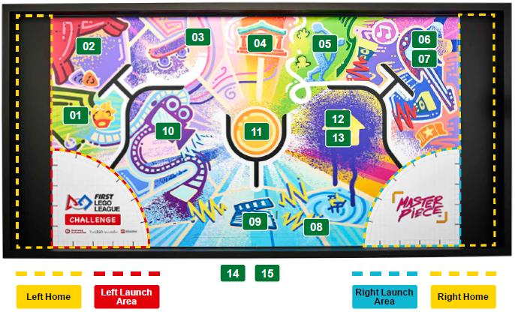
Models built this session are for the circled missions.
Notes:
Facilitator Tips
Provide the digital building instructions for the models for the team.
The team will need Bags 6 and 9 from the Challenge set.
This is the last session for building models. Finish building all the models and place them on the mat before the next session.
The team may need extra time before moving on to the next session to finish building the mission models.
The Project Sparks presented in Sessions 1-4 provide different ideas for the team for their final innovation project.

Slide 18


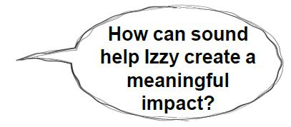
Reflection Questions
How does a sound engineer record music and modify it to make instruments or vocals stand out?
Where do concerts happen in your community?
Notes:
Facilitator Tips
Provide the digital building instructions for the models for the team.
The team will need Bags 6 and 9 from the Challenge set.
This is the last session for building models. Finish building all the models and place them on the mat before the next session.
The team may need extra time before moving on to the next session to finish building the mission models.
The Project Sparks presented in Sessions 1-4 provide different ideas for the team for their final innovation project.

Slide 19


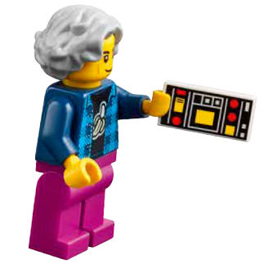

Career Connections
Sound Engineer
Role:
A sound or audio engineer mixes different sounds, controls volume, and creates an optimal listening experience.

Slide 20

Multimedia Resources
You may wish to embed a relevant, age-appropriate video for your students here. See the Notes for an example.
Notes:
Choose a relevant, age-appropriate video for your students.
Example: Career Connections Sound Engineer (5:38)

Slide 21

Clean Up
Notes:
Allow time for cleanup and place any unfinished models and their pieces in a sealed plastic bag.
Clean Up Pointers
You may wish to play a video or song during clean up time Link on
GoNoodle: https://family.gonoodle.com/activities/clean-up
Link on YouTube Kids: https://www.youtubekids.com/watch?v=ZJFk87ZsHn0
Link on Youtube: https://youtu.be/ZJFk87ZsHn0

Slide 22


LEGO, the LEGO logo, the SPIKE logo, MINDSTORMS and the MINDSTORMS logo are trademarks of the LEGO Group. ©2023 The LEGO Group. All rights reserved. FIRST®, the FIRST® logo, Coopertition®, Gracious Professionalism®, and FIRST IN SHOWSM, are trademarks of For Inspiration and Recognition of Science and Technology (FIRST). LEGO® is a registered trademark of the LEGO Group. FIRST® LEGO® League and MASTERPIECESM are jointly held trademarks of FIRST and the LEGO Group. All other trademarks are the property of their respective owners. ©2023 FIRST and the LEGO Group. All rights reserved.

