Slide 1
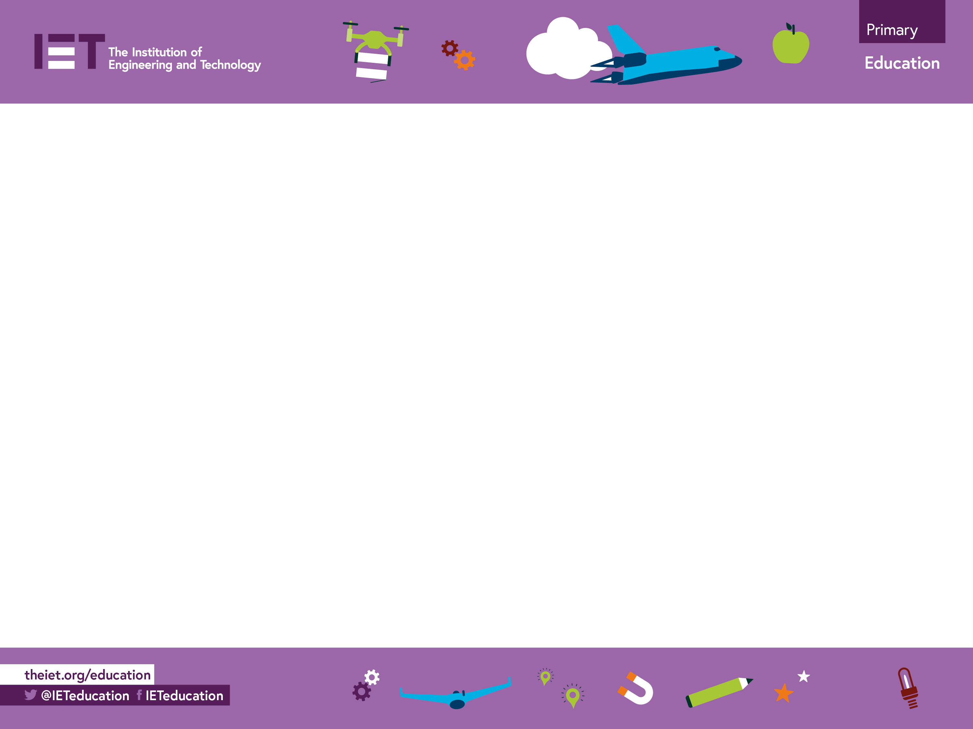

Testing material properties
Working out what materials are used in everyday products

Slide 2

What materials?
Lots of everyday products are made from wood, metal and plastic
How can we find out?

Slide 3
Material properties
Materials have different properties
Flexibility
Magnetism
Transparency
Density

Slide 4
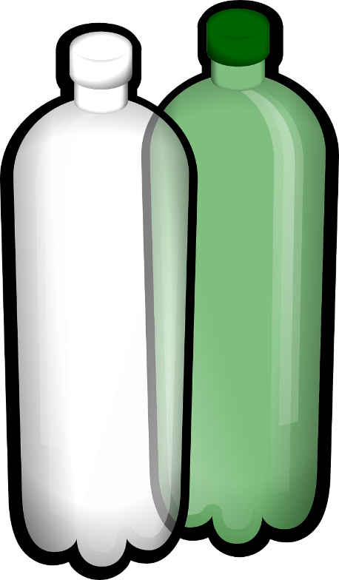


Flexible materials
Metal Wire
Paper
Plastic

Slide 5

Transparent materials
Glass
Plastic

Slide 6
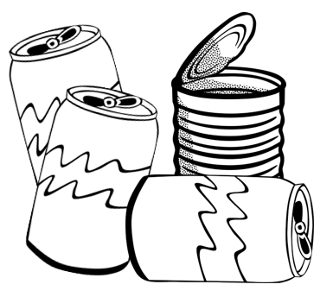
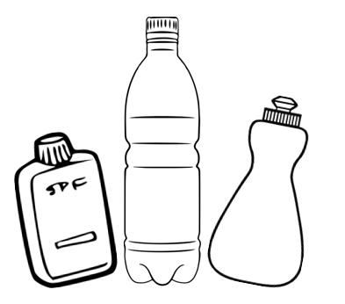

Magnetic materials

X
Paper, plastic and aluminium metal
Steel tins

Slide 7

Material density
If two things are the same size, the one that is more dense is heavier
The cubes are the same size
Low density
High density

Slide 8
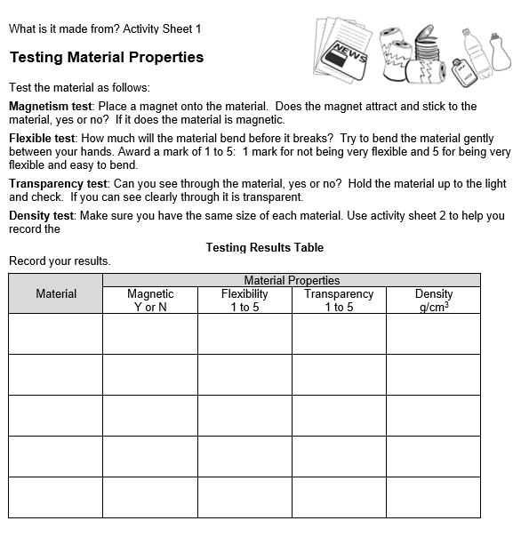
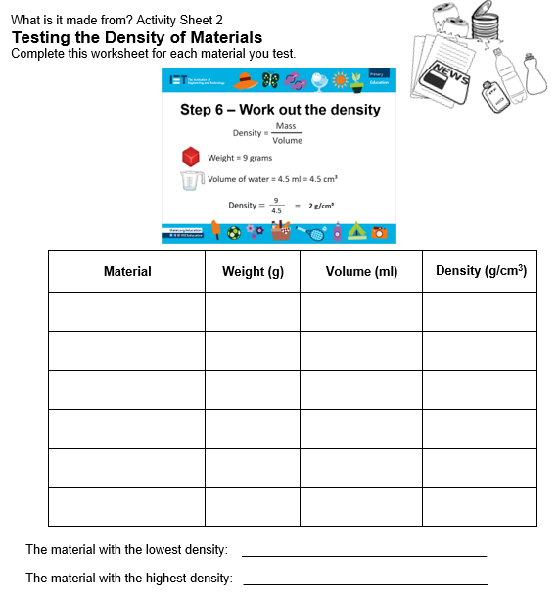
Material testing
Use the activity sheets and choose a material

Slide 9
Step 1 – Magnetism test
Place a magnet onto the material
Does it attach? Yes or no?
Magnet

Slide 10

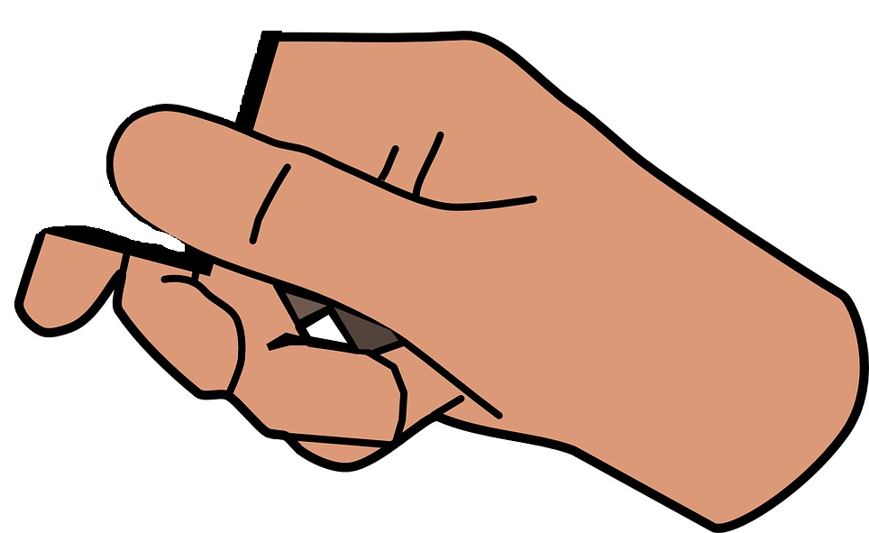
Step 2 – Flexibility test
Try to bend the material between your hands
Rate how easy this is, on a scale of 1 to 5:
  1 mark = not easy to bend
  5 marks = easy to bend

Slide 11
Step 3 – Transparency test
Can you see through the material? Yes or No

Slide 12
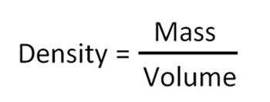
Step 4 – Density test
The density of an object is its mass divided by its volume:
The units of density are g/cm³

Slide 13
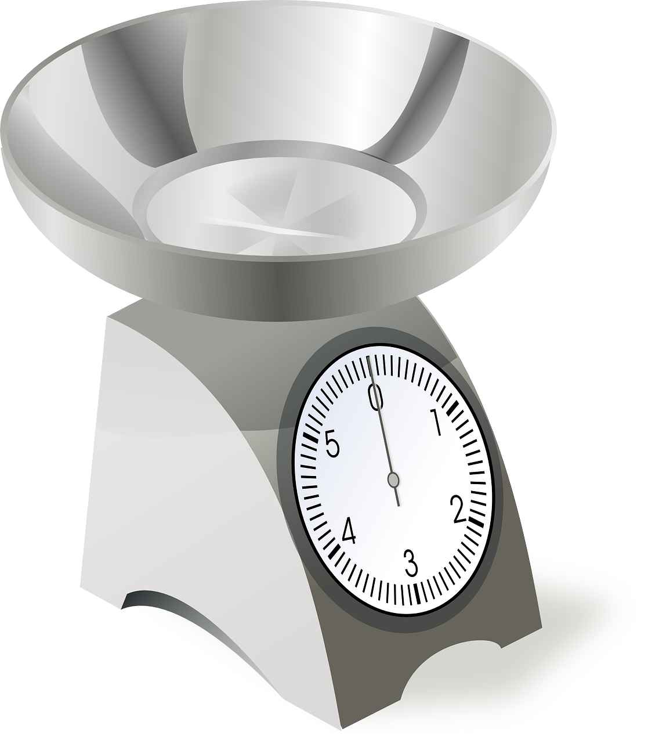
Step 4a – Weigh the material
Use material of the same size
Weigh the material
Write down the weight in grams

Slide 14
Step 4b – Find the volume
Place a bowl on a tray.
Fill the bowl to the brim with water
Put the object in the water
The tray will catch all the water that overflows

Slide 15
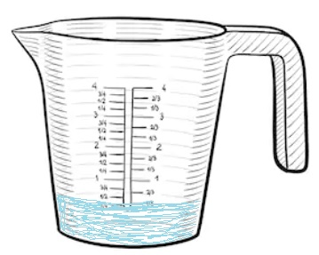
Step 4c – Measure the water
Carefully take the bowl from the tray
Pour the water on the tray into a jug
Write down how much water has been collected in ml

Slide 16

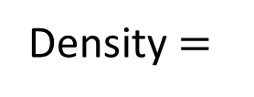
Step 4d – Work out the density
Weight = 9 grams
Volume of water = 4.5 ml = 4.5 cm³
9
____
Density $=$
$$=$$
2 g/cm³
4.5

Slide 17
Review – results of testing
What did you find out about the materials?
Which material was magnetic?
Which material was the most flexible?
Which material was transparent?
Which material was the most dense?

