Slide 1
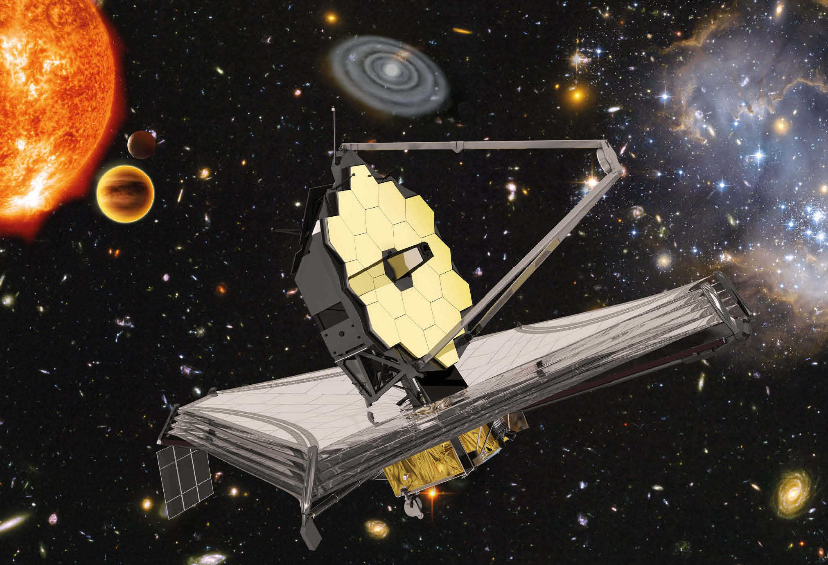
Investigate the James Webb Space Telescope
Researching a material used on the
James Webb Space Telescope

Slide 2
Stay safe
Whether you are a scientist researching a new medicine or an engineer solving climate change, safety always comes first. An adult must always be around and supervising when doing this activity. You are responsible for:
ensuring that any equipment used for this activity is in good working condition
behaving sensibly and following any safety instructions so as not to hurt or injure yourself or others
Please note that in the absence of any negligence or other breach of duty by us, this activity is carried out at your own risk. It is important to take extra care at the stages marked with this symbol: ⚠

Slide 3
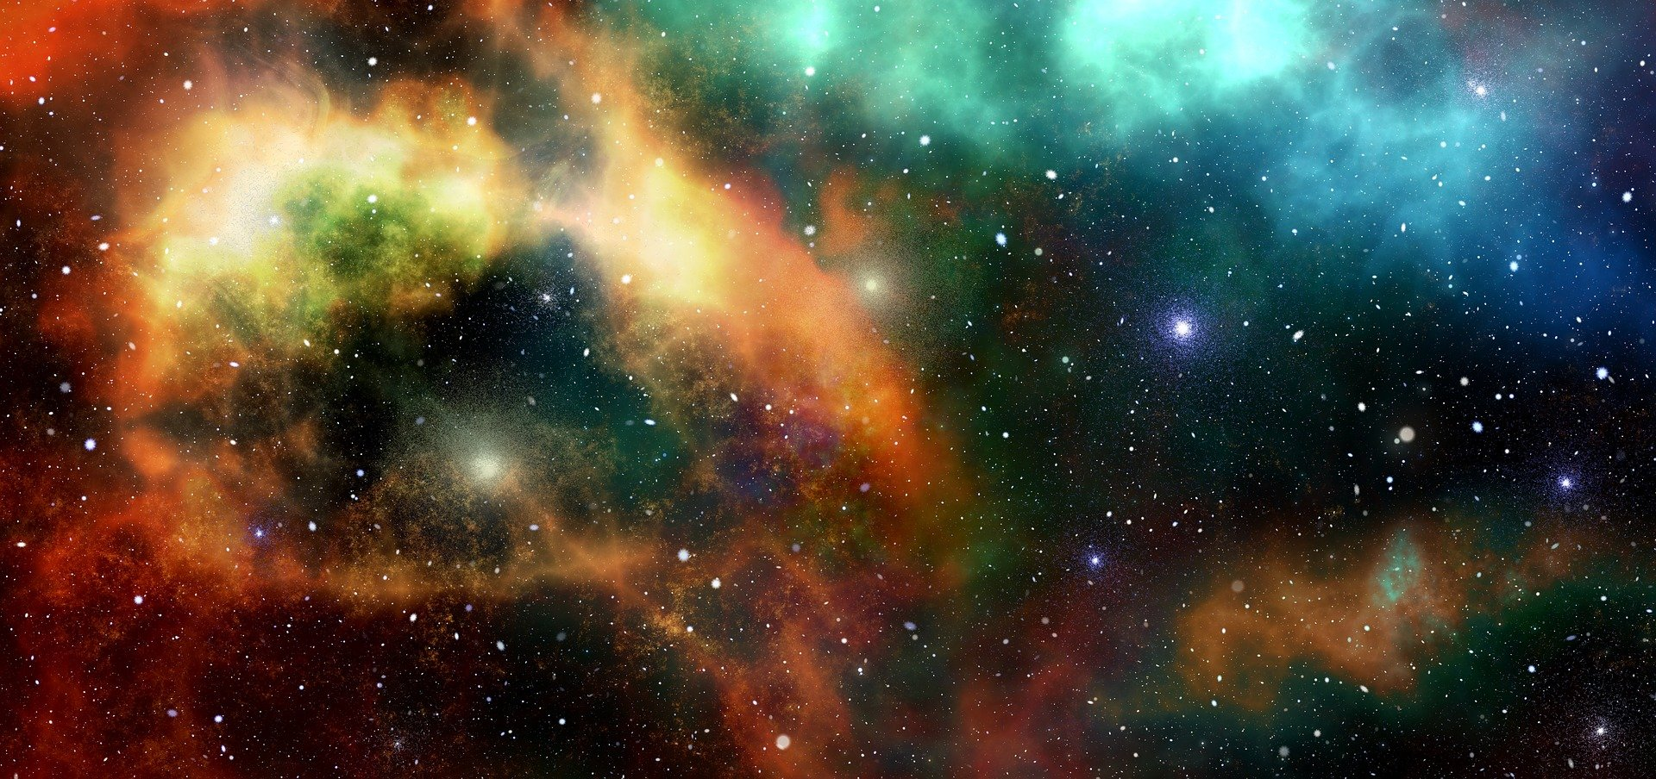
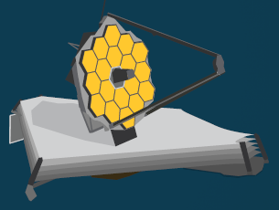
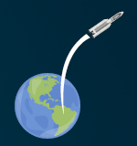
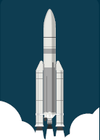
James Webb Space Telescope
The James Webb Space telescope will allow us to look at far away stars and galaxies
We can see some stars from earth – but this telescope will let us see them much better!
It will be positioned in space, 1.5 million km from earth!
It will be launched into space on a rocket
Notes:
The James Webb Space Telescope (Webb) will be the largest, most powerful telescope ever launched into space. It follows in the footsteps of the Hubble Space Telescope as the next great space science observatory, designed to
answer outstanding questions about the Universe and to make breakthrough discoveries in all fields of astronomy.
Webb will reveal the hidden Universe to our eyes: stars shrouded in clouds of dust, molecules in the atmospheres of other worlds, and light from the first stars and galaxies. With its suite of state-of-the-art instruments, Webb will push the frontiers of our knowledge of the Solar System, of how stars and planets form, and of galaxy formation and evolution, in new ways.
The telescope will launch on an Ariane 5 rocket from Europe’s Spaceport in French Guiana. From there it embarks on a month-long journey to its destination orbit around the second Lagrange point (L2), about one and a half million kilometres from Earth. In the first month after launch, Webb will unfold its sunshield, which is the size of a tennis court, and then deploy its 6.5-metre primary mirror that can detect the faint light of distant stars and galaxies with a sensitivity a hundred times greater than that of Hubble.
The bottom right images are an Ariane 5 rocket taking off and leaving earth. The middle image is the James Webb Space Telescope that will be deployed in space. The image at the top right shows distant stars in space.

Slide 4
What properties do the parts of the JWST need?
Identify the different parts and the properties they need

Slide 5
Material investigation
What you must find out:
What are the chemical, physical and mechanical properties of the material?
What part or parts of the JWST is it used for?
Which alternative materials could have been used for this part?
Why was the material selected rather than the alternatives?
How is the part made?
Summarise your findings in a presentation to deliver to the class
Notes:
Possible materials (with their applications for teacher reference) that could be allocated include:
Bonded graphite-epoxy composite (structure of the integrated science equipment module)
Gold (coatings on mirrors)
Beryllium (mirrors)
Kapton polymide film (sunshield)
Aluminium (coatings on layers of sunshield)
Doped silicon (coatings on sunshield)
etc.
Additionally, high performance materials used in the aerospace industry such as aluminium alloys, titanium alloys, carbon reinforced polymer (CRP) could be included, where learners have to identify parts that they could be used for.

